Slide 1
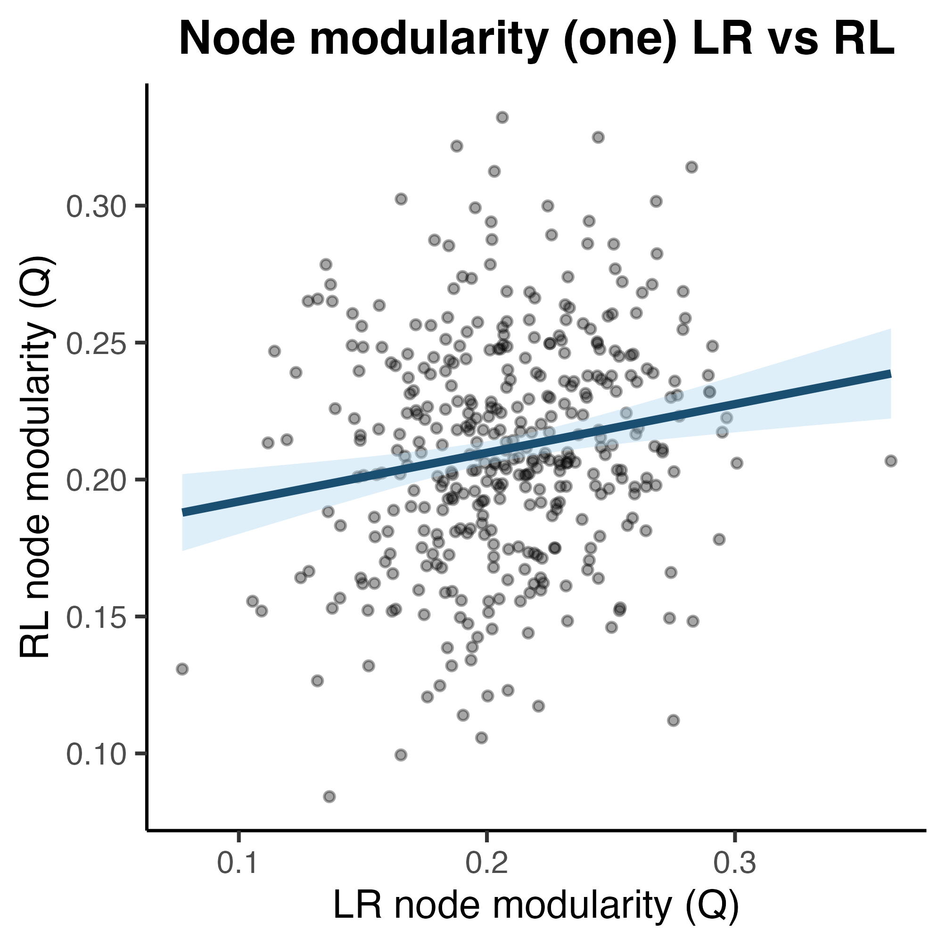
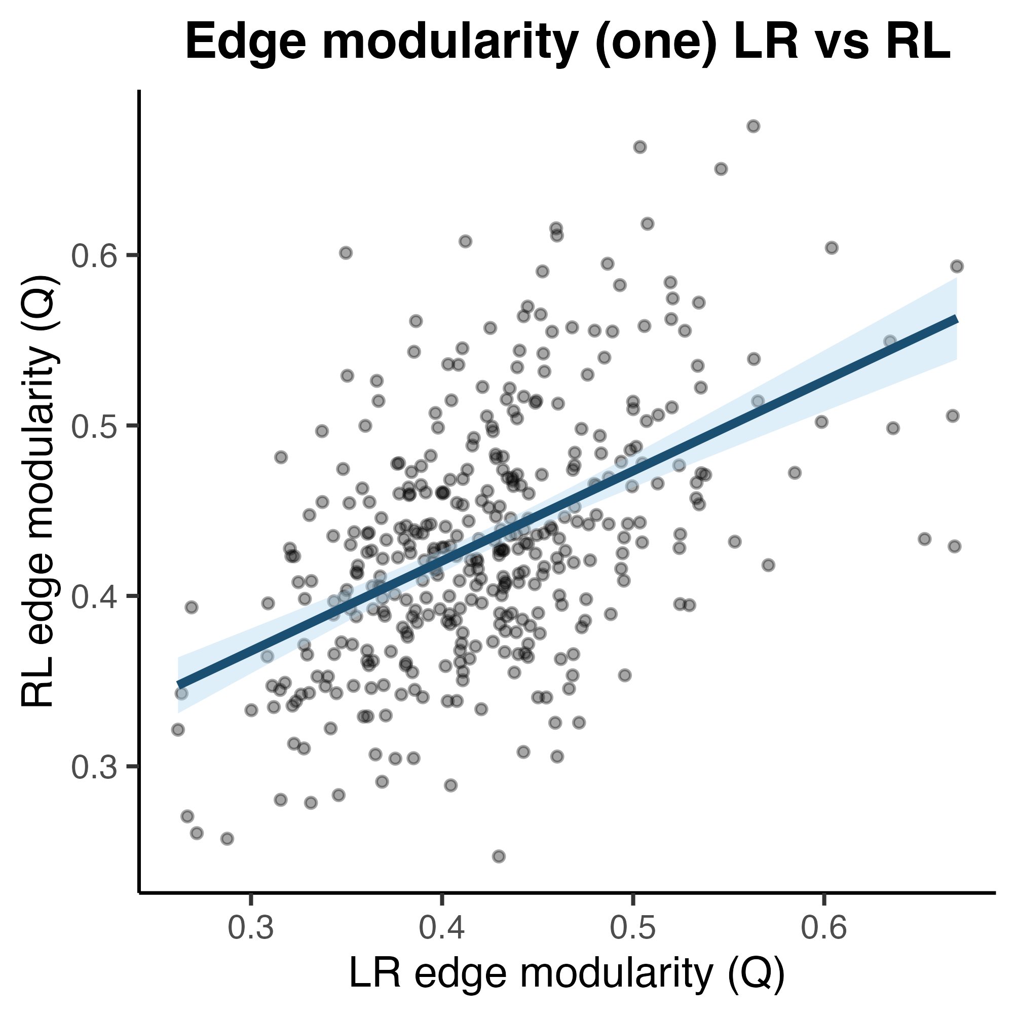
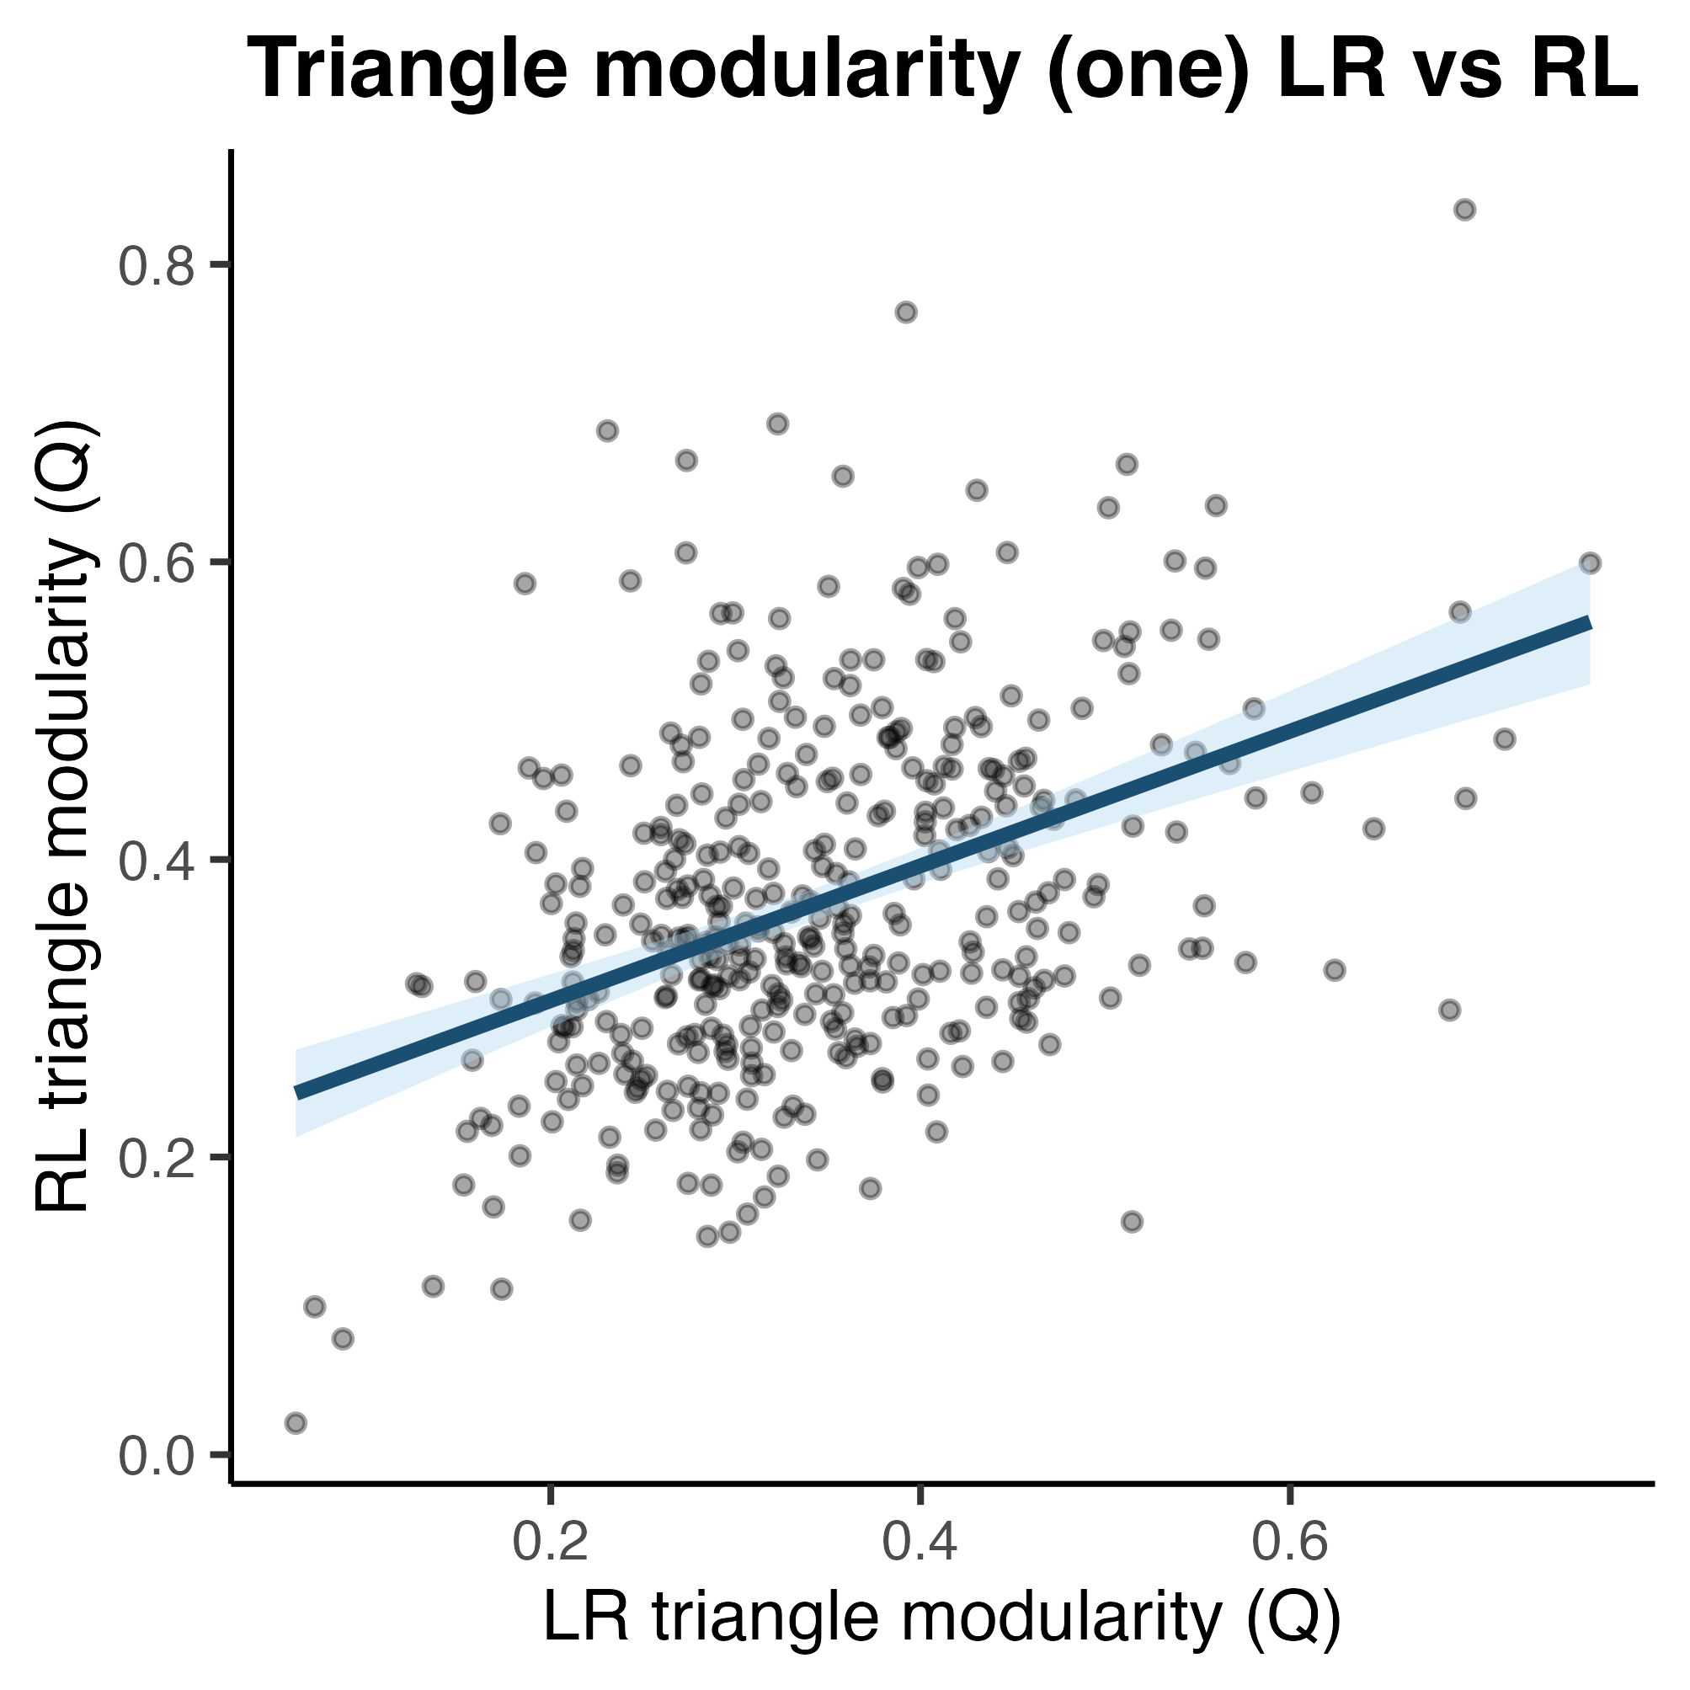
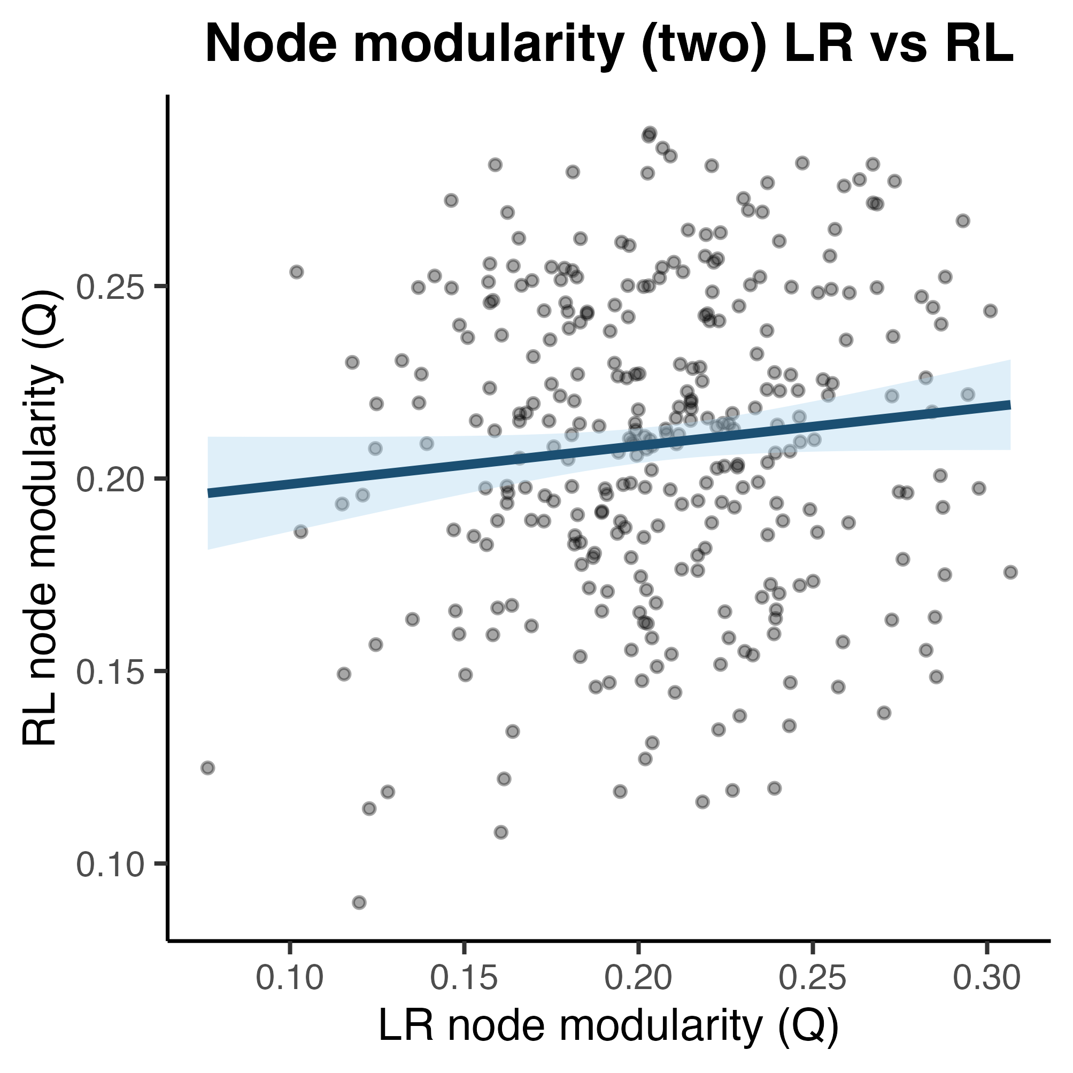
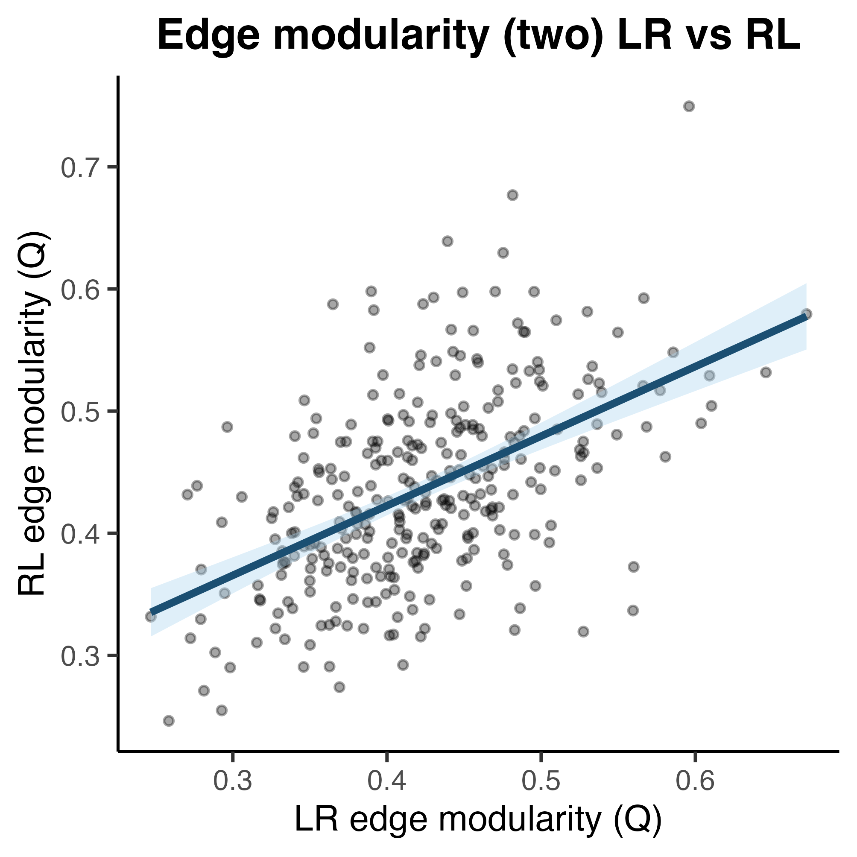
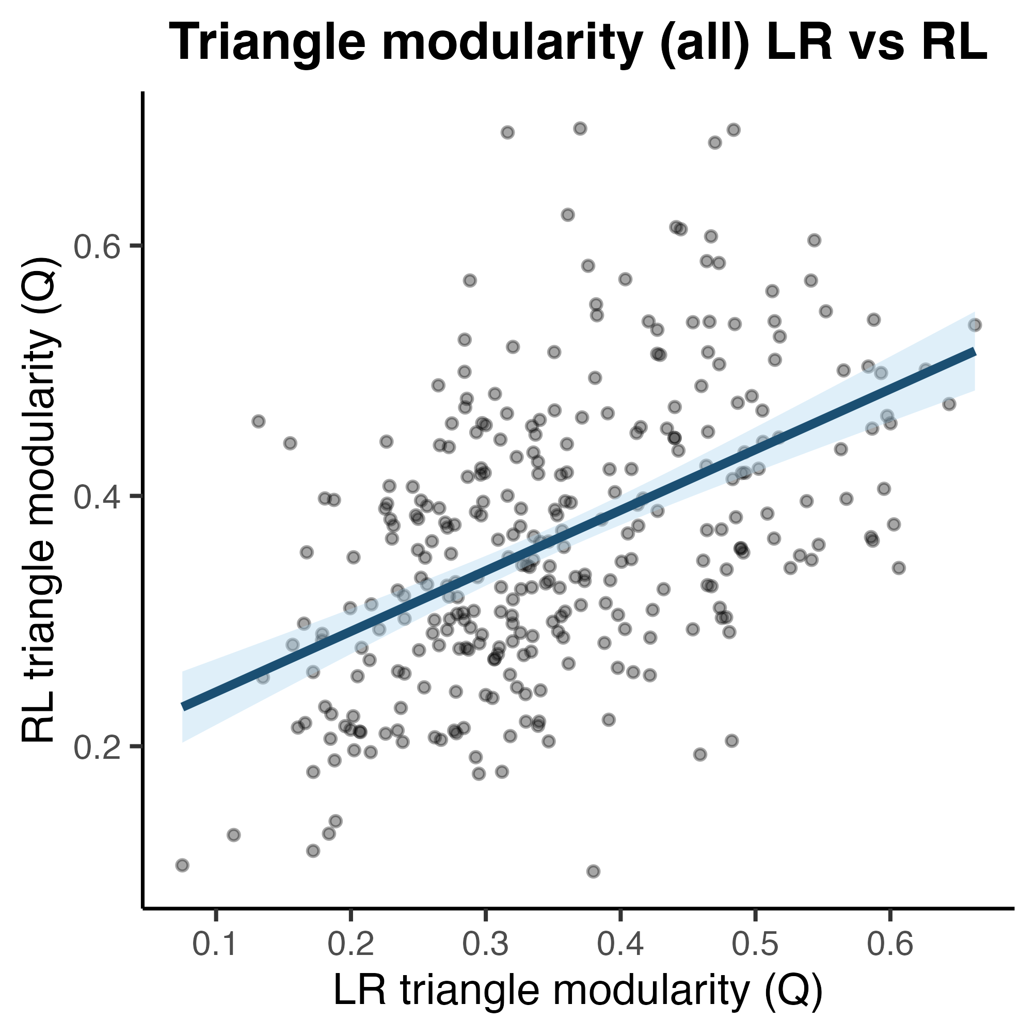
Node
Edge
Triangle
a.
b.
c.
Exploration Cohort
d.
e.
f.
CHANGE THESE PLOTS D-F TO ACTUALLY BE REPLICATION COHORT AND NOT ALL.
Replication Cohort

