Slide 1
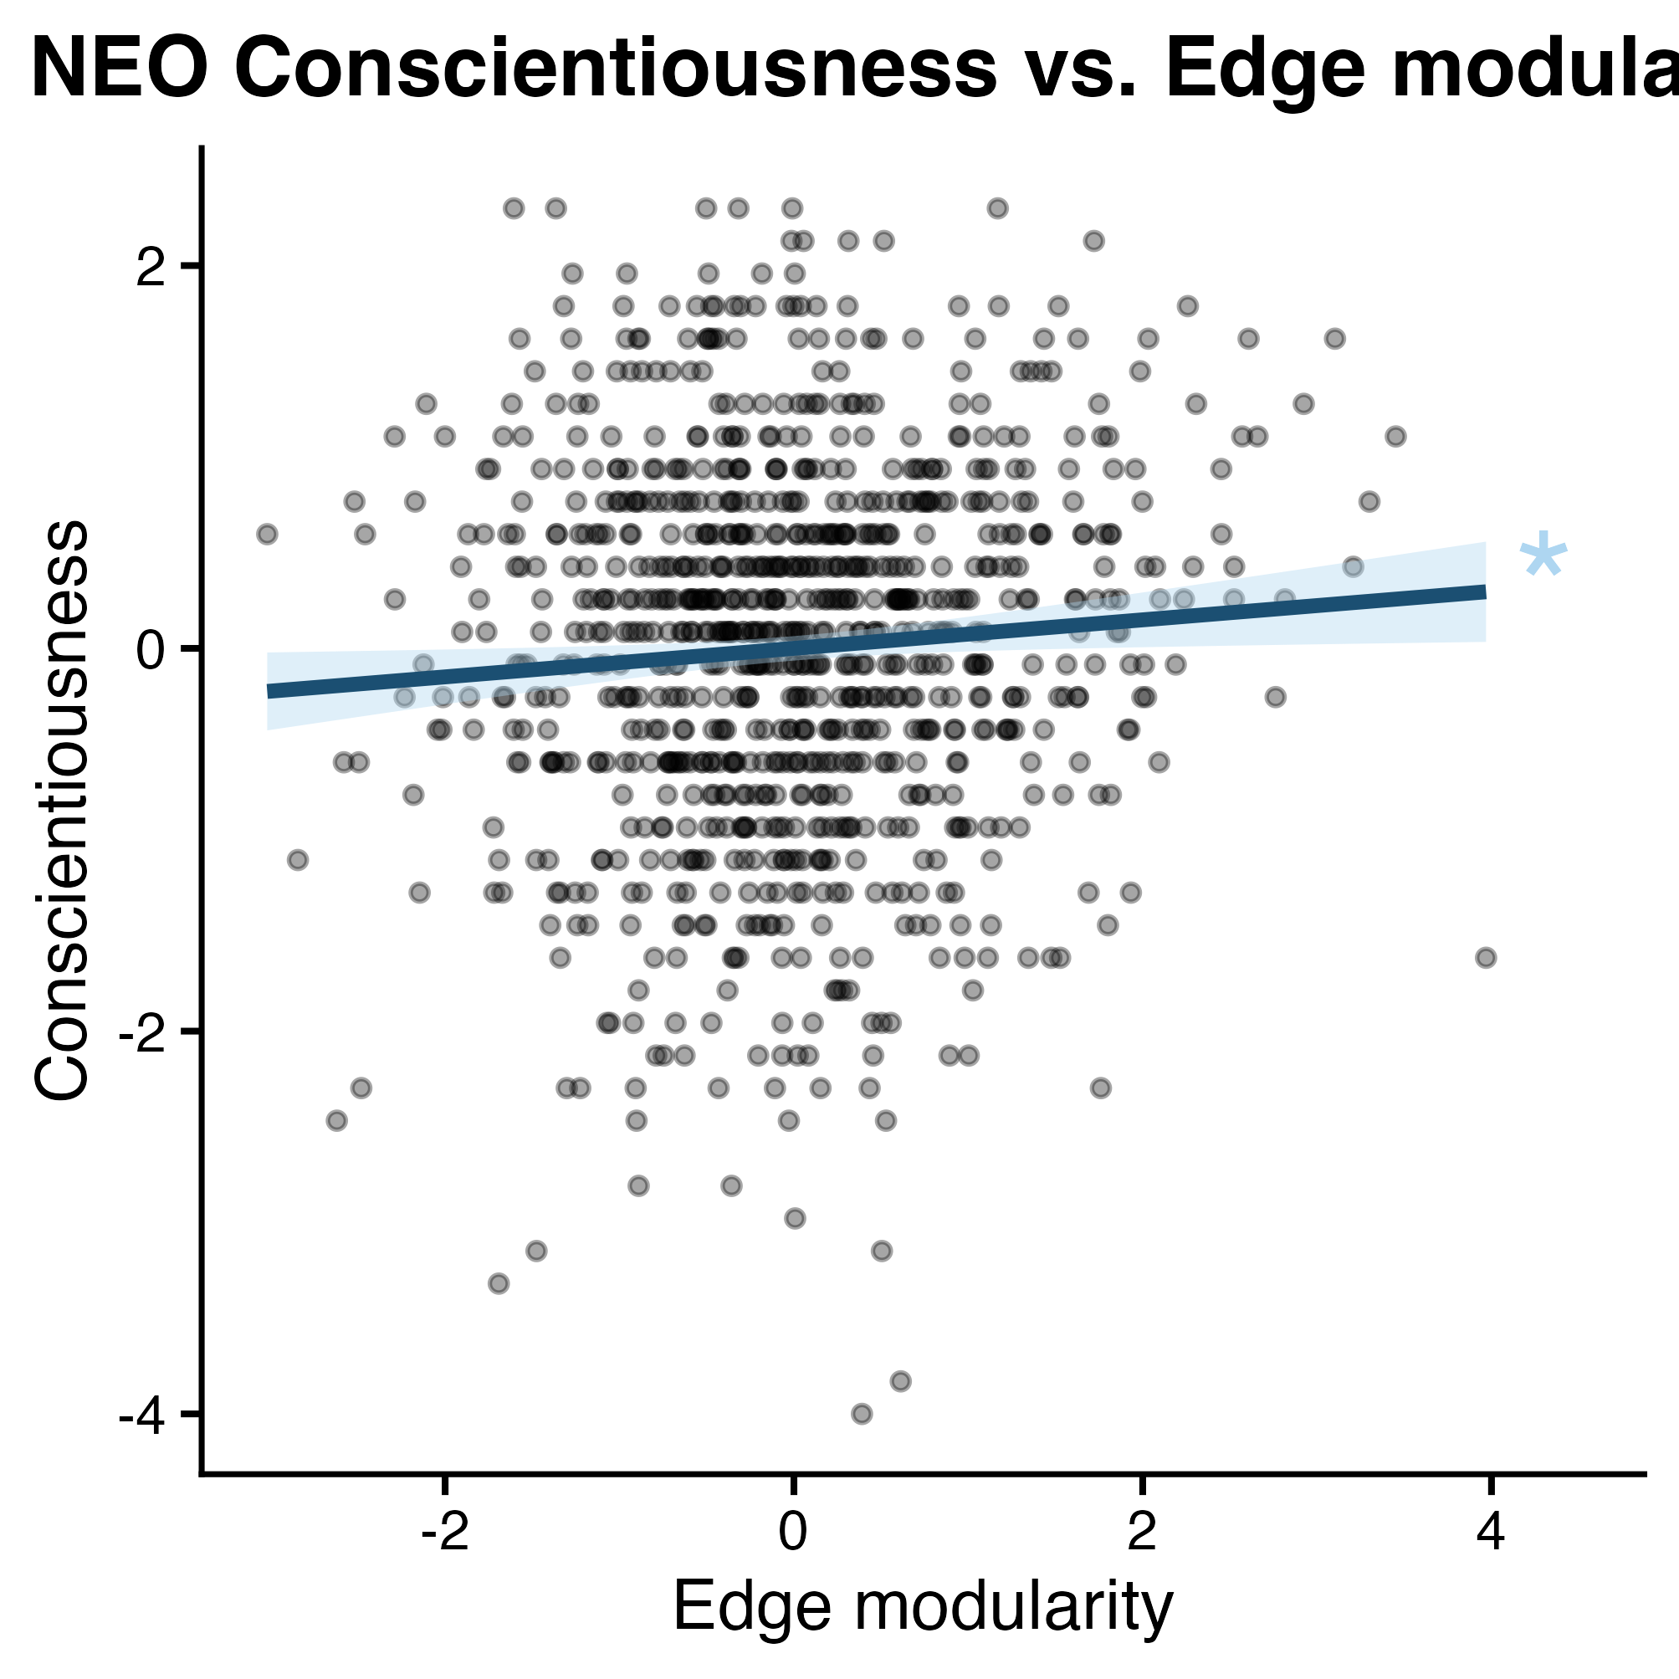
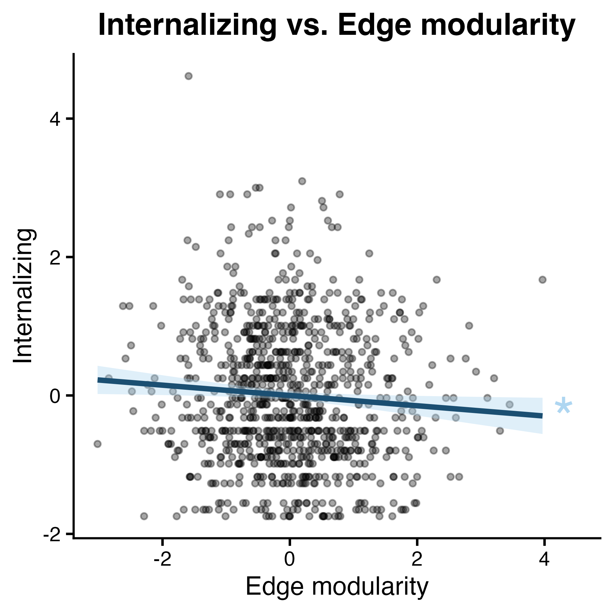
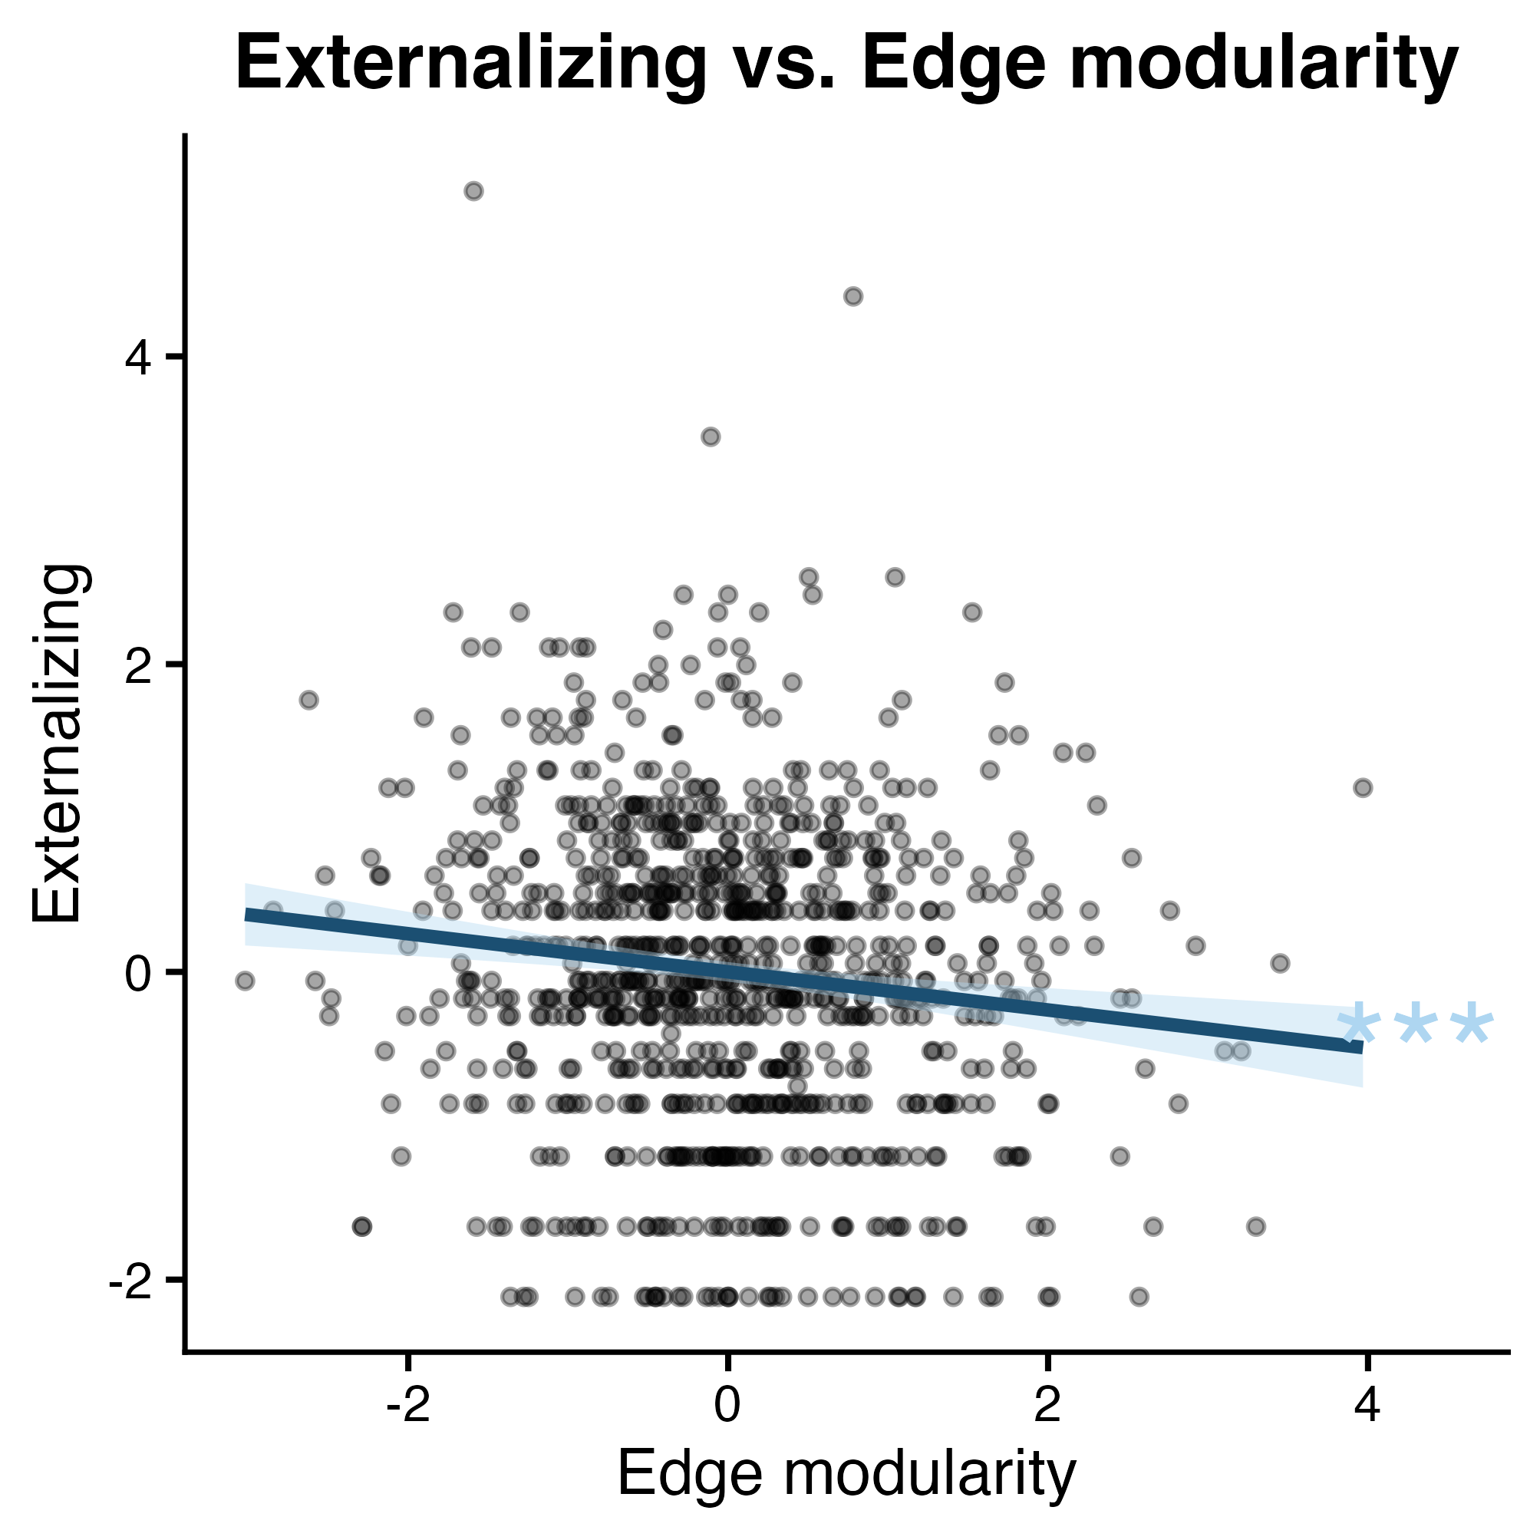
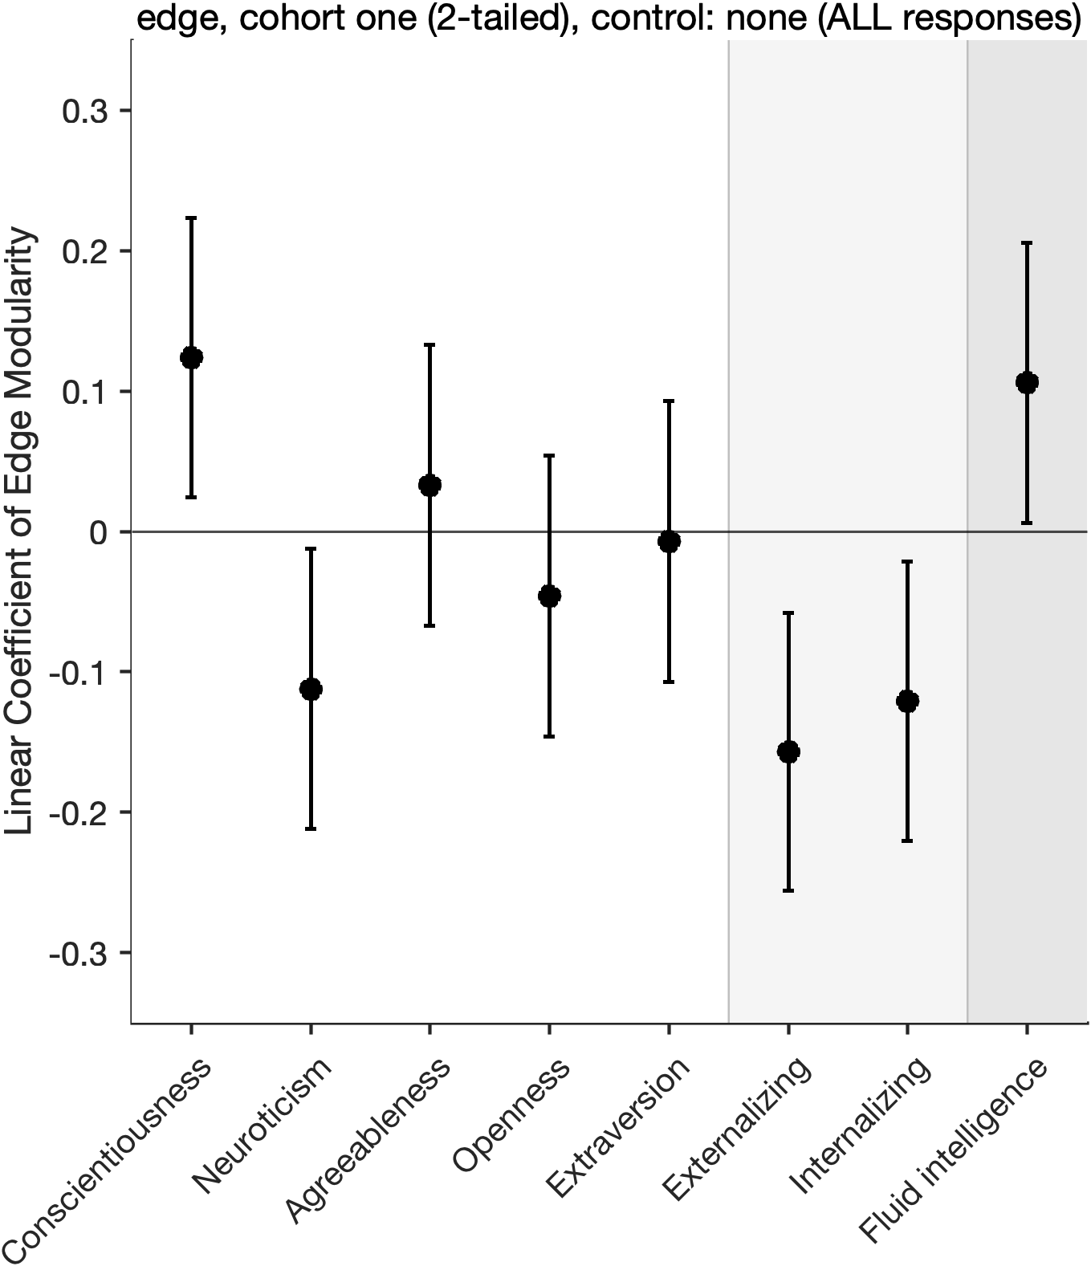
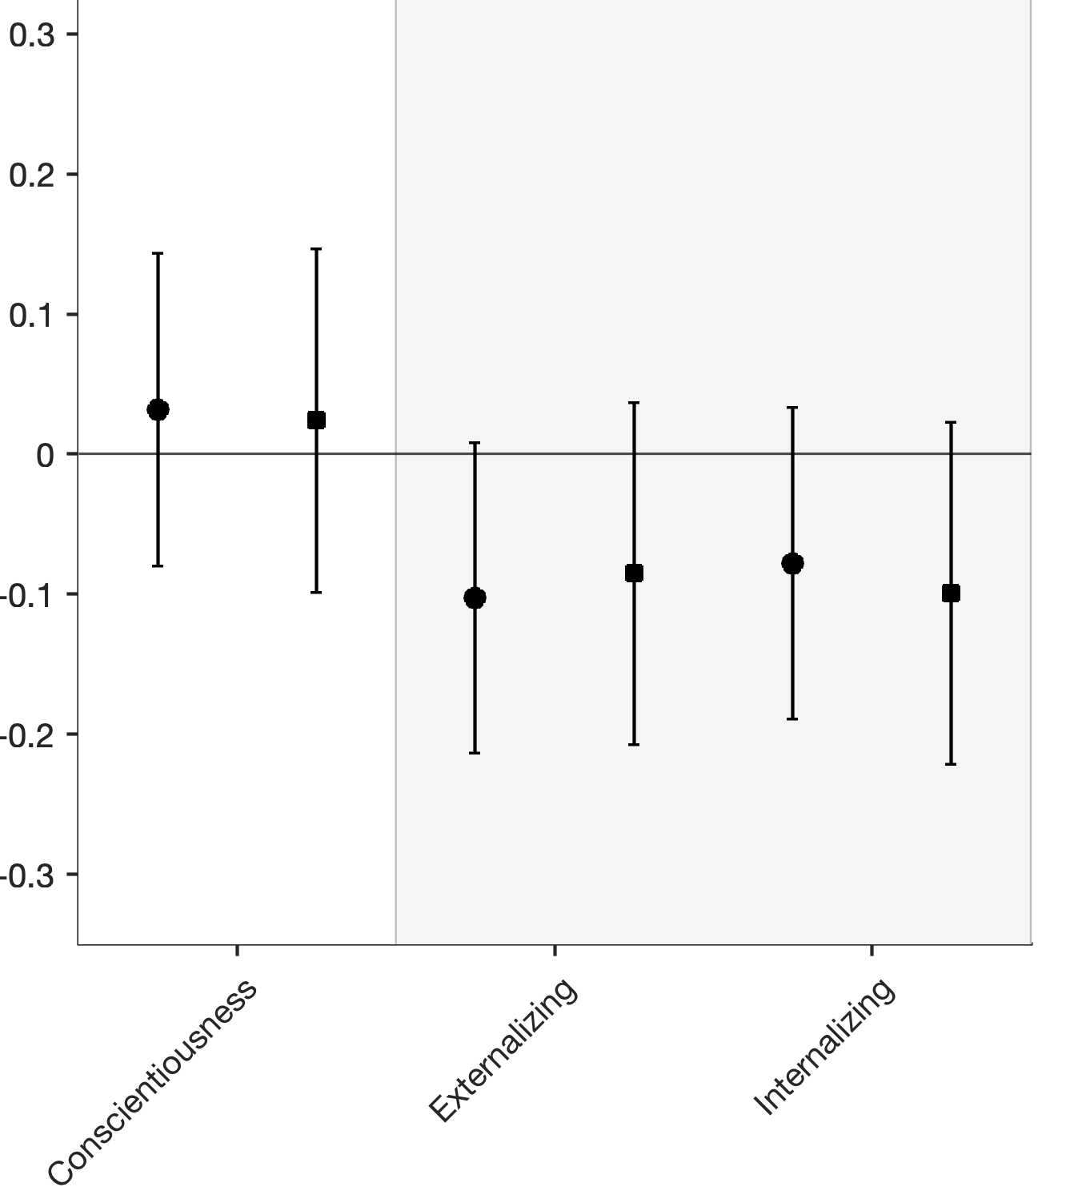
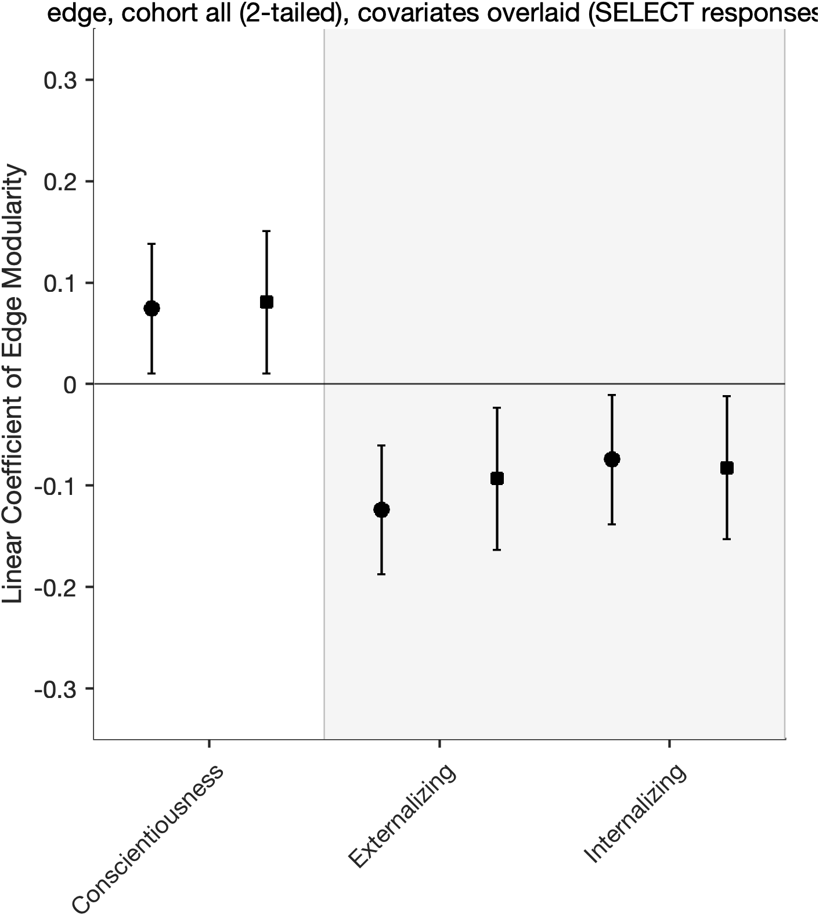
a. Conscientiousness
Total Cohort
b. Internalizing Behavior
Total Cohort
c. Externalizing Behavior
Total Cohort
d. Exploration Cohort
e. Replication Cohort
f. Total Cohort
Behavioral symptom scale
Intelli-
gence
Personality
Personality
Behavioral symptom scale
Personality
Behavioral symptom scale
*
†
†
*
*
*
*
*
†
*
***
*
Legend
No covariate control
Mean head motion and family (if applicable) controlled
Significance (uncorrected)
Significance under FDR correction
p-value | < 0.05 | <0.01 | <0.001
uncorrected | † | †† | †††
corrected | * | ** | ***
†
*

