Slide 1
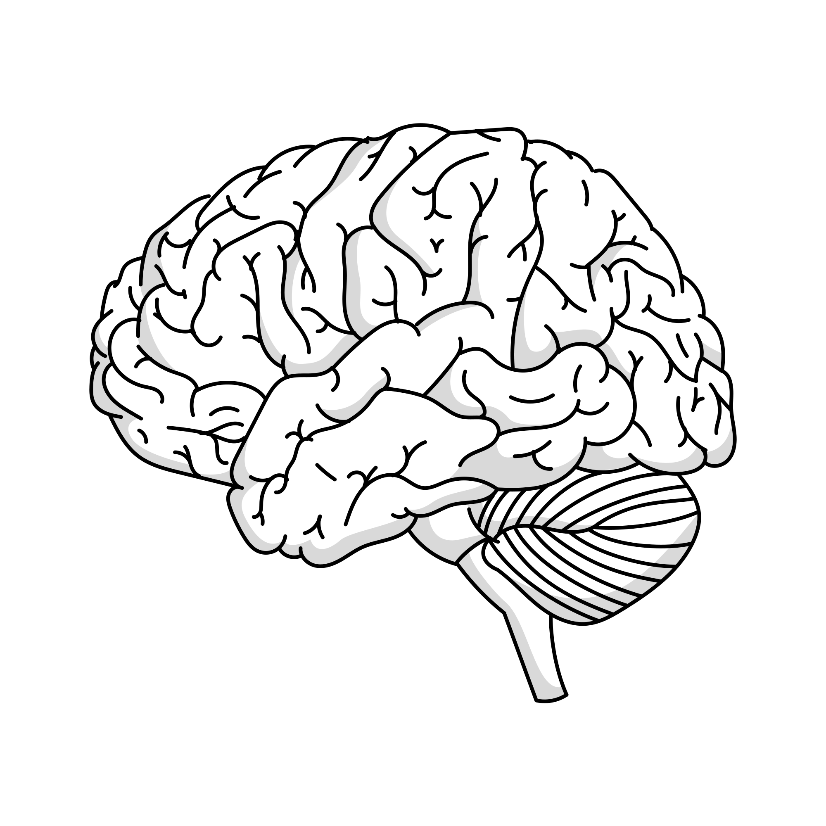
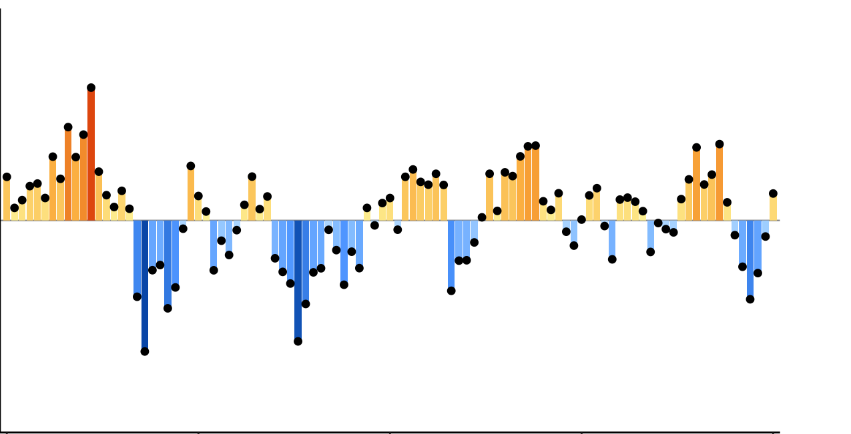
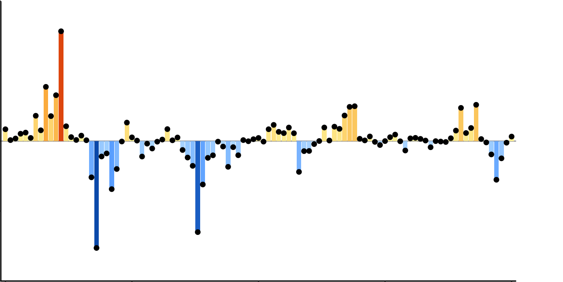
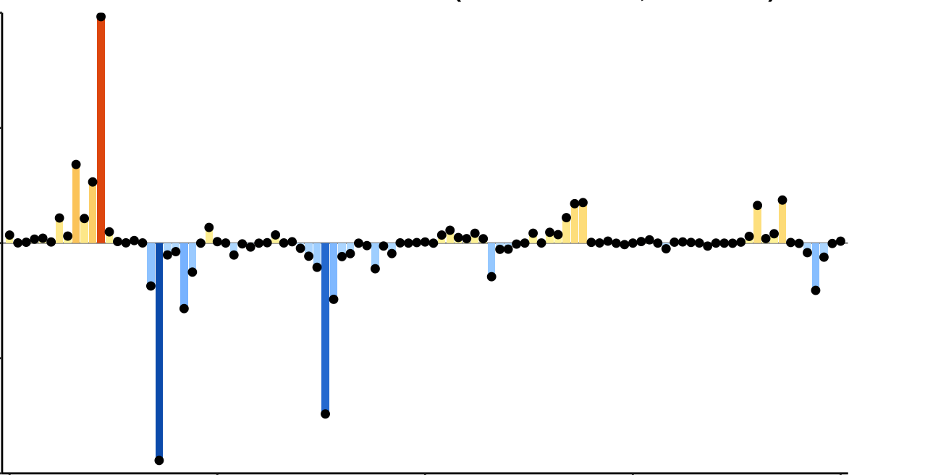
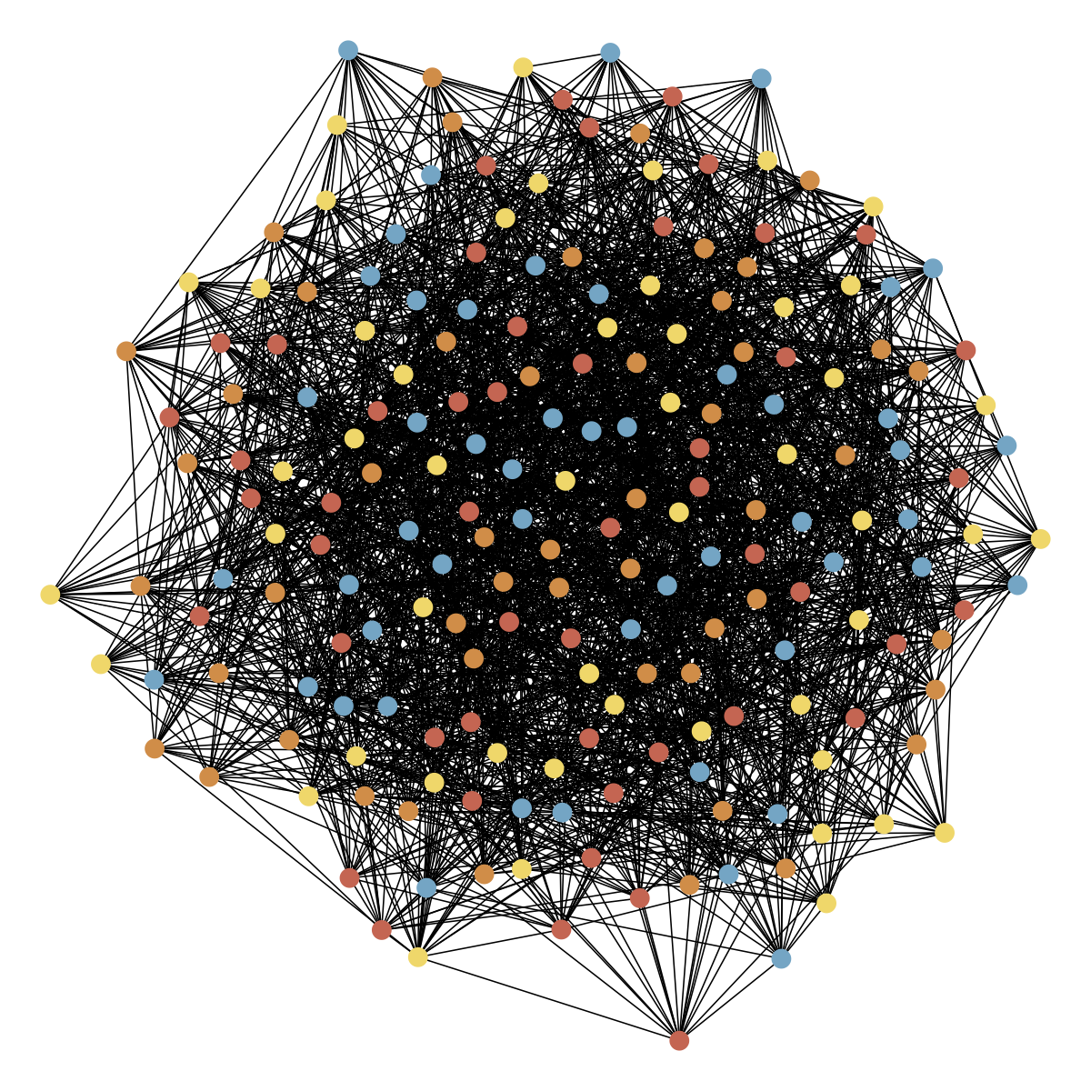
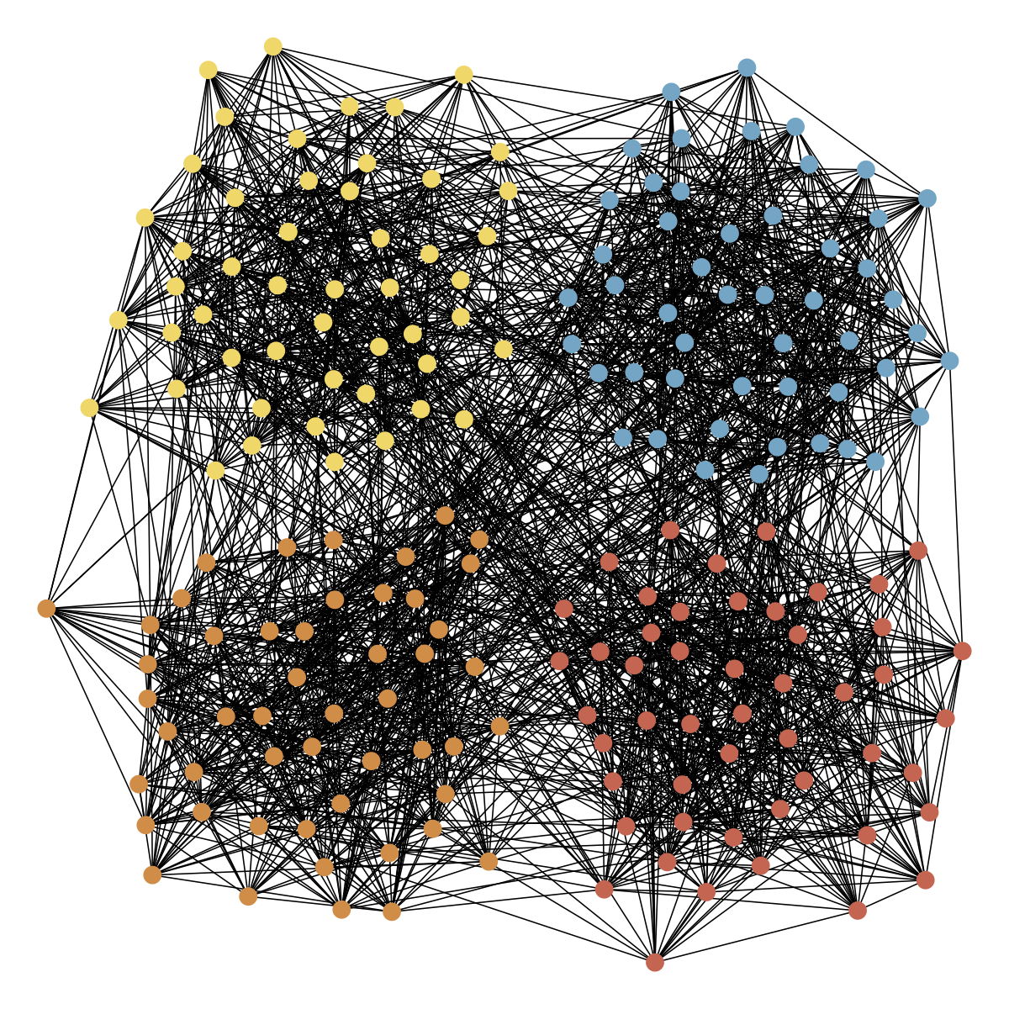
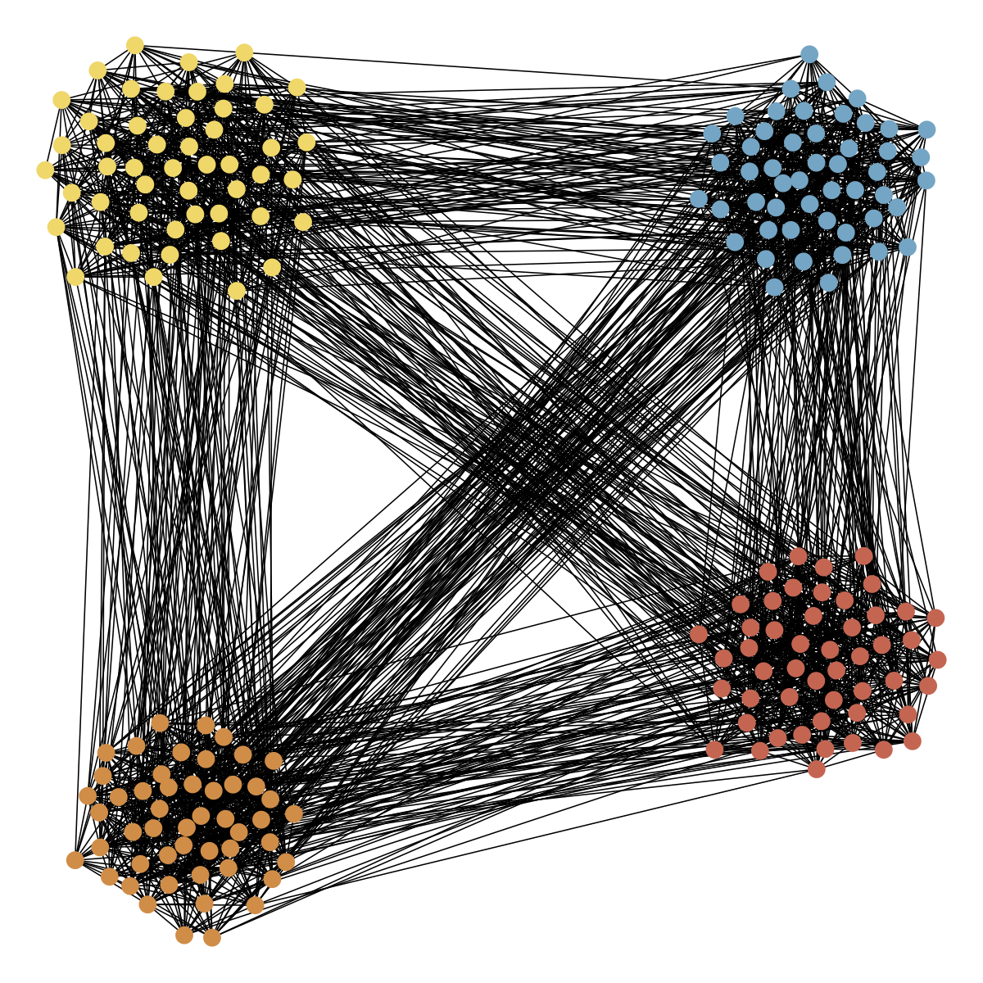
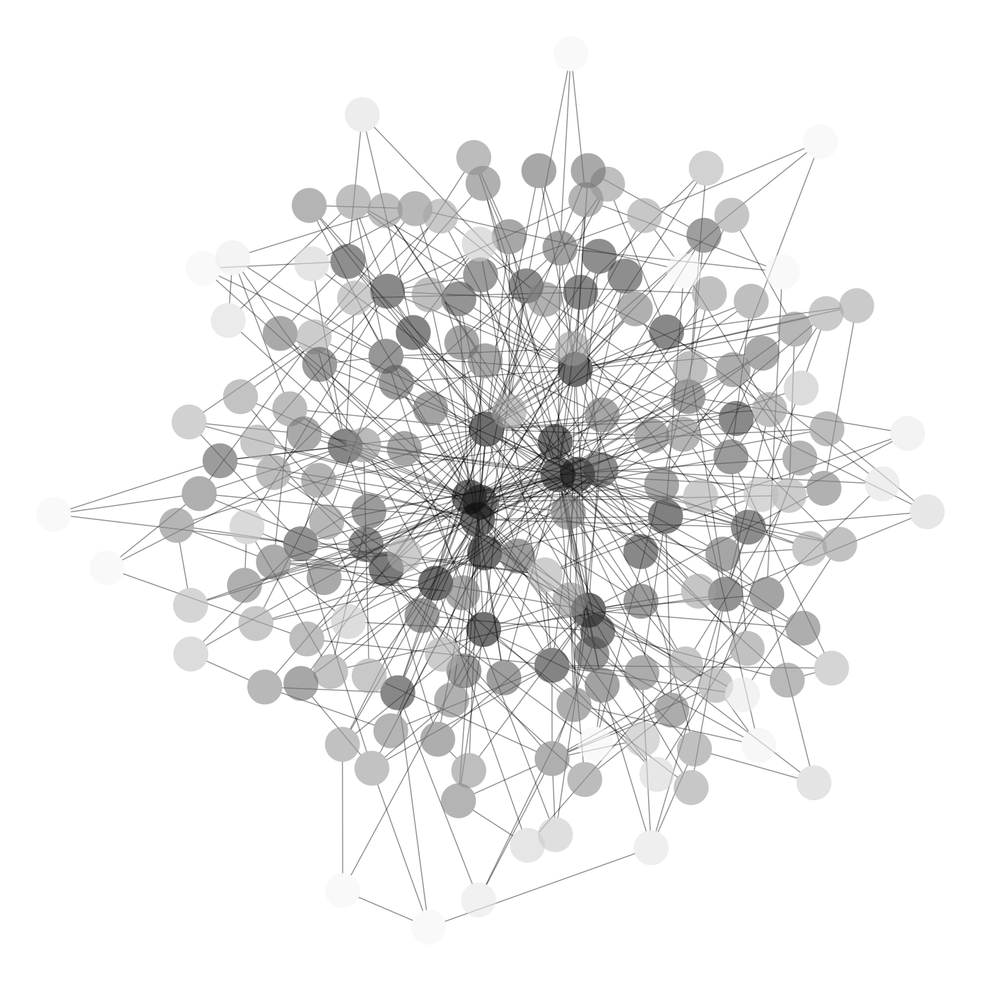
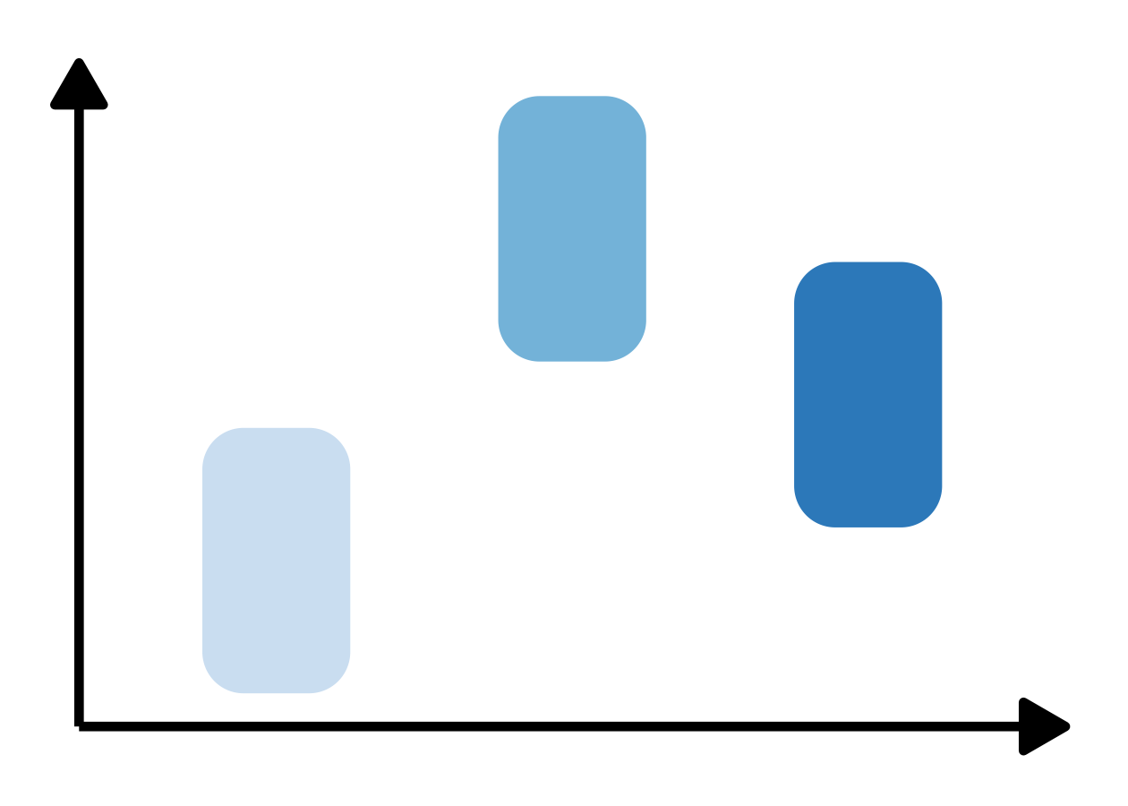
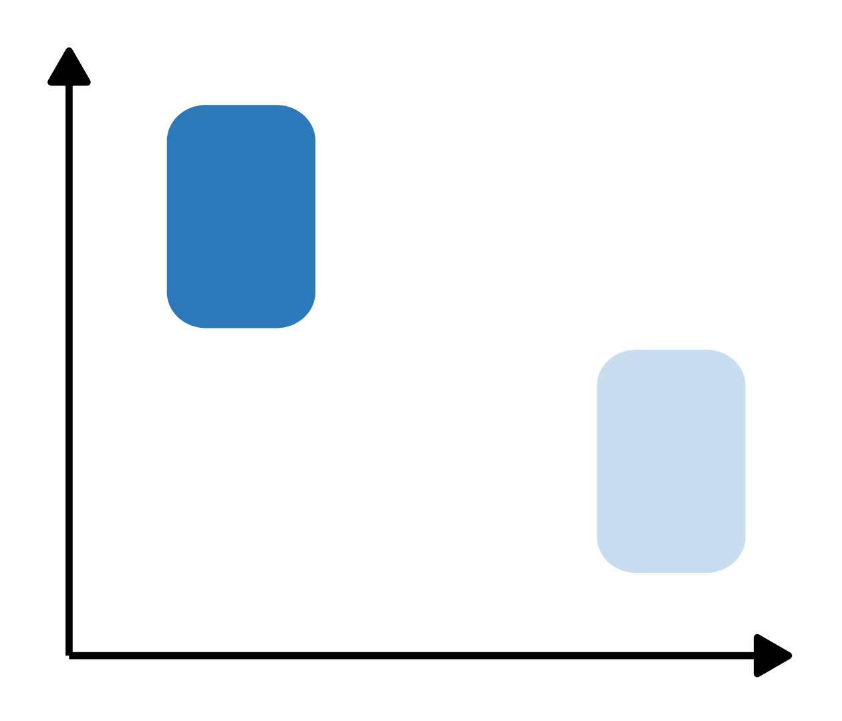
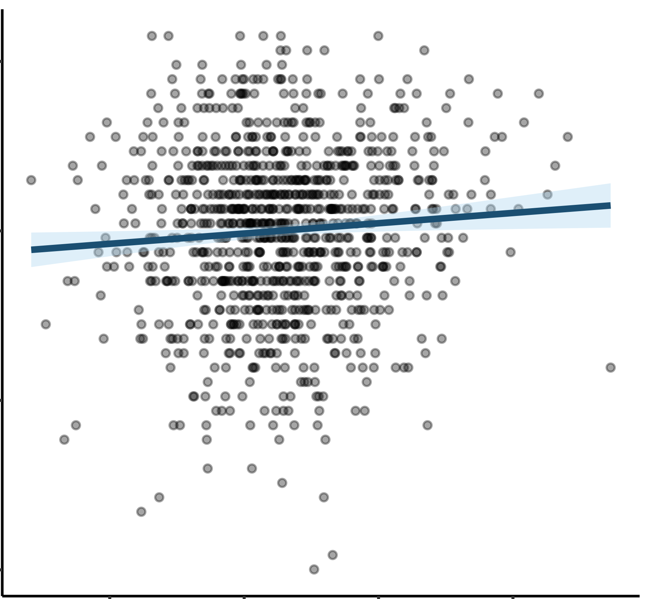










a.
b.
Tasks are concatenated.
Exploration Cohort
Replication Cohort
Total Cohort
Time Frames (TRs)
HCP S1200
Brain
Parcels
Rest
Emotion
Gambling
Motor
Relational
Social
Working Memory
Rest
Emotion
Gambling
Language
Motor
Relational
Social
N = 394
N = 319
N = 968
c. Node
d. Edge
e. Triangle
j
j
k
$$i$$
$$i$$
$$i$$
2
=
BOLD signal at parcel $i$
2
2
BOLD Signal
$$C_{i}\left(t\right)$$
Cofluctuation
$$C_{i,j}\left(t\right)=C_{i}\left(t\right)C_{j}\left(t\right)$$
Cofluctuation
$$C_{i,j,k}\left(t\right)=C_{i}\left(t\right)C_{j}\left(t\right)C_{k}\left(t\right)$$
0
0
0
0
-2
-2
0
10
20
-2
20
0
10
20
0
10
Input to Mapper Algorithm
Time (s)
Time (s)
Time (s)
Node time series
Edge time series
Triangle time series
$$i$$
$$i,j$$
$$i,j,k$$
Time Frames (TRs)
Time Frames (TRs)
Time Frames (TRs)
T x R matrix
T x (~ R²/2) matrix
T x (~ R³/6) matrix
f.
Mapper nodes = Clusters of points (time frames)
Cofluctuations at time frames from the relational task
Cofluctuations from time frames from the social task
Cofluctuation of brain regions at a time frame
Construct Mapper
Pie charts indicate the proportions of time frames from different tasks within the corresponding clusters. A uniform pie chart means similar cofluctuations from different tasks are clustered together.
Cofluctuations from time frames from the working memory task
Mapper edges = Overlapping clusters
g.
Increasing modularity
h.
Increasing centrality
i.
j.
k.
Compare the topological properties across node, edge, and triangle time series Mapper graphs
Investigate the relationship between high-amplitude time frames and centrality in Mapper graphs
Relate Mapper topological properties to individual differences in personality and psychopathology
Behavioral Score
Node Edge Triangle
Peak-dense pure nodes
All other
Pure nodes
Modularity

