Slide 1
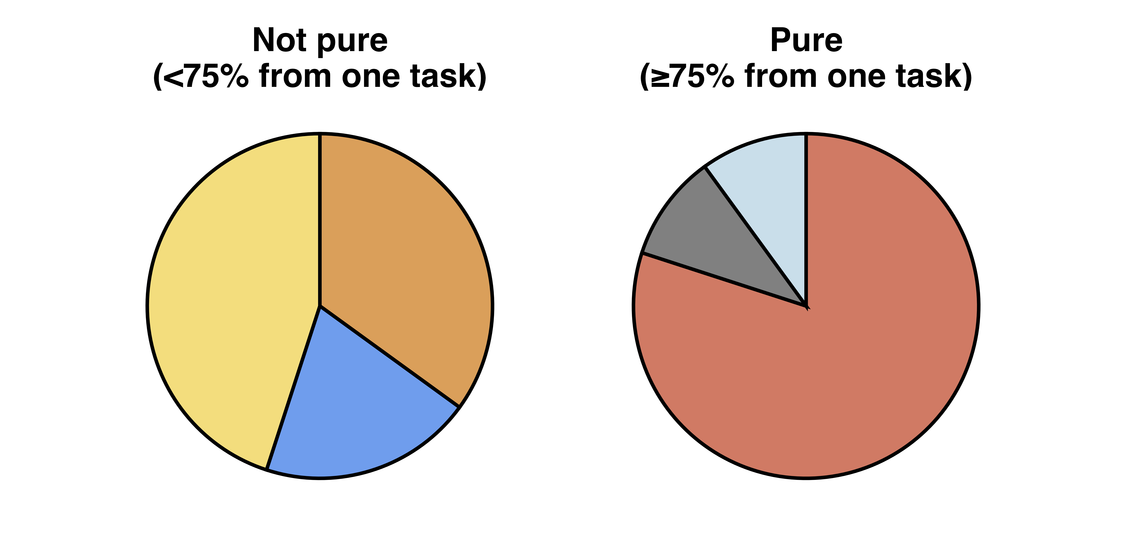
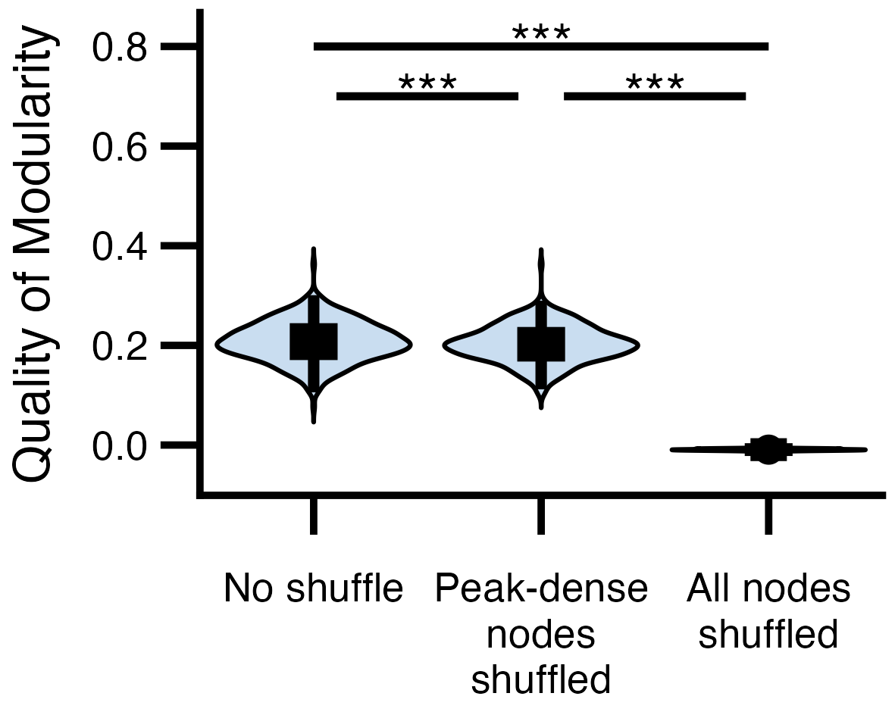
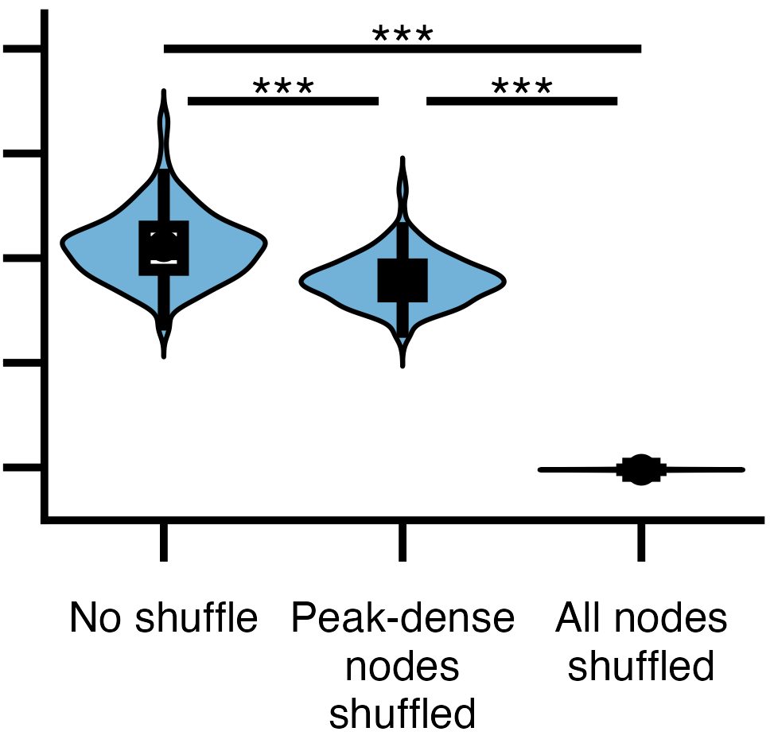
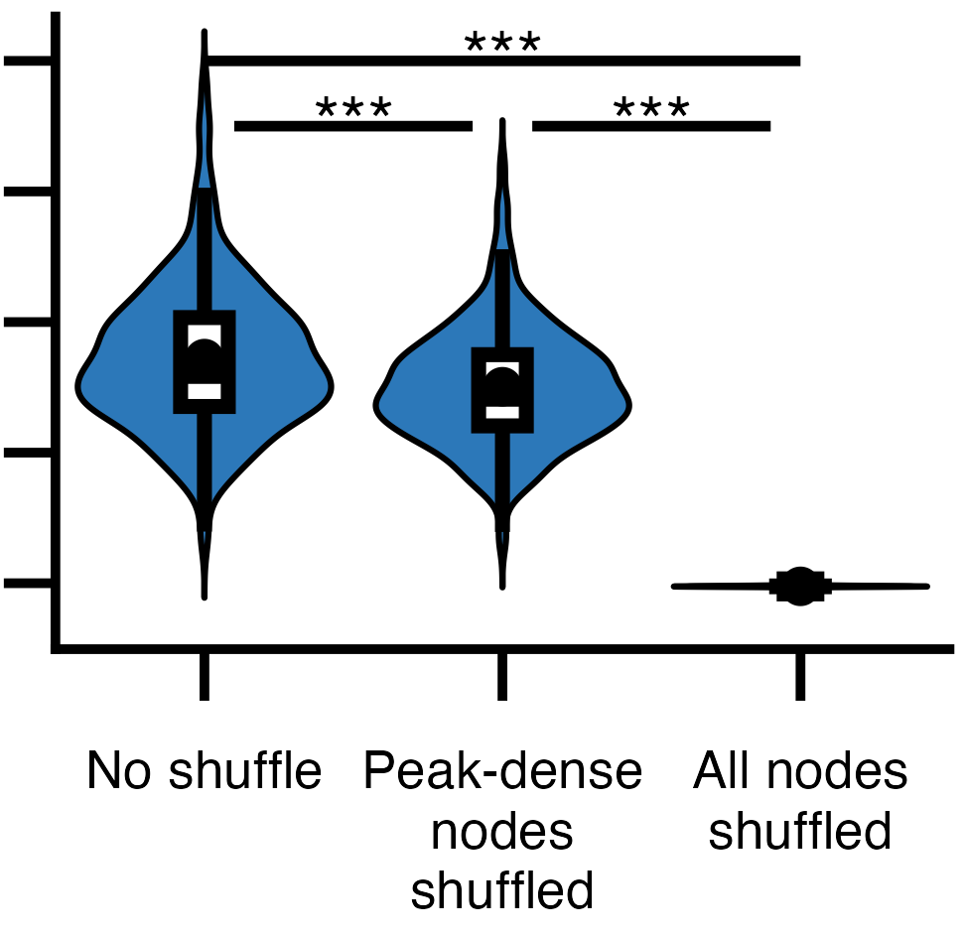
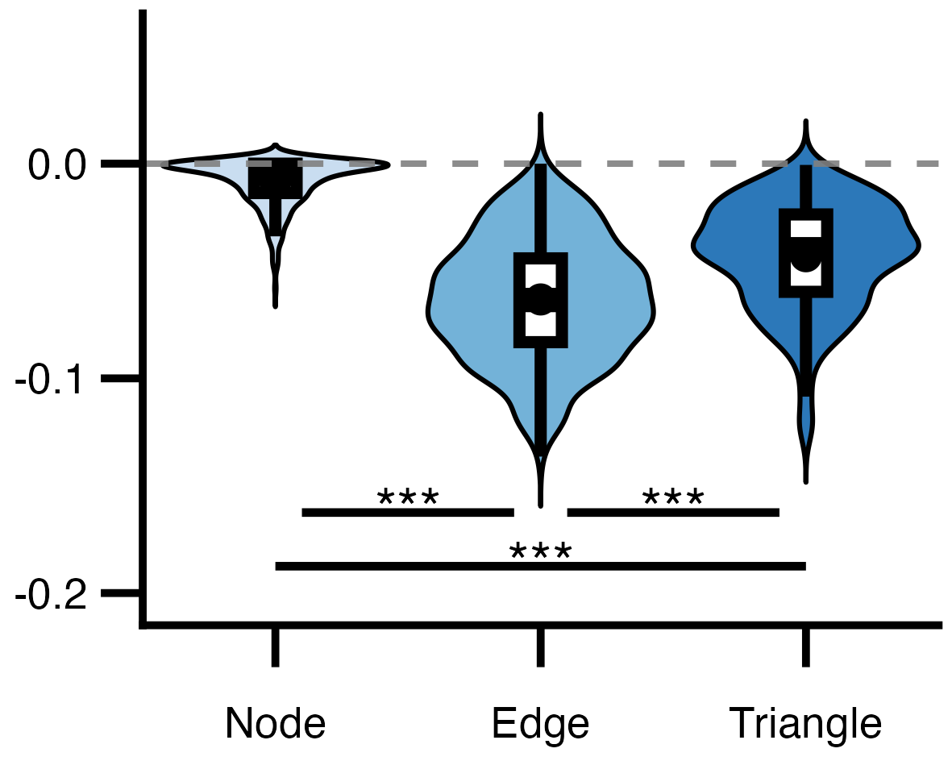
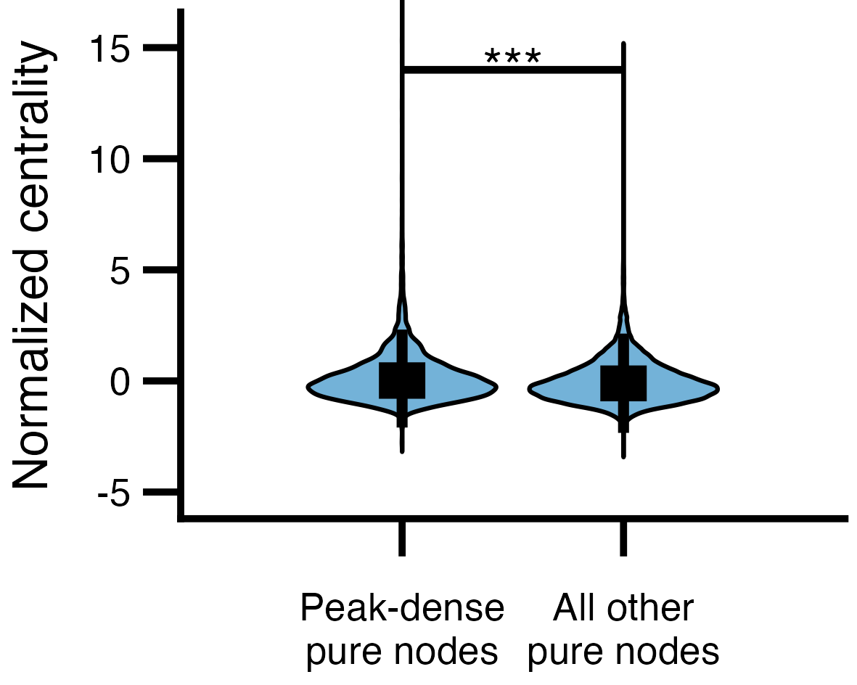

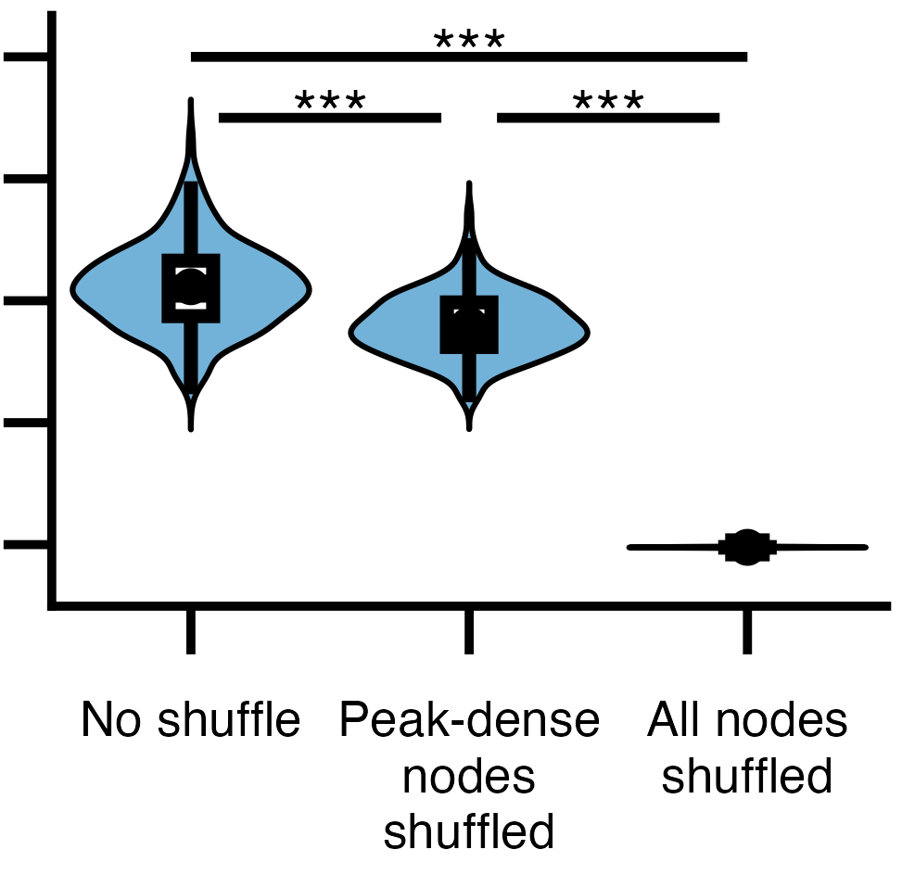

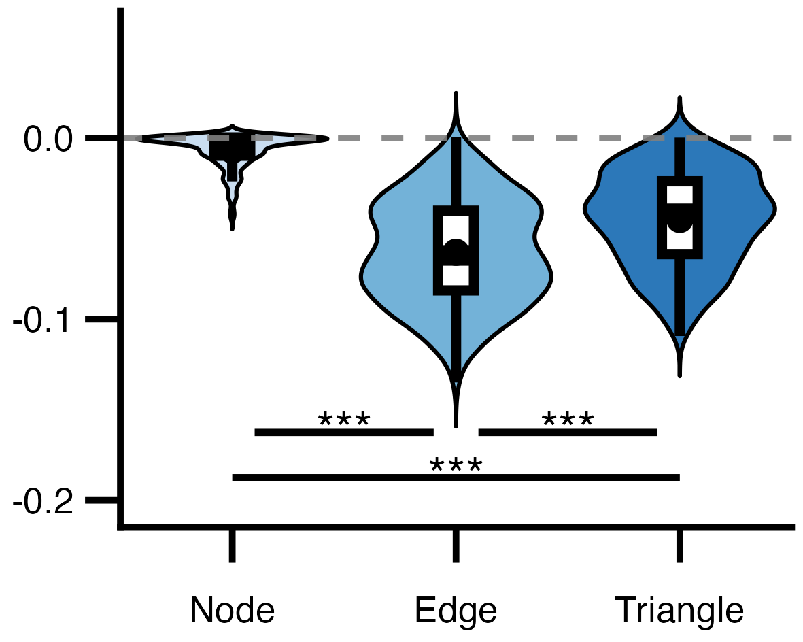

a.
Change this to 95th percentile line (actually say it)
b.
95th Percentile
Not pure
(< 75% from one task)
Pure
(≥ 75% from one task)
Working
Memory
Task
Amplitude
Emotion
Task
Social
Task
Language
Task
Relational
Task
Resting State
Task
Time
c.
Proportion of peak frames
d.
Peak-dense pure nodes
e.
Within-task closeness centrality
1
1.6 x 10⁻³
1.2 x 10⁻³
0.5
0.8 x 10⁻³
0.4 x 10⁻³
0
0
f.
Node
g.
h.
Change in the quality of modularity after shuffling
Edge
Triangle
i.
j. Within-task closeness centrality of nodes in edge Mapper graphs
Exploration Cohort
k.
l.
m.
n.
o. Within-task closeness centrality of nodes in edge Mapper graphs
Replication Cohort

