Slide 1
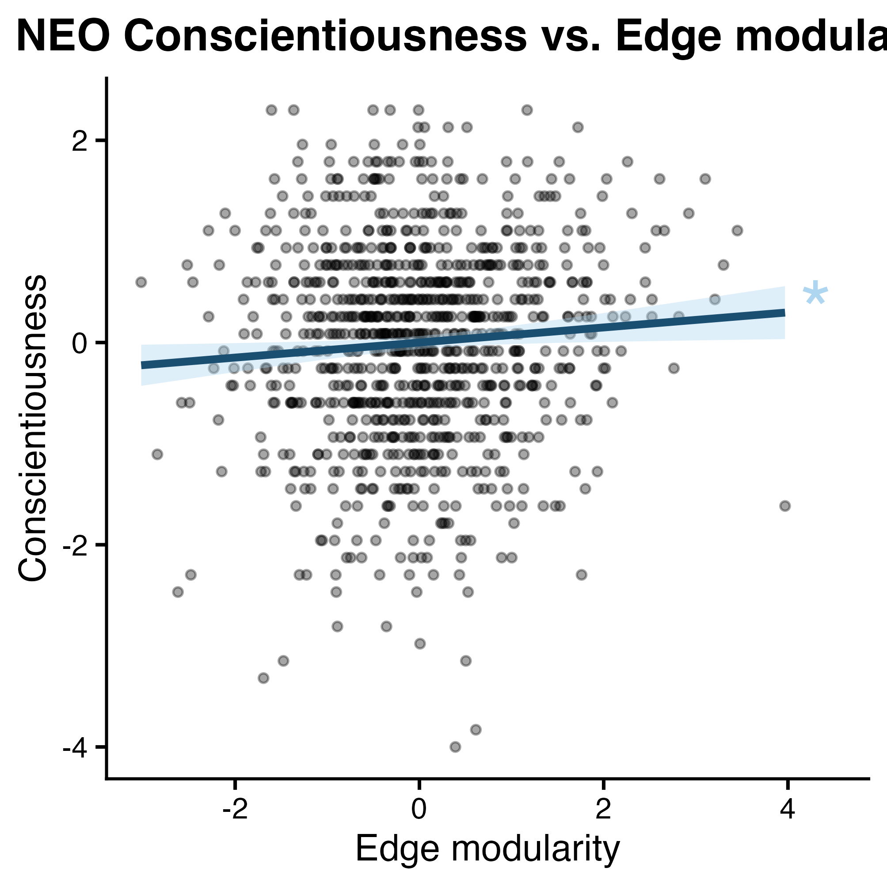
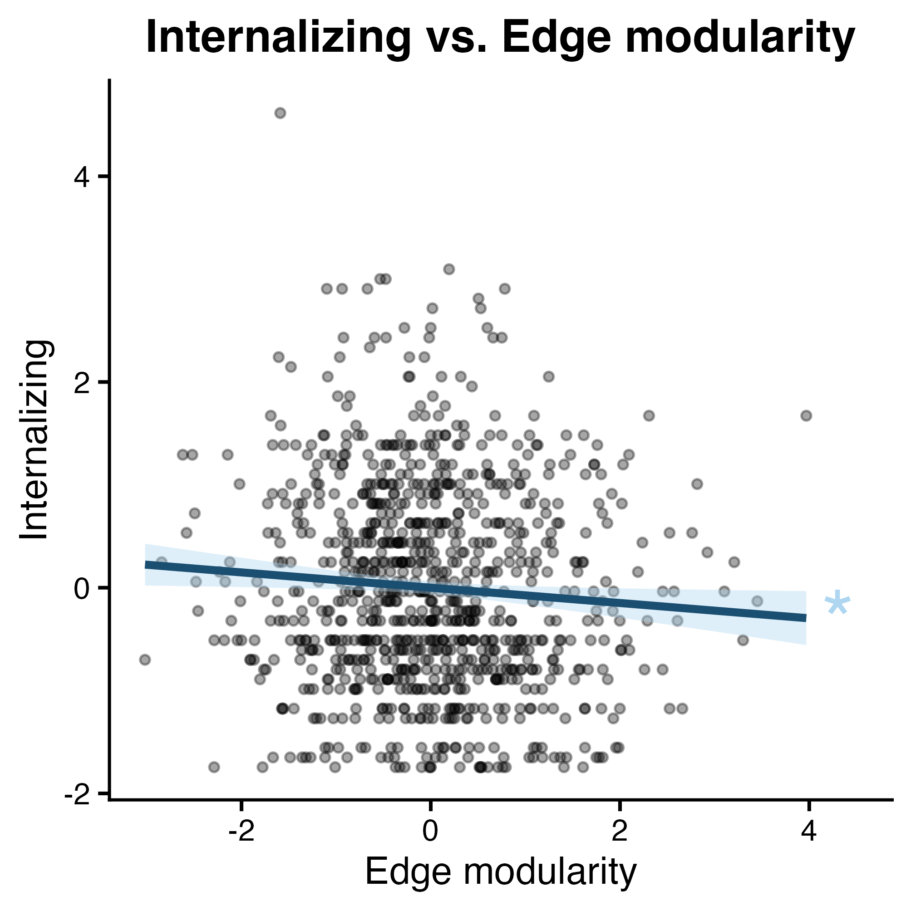
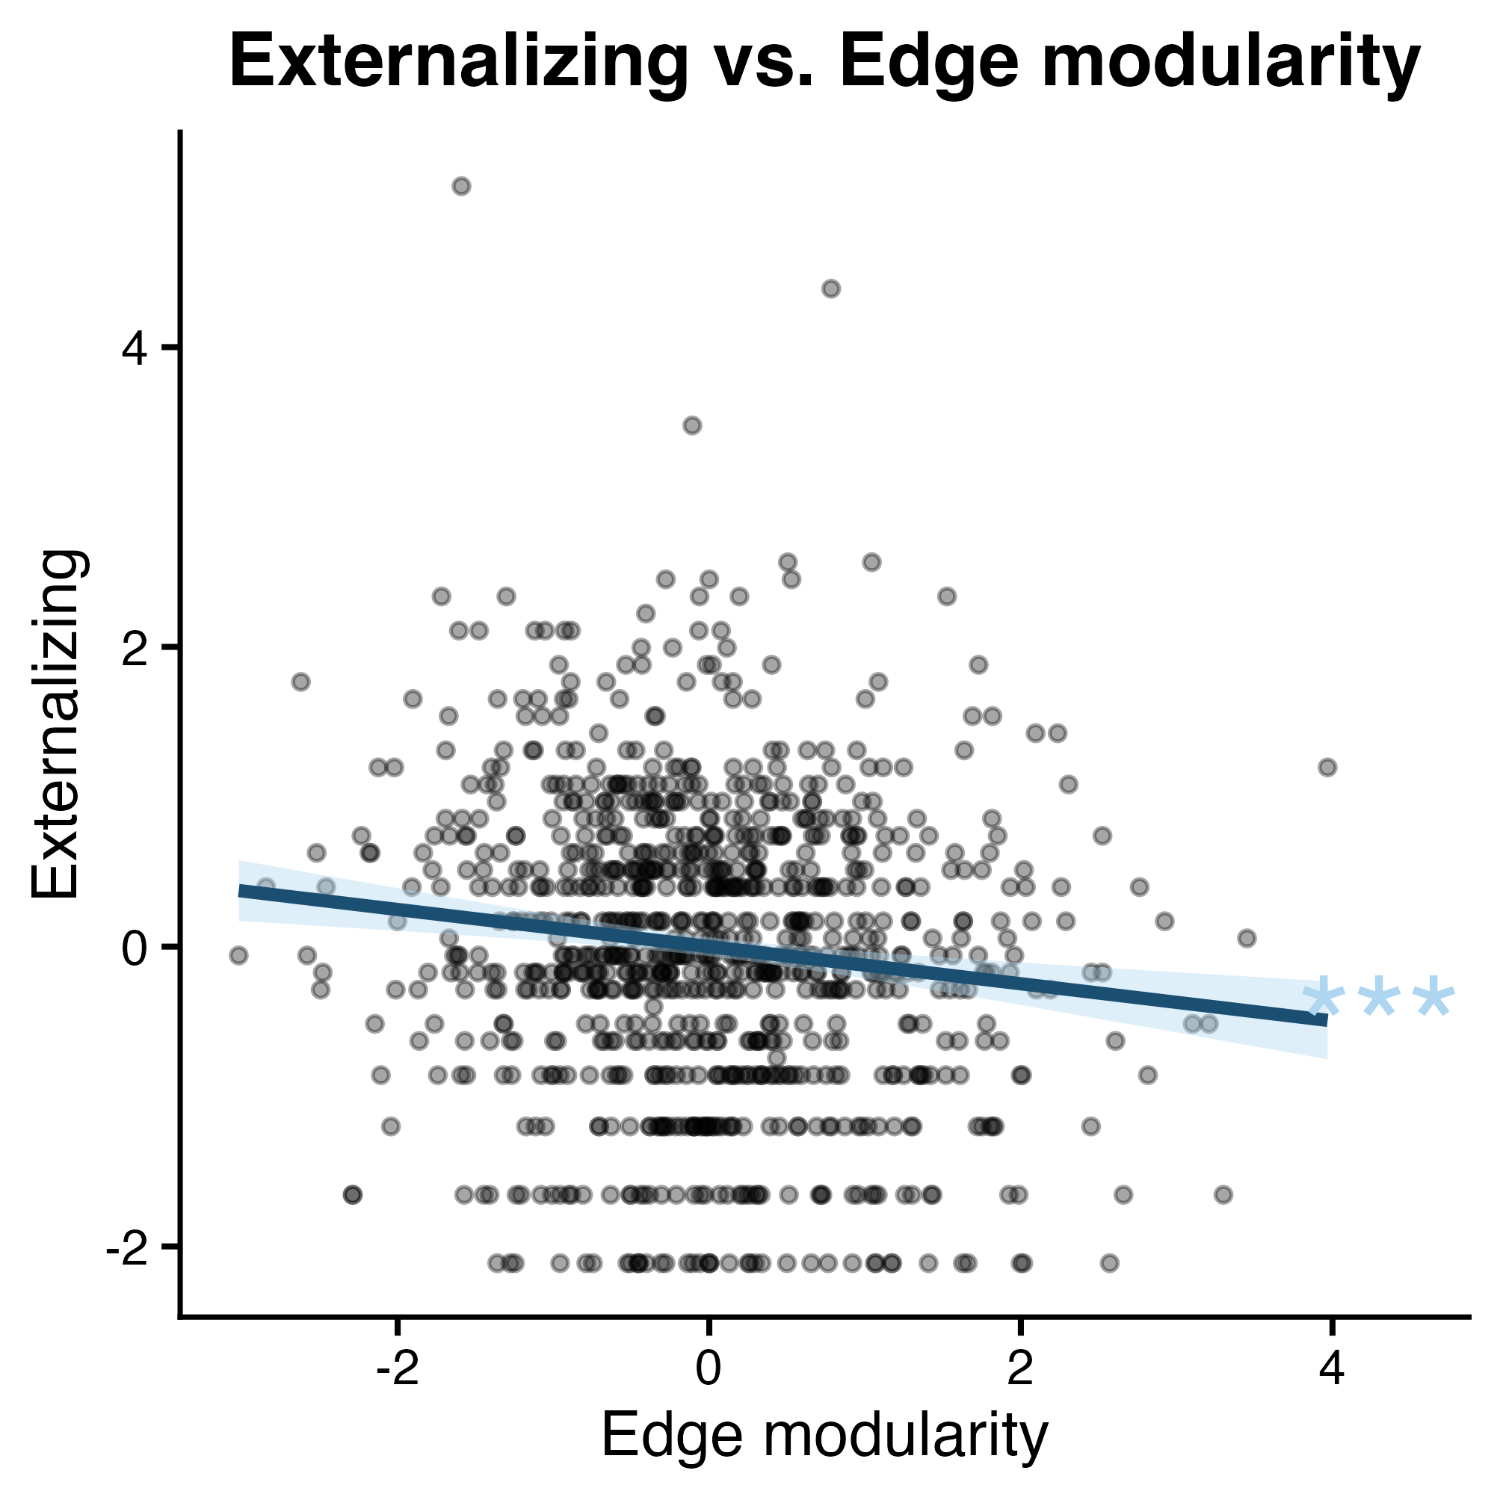
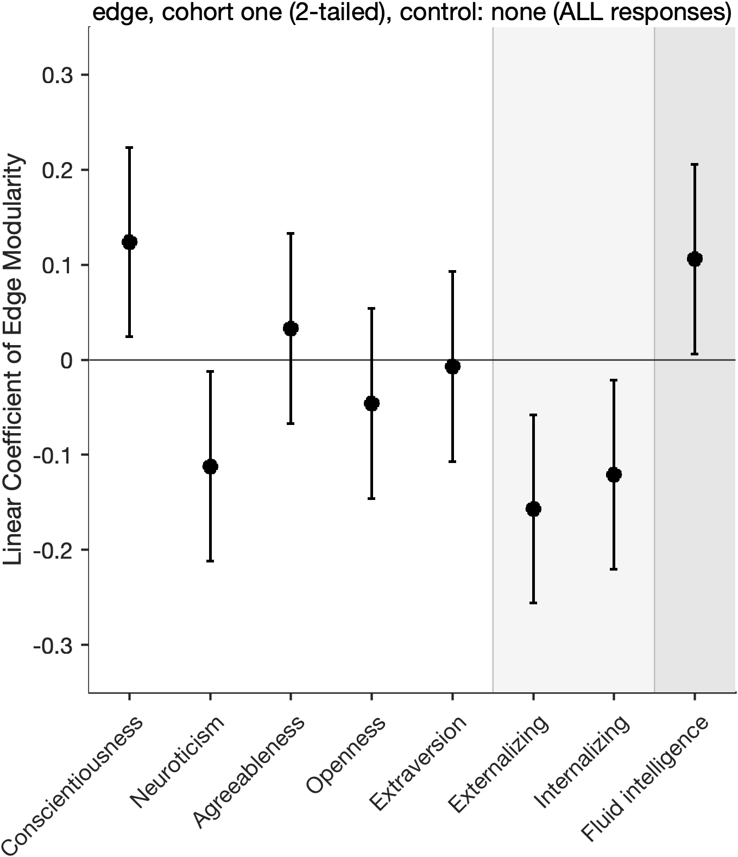
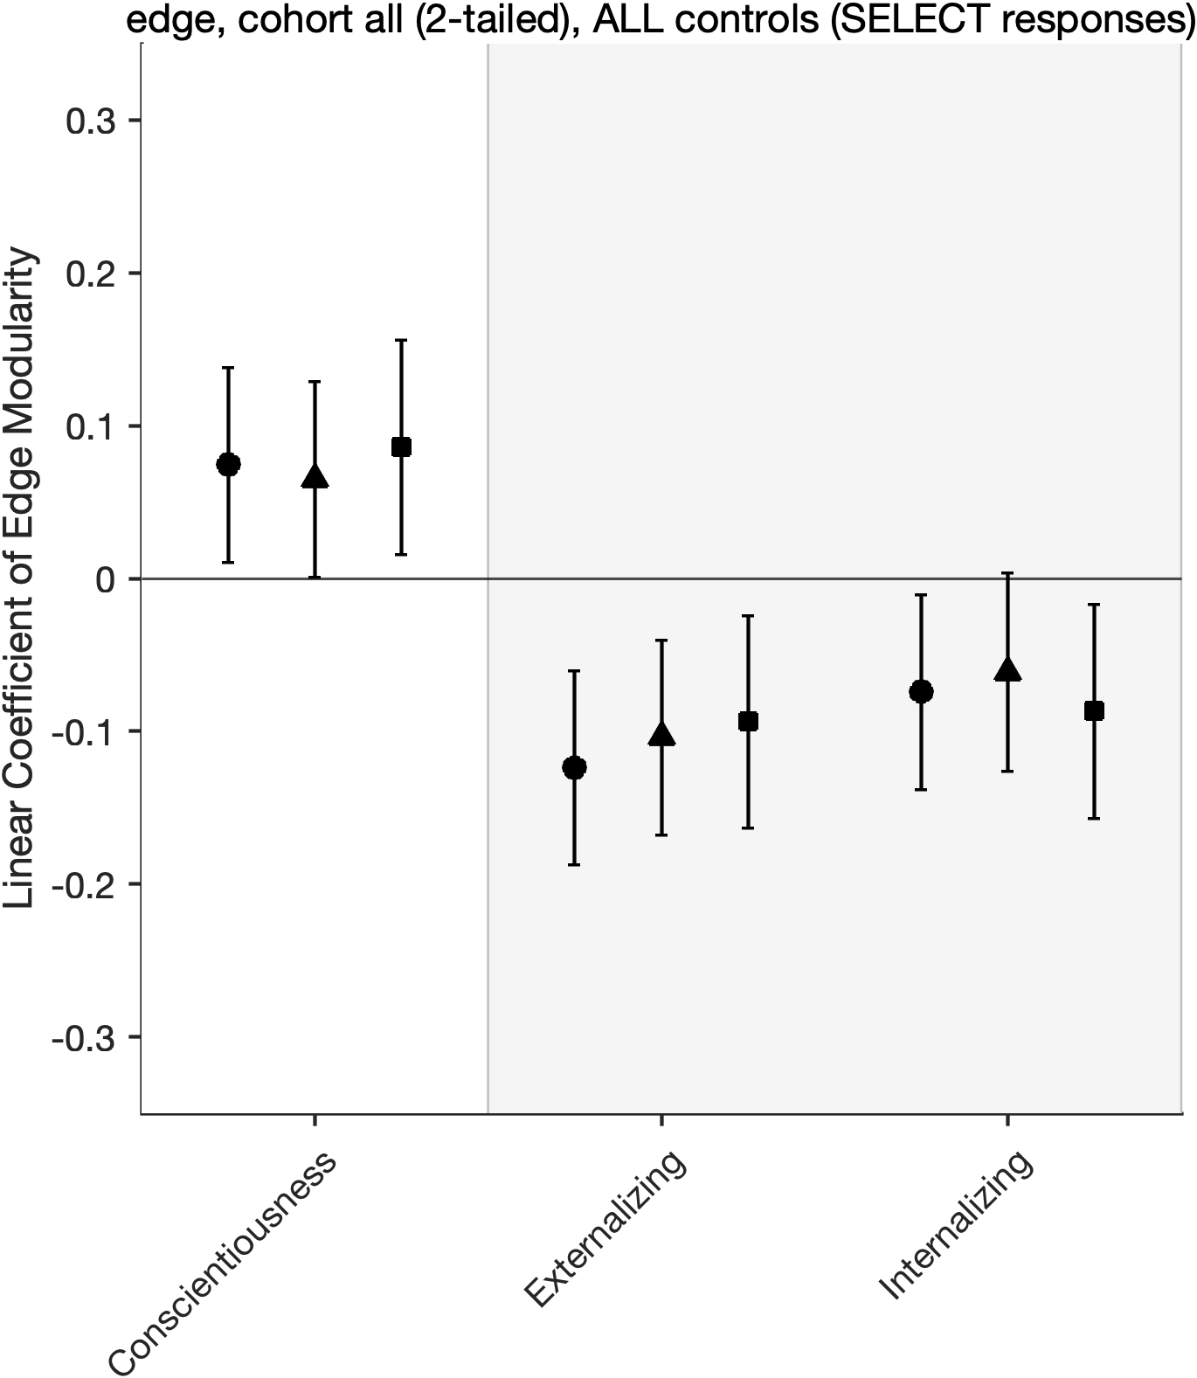
a. Conscientiousness Total Cohort
b. Internalizing Behavior Total Cohort
c. Externalizing Behavior Total Cohort
d. Exploration Cohort
e. Total Cohort
Behavioral symptom scale
Personality
Intelligence
Personality
Behavioral symptom scale
*
†
Legend
*
†
*
No covariate control
Demographics controlled
Mean head motion controlled
Significance (uncorrected)
Significance under FDR correction
†
*
p-value | < 0.05 | <0.01 | <0.001
uncorrected | † | †† | †††
corrected | * | ** | ***
**
*
*
*
†
*
***
*

