Slide 1
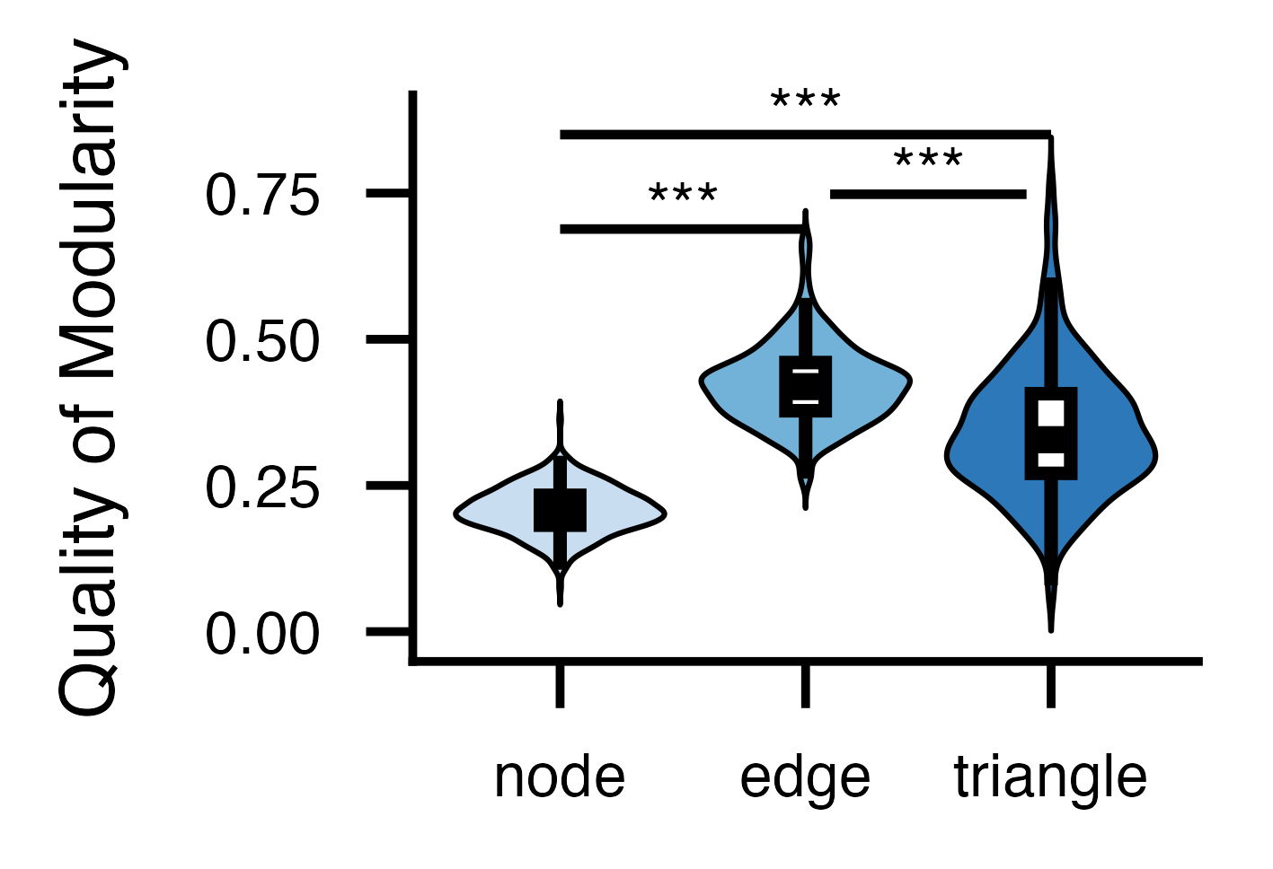
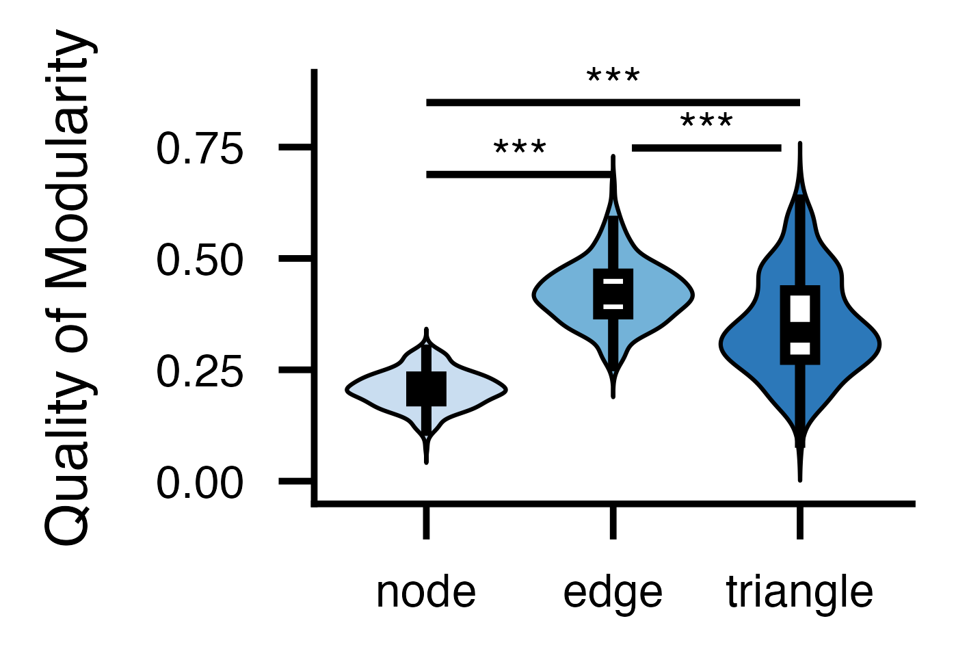
a. Node
b. Edge
c. Triangle
Working Memory
Social
Relational
Motor
Language
Gambling
Emotion
Rest
d. Exploration Cohort
e. Replication Cohort

