Slide 1
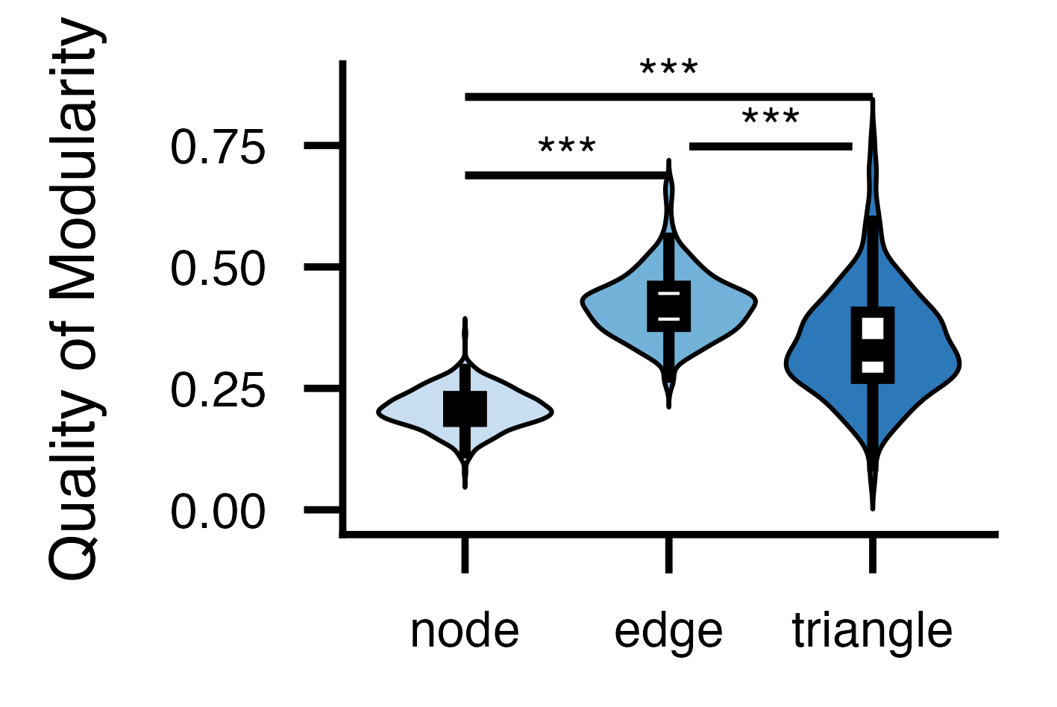
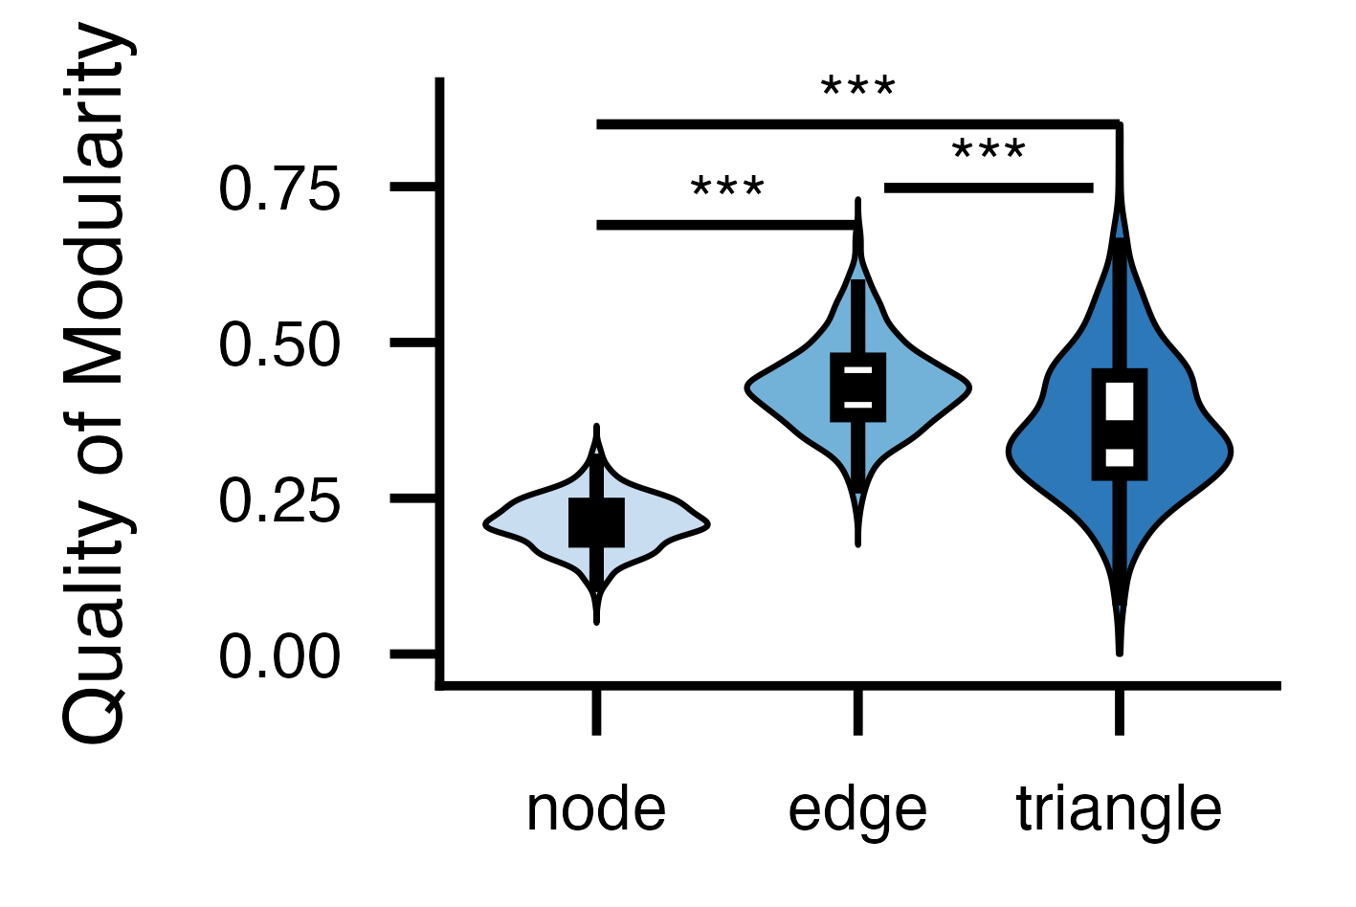
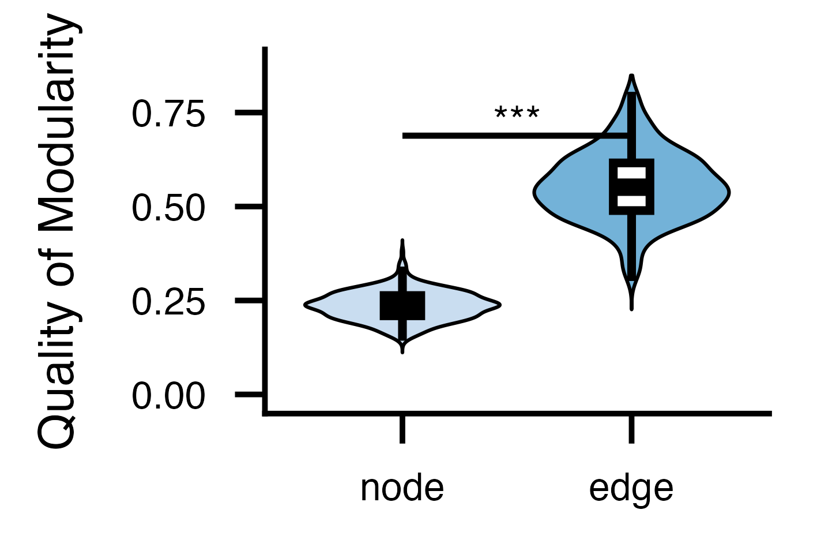
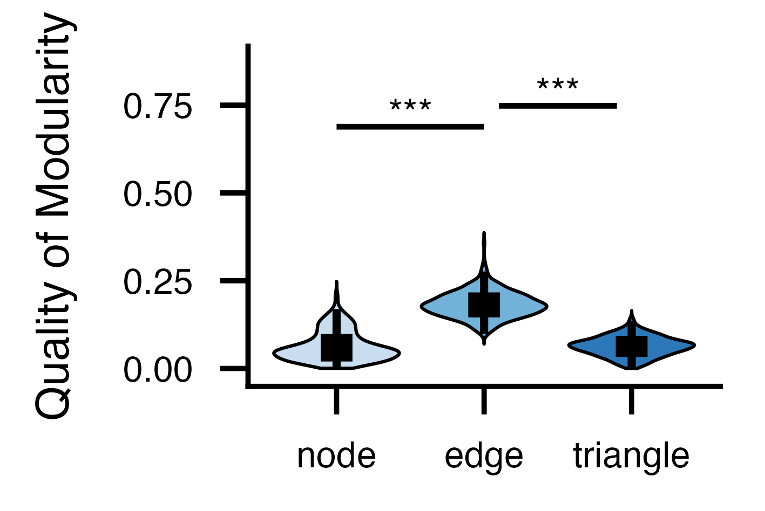
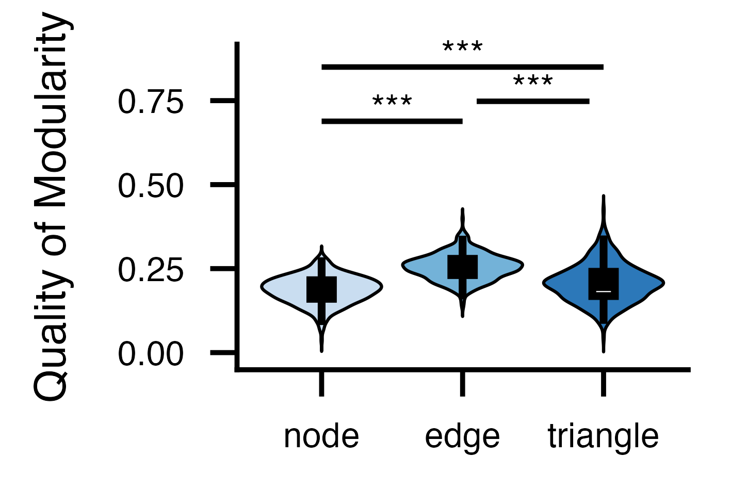
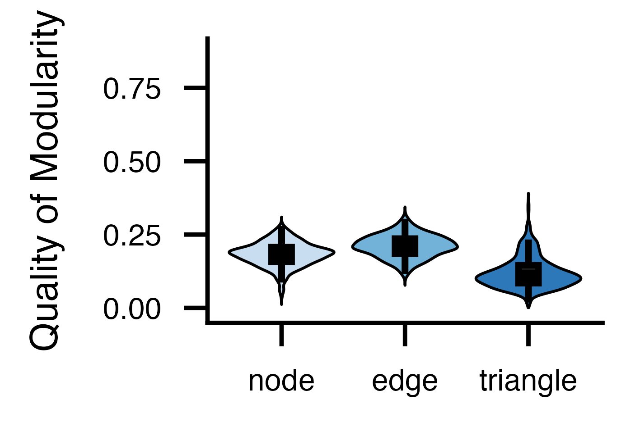
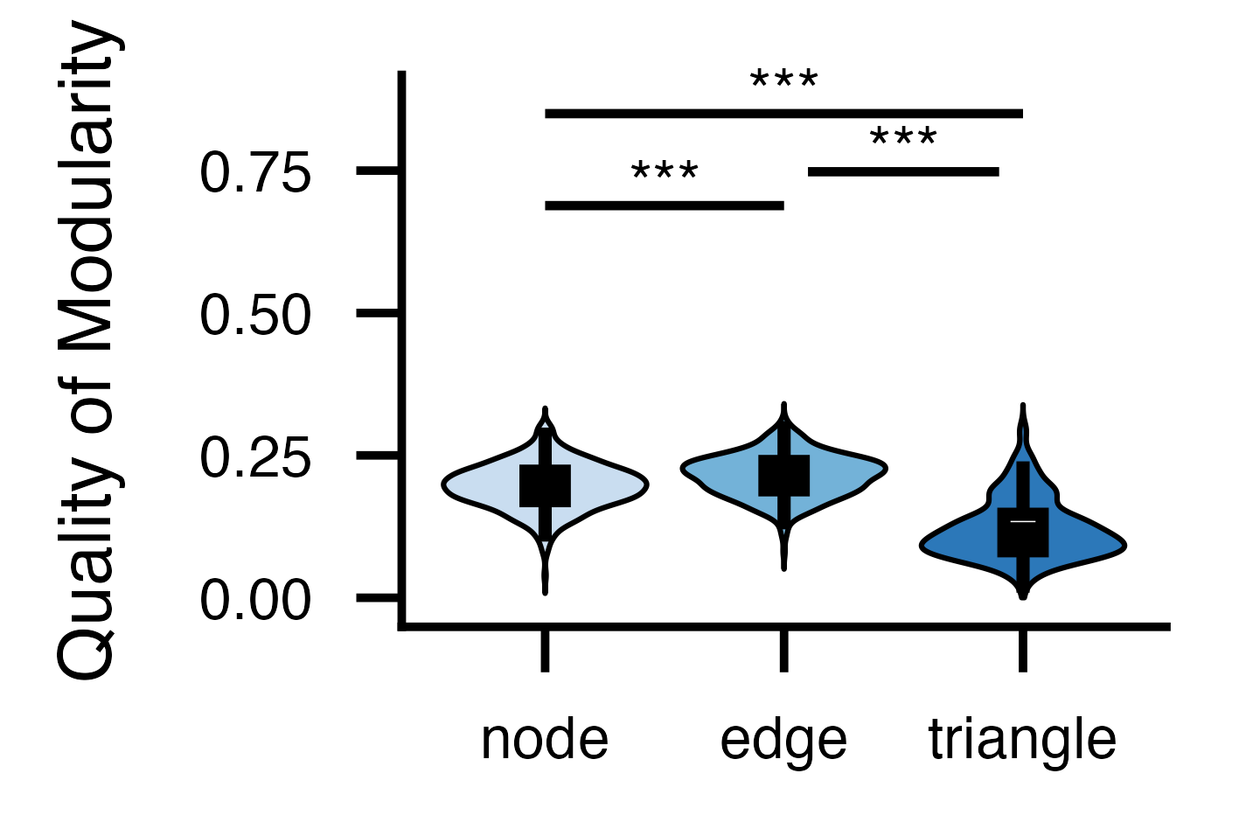

a. Exploration cohort, Schaefer 100 x 7, LR (Fig 2d)
b. Exploration cohort, Schaefer 100 x 7, RL
c. Exploration cohort, Schaefer 200 x 7, LR
d. Coherence Condition Applied
Exploration cohort, Schaefer 100 x 7, LR
f. PCA Applied (30 components)
Exploration cohort, Schaefer 100 x 7, LR
g. PCA Applied (35 components)
Exploration cohort, Schaefer 100 x 7, LR
h. PCA Applied (40 components)
Exploration cohort, Schaefer 100 x 7, LR
e. PCA Applied (90% explained variance)
Exploration cohort, Schaefer 100 x 7, LR

