Slide 1
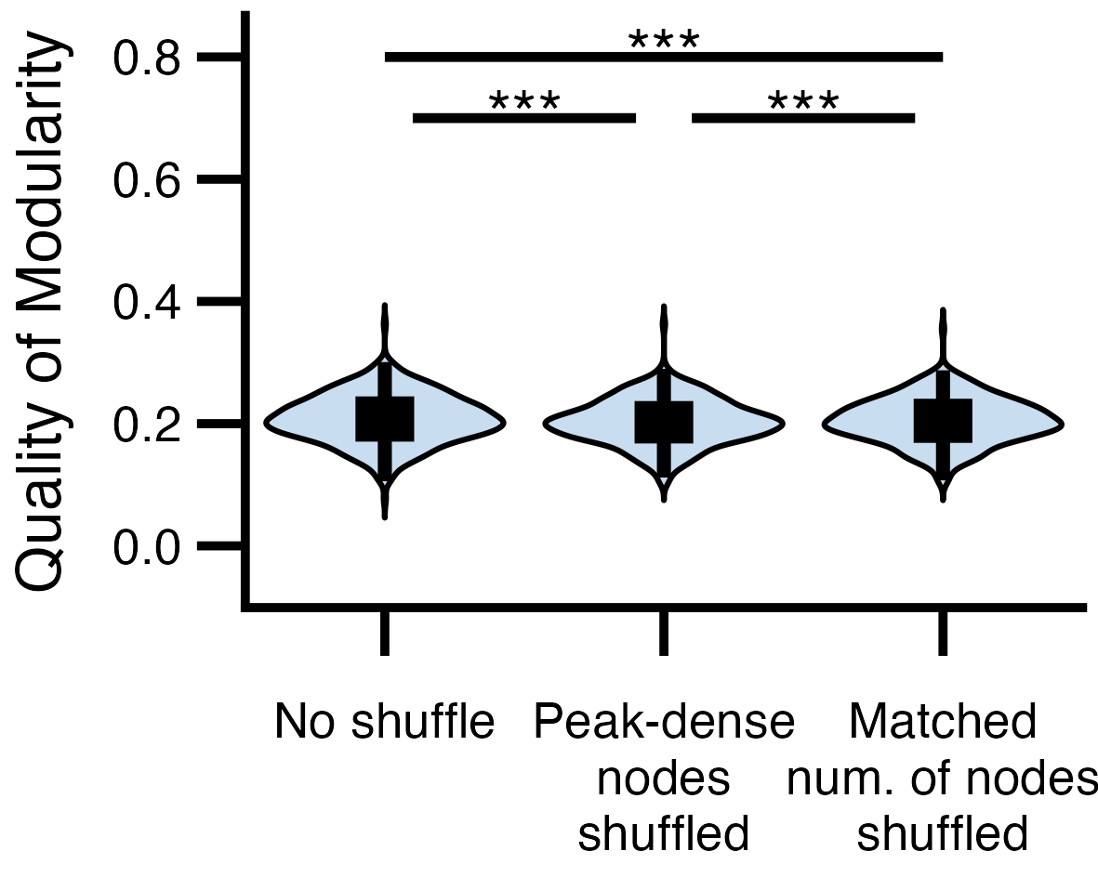
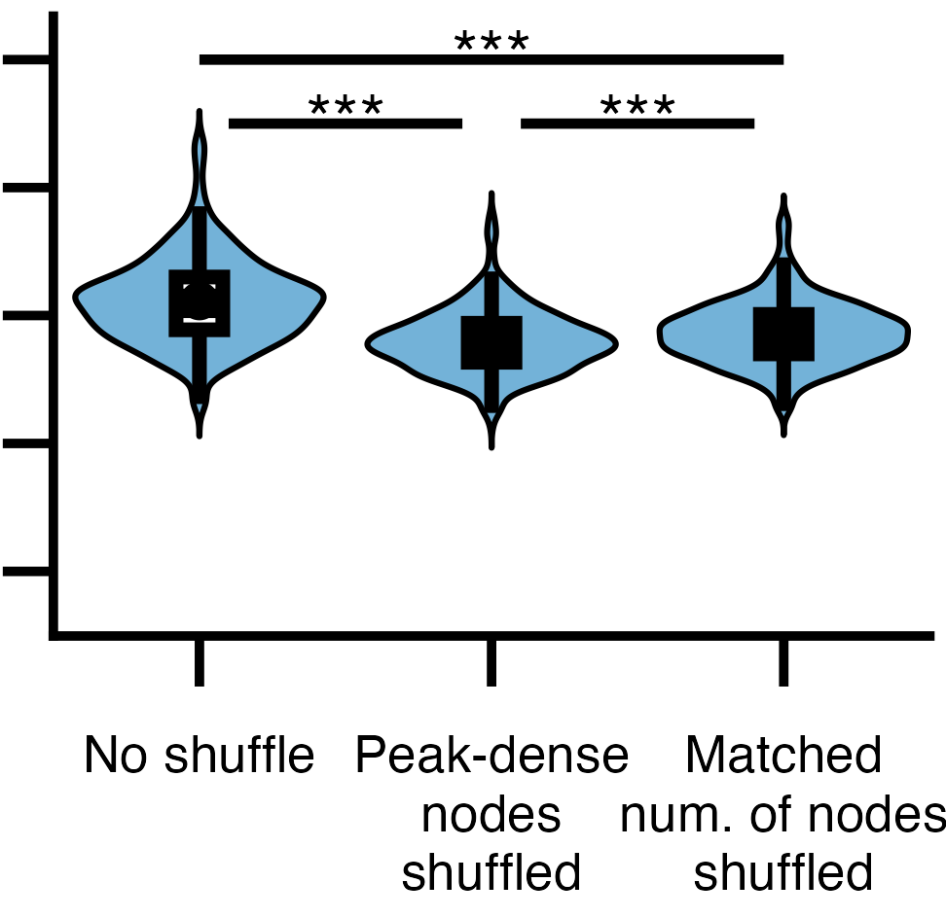
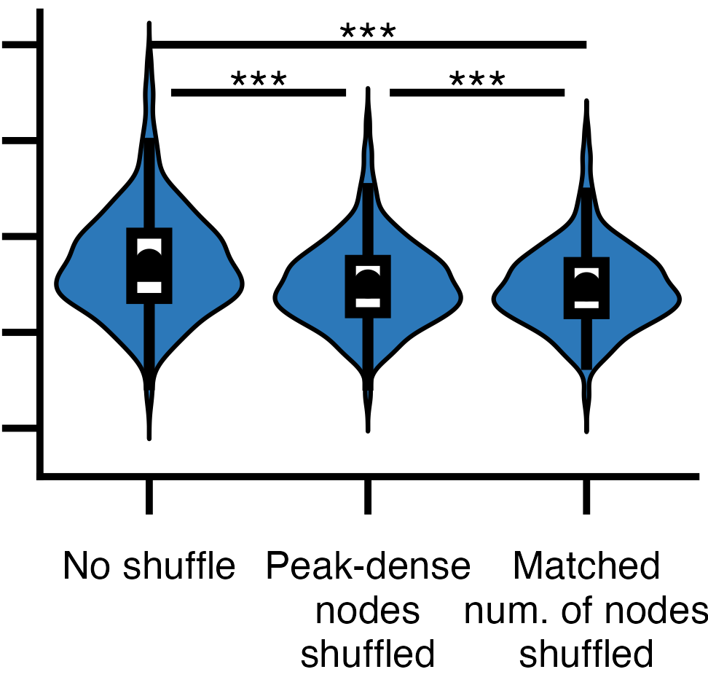
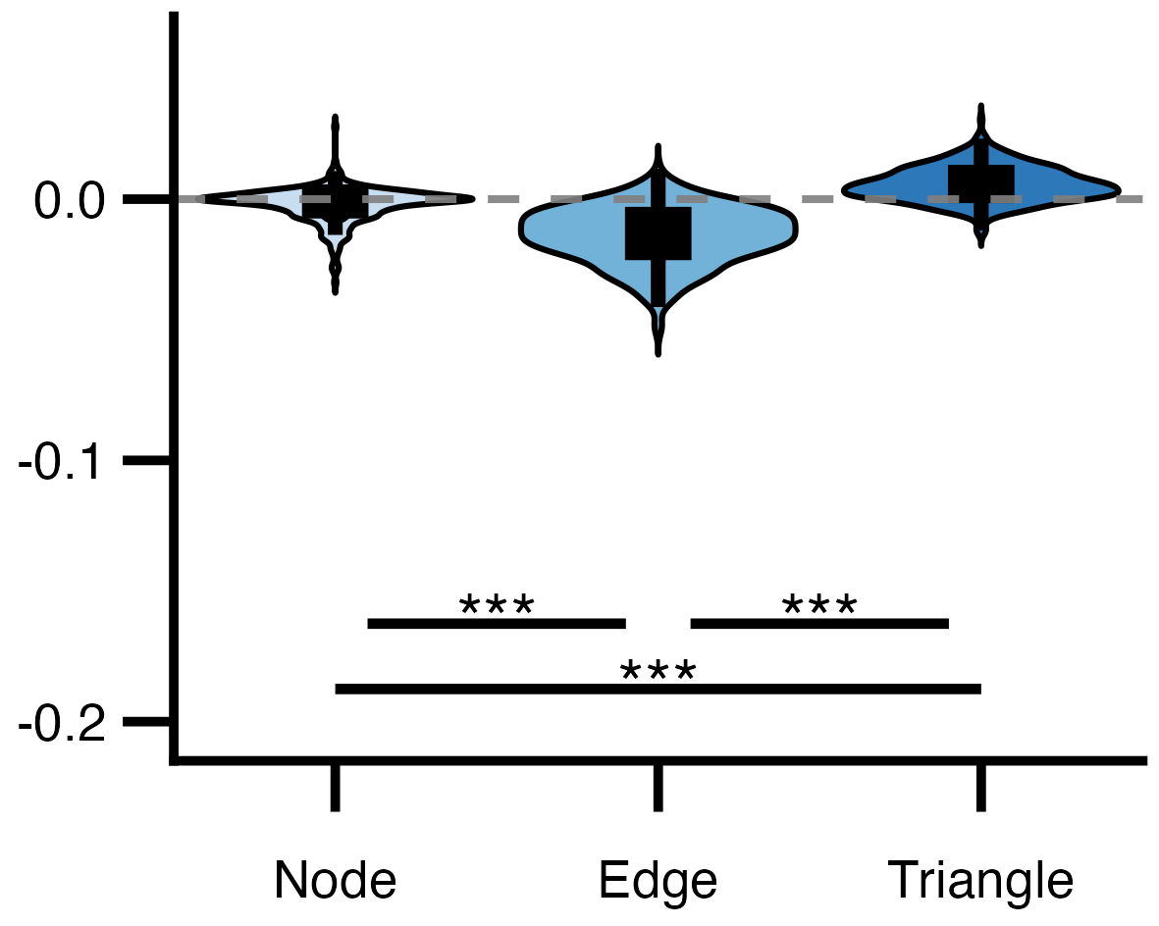
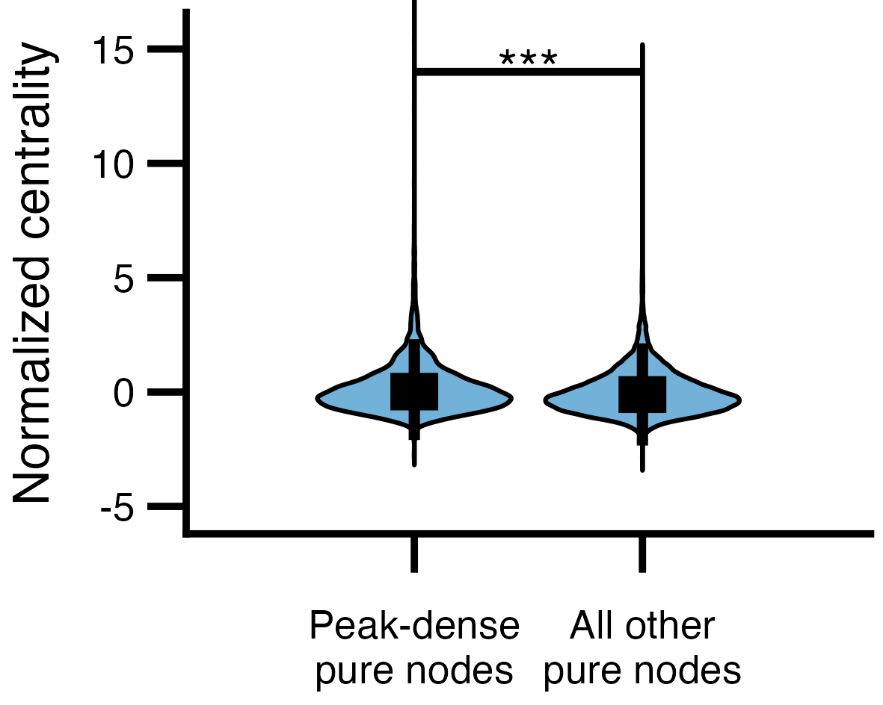
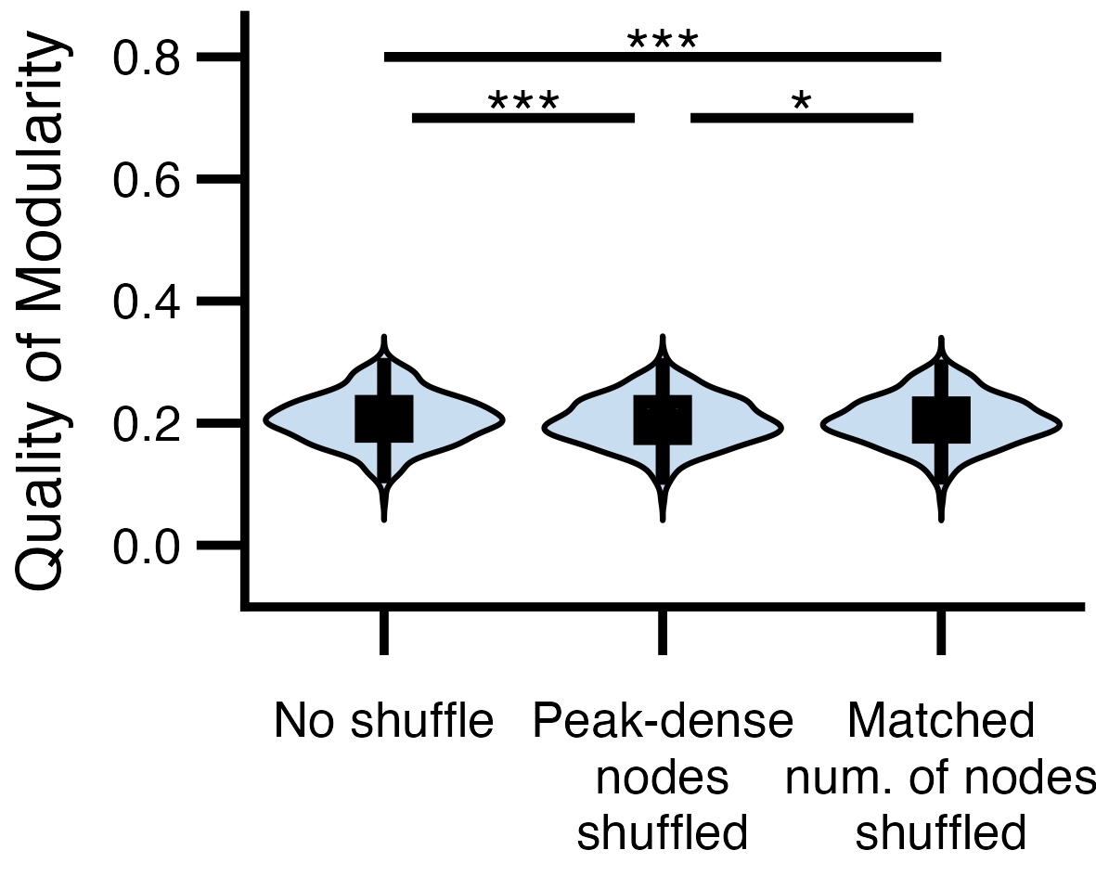

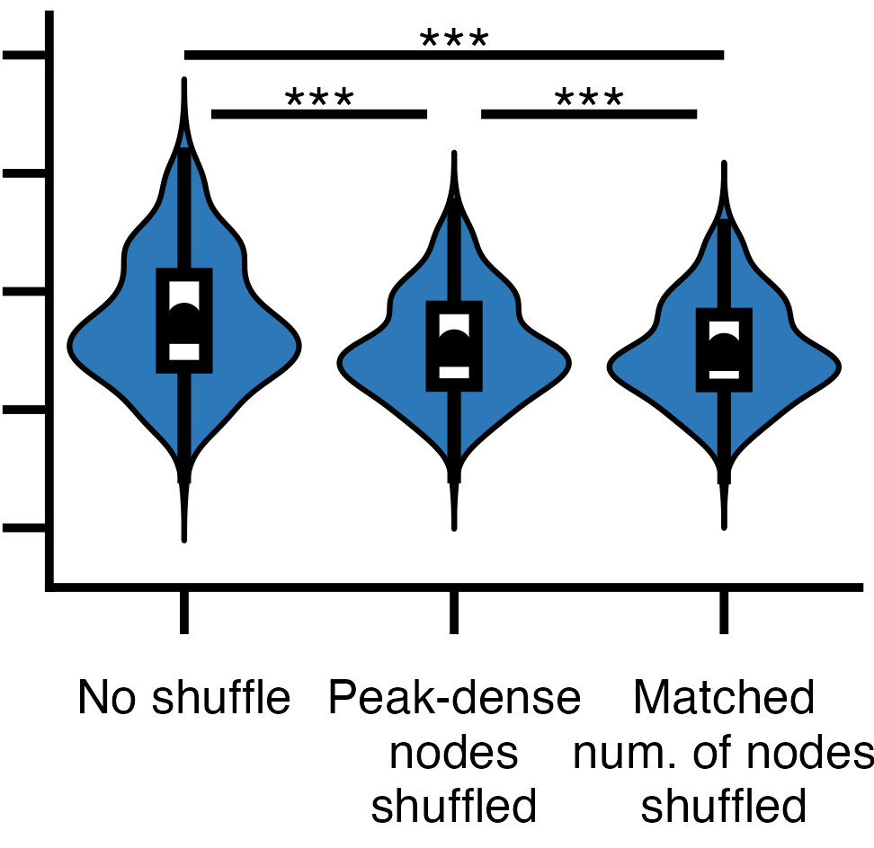
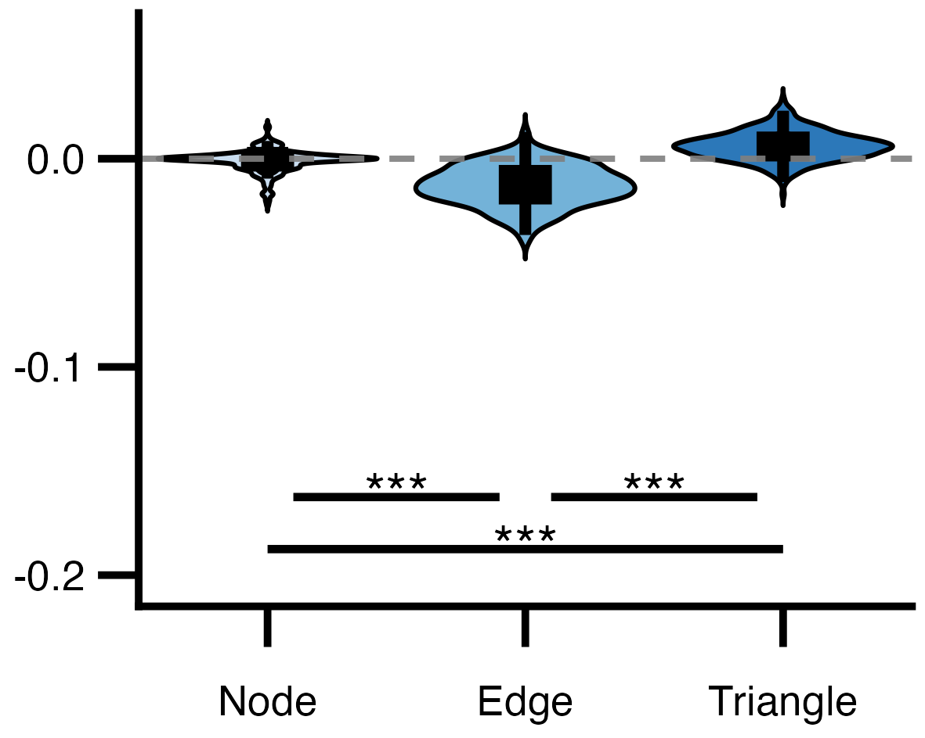

d. Change in the quality of modularity shuffling peak-dense nodes v.s. matched number of random pure nodes
Node
Edge
c.
a.
b.
Triangle
e. Within-task closeness centrality of nodes in edge Mapper graphs
Exploration Cohort
f.
g.
h.
i.
j.
Replication Cohort

