Slide 1
Mining Public Mood for Stock Market Prediction
Gaurav Kharkwal & Brian McMahan

Slide 2
Sentiment Mining from Twitter
Twitter is a repository of mini-blogs or tweets
Thus, an easily available public resource of public opinion
Can it be mined?
Yes
E.g., O’Connor, et al (2010), Pak & Paroubek (2010), Eisenstein, et al (2010), Agarwal, et al (2011)

Slide 3
Predicting the Stock Market
Why?
To make money
Why use sentiments?
Emotions play a role in decision-making
Dolan (2002), Damasio (1994), Kahneman & Tversky (1979)
Critically, financial decisions are significantly driven by emotions
Nofsinger (2005)

Slide 4
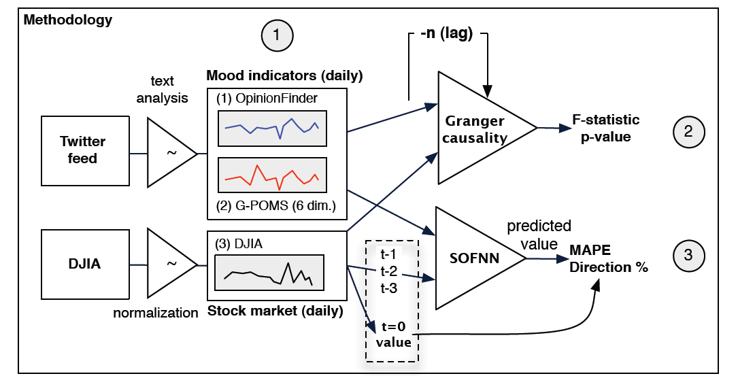
Bollen, Mao, & Zeng (2010)
Mined sentiments from Twitter to predict the stock market

Slide 5
Sentiment Analysis
OpinionFinder (cite)
Collection of positive and negative words
Based on linguistic theory
Google-Profile of Mood States (GPOMS)
Profile of Mood States
Google 1T Web Corpus

Slide 6
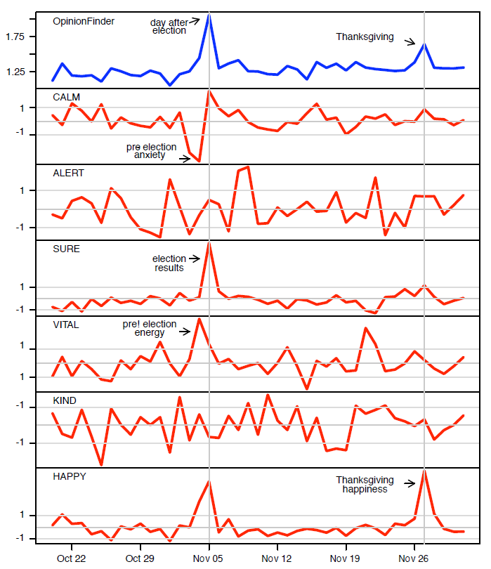
Validation

Slide 7
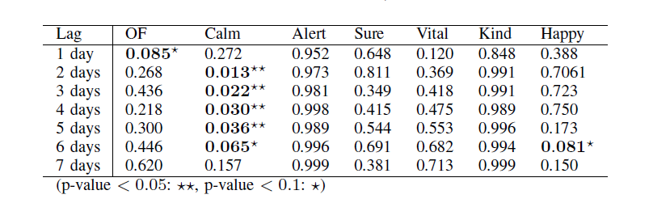
Results: Causality

Slide 8
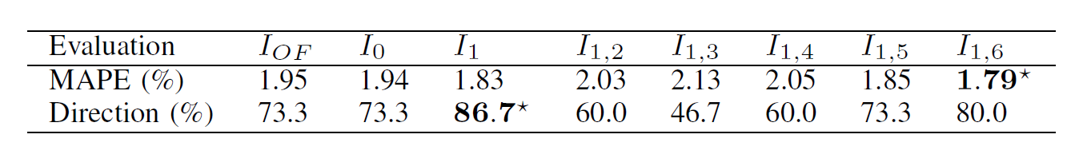
Results: Model-testing

Slide 9
But…
Not all tweets are created equal!

Slide 10
Choosing “good” tweets
Find good users that say smart things
Find good tweets that say smart things

Slide 11
Finding relevant users
Idea
A user that says smart things is more likely to be influential
Influence is gained by an effort to limit tweets to single topics (Cha, et al, 2010)
How to measure influence?
User’s popularity (quantified as RT count)

Slide 12
Finding relevant tweets
Idea
Tweets are classified into classes that are weighed based on relevance
How to classify tweets
Online LDA (Hoffman, Blie & Bach, 2001)

Slide 13
