Slide 1
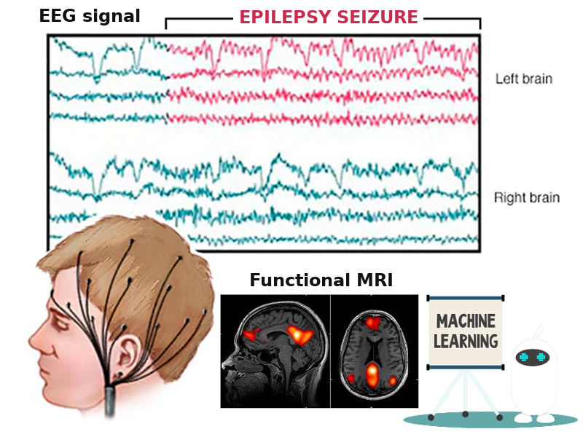
EEG and fMRI connectivity for predicting epilepsy surgery
Ellie Shamshiri | Marion Curdy
Margherita Carboni | Marjorie Metzger
Maria Rubega | Renoud-Grappin Rémi
Rafal Skiba | Wenli Tang

Slide 2
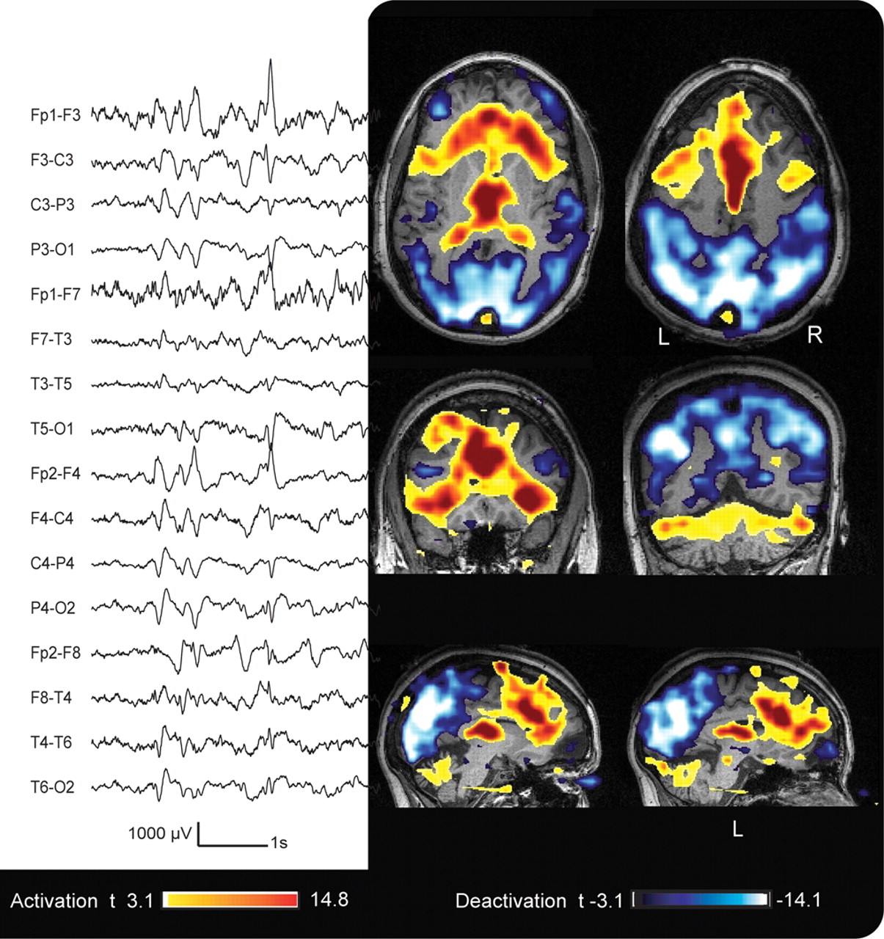
EEG & fMRI
EEGs are used as a very accurate diagnostic method due to its tremendous temporal resolution.
fMRI is a technique with large spatial resolution, which combined with EEGs provides a valuable information about the sources of seizures.

Slide 3
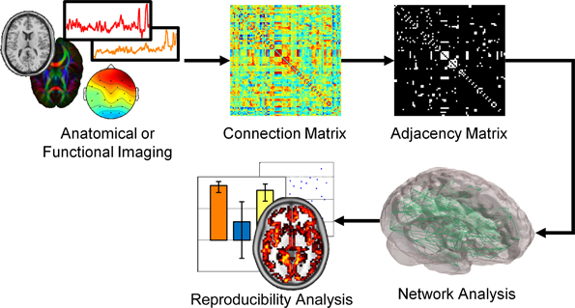
Anatomical and Functional networks

Slide 4
Data
fMRI
EEG
10 focal epilepsy patients (with pre & post operative data)
Functional connectivity
ROI x ROI correlation matrices
ROI timecourses
Both using the Lausanne parcellation via the Connectome Mapper (Daducci et al., 2012)
10 focal epilepsy patients
8 normal controls
Functional connectivity & power spectrum density
ROI x ROI x frequency x time matrices

Slide 5
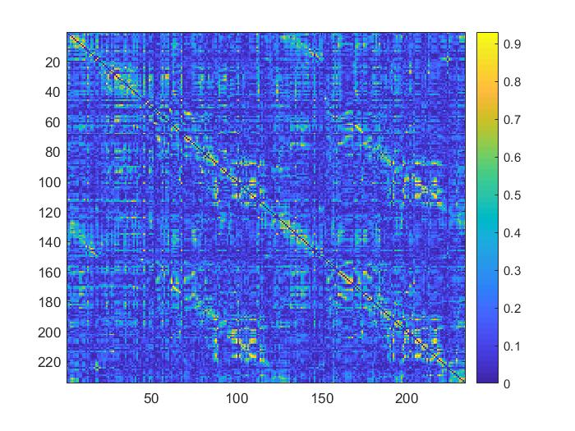
Feature extraction: fMRI
Features computed from data were:
Minimal strength
Maximized modularity
Maximal number of optimal community
Global efficiency
…

Slide 6

Feature extraction: EEG
4 D matrix: ROI x ROI x freq x time
Average over time in precise frequencies (alpha, beta, gamma and theta)
Building of the feature matrix:
Time
ROI
ROI
Frequency
 | beta | theta | …
Patient 1
Patient 2
…
Patient 10
10’224

Slide 7
Methodology: EEG/fMRI
2. Feature selection :
Rank the most important features according to the correlation score
Classification ?
Discriminant analysis
Cross-validation
SVM
…

Slide 8
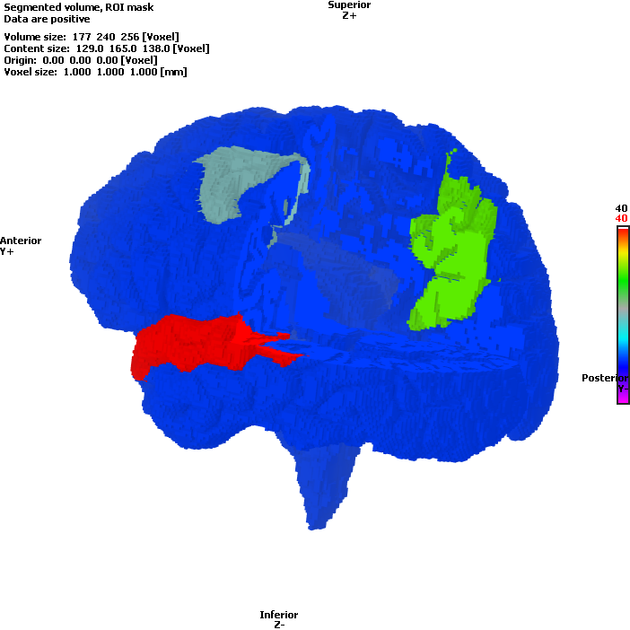
Results: EEG
Most important features found:
High alpha/beta : Caudal middle frontal Left and Precuneus Right
High alpha/beta: Caudal middle frontal Left and Superior temporal Left

Slide 9
Results: fMRI
Features extracted from Connectivity matrix, ranked according to the correlation coefficient:
Minimal strength | Maximized modularity | Global STD | Maximal number of optimal community | Average clustering coefficient | Global efficiency

Slide 10

THANK YOU!
MERCI!

