Slide 1
Brain Imaging Data Structure ( BIDS )
An introduction

Slide 2
BIDS
Developed by Chris Gorgolewski, Russ Poldrack, et al.
BIDS is a standard format for naming and structuring files and meta data for neuroimaging.
The basic principle behind BIDS is how you name your files and folders to create a coherent, easily navigable file structure.
Clear separation of raw and processed (derivatives) data

Slide 3
Benefits
Facilitate data sharing within and across labs
Validation tools to spot missing data
Can upload to public data repositories
OpenfMRI.org, LORIS, COINS, XNAT, SciTran
Can use BIDS Apps

Slide 4
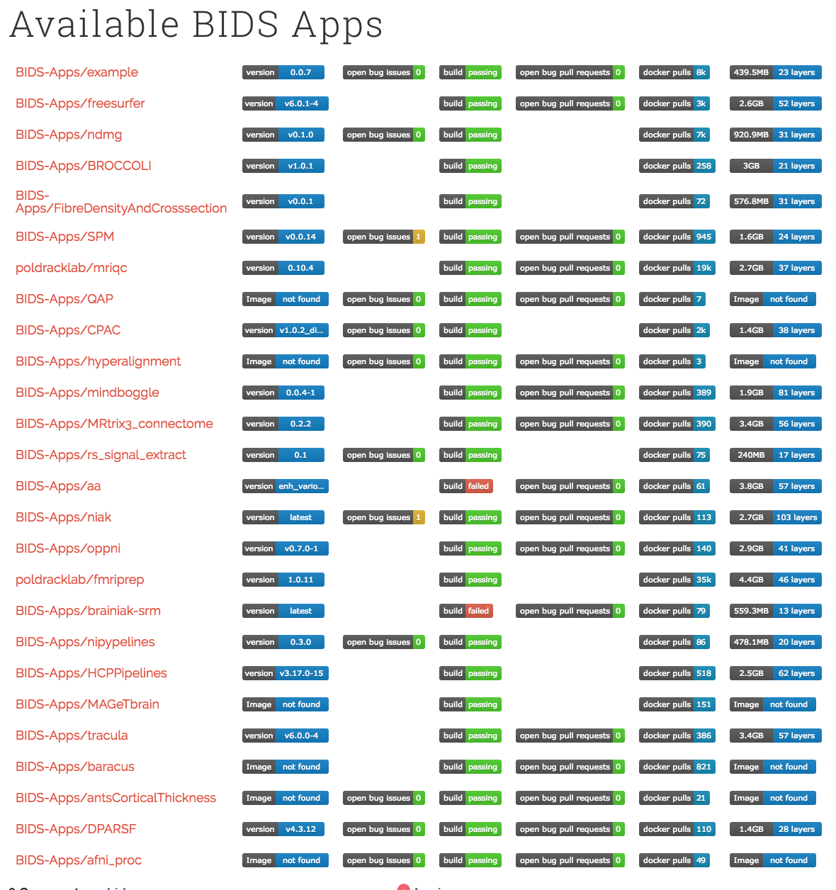

Slide 5
BIDS Hierarchy
project
Can have any name
subject
Structure: sub-<participant label>
One folder per subject
session
Structure: ses-<session label>
acquisition
Represents different types of data.
E.g. 'anat', 'fmri', 'dwi', 'eeg', 'derivatives', etc.
See the BIDS specifications for a list of possible acquisition names.
project/sub-<participant_label>[/ses-<session_label>]/<data_type>/

Slide 6
Image: https://www.nature.com/articles/sdata201644

Slide 7
FILE formats
Imaging files
Nifti[.gz]
Metadata (scanner parameters, participant info, etc.)
.json files contain key: value metadata
.tsv files contain tables of metadata
File names are structured as key-value pairs
e.g. sub-01_task-rest_bold.nii.gz
where each key-value pair is separated by an underscore.
http://bids.neuroimaging.io/bids_spec1.1.0.pdf

Slide 8
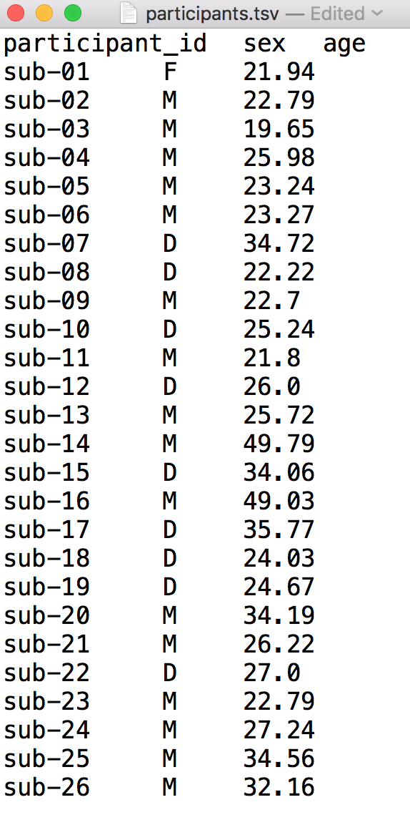
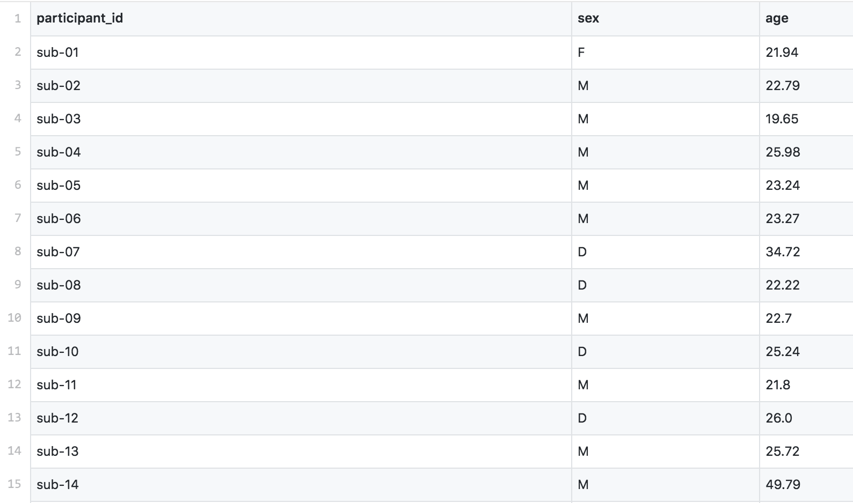
Sample .tsv
Notes:
Participant or task information

Slide 9
Study info
Metadata (.json files) can be specified at any of the four levels (in hierarchical order):
MRI acquisition
Session
Subject
Dataset
Metadata propagates recursively unless overridden at a lower level.

Slide 10
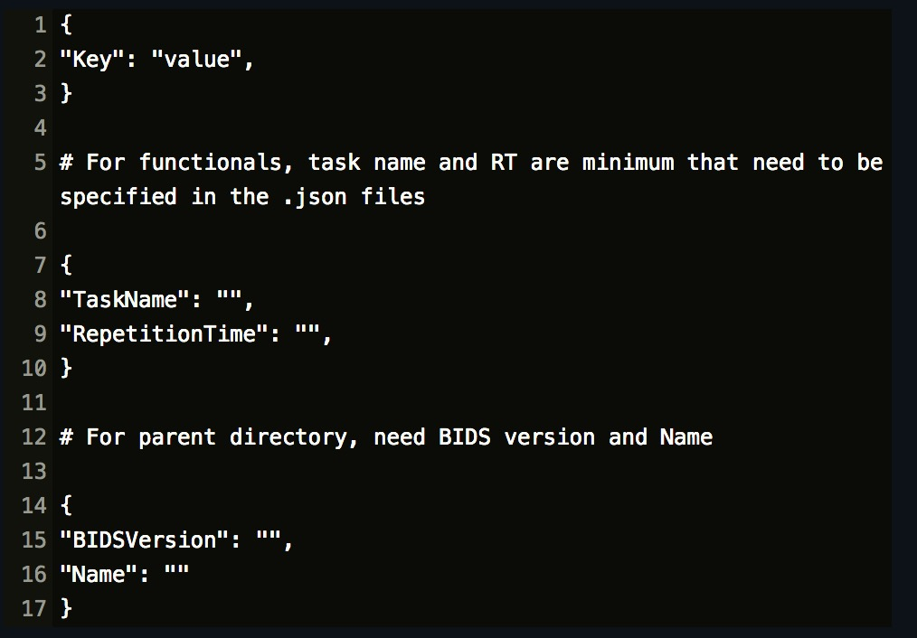
.Json Files

Slide 11
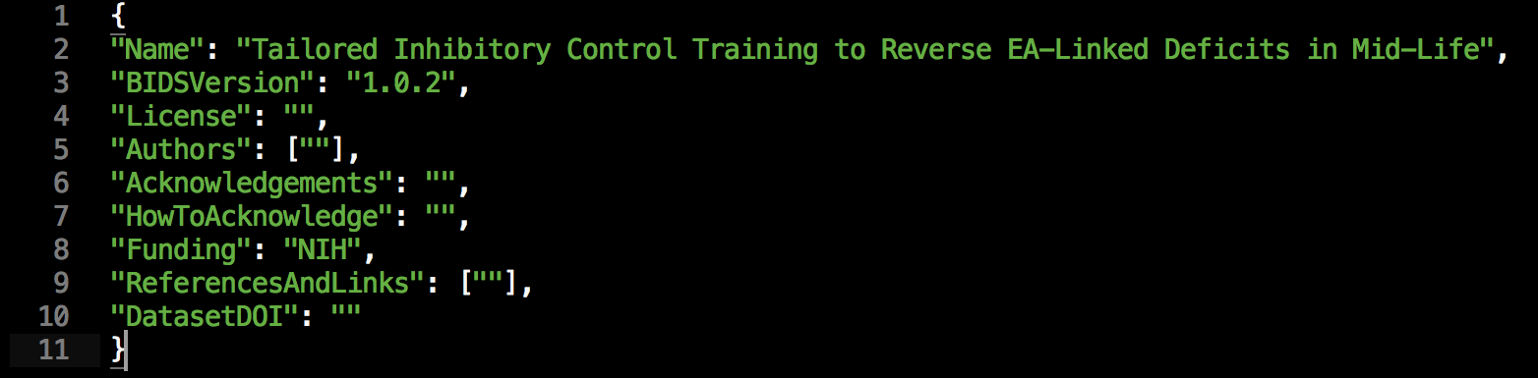
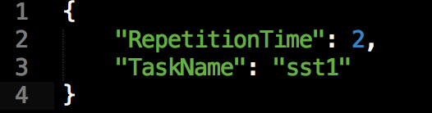
Parent Directory Example
Functional Directory Example

Slide 12
Questions?

