Slide 1
BIDS Apps
http://bids-apps.neuroimaging.io/

Slide 2
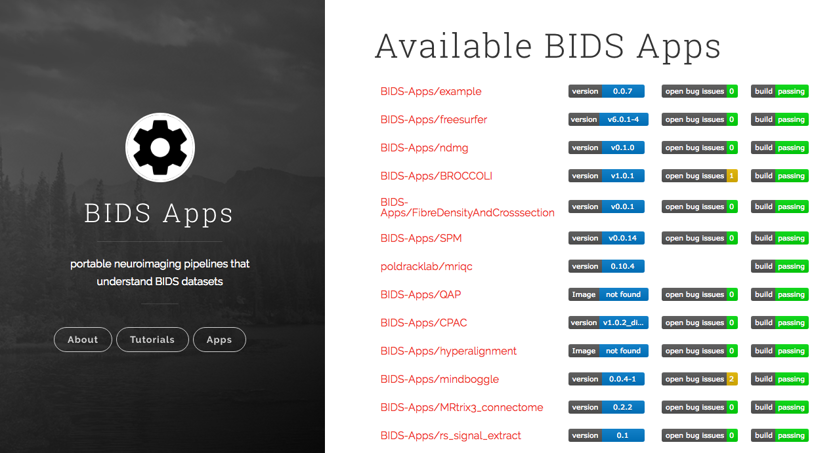
Notes:
Portable neuroimaging pipelines. Use BIDS-formatted data as input. Developed by labs all over the world. 25 apps so far, span data quality, structural, functional, anatomically and functional connectivity.

Slide 3
Neuroimaging pipelines are usually…
Complicated
Require multiple software packages
Installation & use can be difficult
Susceptible to version changes

Slide 4
But BIDS Apps are…
Easy to use
All apps use BIDS-formatted datasets
All apps have same command-line arguments
Compatible with Windows, Linux, Mac
Supports replication
With BIDS App name and version, others can exactly replicate analyses

Slide 5
Container Image
Has all required software
We need to have
container
software to run containers: DOCKER & SINGULARITY
https://fmriprep.readthedocs.io/en/latest/installation.html
Notes:
Can also do it manually by installing all software. But they don’t recommend doing this.

Slide 6
Execution
Minimum info needed to run a container:
Image name
Input directory
Output directory
Level of analyses (participant or group)

Slide 7
Example: fmriprep
fMRI pre-processing pipeline
Combines multiple packages
FSL, ANTS, AFNI, FreeSurfer...
But you…
only need to download one container image
don’t need to know much else about each of these packages
Notes:
Citing options – you can tick what you want chose to do, and it will update the citation language for you.

Slide 8
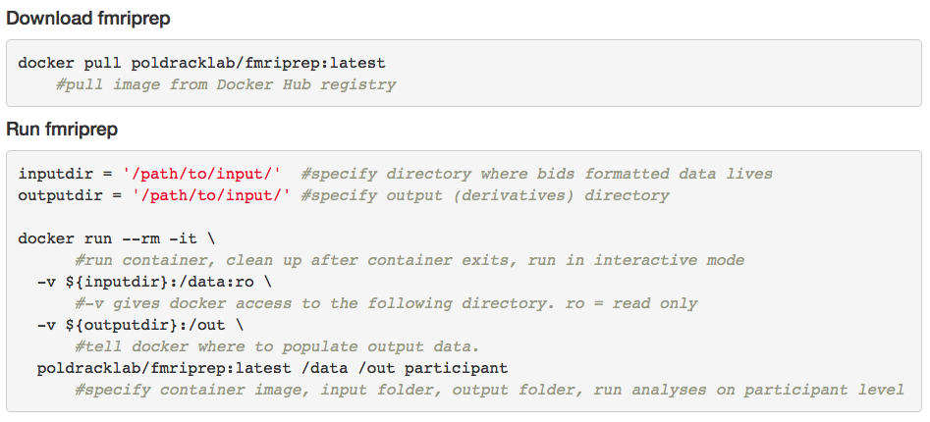
Useage
Notes:
Citing options – you can tick what you want chose to do, and it will update the citation language for you.

Slide 9
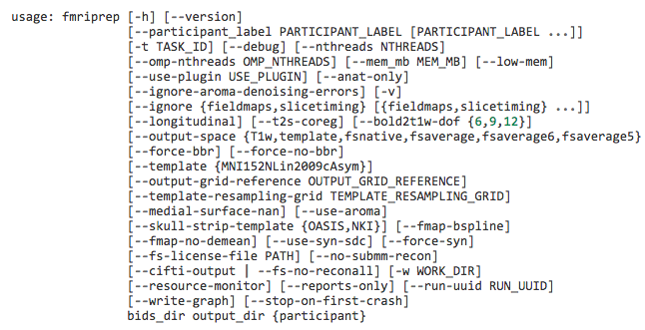
Options

Slide 10
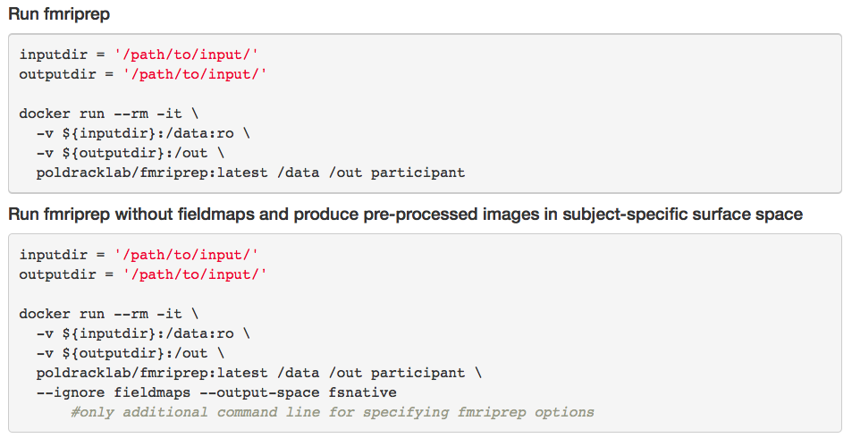

Slide 11
Outputs
Pre-processed imaging data
BOLD images - head-motion correction, slice-timing correction, aligned to same-subject’s anatomical space or to a group template
Visual QA (quality assessment) reports
https://fmriprep.readthedocs.io/en/latest/outputs.html
Notes:
Citing options – you can tick what you want to do, and it will update the citation language for you.

Slide 12
Motion
White Matter | Global Signal | std DVARS | non-std DVARS | vx-wise std DVARS | FD | tComp Cor | aComp Cor | X | Y | Z | RotX | RotY | RotZ | AROMA
0.63 | 2.72 | n/a | n/a | n/a | n/a | 0 | 0 | 0 | 0 | 0 | 0 | 0 | 0 | 2.62
3.14 | 0.51 | 1.18 | 16.05 | 1.21 | 0.07 | -0.21 | -0.33 | 0 | 0.02 | 0.05 | 0 | 0 | 0 | 1.66
-1.23 | -0.85 | 1.09 | 14.86 | 1.11 | 0.03 | 0.02 | 0.11 | 0 | 0 | 0.05 | 0 | 0 | 0 | 0.35
-1.61 | -1.53 | 1.01 | 13.83 | 1.05 | 0.03 | 0.27 | 0.24 | 0.01 | -0.01 | 0.04 | 0 | 0 | 0 | -0.42
-3.43 | -1.48 | 0.98 | 13.32 | 1.02 | 0.03 | 0.06 | 0.25 | 0.02 | -0.01 | 0.03 | 0 | 0 | 0 | -1.12
0.71 | -0.66 | 0.97 | 13.26 | 1.02 | 0.04 | -0.29 | 0.4 | 0.02 | -0.02 | 0.03 | 0 | 0 | 0 | -1
-2.81 | 0.61 | 0.95 | 12.98 | 1.01 | 0.08 | -0.48 | 0.38 | 0 | 0 | 0.05 | 0 | 0 | 0 | -0.66
2.85 | 0.35 | 0.95 | 12.99 | 1.01 | 0.04 | -0.22 | 0.3 | 0 | -0.01 | 0.03 | 0 | 0 | 0 | 0.01
-2.57 | -0.54 | 1.04 | 14.22 | 1.07 | 0.05 | 0.45 | 0.13 | 0 | 0 | 0.06 | 0 | 0 | 0 | 0.6
3.41 | -0.72 | 1.03 | 14.04 | 1.05 | 0.07 | 0.37 | -0.1 | 0 | 0.02 | 0.07 | 0 | 0 | 0 | 0.52
3.75 | -0.54 | 1.01 | 13.83 | 1.04 | 0.06 | 0.16 | -0.11 | 0 | 0 | 0.06 | 0 | 0 | 0 | -0.53
0.41 | 1.19 | 1.05 | 14.28 | 1.08 | 0.06 | -0.27 | -0.31 | 0 | 0.01 | 0.09 | 0 | 0 | 0 | -0.75
-4.14 | 0.72 | 0.97 | 13.2 | 1.01 | 0.03 | -0.13 | -0.26 | 0 | 0 | 0.08 | 0 | 0 | 0 | -0.44
2.21 | -0.02 | 0.96 | 13.09 | 1 | 0.01 | 0.18 | -0.26 | 0 | 0 | 0.08 | 0 | 0 | 0 | 0.28
0.08 | -0.06 | 0.95 | 12.89 | 0.99 | 0.01 | 0.15 | -0.22 | 0 | 0 | 0.08 | 0 | 0 | 0 | -0.46
-1.41 | 0.29 | 0.96 | 13.06 | 0.99 | 0.01 | -0.04 | -0.22 | 0 | 0 | 0.07 | 0 | 0 | 0 | -0.67

Slide 13
End product
Notes:
Let’s have a look at our fmriprep derivatives output

Slide 14


Slide 15
OpenNeuro
Incentivize data sharing via providing data analysis service
Free cloud service
Upload BIDS-compatible dataset
Run fmriprep (no installation required)
Run subject and group level models
Data (and analyses) become publically available after 1.5 years
Notes:
Images need to be de-faced, can’t have any identifiable info. They discourage use of OpenNeuro for publically available datasets.

Slide 16
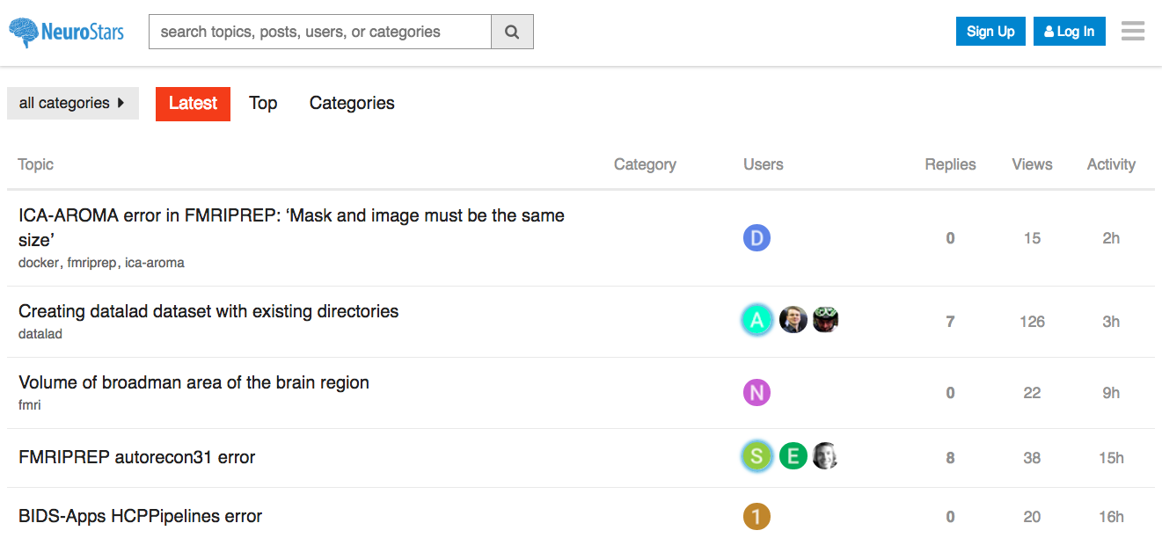
Notes:
Lots of queries about Singularity

Slide 17
Docker

Slide 19
Docker
Download & install: https://www.docker.com/docker-mac
Set up account online
Sign into app with username, not email
It will allow you to sign in with email, but then doesn’t allow you to pull container.
Change memory that container can use
Mac: set to 2GB
Docker > Preferences > Advanced
Increase memory limit, and press “Apply & Restart”

