Slide 1

Classical Paradigms (cf Human Connectome Project)
6 subjects :
3 men
3 women
fMRI
Classical Paradigms (Human Connectome project)
MEG
Natural Paradigms :
film viewing
... And more to come !
Biosignals
video game

Slide 2
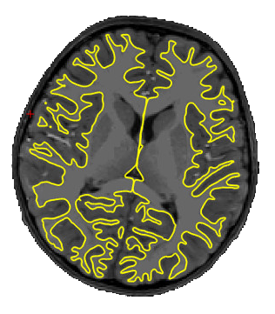
General statistics
INFOS of sub_1
in Dataset :
in Paradigm :
Informative Tree
subject
sub_1
Dataset
run
session
group
None
sub_2
sub_3
sub_4
sub_5
sub_6
run
Visualisation in Time
raw
parcellation_1
parcellation_2
Coordinates
X
100
Y
24
Z
73
ROI : <name>
in Run : <run_1>...<run_2>
in Paradigm : ...
in Dataset : movie10, HCPTR

