Slide 1


Spinal Cord Segmentation Generalizable Across Datasets
Louis-François Bouchard - PhD Student at Polytechnique Montréal

Slide 2
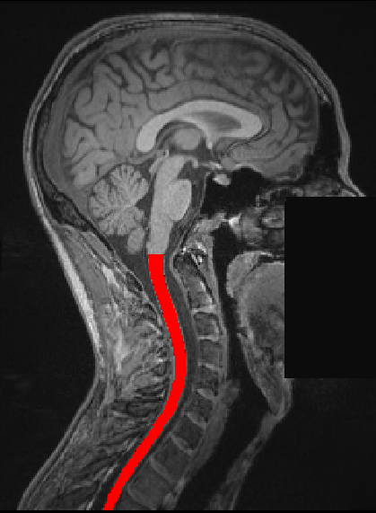
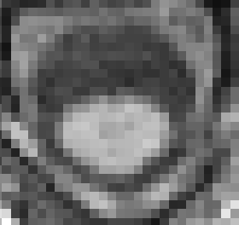
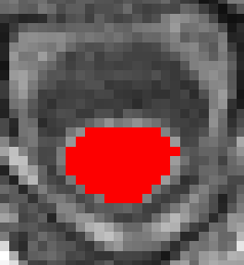
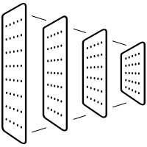


Background
Spinal cord segmentation is clinically relevant
(e.g. notably to compute cross-sectional area for the diagnosis and monitoring neurodegenerative diseases such as multiple sclerosis*, characterizing spinal cord compression**, …)
Problem, MRIs depend on…
MRI Contrast
Vendor
Pathologies
U-Net
Ground Truths (Manual Segmentation)
*Martin, A.R., De Leener, B., Cohen-Adad, J., Kalsi-Ryan, S., Cadotte, D.W., Wilson, J.R., Tetreault, L., Nouri, A., Crawley, A., Mikulis, D.J., et al.: Monitoring for myelopathic progression with multiparametric quantitative mri. PLoS One 13(4), e0195733 (2018)
**Barkhof, F., Filippi, M., Miller, D.H., Scheltens, P., Campi, A., Polman, C.H., Comi, G., Ader, H.J., Losseff, N., Valk, J.: Comparison of mri criteria at first presentation to predict conversion to clinically definite multiple sclerosis. Brain: a journal of neurology 120(11), 2059–2069 (1997)

Slide 3
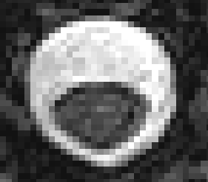
Main Question
Can we build a general approach to automatically perform Spinal Cord Segmentation across contrasts, vendors and pathologies?
A
A
R
L
R
L
P
P
T1-weighted
T2-weighted

Slide 4
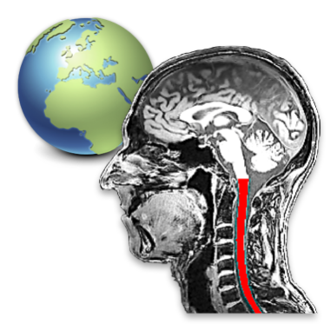
Data:
Various (4) Spinal Cord MRI datasets at Neuropoly with available manual segmentation.
Including:
Spine Generic Public Database* (multi-subject), n=244, 3 vendors, 6 contrasts, pathology: Mild Compression, Healthy Controls.
Basel-mp2rage, n=283, 1 contrast, pathology: Multiple Sclerosis (180), Healthy Controls (103).
INSPIRED, n=79, 5 contrasts, pathology: Degenerative Cervical Myelopathy (38), Spinal Cord Injury, Healthy Controls.
SCI-Colorado, n=80, 2 contrasts, pathology: Spinal Cord Injury.
Multiple contrasts, conditions, vendors… 👍
* Cohen-Adad, J., Alonso-Ortiz, E., Abramovic, M., Arneitz, C., Atcheson, N., Barlow, L., Barry, R.L., Barth, M., Battiston, M., Büchel, C., et al.: Open-access quantitative mri data of the spinal cord and reproducibility across participants, sites and manufacturers. Scientific data 8(1), 219 (2021)

Slide 5

Tools & Methods
$$CSA_{T1w}$$
nnU-Net
Python/Pytorch/Git/ssh/Jupyter Notebooks
nnU-Net -> a state-of-the-art “self-configuring method for deep learning-based biomedical image segmentation”.
Train and compare 2 frameworks for performing automatic spinal cord segmentation.
nnU-Net
nnU-Net
nnU-Net

Slide 6
Objectives
Create a script for converting N BIDS datasets into one large “nnU-Net-ready” dataset train/test split.
Compare a general model to specific models for spinal cord segmentation on the datasets’ test sets.
Test the resulting 2 frameworks on a fourth dataset to demonstrate the generalizability capabilities of the larger model.

Slide 7
Deliverables
A Github repository with codes and scripts to reproduce training and testing.
A jupyter notebook of the analysis codes and visualisations for comparing the results.
Documentation.
Model checkpoints for the nnUnet models trained on all 3 datasets.

Slide 8
References
GitHub: https://github.com/brainhack-school2023/bouchard_project
Cohen-Adad, J., Alonso-Ortiz, E., Abramovic, M., Arneitz, C., Atcheson, N., Barlow, L., Barry, R.L., Barth, M., Battiston, M., Büchel, C., et al.: Open-access quantitative mri data of the spinal cord and reproducibility across participants, sites and manufacturers. Scientific data 8(1), 219 (2021)
Martin, A.R., De Leener, B., Cohen-Adad, J., Kalsi-Ryan, S., Cadotte, D.W., Wilson, J.R., Tetreault, L., Nouri, A., Crawley, A., Mikulis, D.J., et al.: Monitoring for myelopathic progression with multiparametric quantitative mri. PLoS One 13(4), e0195733 (2018)
Barkhof, F., Filippi, M., Miller, D.H., Scheltens, P., Campi, A., Polman, C.H., Comi, G., Ader, H.J., Losseff, N., Valk, J.: Comparison of mri criteria at first presentation to predict conversion to clinically definite multiple sclerosis. Brain: a journal of neurology 120(11), 2059–2069 (1997)

