Slide 1

Effects of sleepiness on resting-state connectivity
Thomas Perrin - Polytechnique Montréal

Slide 2

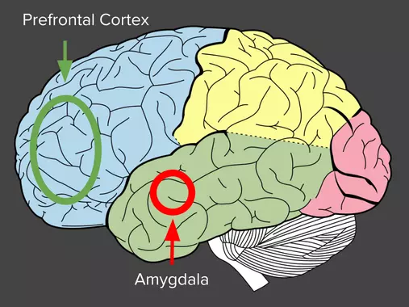
Background
Sleep deprivation is commonplace in society
Sleepiness has effects on cognitive and affective functioning:
Associations with amygdala-prefrontal functional connectivity
Inhibition of top-down-control in emotion
Further analysis on functional connectivity
Notes:
Image link: http://en.wikipedia.org/wiki/File:Chronic_fatigue_syndrome.JPG
Brain: https://igorminar.github.io/story-about-superpower-management/

Slide 3
Objectives
Familiarize myself with neuroimaging data organization and open science practices
Learn reproductible neuroimaging workflow from data access to visualization
Visualize and compare functional connectomes of resting-state networks
Create a pipeline to prepare the dataset for machine learning

Slide 4

Data
What? Resting state fMRI from the Stockholm Sleepy Brain Study: Effects of Sleep Deprivation on Cognitive and Emotional Processing in Young and Old. 2 sessions/subject (normal sleep vs. sleep deprived)
Why? Investigation on the effects of partial sleep deprivation (PSD) on resting state brain connectivity.
Where? OpenNeuro

Slide 5







Tools & Methods
Git and GitHub for project management
DataLad for retrieval and version control of data
BIDS-validator to check updated dataset integrity
Neurodesk for a computing environment in browser
FMRIPrep for data preprocessing
Python for preparation and analysis (Nilearn)

Slide 6
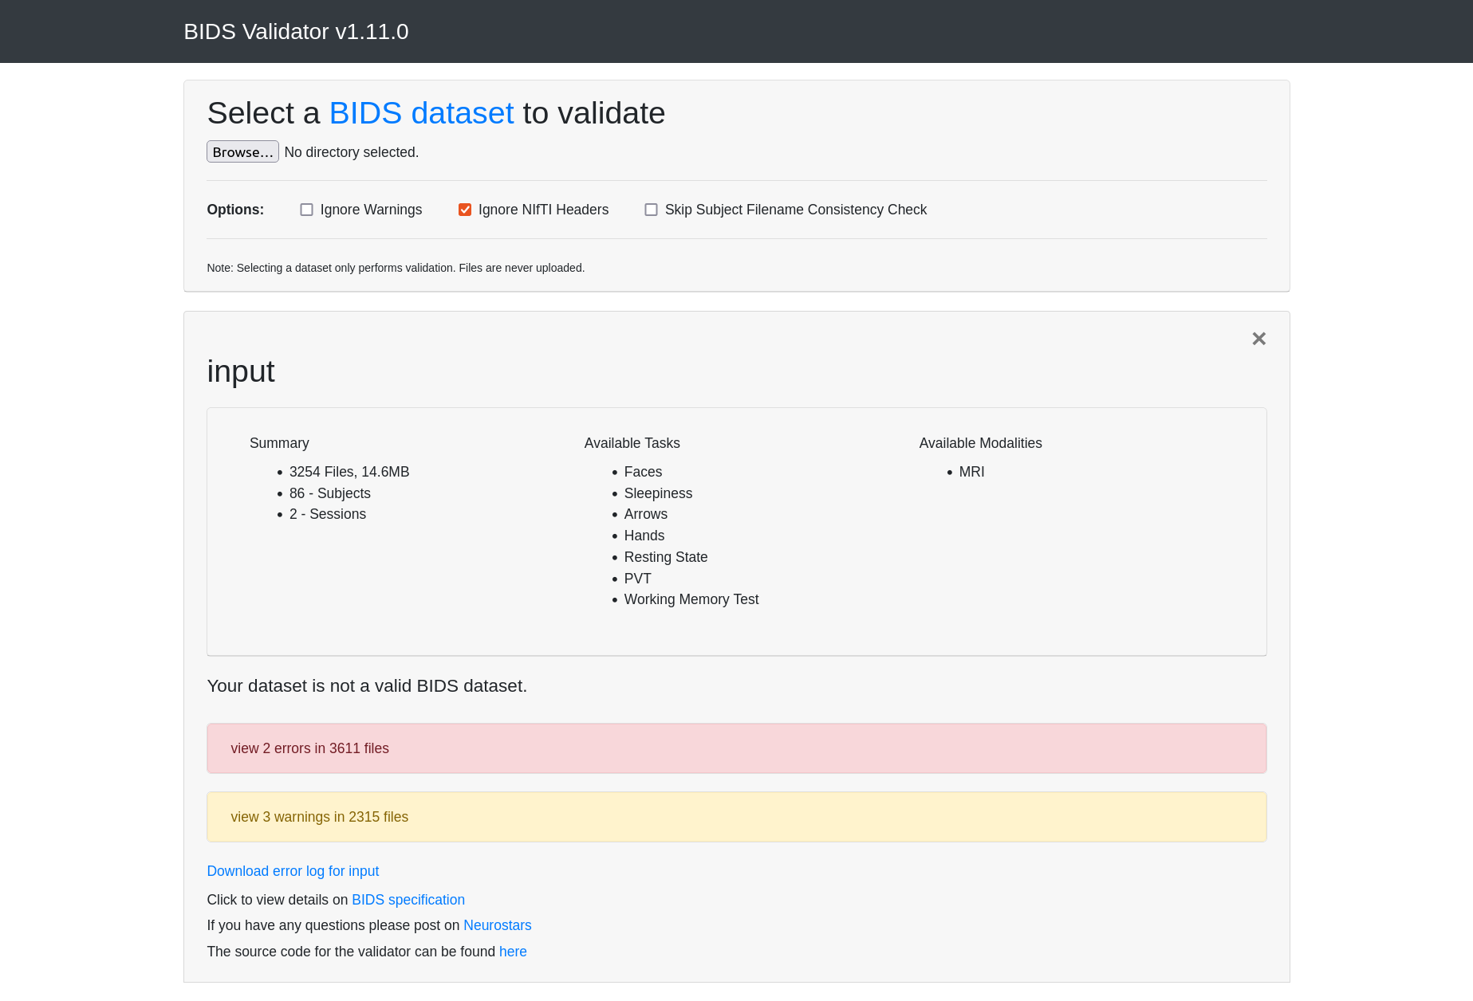
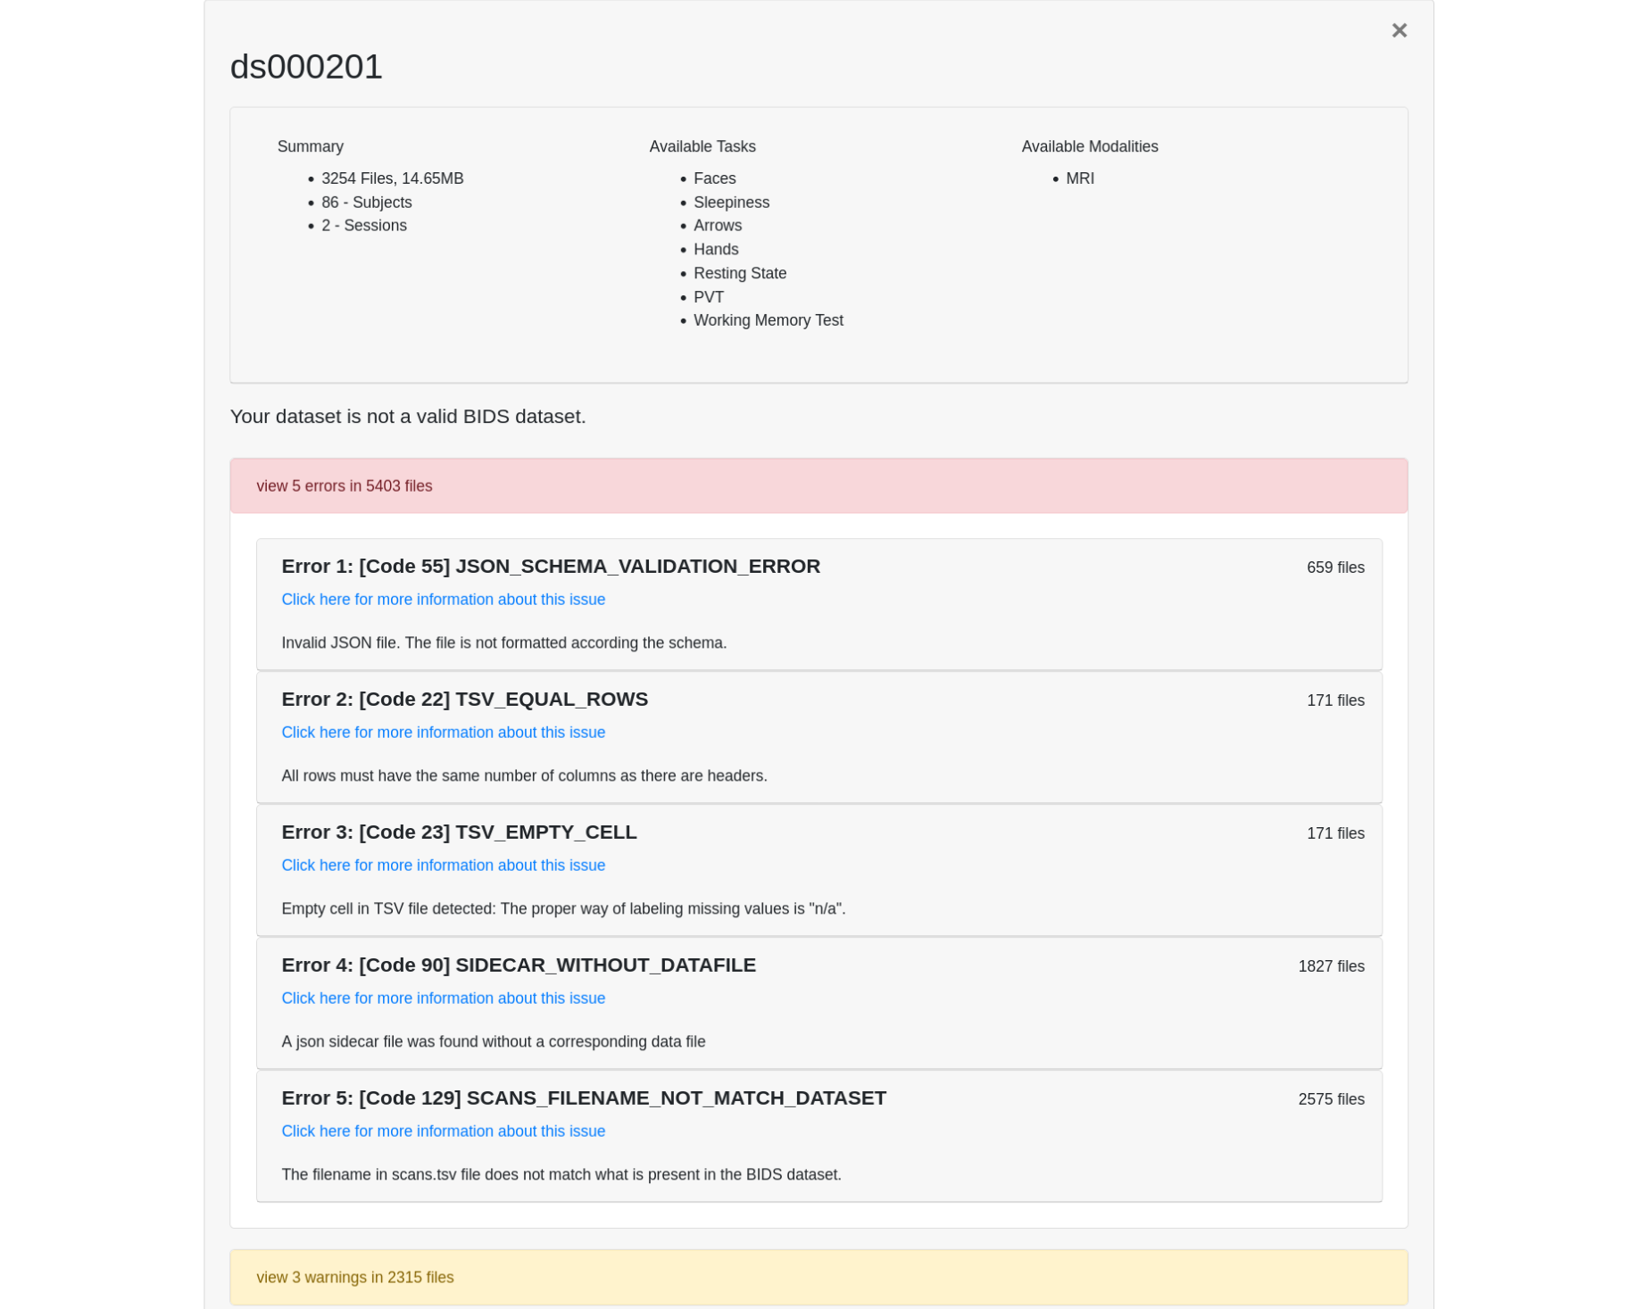
Results - BIDS-compliant dataset
Before After
Last 2 errors due to DataLad

Slide 7
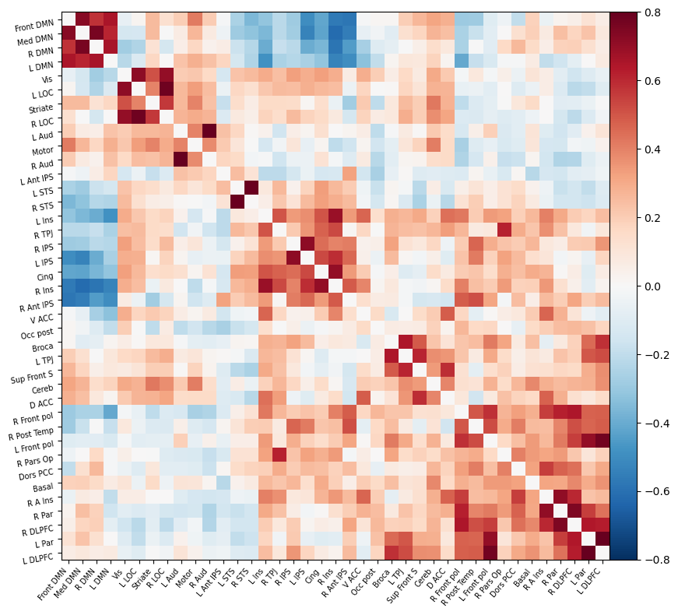
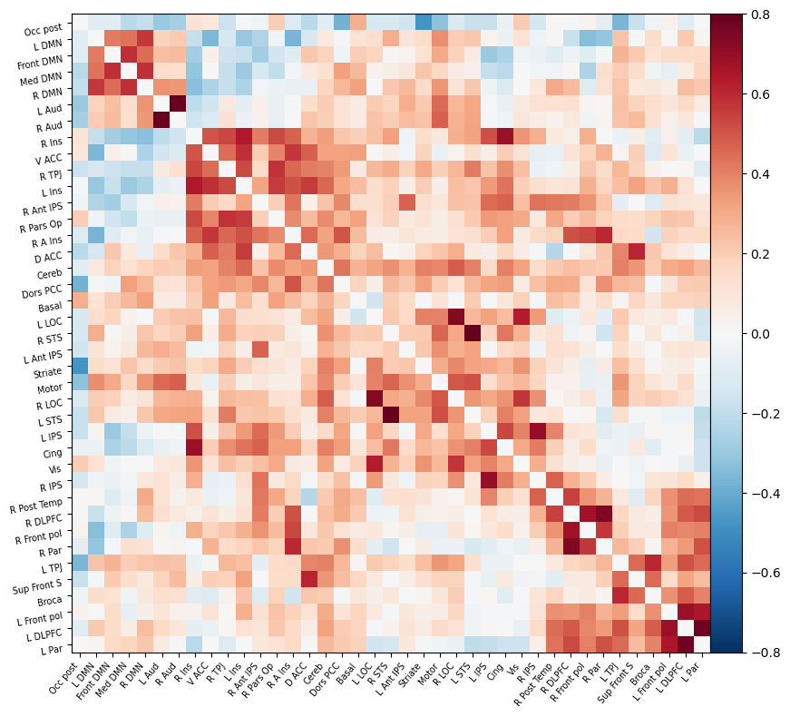
Results - Correlation matrix
MSDL brain Probabilistic atlas
Normal sleep Sleep deprived

Slide 8
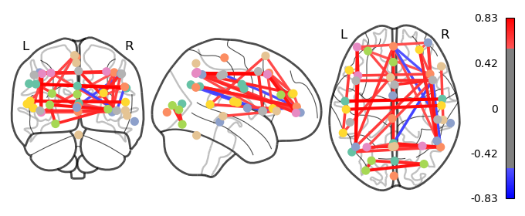
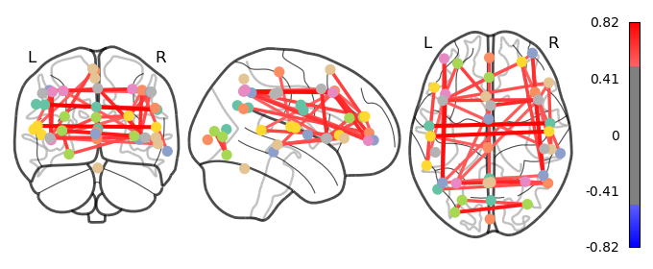
Results - Connectome
Normal sleep
Sleep-deprived
5% of edges with the highest value

Slide 9
Results - What I have learned
Using version control (Git, GitHub and DataLad)
Installing the software on different OS (Ubuntu and Windows with WSL)
Sharing my work (with myself) to work on multiple computers
BIDS organization
Neuroimaging pipeline: management → preprocessing → preparation
⇒ Open-science best practices

Slide 10
Deliverables
GitHub repository containing all the elements of the project
Markdown file for the project description
Python script to update dataset to BIDS
Bash code for Datalad and fMRI preprocessing
Jupyter Notebook for visualization

Slide 11
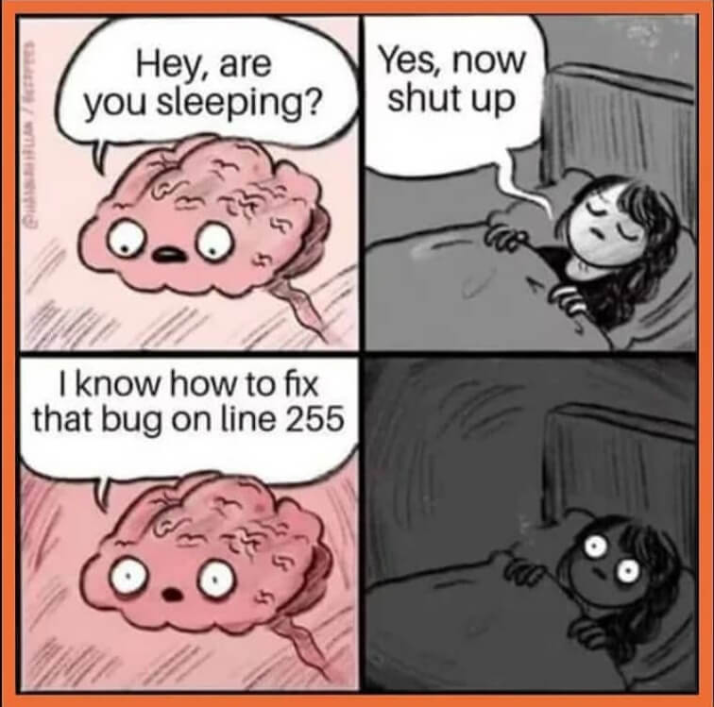
Conclusion
Challenges encountered
Balance research and implementation
Limitations in software installation
Solutions
Use cases are helpful
Using NeuroDesk

Slide 12
References
Killgore WD. Effects of sleep deprivation on cognition. Prog Brain Res. 2010;185:105-29. doi: 10.1016/B978-0-444-53702-7.00007-5. PMID: 21075236.
Reidy BL, Hamann S, Inman C, Johnson KC, Brennan PA. Decreased sleep duration is associated with increased fMRI responses to emotional faces in children. Neuropsychologia. 2016 Apr;84:54-62. doi: 10.1016/j.neuropsychologia.2016.01.028. Epub 2016 Jan 25. PMID: 26821063.
Gustav Nilsonne and Sandra Tamm and Paolo d’Onofrio and Hanna Å Thuné and Johanna Schwarz and Catharina Lavebratt and Jia Jia Liu and Kristoffer NT Månsson and Tina Sundelin and John Axelsson and Peter Fransson and Göran Kecklund and Håkan Fischer and Mats Lekander and Torbjörn Åkerstedt (2020). The Stockholm Sleepy Brain Study: Effects of Sleep Deprivation on Cognitive and Emotional Processing in Young and Old. OpenNeuro. [Dataset] doi: 10.18112/openneuro.ds000201.v1.0.3
Tamm S, Schwarz J, Thuné H, Kecklund G, Petrovic P, Åkerstedt T, Fischer H, Lekander M, Nilsonne G. A combined fMRI and EMG study of emotional contagion following partial sleep deprivation in young and older humans. Sci Rep. 2020 Oct 21;10(1):17944. doi: 10.1038/s41598-020-74489-9. PMID: 33087746; PMCID: PMC7578048.
Dimitrijevic A, Exploratory Work on the Predictive Clinical Neuroscience (PCN) Toolkit, BrainHackCloud_steps, https://github.com/brainhack-school2022/dimitrijevic_project.git

