Slide 1


Identifying Potential Biomarkers for Parkinson’s Disease Using Neurite Orientation Dispersion and Diffusion Imaging (NODDI)
Samuelle St-Onge – Polytechnique Montréal

Slide 2
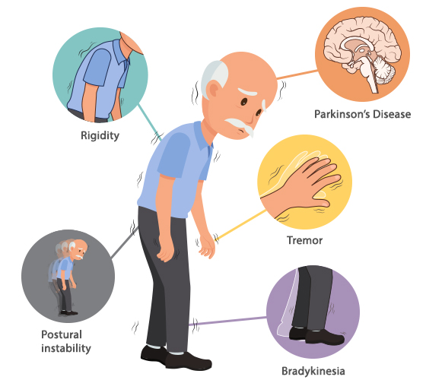
Background
Parkinson’s disease
No existing cure
Importance of early diagnosis
Early treatment
Slow disease progression
Importance of understanding disease causes and progression
Develop better treatment options
(Neurology & Sleep Center, 2021)

Slide 3
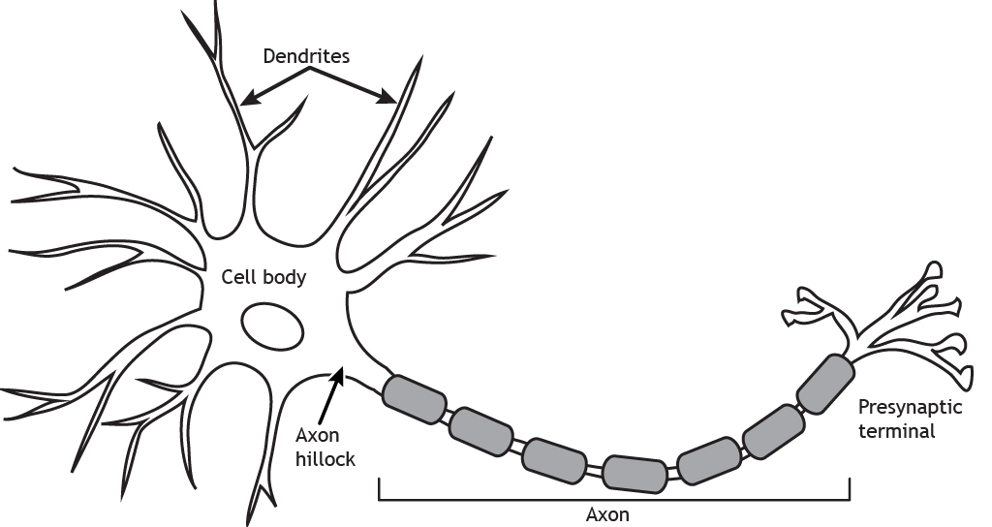
Background
Diffusion MRI
Interest for identifying biomarkers for Parkinson’s disease (Mitchel et al, 2019; Wang et al. 2019)
NODDI (Neurite orientation dispersion and density imaging (Zhang et al., 2012)
dendrites
Neurite morphology : linked to neurological disorders (i.e. Parkinson’s disease)
axons
(H. Casey, 2021)

Slide 4
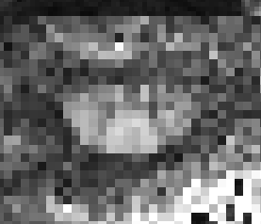
Main Question
Can we identify biomarkers for Parkinson's disease using the NODDI model on diffusion MRI images of the spinal cord?

Slide 5



Data
What?
Spinal cord diffusion MRI
113 subjects
87 diagnosed with Parkinson’s disease (low, medium and advanced stages)
26 healthy control subjects
Where?
McGill University, Montreal, CA
Why?
Specific protocol for project
Identify differences in spinal cord microstructure with disease progression

Slide 6

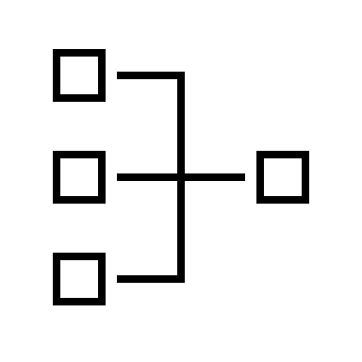


Tools & Methods
Python
NODDI toolbox
Data analysis
Parallel computing (ex: Alliance Canada)
Speed up fitting process for 113 participants
BIDS
Data organization
Tools such as pyBids
Git and Github
Version control, project documentation

Slide 7
Objectives
Model fitting (NODDI)
+
Data analysis
+
Identify potential biomarkers
NODDI python toolbox
Parallel computing (ex : Alliance Canada)
Compare NODDI metrics
Control subjects vs subjects with Parkinson’s disease
Changes in spinal cord microstructure with disease progression?

Slide 8
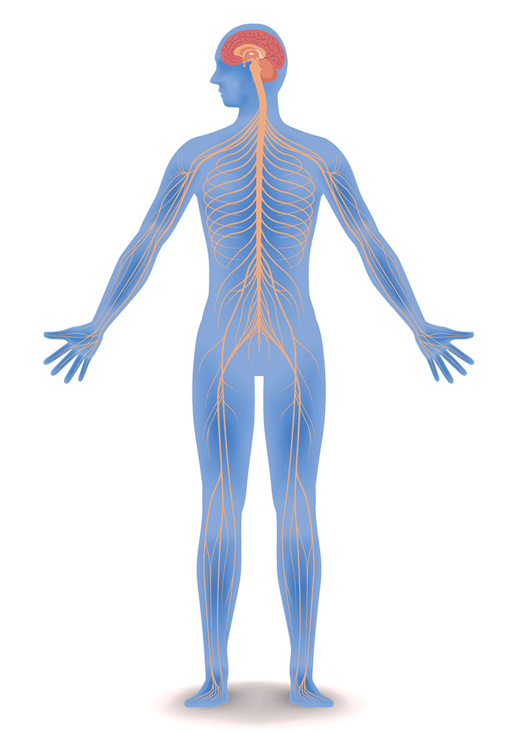
Deliverables
Workflow and pipeline
NODDI metrics computation (i.e., neurite density index and orientation dispersion index)
Data analysis
Results
Differences in spinal cord microstructure with disease progression?
Potential biomarkers for Parkinson’s disease?
(University of Queensland Australia, 2017)

Slide 9
References
Henley, Casey. 2021. « The Neuron ». <https://openbooks.lib.msu.edu/neuroscience/chapter/the-neuron/>.
Mitchell, Trina, Derek B. Archer, Winston T. Chu, Stephen A. Coombes, Song Lai, Bradley J. Wilkes, Nikolaus R. McFarland, Michael S. Okun, Mieniecia L. Black, Ellen Herschel, Tanya Simuni, Cynthia Comella, Tao Xie, Hong Li, Todd B. Parrish, Ajay S. Kurani, Daniel M. Corcos et David E. Vaillancourt. 2019. « Neurite orientation dispersion and density imaging (NODDI) and free‐water imaging in Parkinsonism ». Human Brain Mapping, vol. 40, nº 17, p. 5094‑5107. <https://doi.org/10.1002/hbm.24760>.
Neurology & Sleep Center. 2021. « What is Parkinsons Disease | Parkinsons Disease Treatment ». Neurology & Sleep Centre. <https://neurologysleepcentre.com/blog/what-is-parkinsons-disease>.
University of Queensland Australia. 2017. « Central Nervous System: brain and spinal cord ». <https://qbi.uq.edu.au/brain/brain-anatomy/central-nervous-system-brain-and-spinal-cord>.
Wang, Nian, Jieying Zhang, Gary Cofer, Yi Qi, Robert J. Anderson, Leonard E. White et G. Allan Johnson. 2019. « Neurite orientation dispersion and density imaging of mouse brain microstructure ». Brain Structure and Function, vol. 224, nº 5, p. 1797‑1813. <https://doi.org/10.1007/s00429-019-01877-x>.
Zhang, Hui, Torben Schneider, Claudia A. Wheeler-Kingshott et Daniel C. Alexander. 2012. « NODDI: Practical in vivo neurite orientation dispersion and density imaging of the human brain ». NeuroImage, vol. 61, nº 4, p. 1000‑1016. <https://doi.org/10.1016/j.neuroimage.2012.03.072>.

