Slide 1

Identifying Potential Biomarkers for Parkinson’s Disease Using Neurite Orientation Dispersion and Diffusion Imaging (NODDI)
Samuelle St-Onge – Polytechnique Montréal

Slide 2
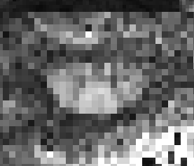
Background
Parkinson’s disease
Importance of understanding disease causes and progression
Develop better treatment options
Find biomarkers
Neurite orientation dispersion and diffusion imaging (NODDI)
Diffusion MRI technique
Extract metrics based on neurite (dendrites + axons) morphology
Orientation dispersion index (ODI) : variability in neurite orientation
Neurite density index (NDI)
Isotropic volume fraction (Viso)

Slide 3
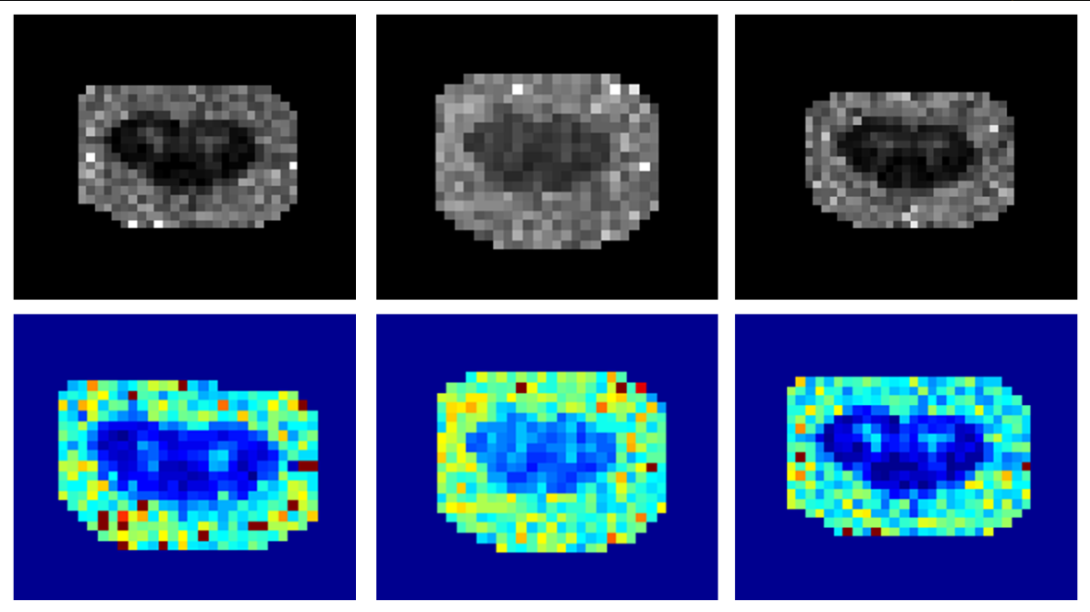
Background
Why NODDI for Parkinson’s disease?
Literature shows interest in DWI for potential PD biomarkers in brain images (Zhang et al., 2012)
Changes in neurite morphology linked with other neurodegenerative diseases (i.e. MS)
Why spinal cord images for PD biomarkers?
To our knowledge, NODDI in spinal cord for PD has not been studied
Spinal cord lesions in PD patients (Tredici et al., 2012)

Slide 4
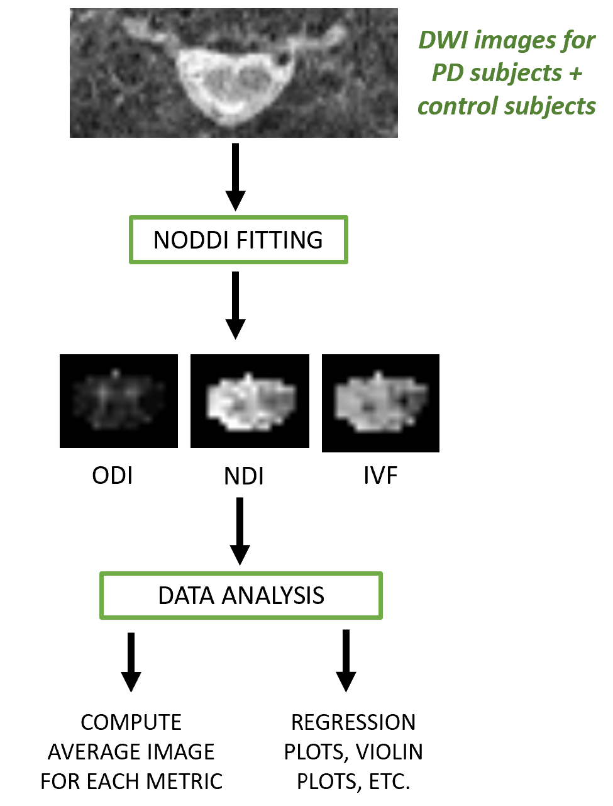
Objectives
Perform NODDI fitting on DWI dataset from PD patients
Using existing NODDI toolbox
Write script to perform multi-subject fitting
Use parallel computing
Analyze NODDI metrics
Write python script for regression plots, etc.
Write python script to display average metric for each PD stage
*** Identify potential biomarkers for PD

Slide 5
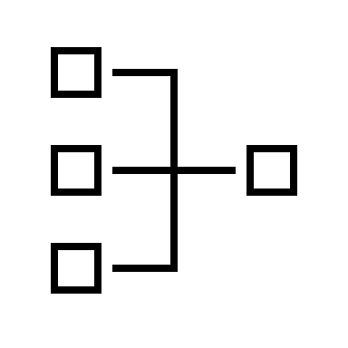
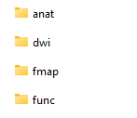
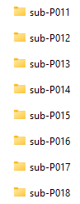
Data
Dataset from McGill University
113 subjects
87 diagnosed with Parkinson’s disease (low, medium and advanced stages)
26 healthy control subjects
For this project : focus on DWI
Why this dataset?
Part of a larger study with other MRI modalities
To our knowledge, no similar public dataset available
…
…

Slide 6
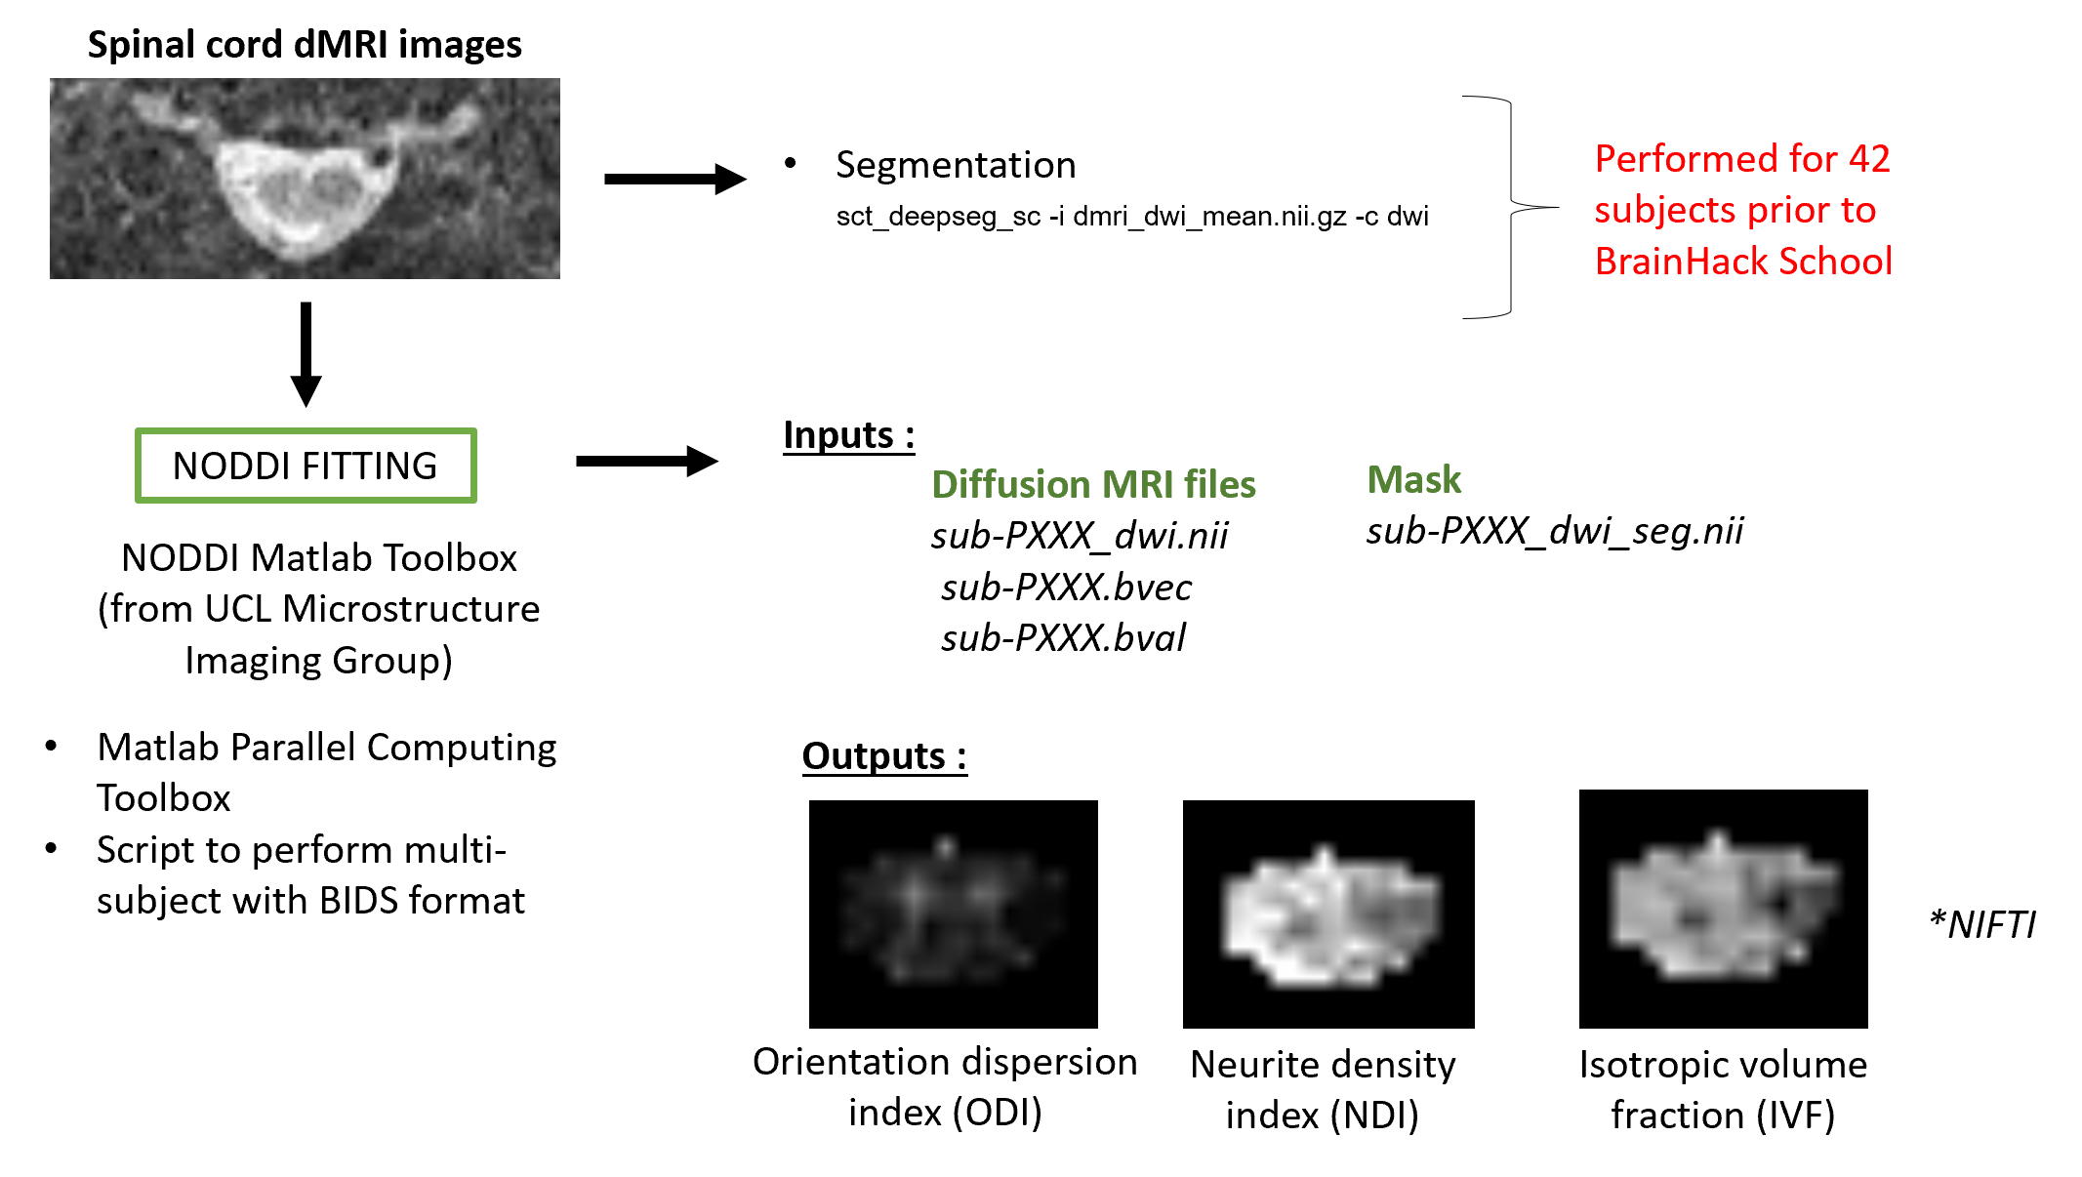
Tools and methods

Slide 7
Tools and methods

Slide 8
Tools and methods

Slide 9
Tools and methods

Slide 10
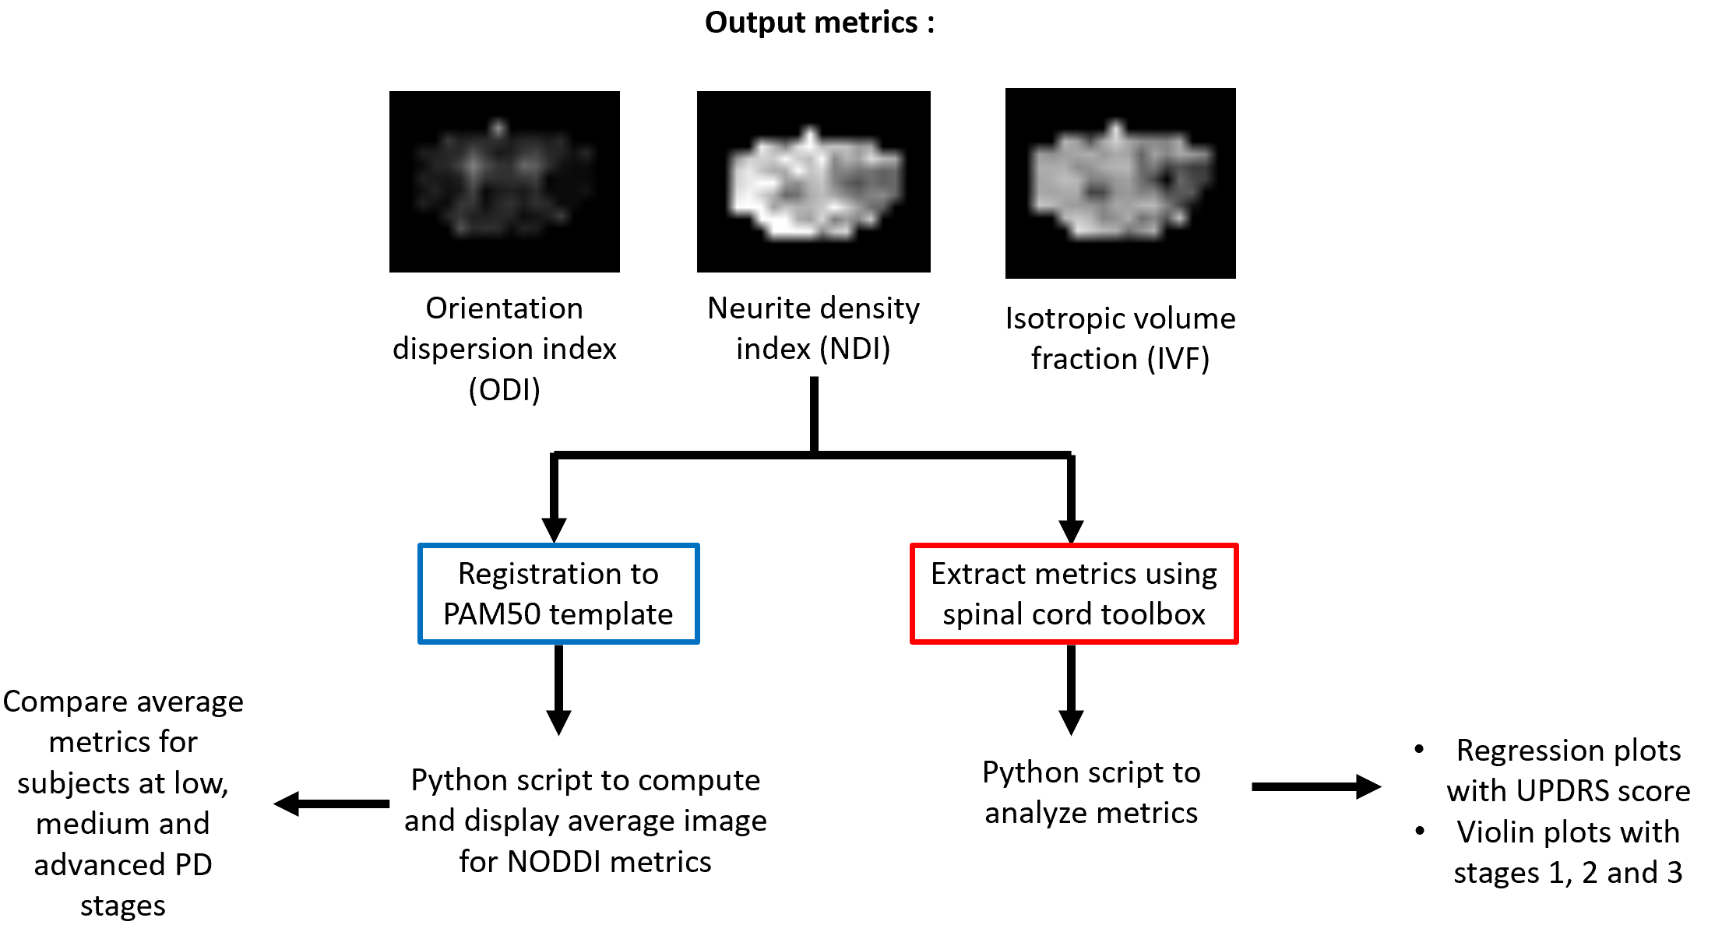
Tools and methods

Slide 11
Tools and methods

Slide 12
Tools and methods

Slide 13
Tools and methods

Slide 14
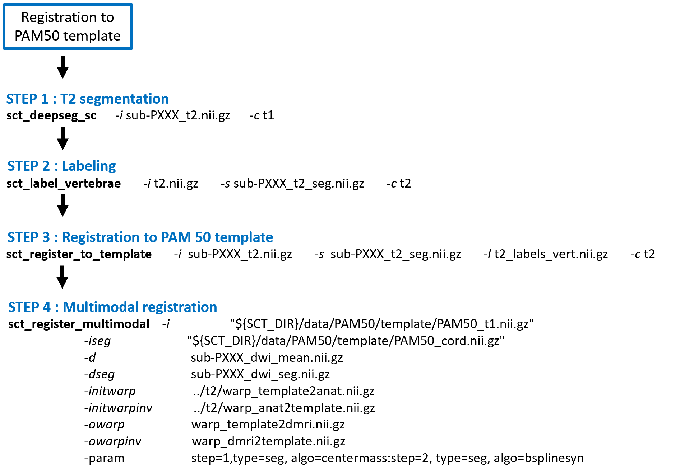

Slide 15
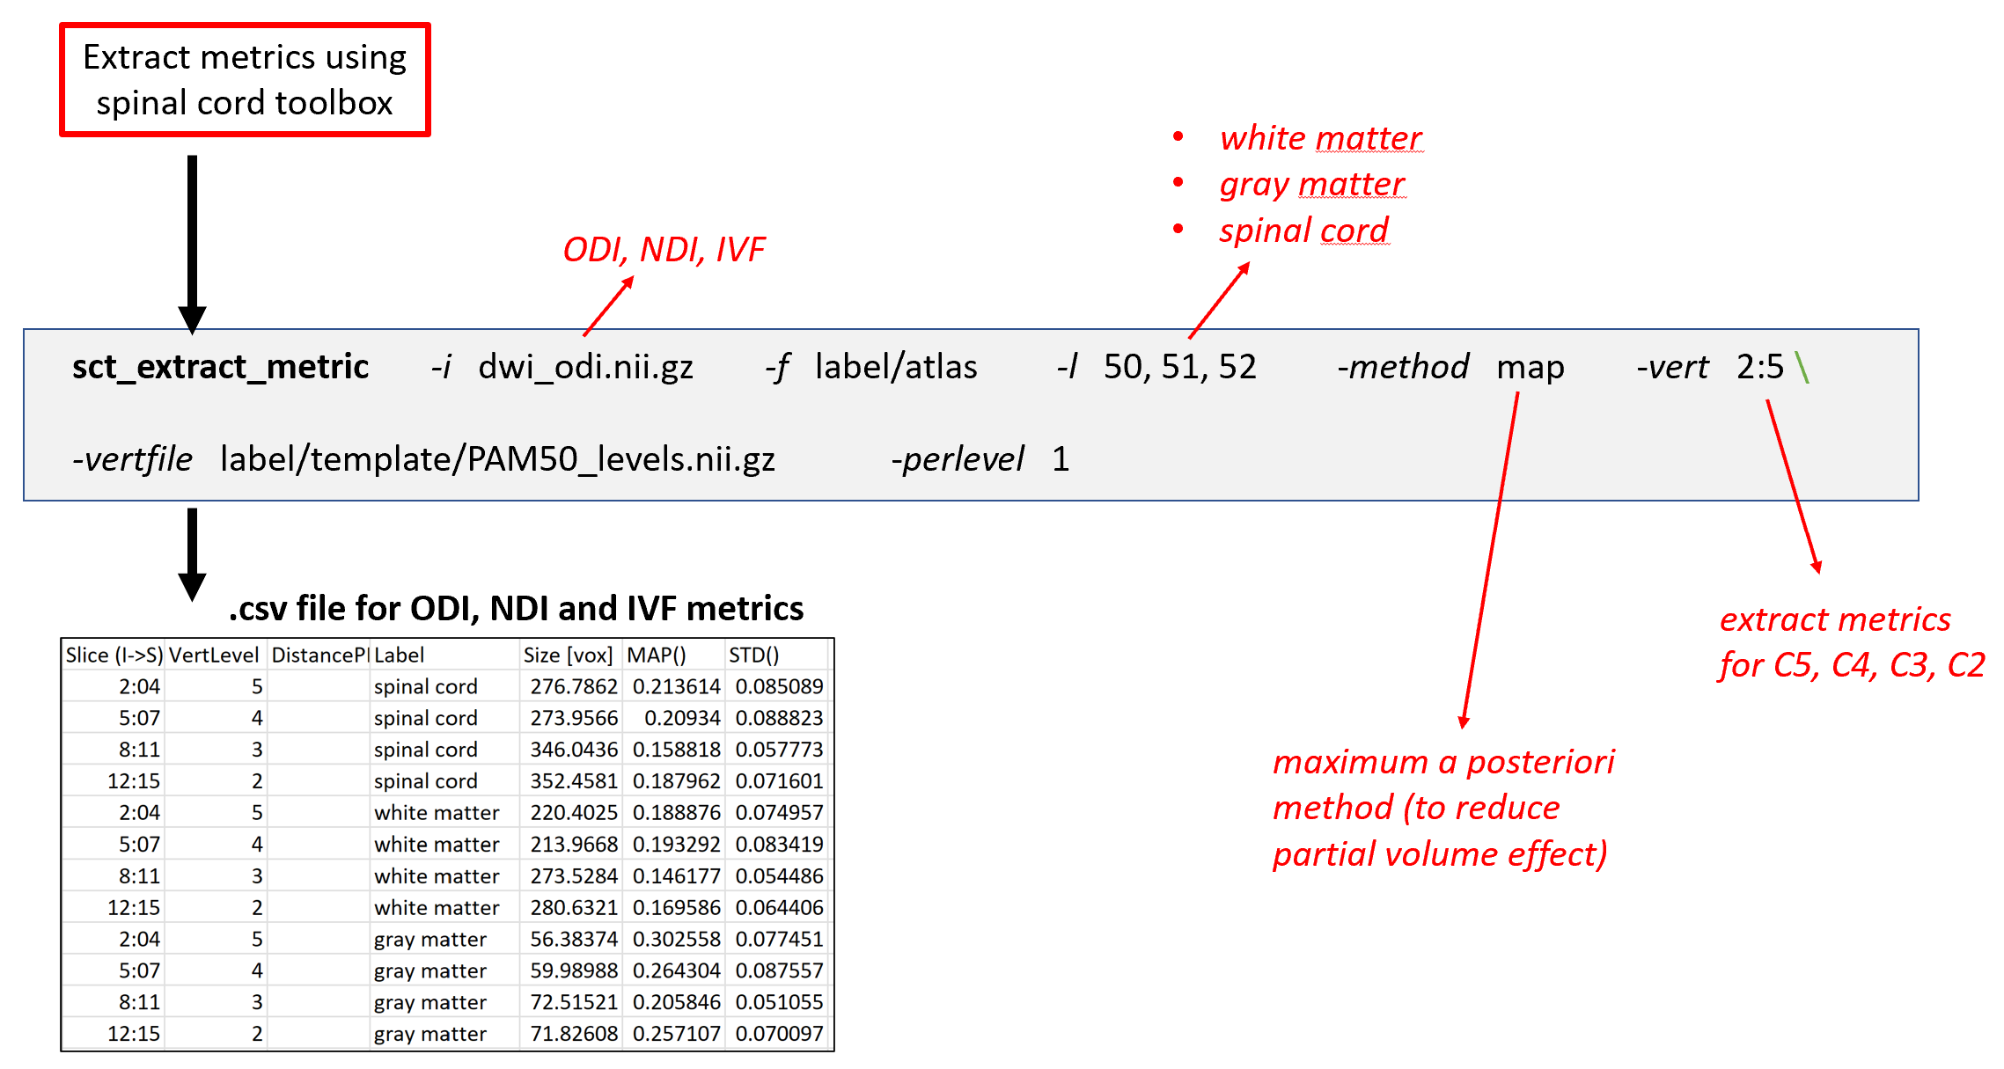

Slide 16
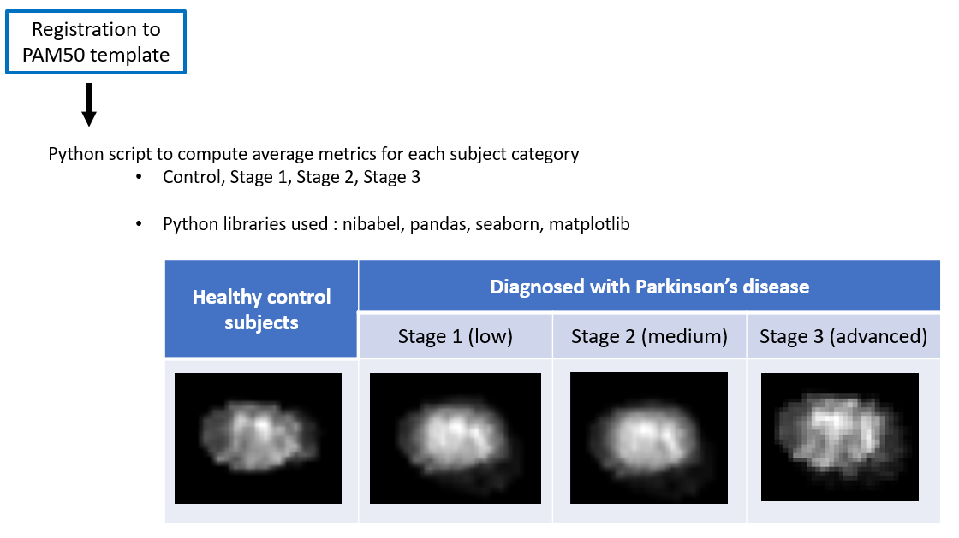
Results
*problem with registration to PAM50 (future steps : try with different parameters)
Orientation dispersion index (ODI)

Slide 17
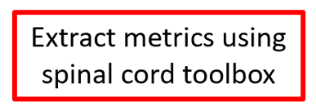
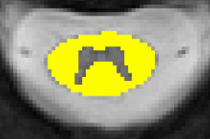
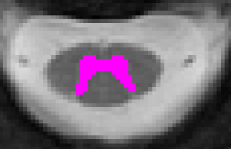
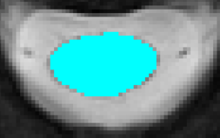
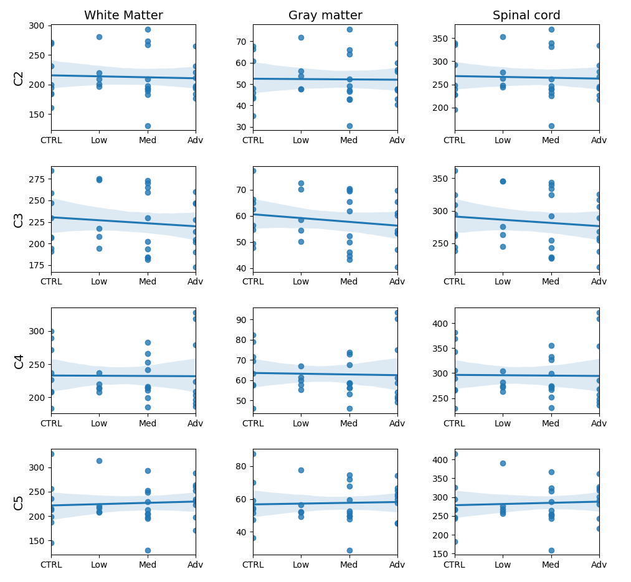
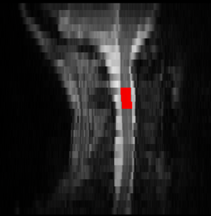
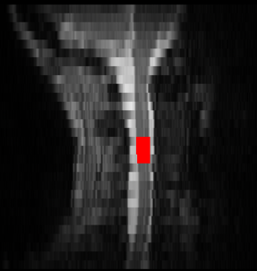
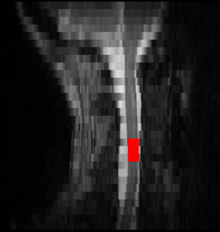
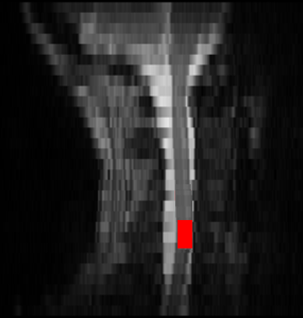
Results
Orientation dispersion index
According to literature :
↑ ODI in white matter
↓ ODI in gray matter
Linked to neurodegeneration (Zhang et al., 2012)
For this project :
Not enough subjects
Need more rigorous statistics (regression model with p-value)

Slide 18



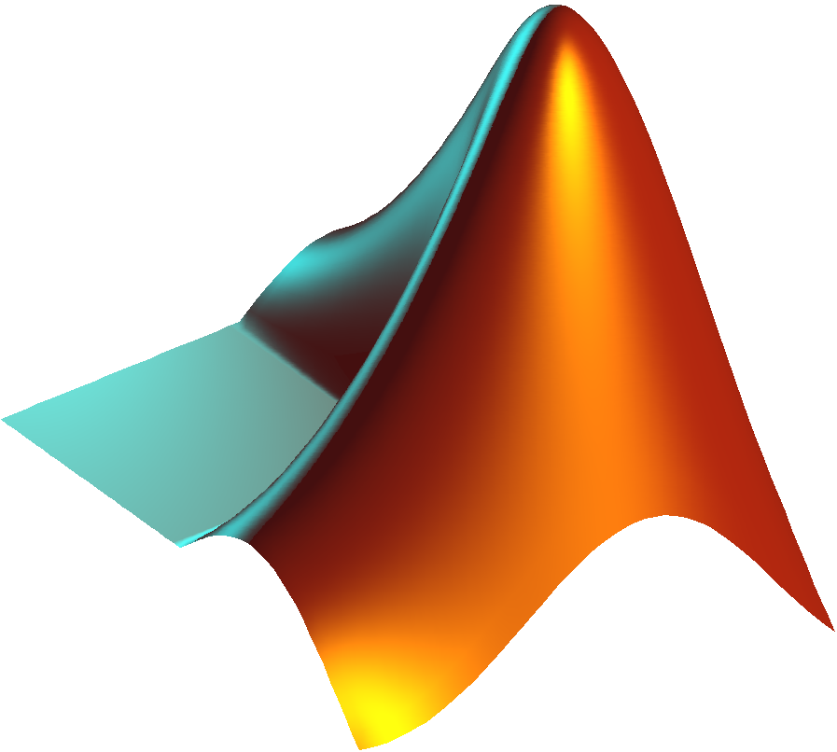
Deliverables
Python script
to compute average metric and display average metric images
Matlab script
for multi-subject NODDI fitting
(using NODDI Matlab Toolbox from UCL Microstructure Imaging Group)
Python script
for data analysis (regression plots, violin plots, box plots)

Slide 19

Limitations and future steps
For NODDI fitting :
Pre-processing for entire dataset (113 subjects)
Motion correction
Mask instead of segmentation for fitting (help reduce potential partial volume effect?)
Registration prior to NODDI fitting
For the NODDI metric analysis :
Registration to PAM50 : try different parameters
Regression plot : consider age as control variable (avoid overestimating effect of PD progression)
Incorporate regression model with p-values

Slide 20
Conclusion
What I have learned during this project ?
Notes:
Having started my PhD this semester, BHS was a great opportunity for me to learn about the basics of neuroscience imaging. There are still a lot that can be improved in my project, but I look forward to apply the skills that I learned during BHS to work on improving what I have done so far.

Slide 21
References
Henley, Casey. 2021. « The Neuron ». <https://openbooks.lib.msu.edu/neuroscience/chapter/the-neuron/>.
UCL Microstructure Imaging Group. 2021. NODDI Matlab Toolbox. <http://mig.cs.ucl.ac.uk/index.php?n=Tutorial.NODDImatlab>.
Mitchell, Trina, Derek B. Archer, Winston T. Chu, Stephen A. Coombes, Song Lai, Bradley J. Wilkes, Nikolaus R. McFarland, Michael S. Okun, Mieniecia L. Black, Ellen Herschel, Tanya Simuni, Cynthia Comella, Tao Xie, Hong Li, Todd B. Parrish, Ajay S. Kurani, Daniel M. Corcos et David E. Vaillancourt. 2019. « Neurite orientation dispersion and density imaging (NODDI) and free‐water imaging in Parkinsonism ». Human Brain Mapping, vol. 40, nº 17, p. 5094‑5107. <https://doi.org/10.1002/hbm.24760>.
Neurology & Sleep Center. 2021. « What is Parkinsons Disease | Parkinsons Disease Treatment ». Neurology & Sleep Centre. <https://neurologysleepcentre.com/blog/what-is-parkinsons-disease>.
University of Queensland Australia. 2017. « Central Nervous System: brain and spinal cord ». <https://qbi.uq.edu.au/brain/brain-anatomy/central-nervous-system-brain-and-spinal-cord>.
Del Tredici, Kelly et Heiko Braak. 2012. « Spinal cord lesions in sporadic Parkinson’s disease ». Acta Neuropathologica, vol. 124, no 5, p. 643‑664. <https://doi.org/10.1007/s00401-012-1028-y>.
Wang, Nian, Jieying Zhang, Gary Cofer, Yi Qi, Robert J. Anderson, Leonard E. White et G. Allan Johnson. 2019. « Neurite orientation dispersion and density imaging of mouse brain microstructure ». Brain Structure and Function, vol. 224, nº 5, p. 1797‑1813. <https://doi.org/10.1007/s00429-019-01877-x>.
Zhang, Hui, Torben Schneider, Claudia A. Wheeler-Kingshott et Daniel C. Alexander. 2012. « NODDI: Practical in vivo neurite orientation dispersion and density imaging of the human brain ». NeuroImage, vol. 61, nº 4, p. 1000‑1016. <https://doi.org/10.1016/j.neuroimage.2012.03.072>.

