Slide 1


Generating Synthetic CT Scans from MRI for Enhanced Radiotherapy Planning
Khaled Ashkar - Biomedical Engineering

Slide 2
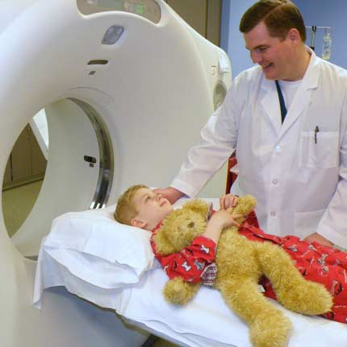
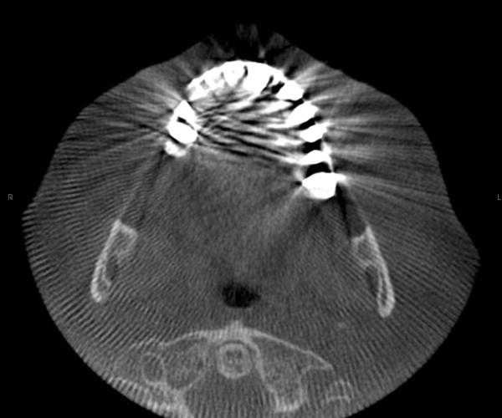
Background
What we want
Treatment planning
What we need
Accurate imaging for patient positioning and monitoring
CT scans
CBCT scans
Best for dose calculation and tissue attenuation factor
Coupled to dose delivery machines
But!
Increases radiation exposure (pediatric patients)
Introduces shading, distortion and bad dose calculation
Solution? Challenges?
My project! Synthetic CTs from MRIs
Lack of:
Tissue attenuation information in MRIs
Open datasets designed as ground truth
Evaluation metrics
https://www.radiologyinfo.org/en/info/pedia-ct
https://oralradiology.wordpress.com/2012/01/12/cone-beam-ct-caries-interpretation/

Slide 3
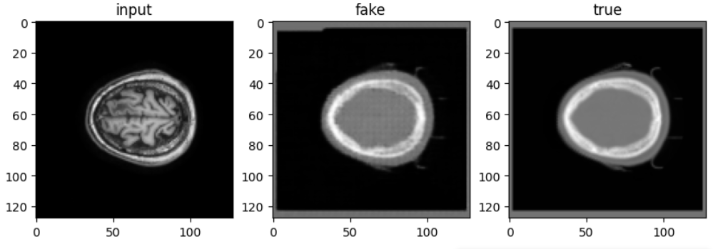
Objectives
On the personal level: Opensource Data, DataSet manipulation, DeepLearning models, Data visualization
Short term: Provide a pipeline to generate synthetic CTs from MRIs (training/testing)
Long term: Generating the model on different Contrasts and Field magnitudes.

Slide 4
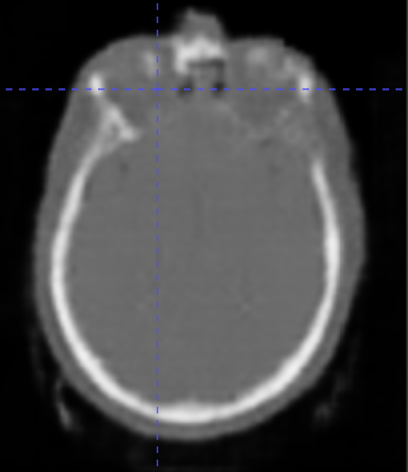
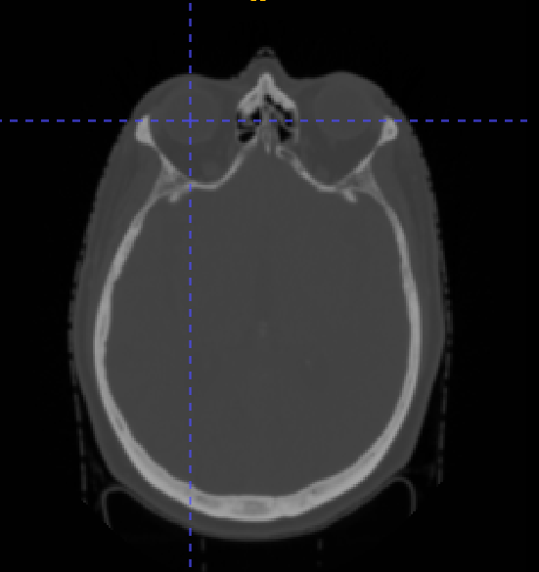
Main Questions – Recap
1- How effective are AI-driven methods in creating reliable synthetic CTs for clinical use in radiotherapy?
2- Can the generated CTs from MRI eliminate the need for additional CT scans while maintaining or even improving treatment quality?
Real?
Fake?

Slide 5
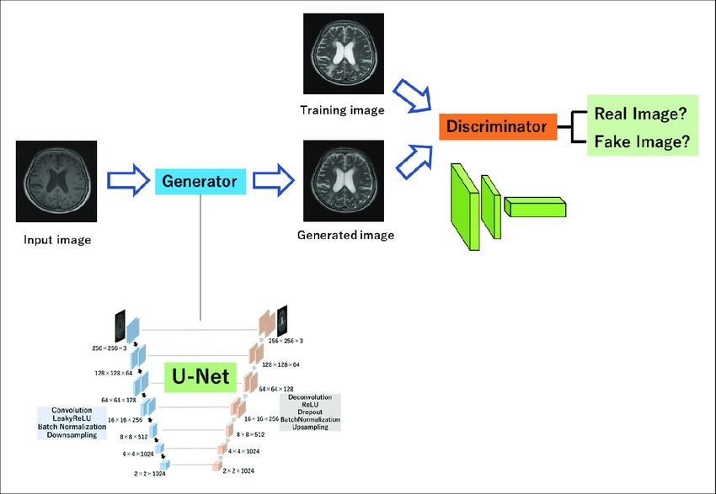
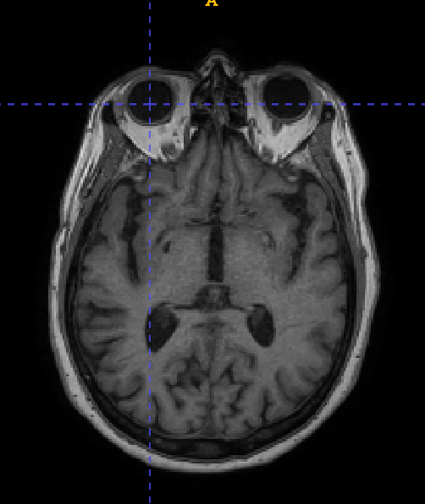



Training Model
Deep Learning U-Net Model: Model known for its effectiveness in medical image segmentation and synthesis
CGAN: To accurately translate between the two distribution probabilities between CT and MRI.
80% Training
20% Validation
https://emojiterra.com/thinking-face/

Slide 6
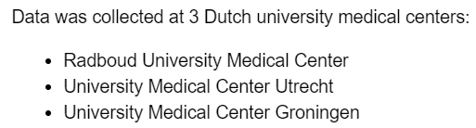
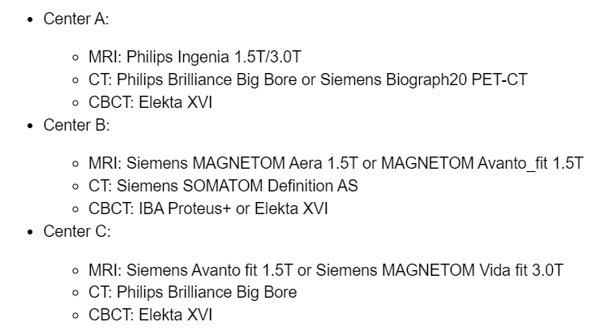
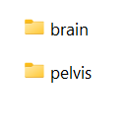
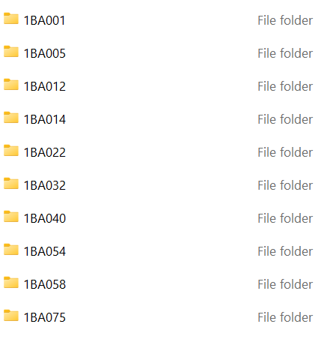
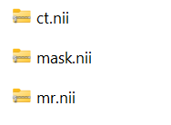
Data & Tools
720 patients: -360 paired brain scans
-360 paired pelvis scans
First Training DataSet: 10 subjects
Second Training DataSet: 20 subjects
Third Training DataSet: 7 subjects
https://doi.org/10.5281/zenodo.7260705

Slide 7
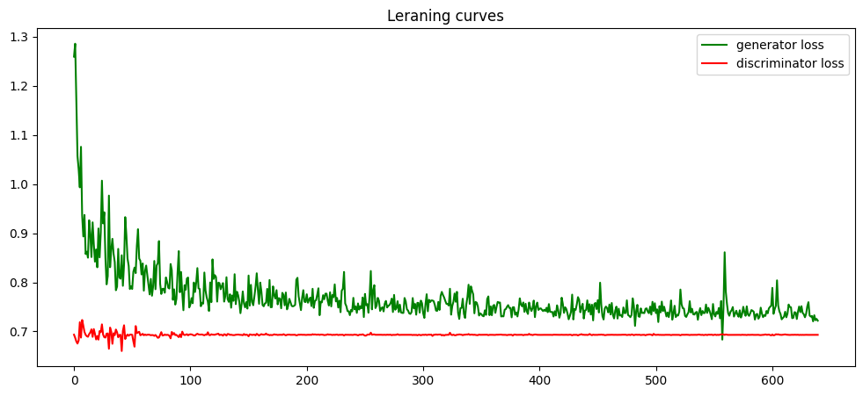
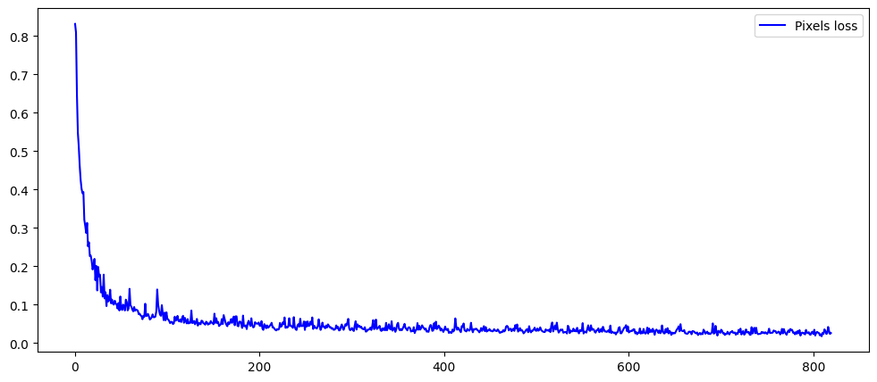
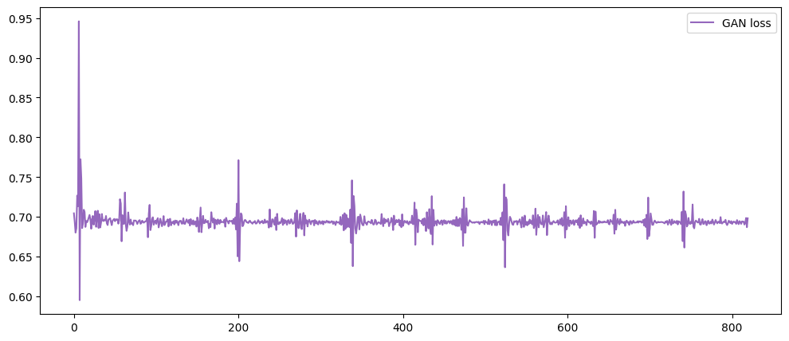
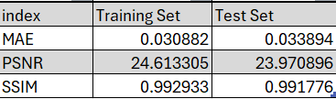
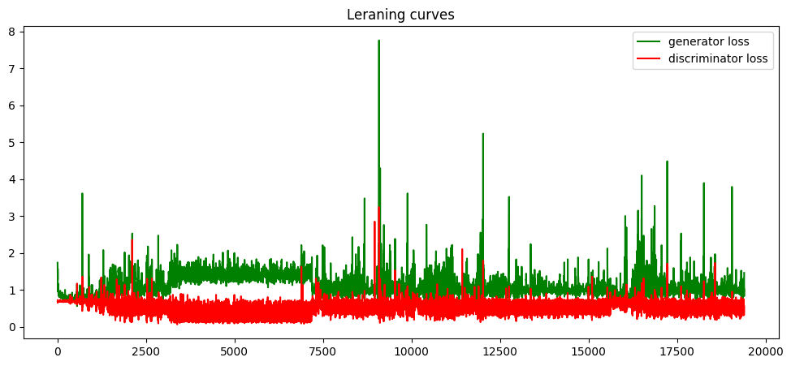
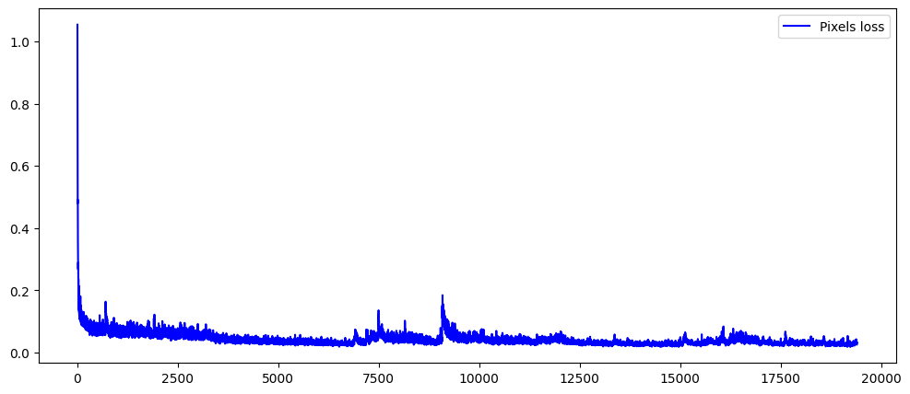
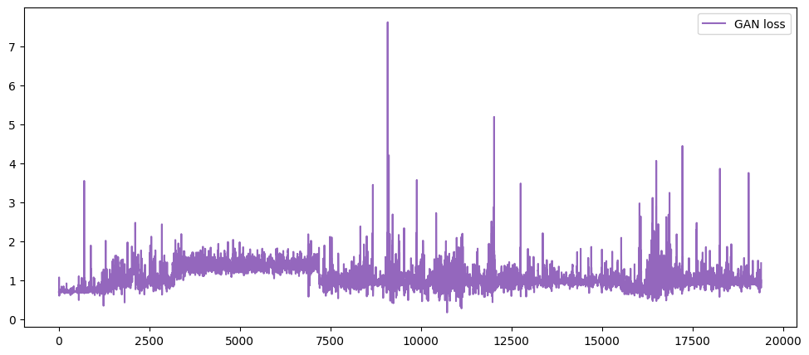
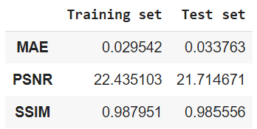
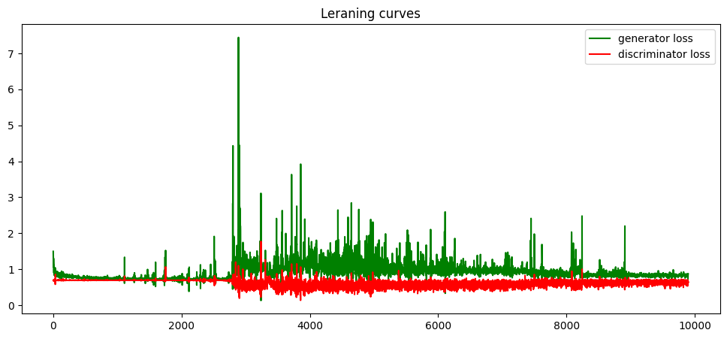
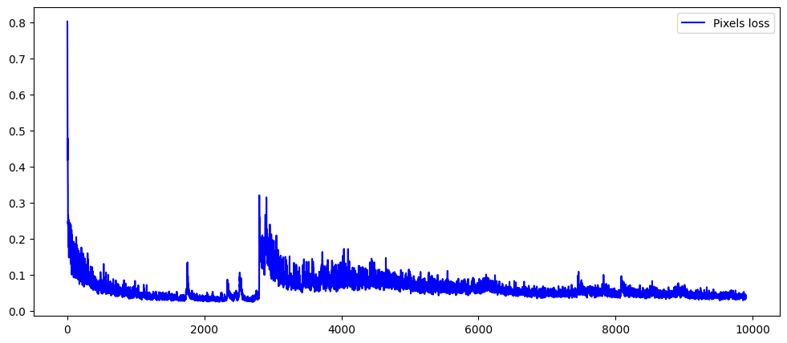
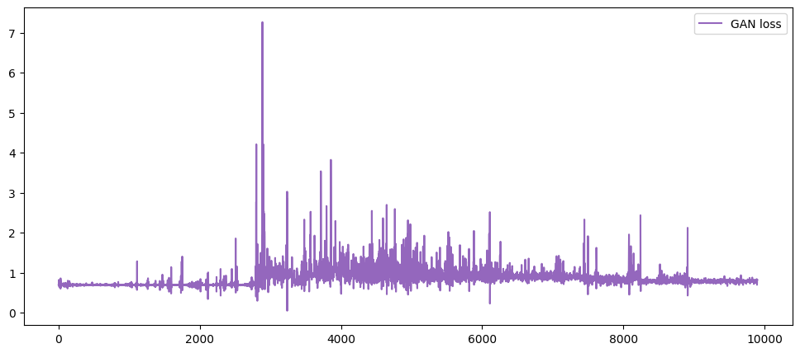
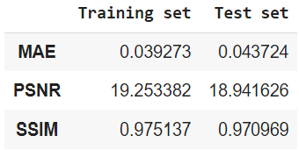
Model Loss functions
20 ep – batch 4 – 1 subject
200 ep – batch 5 – 3 subjects
100 ep – batch 10 – 7 subjects

Slide 8
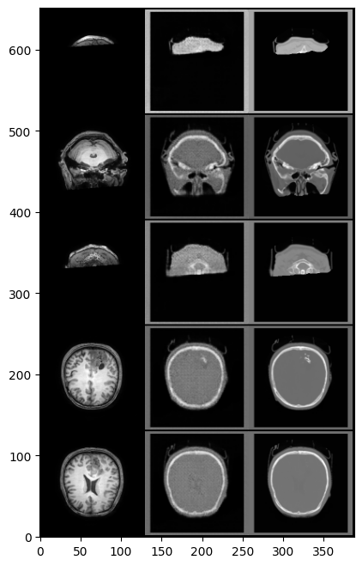
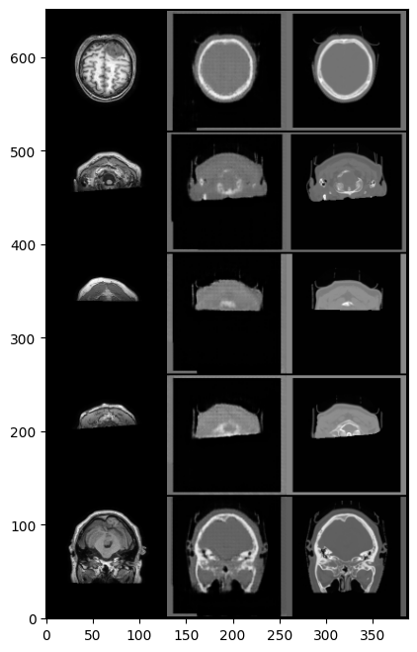
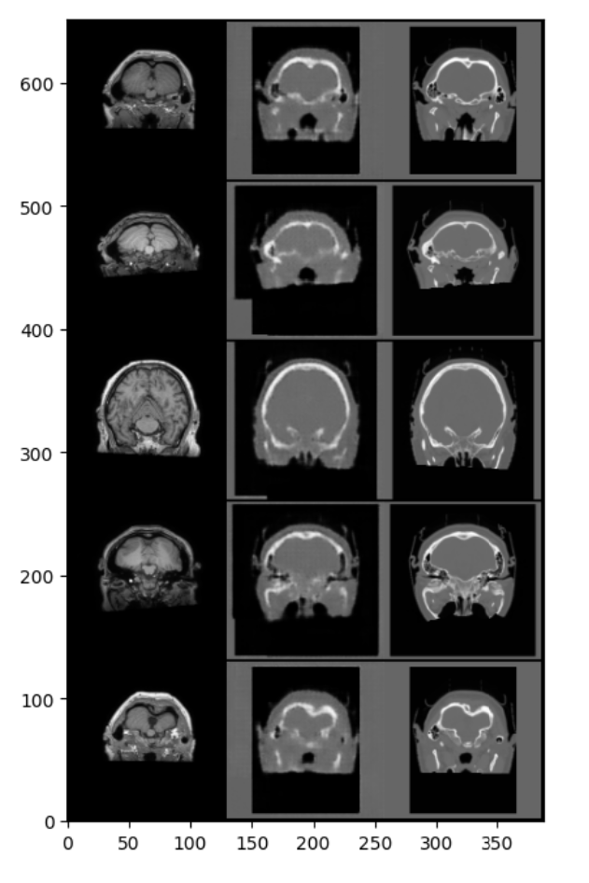
Model validation
20 ep – batch 4 – 1 subject
200 ep – batch 5 – 3 subjects
100 ep – batch 10 – 7 subjects

Slide 9
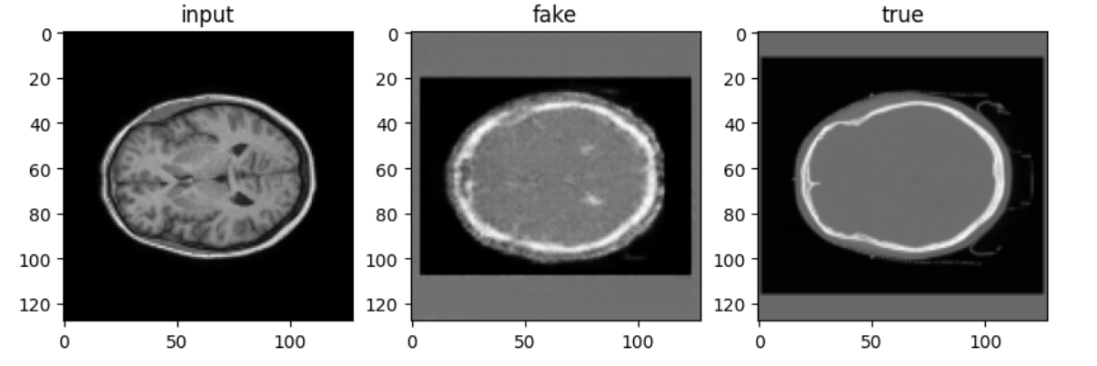
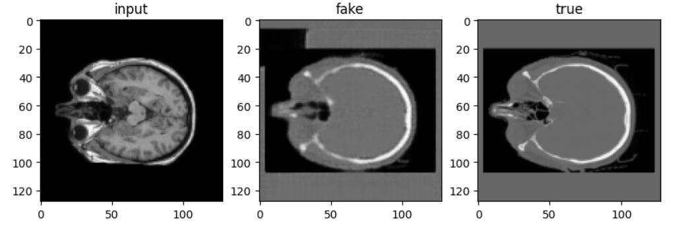
Model Validation
20 ep – batch 4 – 1 subject
200 ep – batch 5 – 3 subjects
100 ep – batch 10 – 7 subjects

Slide 10
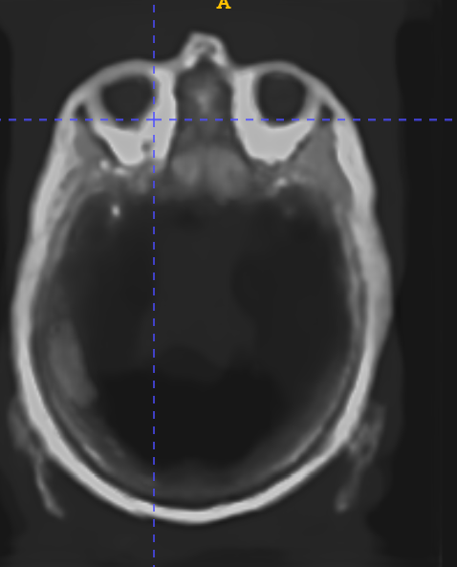
Model Testing
Synthetic CT
Synthetic MRI
Real
https://surfer.nmr.mgh.harvard.edu/fswiki/SynthSR

Slide 11
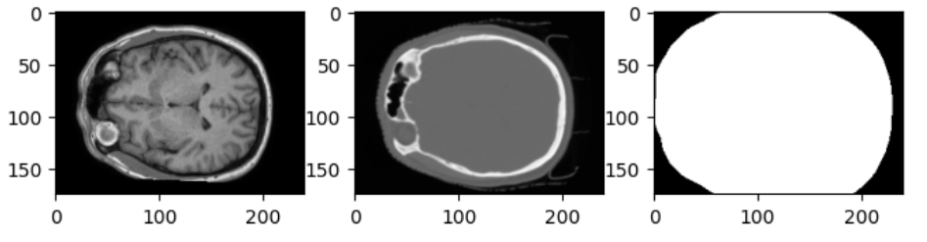


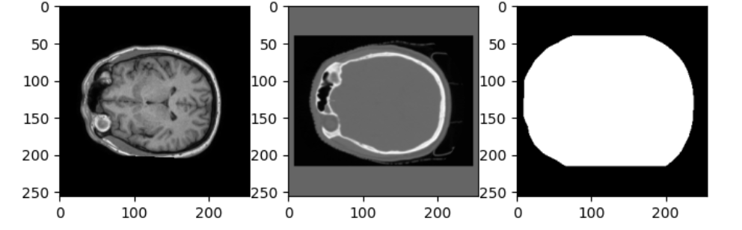
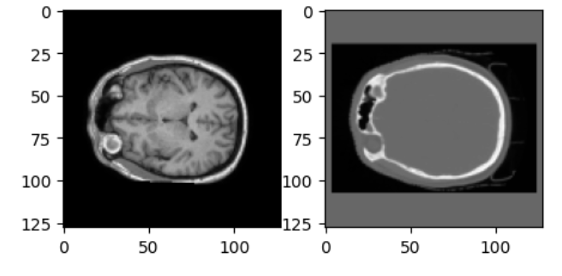
Challenges and Solutions
Original size
Input Data with different size and high resolution
Degrading the resolution
Padding the input data and resizing from any size to 256x256
Then Resizing to
Padded images
Computational resources
Resized images
Training on small DataSets and low epoch number (10-20) on CPU and 100-200 epochs on Google Colab:
1, 3, 7, 10 and 20 subjects

Slide 12
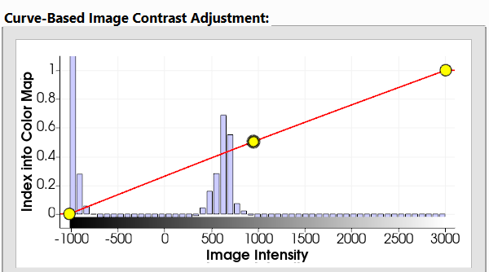
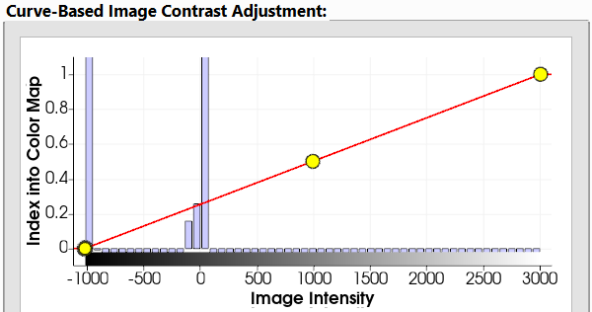
Limitations
Synthetic CT
Hounsfield conversion factor
Real

Slide 13
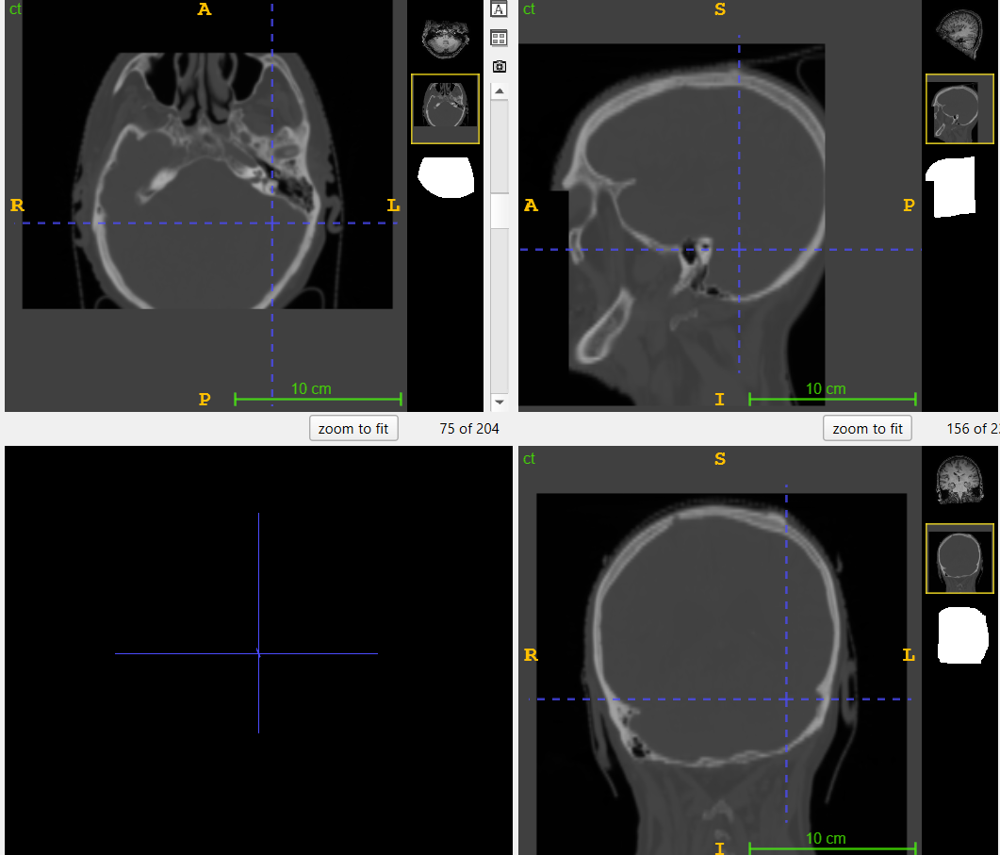
Limitations
Technical limitations:
1- No computational resources
2- 2D Model
3- 360 Brain subjects : Not a big Dataset
4- Architecture limitations (try a more complexed model)
Personal: Have to admit the lack of understanding and expertise!

Slide 14


Deliverables
A trained deep learning model for generating synthetic CTs, Testing and Finetuning
Detailed documentation and code available in a public GitHub repository with all the datasets used to train the model.

Slide 15

https://www.shutterstock.com/search/thank-you-card-multi-language

Slide 16
References
Gupta, D., Kim, M., Vineberg, K. A., & Balter, J. M. (2019). Generation of synthetic CT images from MRI for treatment planning and patient positioning using a 3-Channel U-Net trained on sagittal images. Frontiers in Oncology, 9. https://doi.org/10.3389/fonc.2019.00964
Liu, Y., Lei, Y., Wang, Y., Shafai-Erfani, G., Wang, T., Tian, S., Patel, P., Jani, A. B., McDonald, M., Curran, W. J., Liu, T., Zhou, J., & Yang, X. (2019). Evaluation of a deep learning-based pelvic synthetic CT generation technique for MRI-based prostate proton treatment planning. Physics in Medicine & Biology/Physics in Medicine and Biology, 64(20), 205022. https://doi.org/10.1088/1361-6560/ab41af
Tahri, S., Texier, B., Nunes, J., Hemon, C., Lekieffre, P., Collot, E., Chourak, H., Guevelou, J. L., Greer, P., Dowling, J., Acosta, O., Bessieres, I., Marage, L., Boue-Rafle, A., De Crevoisier, R., Lafond, C., & Barateau, A. (2023). A deep learning model to generate synthetic CT for prostate MR-only radiotherapy dose planning: a multicenter study. Frontiers in Oncology, 13. https://doi.org/10.3389/fonc.2023.1279750
SynthRAD2023 - Grand Challenge. (n.d.). grand-challenge.org. https://synthrad2023.grand-challenge.org/
Deep learning based synthetic‐CT generation in radiotherapy and PET: A review
Deep learning to generate synthetic CT Images from MR for Radiotherapy treatment planning – MVision AI

