Slide 1


g-Ratio mapping of the optic nerve
Hugo Albert Plante - NeuroPoly

Slide 2

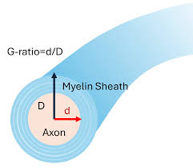
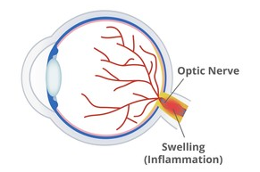
Background
Optic neuritis
McDonald Criteria for Multiple Sclerosis
(Barranco Hernandez et al., 2024)
(Pediatric Optic Neuritis (ON) – Children’s Health Neurology, n. d.)
(Demyelination & Remyelination in the Cuprizone Model, n. d.)

Slide 3
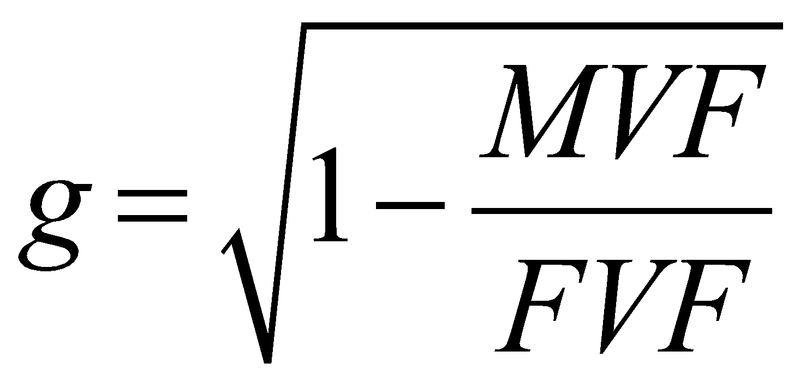
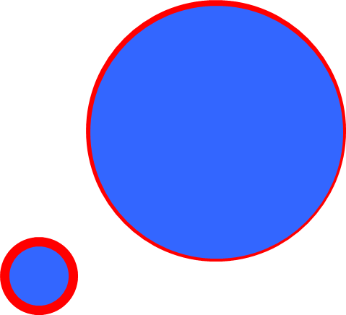
Main Question
Reproducible pipeline to standardize the g-ratio mapping
Myelin Volume Fraction (MVF) =
+
+
+
Fiber Volume Fraction (FVF) =
+
+
Optic pathway template
g-Ratio

Slide 4
Objectives
Open-Source Tool
Standardized template
Standardized g-ratio maps in the optic pathway
Enable multi-site inter-subject comparison
Reproducible Pipeline

Slide 5

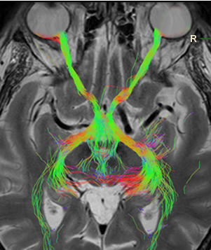
Data
Fiber volume fraction (FVF)
Diffusion MRI (dMRI)
Myelin volume fraction (MVF)
Quantitative MRI (MP2RAGE)
Optic Pathway
Template
Segmentations
(Barranco Hernandez
et al., 2024)
(Radioanatomie, 2025)

Slide 6


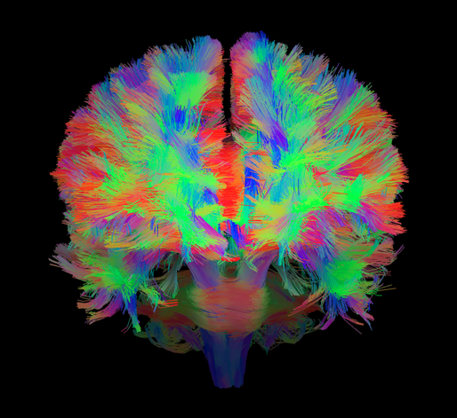
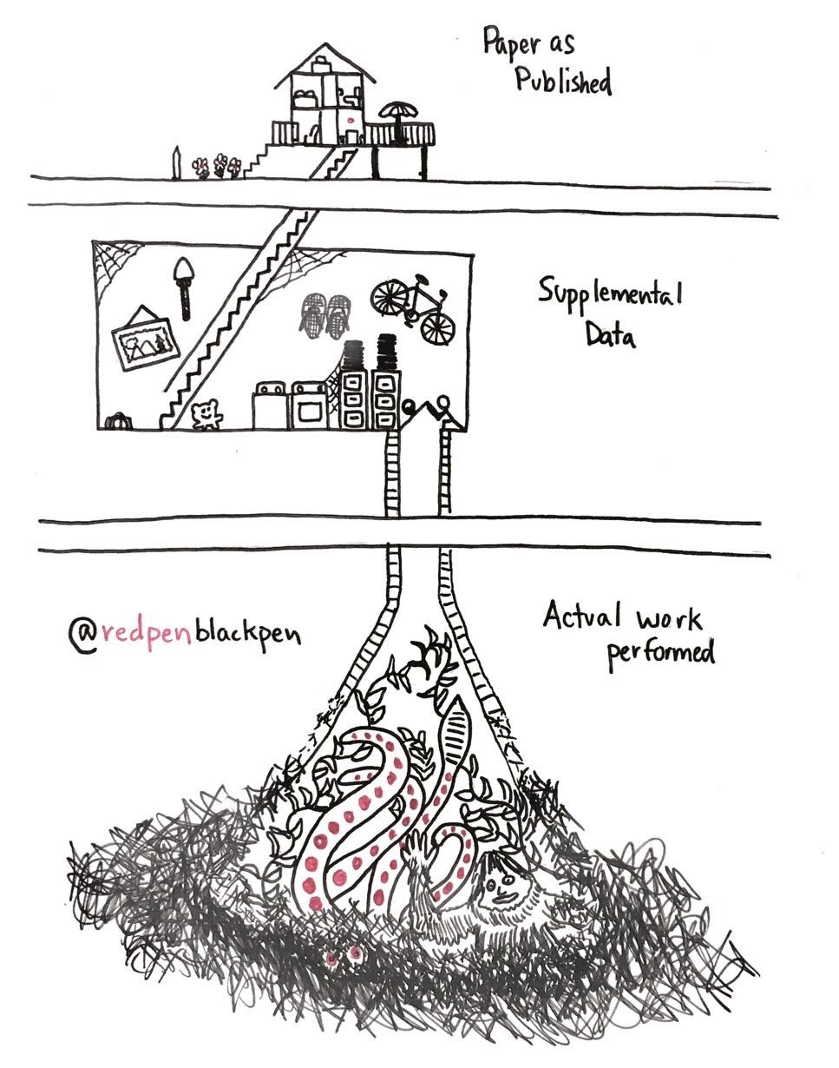

Tools & Methods
(BRAINHACK SCHOOL, 2025)

Slide 7


Deliverables
Reproducible pipeline
Template of the optic pathway including the optic nerve
Standardize g-ratio map of the optic pathway

Slide 8
References
Barranco Hernandez, J., Luyken, A., Kebiri, H., Stachs, P., Macias Gordaliza, P., Esteban, O., Aleman Gomez, Y., Sznitman, R., Stachs, O., Langner, S., Franceschiello, B., & Bach Cuadra, M. (2024). Eye-Opening Advances: Automated 3D Segmentation, Key Biomarkers Extraction, and the First Large-Scale MRI Eye Atlas. https://doi.org/10.1101/2024.08.15.608051
Brainhack school. (n.d.). Retrieved May 29, 2025, from https://school-brainhack.github.io/
Demyelination & Remyelination in the Cuprizone Model. (n.d.). Biospective. Retrieved May 28, 2025, from https://biospective.com/resources/measuring-demyelination-and-remyelination-in-cuprizone-mouse-model-of-multiple-sclerosis
Link between neurological visual field defects and injury localization on an optic pathway tractography. (n.d.). Retrieved May 30, 2025, from https://www.radioanatomie.com/32_voies_optiques/voies_optiques.php?vue=1&titre=&langue=en
Pediatric optic neuritis (ON) – Children’s Health Neurology. (n.d.). Retrieved May 28, 2025, from https://www.childrens.com/specialties-services/conditions/optic-neuritis
Rokers Vision Laboratory. (n.d.). Retrieved May 30, 2025, from https://sites.nyuad.nyu.edu/rokersvisionlaboratory/
Stikov, N., Campbell, J. S. W., Stroh, T., Lavelée, M., Frey, S., Novek, J., Nuara, S., Ho, M.-K., Bedell, B. J., Dougherty, R. F., Leppert, I. R., Boudreau, M., Narayanan, S., Duval, T., Cohen-Adad, J., Picard, P.-A., Gasecka, A., Côté, D., & Pike, G. B. (2015). In vivo histology of the myelin g-ratio with magnetic resonance imaging. NeuroImage, 118, 397–405. https://doi.org/10.1016/j.neuroimage.2015.05.023
Trust, M. S. (n.d.). McDonald criteria | MS Trust. Retrieved May 29, 2025, from https://mstrust.org.uk/a-z/mcdonald-criteria

