Slide 1

Independent Component Analysis (ICA) and Code Intro
Iowa BrainHack 2021
July 9th

Slide 2
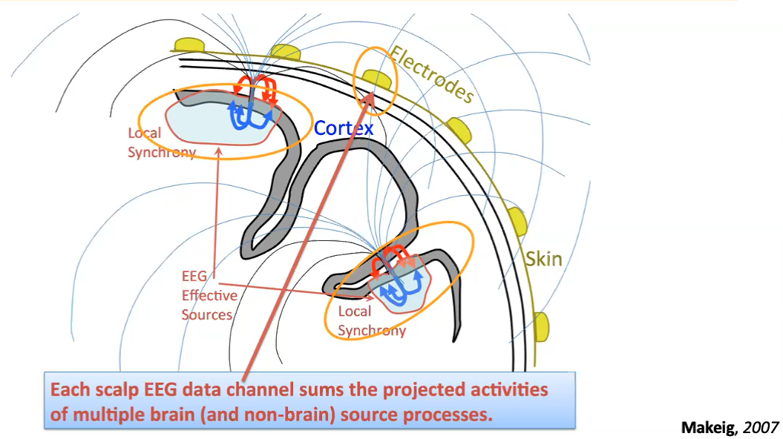
Slide taken from Dr. Jan Wessel’s Neural Field Potentials course
Notes:
Implication of inverse problem - Infinite number of configurations of dipoles that could result in some recorded EEG activity
Discuss orientation of dipoles, fields
Can’t pick up all signals (not all are strong enough)
Determinants of inclusion in LFP: synchrony of firing of a large population of neurons and alignment of neurons (affects the location of the sink/source of the dipole) and alignment of dipoles (which can depend on other things)

Slide 3
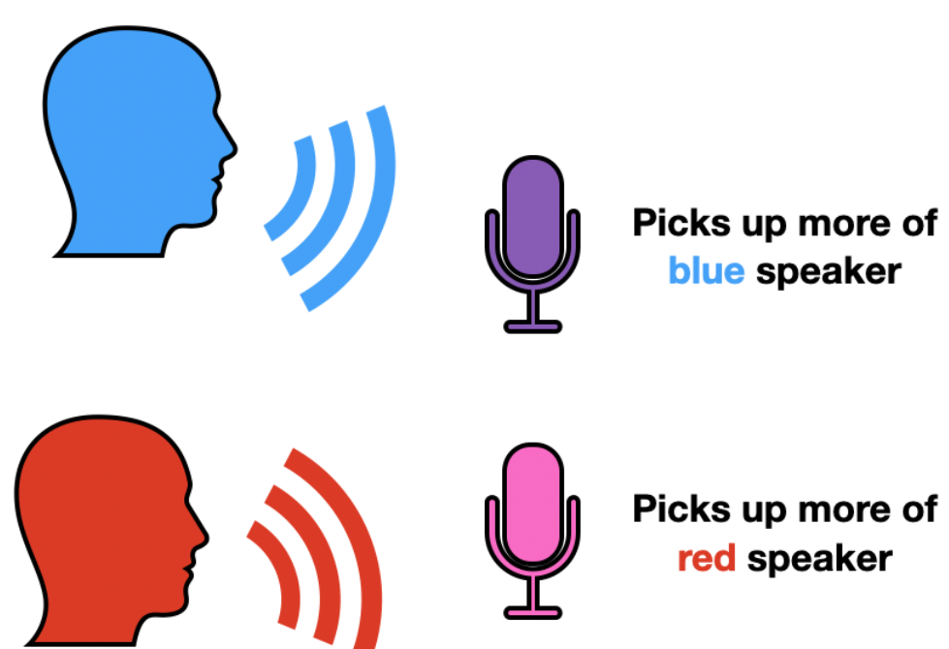
Cocktail Party Problem
Image source: https://towardsdatascience.com/independent-component-analysis-ica-a3eba0ccec35
Notes:
Party with lots of people talking so you need to parse out sources of sounds, which each source is representing something unique.
2 people in the party, 1 mic close to person A and 1 mic close to person B
Both mics pic up both voices, but at different intensities based on distance between the voice and the mic
How do we separate the voices?

Slide 4
Cocktail Party Problem: Solved with ICA
Blind source separation
Independent component analysis (ICA) – separates a multivariate signal into subcomponents
Assumes statistical independence of components
Notes:
Blind source – source is original signal like speaker; blind that we know little on the mixing matrix (we don’t know what signals are coming from where)
ICA is a generative model, meaning it describes how the observed data are generated by a process of mixing the components
Independent components are latent variables
Mixing matrix is unknown

Slide 5
ICA
Number of inputs and outputs are the same
Assumptions:
Statistical independence of latent components
Non-Gaussianity of latent components
Notes:
Outputs are mutually independent and there is no obvious way to drop components
Independent – information about x does not give you information about y
Gaussianity can be thought of as quantifying how far the distribution of a random variable is from being Gaussian
Ex: kurtosis
If the sum of 2 independent random variables has a distribution closer to Gaussian than either of the original variables
The least gaussian signal components are likely closest to the original source signal configuration
Why not use kurtosis instead of independence?
Kurtosis is more sensitive to outliers and with more than one gaussian source, it wouldn’t be distinguishable from other gaussian sources

Slide 6
But What About PCA?
Principal Component Analysis (PCA) – used to compress information for dimensionality reduction
ICA separates information
Notes:
ICA – number of inputs = number of outputs
PCA – number of inputs > number of outputs

Slide 7
Re-Referencing Data
We will compute the average reference
Only works for high density EEG caps (like 64 channel EEG caps)
Notes:
Rereferencing data can be done by measuring an electrically neutral part of the head (earlobe or mastoid) with the caveat being there are no true electrically neutral parts of the brain. Like computing average reference, this is comparing the brain against itself
Reference electrode is called the common reference for the data if all the channels use this same reference. Typically, this is the mastoid
Rereferencing the data is going to compute an average reference and this is particularly well suited to eeg caps with lots of electrodes (not the 10-20 system)
For each electrode, it removes the data from electrode from the data, computes the average across all other 63 electrodes, then subtracts
Each signal becomes the signal in relation to the rest of the scalp

Slide 8
ICA Limitations
Overfitting
Underfitting
Disregard to temporal order of signals
Blind towards source signal power
Notes:
Overfitting – not as many source signals in data as are being extracted
ICA will then split one source into several components
Blinks get split first but some people have funky different blink types
How might you address overfitting? This is a trick question.
Underfitting – more source signals in data than are being extracted
ICA is blind to source signal power
ICA disregards temporal ordering of signals, assuming samples to be independent over time (think connectivity and how this could pose an issue)

Slide 9
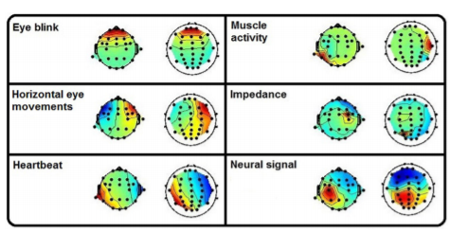
(Radüntz et al, 2017)
Notes:
Doesn’t show saccades
Use topos to make hypotheses about components to remove, then check in the plot for characteristic signatures of that artifact at some

Slide 10
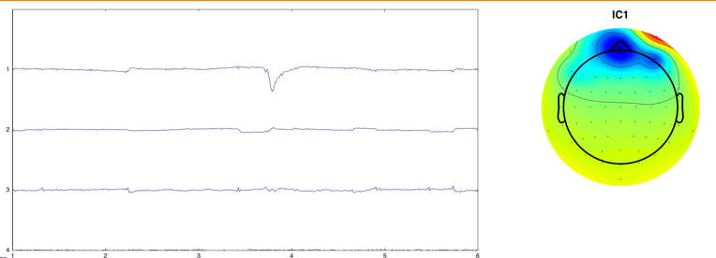
Eye blinks
(Dr. Wessel’s NFP course slideshow #5, 2021)

Slide 11
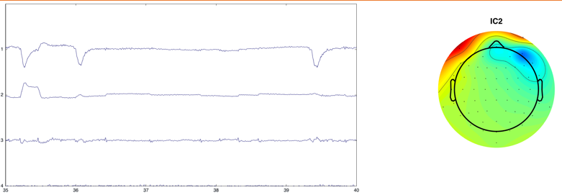
Saccades
(Dr. Wessel’s NFP course slideshow #5, 2021)

Slide 12
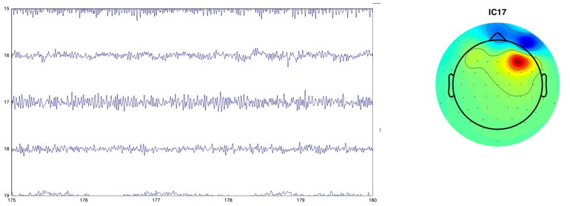
Electrode Artifacts
(Dr. Wessel’s NFP course slideshow #5, 2021)

Slide 13
I = V/R and Friends
Ohm’s Law
Only applicable to simple circuits
Kirchhoff’s Voltage Law
The algebraic sum of the products of I and R in each part of a closed circuit is equal to the algebraic sum of the emfs in that closed circuit
Notes:
DID NOT COVER TO AVOID POTENTIAL CONFUSION
Average reference rests on idea that there are outward positive and negative currents summed across the entire sphere (brain) and they will sum to 0 because of Ohm’s law
Think theoretically here. How many familiar with Kirchoffs Laws?
The current (I) through some conductor between two spatially disparate points is directly proportional to the voltage across the two points. Resistance is a constant
I = current (stream of charged particles moving through an electrical conductor or space; conductor has some resistance R dictated by properties of the conductor, V = voltage (difference in electric potential between two points; defined as the work needed per unit of charge to move a test charge between the two points)
Kirchhoff’s current law: the algebraic sum of currents meeting at some junction in a circuit is zero
Kirchhoff’s voltage law: the algebraic sum of the products of resistance and current in each part of any closed circuit is equl to the algebraic sum of the emfs in that closed circuit; consequence of the conservation of energy
appreciate the necessity for re-referencing data theoretically
There are different ways of going about re-referencing, but for the application of ICA, it does not matter as much.

