Slide 1




Git and Visual Studio Code Workflow for Open Source Development
BrainHack Vanderbilt

Slide 2

What is Git and GitHub?
Git: Version control system used to track code history and offers the ability to coordinate code development between multiple programmers
GitHub: Hosting platform for Git Projects online

Slide 3


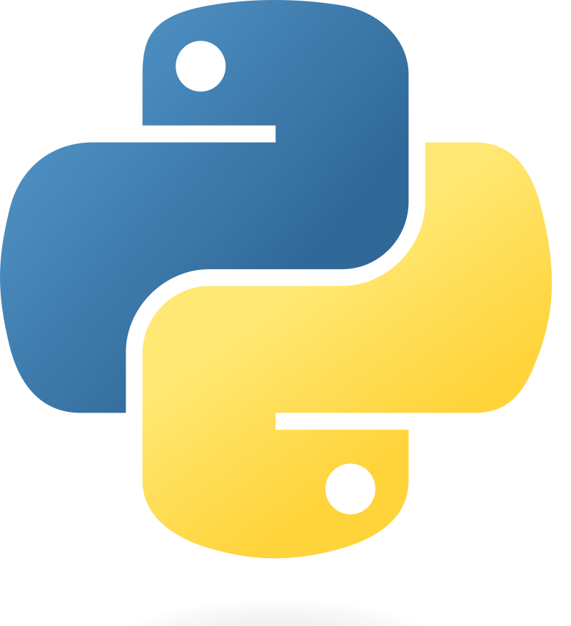
What is Visual Studio Code?
Virtual Studio Code (aka VSCode) is an Integrated Development Environment that has many advantages:
Integrated Git Support
Cross Platform Compatibility
Support for Multiple Languages
Remote Desktop Access
Extensions!!

Slide 4
Installation
Visual Studio Code: https://code.visualstudio.com/download
Git: https://www.git-scm.com/downloads

Slide 5
Open Source Development with Git
Fork and Clone
Branch
Make Edits
Commit and
Push
Open
Pull Request

Slide 6
Fork and Clone
Find a public GitHub repository
Fork the repository to your own account
Clone it to your local computer
git clone [url of forked repository]

Slide 7

Branch
Creates a new parallel workstream for you to make edits without disrupting the main workstream
Should always be used in open source development for version control
git checkout -b [name of new branch]

Slide 8
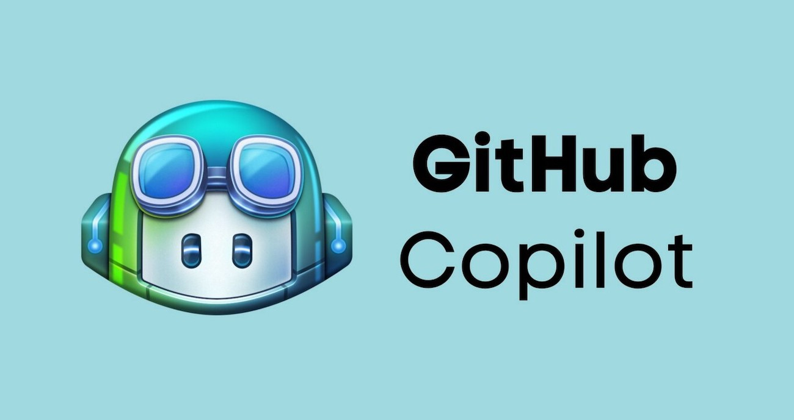
Making Edits: GitHub Copilot
Built-in AI coding assistant in VSCode
Install through GitHub Copilot Extension in VSCode. Free for all students
Think ChatGPT, but it already has access to all of your code!
Setup Instructions: https://techcommunity.microsoft.com/t5/educator-developer-blog/step-by-step-setting-up-github-student-and-github-copilot-as-an/ba-p/3736279

Slide 9
Commit and Push
1) Stage all of your edited files
2) Commit your changes
3) Push your commit to your remote forked repository
git add .
git commit -m “[commit message]”
git push -u origin [name of branch]

Slide 10
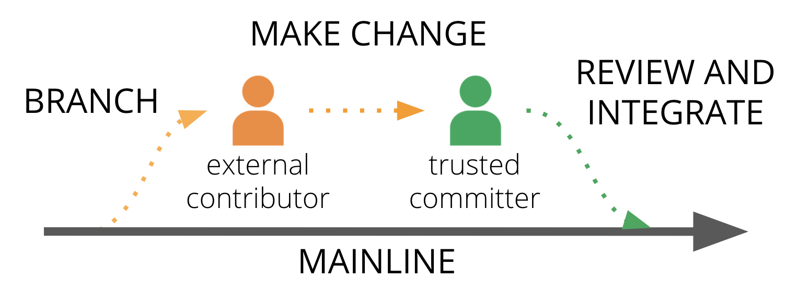
Open Pull Request
Allows the owner of the original repository to review changes that you have made. Once approved, your changes can be reflected in the original repository!

Slide 11
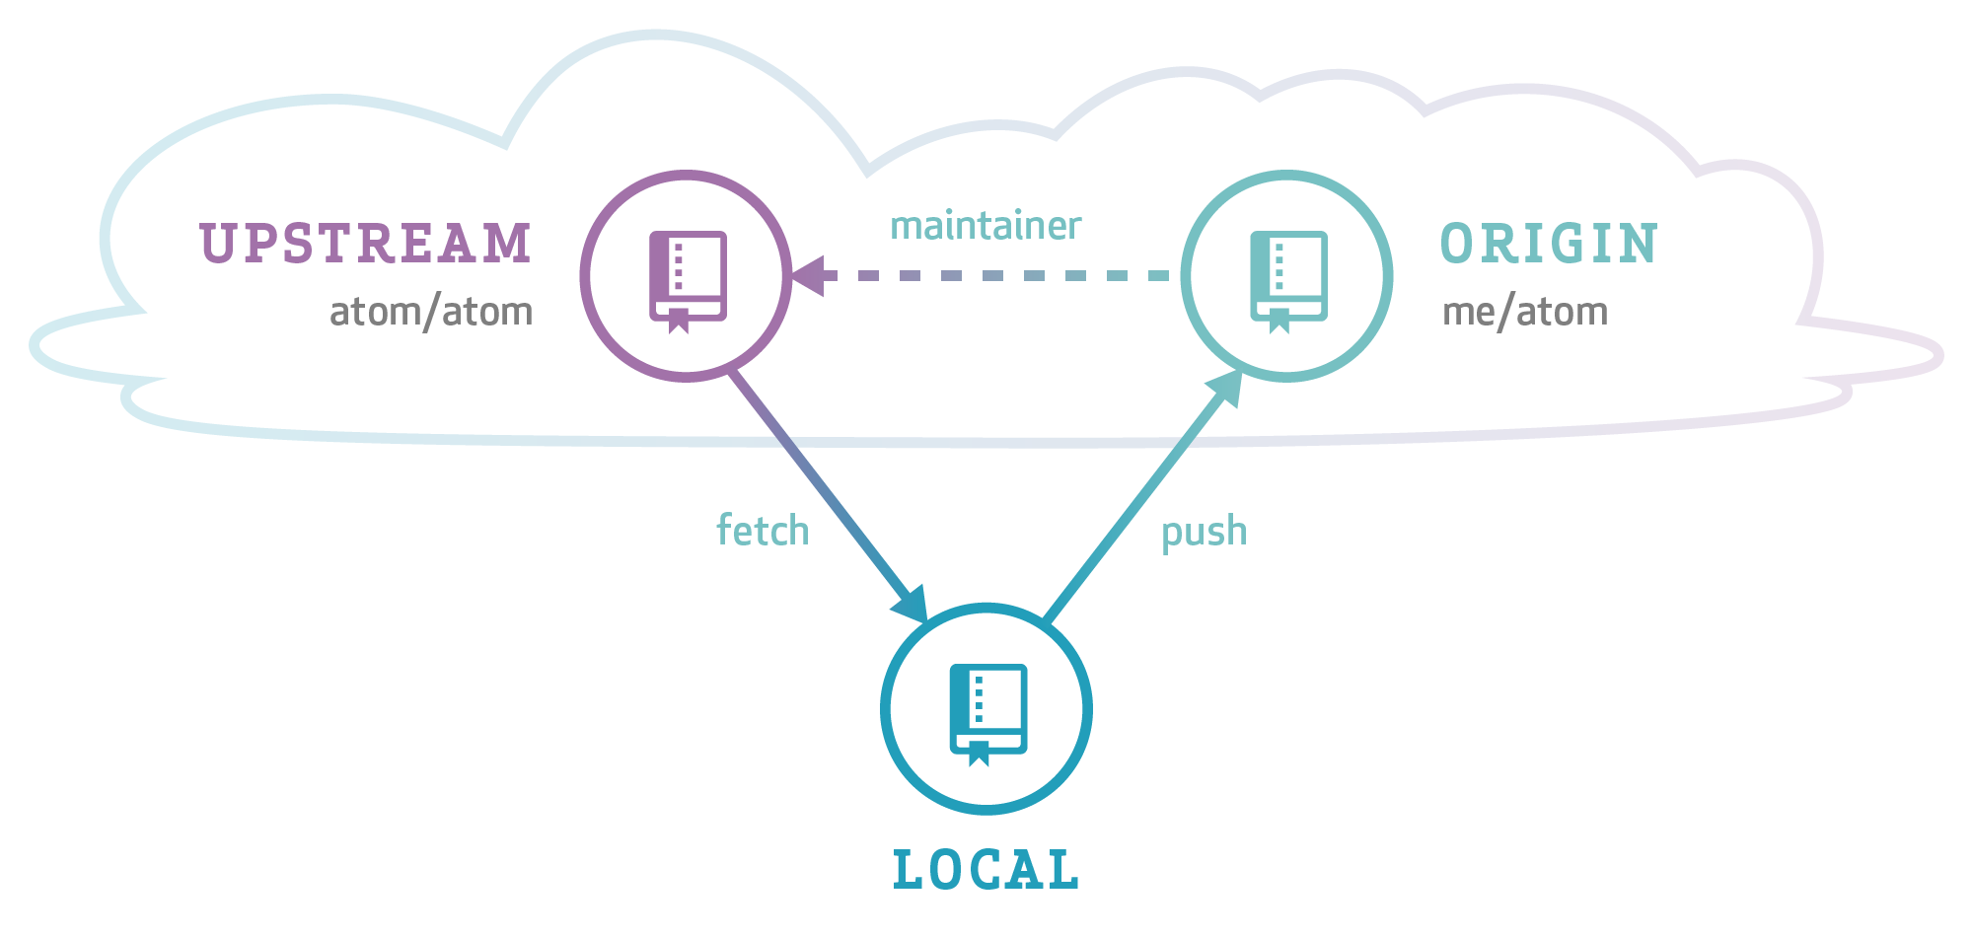
Extra: Syncing Forked Repo with Original
Allows you to keep up-to-date with changes that have been made in the original repository in case someone else made another contribution.
Store changes in original repository to “upstream” branch
Add changes on top of your existing work
git remote add upstream [url of original repository]
git fetch upstream
git rebase upstream/master

Slide 12
How to Contribute to a BrainHack Project
Take a look at the list of projects that you find interesting and refer to their github repos: https://github.com/brainhack-vandy/projects?tab=readme-ov-file
Follow any onboarding instructions and make sure that you join the project’s channel on discord!
Fork, clone, make edits, push, and open pull requests!

