Slide 1


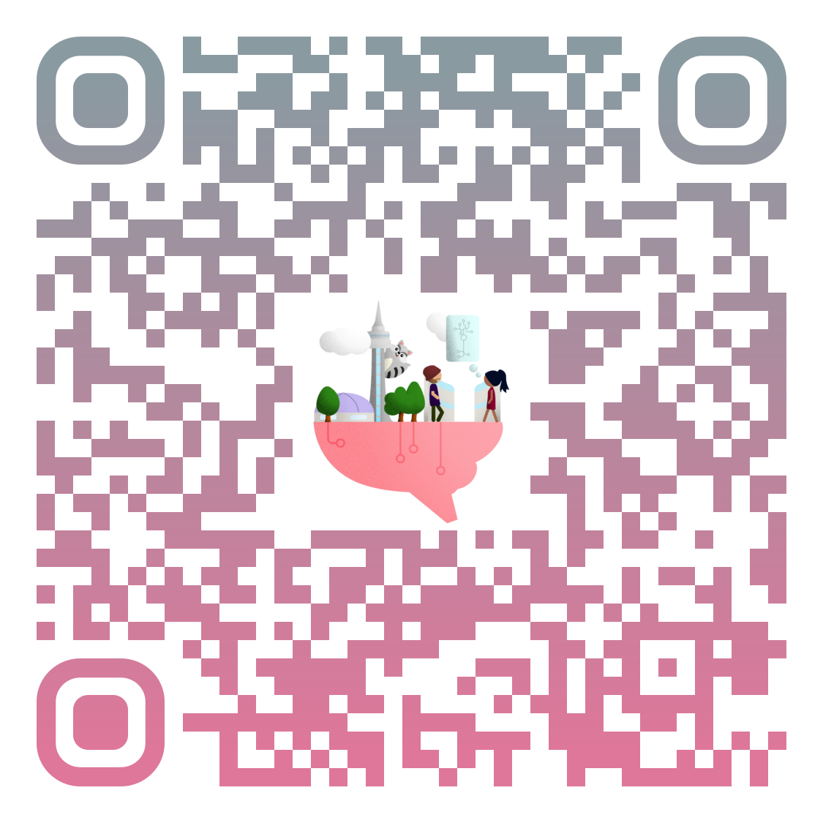




If you are interested in brain or brain research,
come join us at BrainHack Global @ Toronto to
learn about brain,
code about brain,
work with other beautiful brains,
challenge your brain,
and contribute to research for brain.
You can come with ideas, with projects,
or just with curiosity.
Mark your calendar!
Registration will open soon!
Toronto, Dec 11-13
@ SickKids
Visit our website
for details and updates

