Slide 1


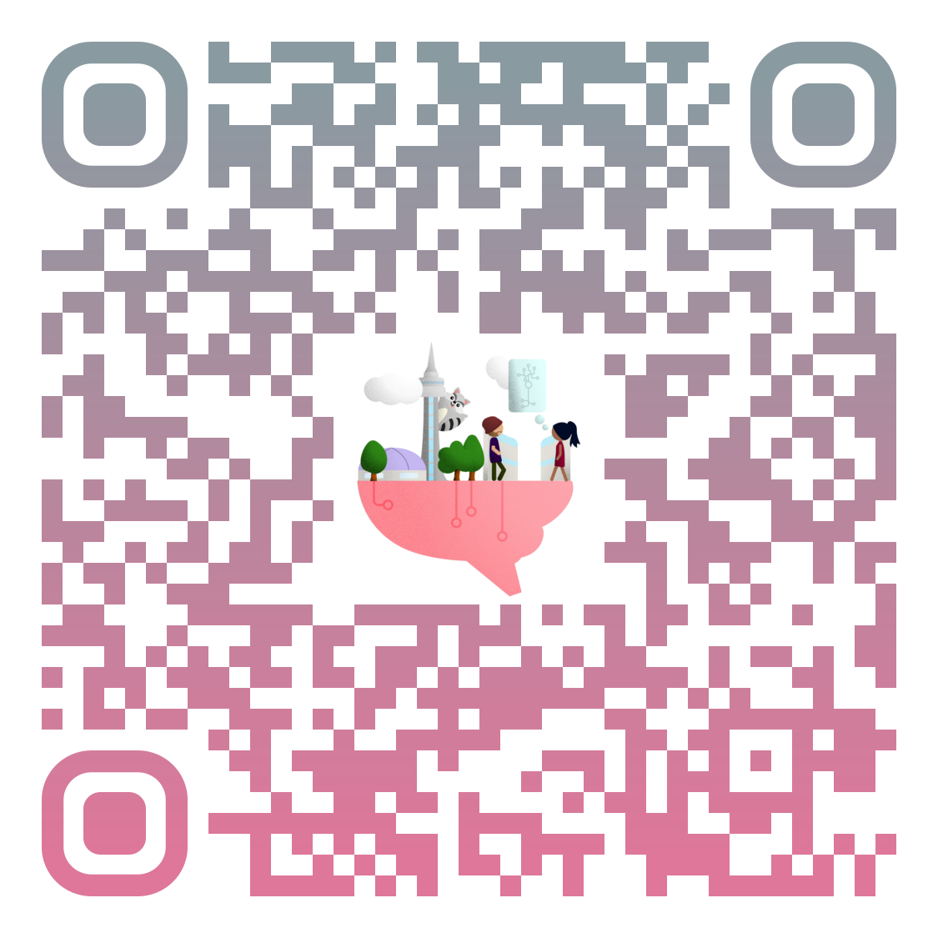




If you are interested in the brain or brain research,
come join us at BrainHack Global @ Toronto to
learn about the brain,
code about the brain,
work with other beautiful brains,
challenge your brain,
and contribute to research for the brain.
You can come with ideas, with projects,
or just with curiosity.
Mark your calendar!
Registration will open soon!
Toronto, Dec 11-13
@ SickKids
Visit our website
for details and updates

