Slide 1
FINAL DESIGN PROJECT 2026
Vitality Watchdog System
Presented by Orien S. Harichand (222012115)
Supervisor: Prof T. quazi

Slide 2
TABLE OF CONTENTS
03
04
05
06
Conceptual block diagram
Project Specifications
01
02
An abstract overview of how the system works in operation
Specifications and target metrics the project must meet and their contribution to project success
Project work
GA fulfillment
Work completed thus far and outstanding work to do
What has been done and what is outstanding to meet the criteria of GA1, GA2 and GA3
Work plan
References
Expected timetable and propose plan to finish the project

Slide 3
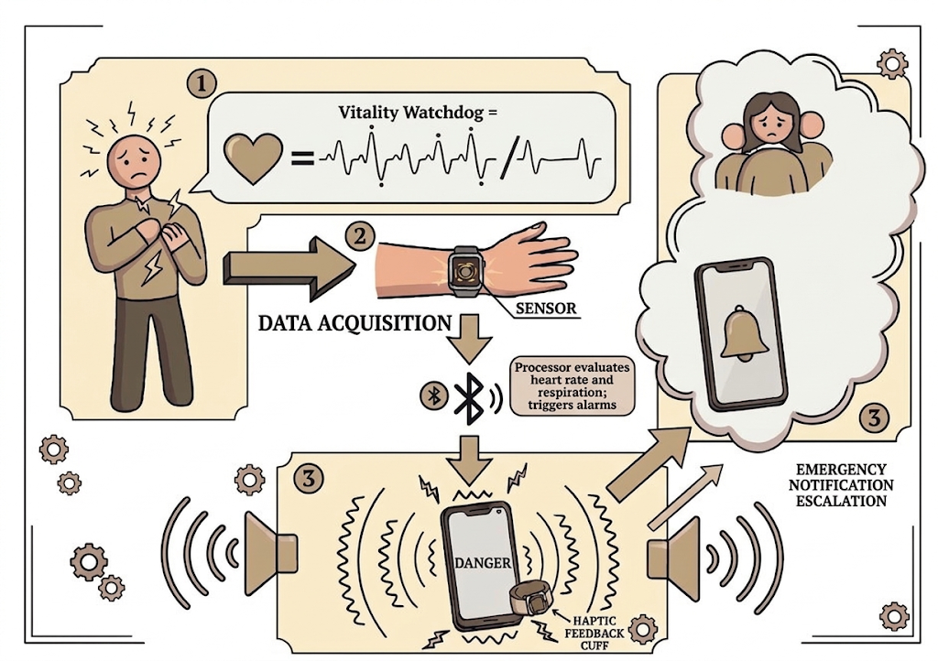
Conceptual block diagram

Slide 4
Project Specifications (summary of most important)
The system must implement rolling buffers to store data continuously | The system must classify stress states to an accuracy of 70%//ref
The system must successfully identify deviated heart rates sustained for 5 minutes//ref | Successful mobile UI updates of stress state
Push notifications to user’s mobile device upon detection of moderate, severe or extreme stress | Audible and haptic alerts for 5 to 10 seconds upon severe/extreme stress detection //ref
Remote notifications are sent out to selected emergency contacts when extreme stress states are detected. | The system pairs successfully via Bluetooth to the hardware sensor
The system must be ergonomic to use

Slide 5
Performance metrics of system

Slide 6
The project so far

Slide 7
What lies ahead

Slide 8
GA’s: What’s been done

Slide 9
GA’s: What’s left to do

Slide 10
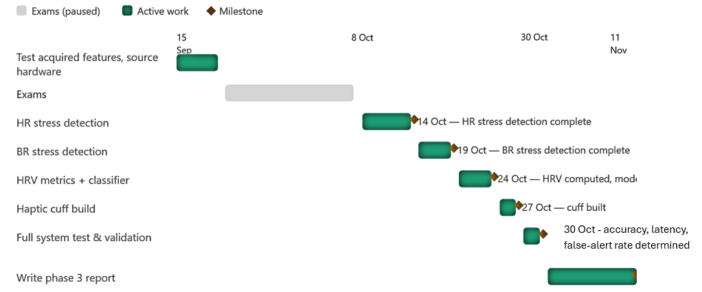
Work Plan

Slide 11
References

