Slide 1
Integrating the Brain Imaging Data Structure with RT-Cloud, a Cloud Platform for Real-Time fMRI Analysis
Stephen Polcyn '21 | COS (BSE)
Advisors:
Professor Ken Norman, PNI/PSY (Primary Advisor)
Professor Kai Li, COS (Second Reader)
Grant Wallace, COS (Project Mentor)

Slide 2
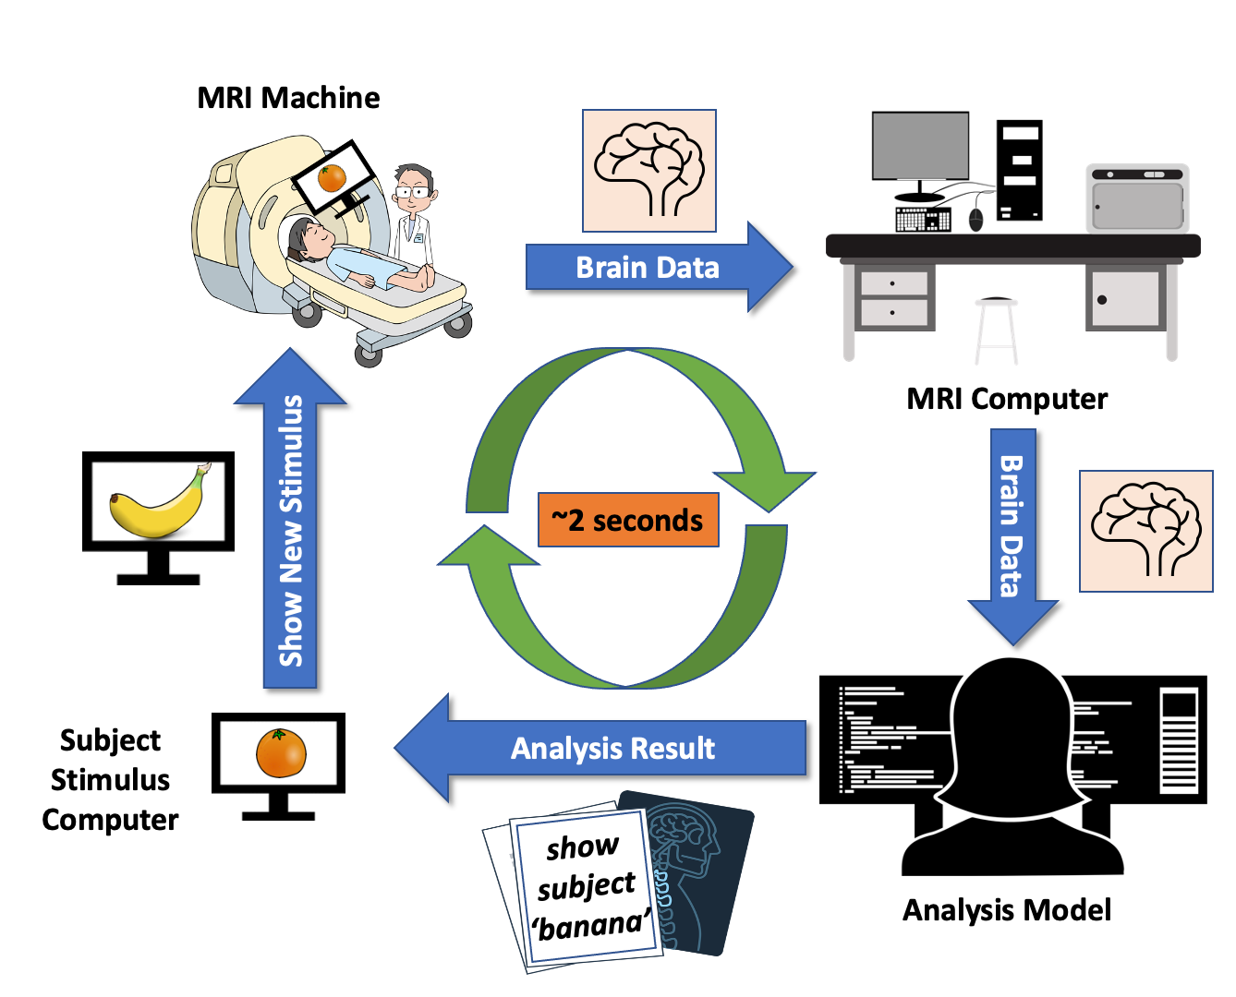
Real-Time fMRI (RT-fMRI) Overview

Slide 3
Real-Time fMRI (RT-fMRI) Overview
Challenges:
Timing
Complexity
Collaboration

Slide 4
Compatibility Advantage:
Both Users and Software Understand the Format
Users can...
Understand system input and output
Link system with standards-compatible software
Easily share data with external collaborators
Notes:
When users can understand the system I/O, link the system with their existing software, and easily share data, we reduce the amount they must learn and therefore the complexity of use, and we increase opportunities to collaborate by sharing software and data with other collaborators.
Additionally, developer resources can be focused on creating performant software targeting this standard, helping with overall timing issues.

Slide 5
Compatibility Advantage:
Both Users and Software Understand the Format
Users can...
Understand system input and output
Link system with standards-compatible software
Easily share data with external collaborators
Developers can...
Quickly develop new features
Maintain system for long-term
Notes:
When users can understand the system I/O, link the system with their existing software, and easily share data, we reduce the amount they must learn and therefore the complexity of use, and we increase opportunities to collaborate by sharing software and data with other collaborators.
Additionally, developer resources can be focused on creating performant software targeting this standard, helping with overall timing issues.

Slide 6
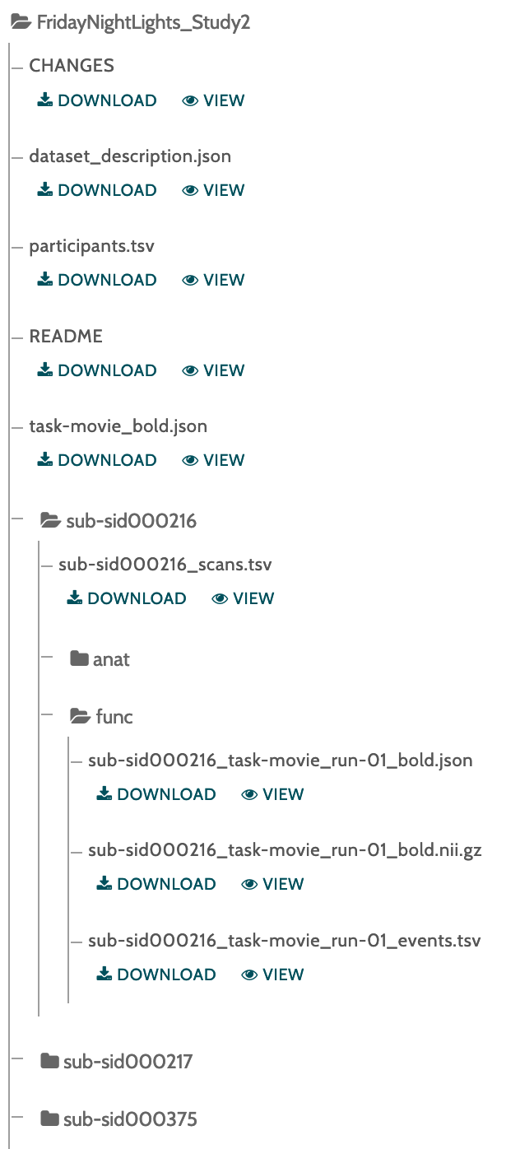
Brain Imaging Data Structure (BIDS):
A standardized, hierarchical format for storing brain imaging data and metadata.
Sample BIDS Dataset from OpenNeuro
Notes:
Why BIDS?
Sharing/maintainability (in lab, external collaborators, future, openneuro, publishing)
Software ecosystem (BIDS apps, analysis)
In brief:
2) Easy Setup: The system can be linked together with other, familiar tools that support the data standard.
3) User Friendly: Users know the data format to input to the system, and they understand its output.
4) Variety of Analysis Methods: As we'll see, the there are existing software packages that do analysis for data formatted in this way, as well as a whole class of software called 'BIDS Apps'

Slide 7
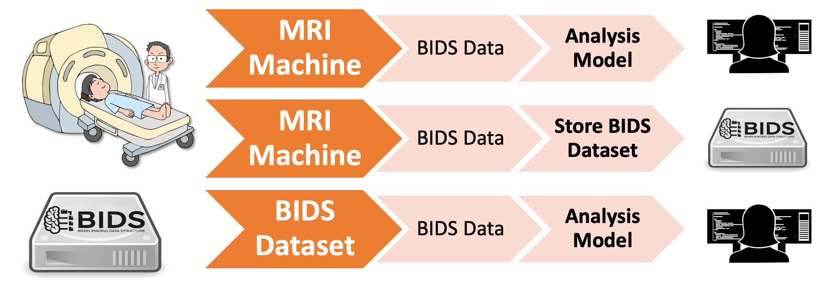
Three BIDS Workflows to Support:
Live fMRI
Testing

Slide 8
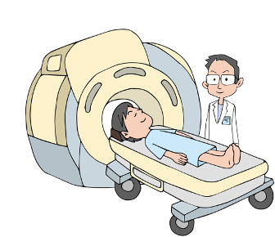

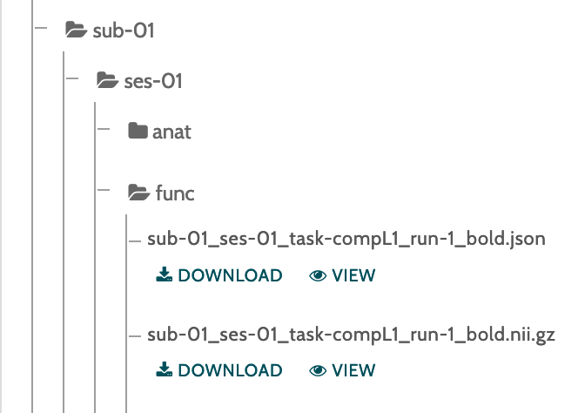

Stream
Data
From MRI
From Dataset
Notes:
These 3 workflows can be thought of as Stream, Append, and Query.
We have 3 operations to enable: Stream, Append, and Query.
Stream:
Both from MRI and from an existing dataset. From an MRI is relatively straightforward, that's what we want to do when we're running an experiment. However, we also want to be able to stream from a dataset, as that enables us to re-do analyses after data collection, to test our analysis method before data collection, to run our analysis method on other real-time datasets, and to reproduce results that other scientists got.

Slide 9
Stream
Data
From MRI
From Dataset
Append
Data
Store Brain Data In Dataset
Notes:
These 3 workflows can be thought of as Stream, Append, and Query.
We have 3 operations to enable: Stream, Append, and Query.
Stream:
Both from MRI and from an existing dataset. From an MRI is relatively straightforward, that's what we want to do when we're running an experiment. However, we also want to be able to stream from a dataset, as that enables us to re-do analyses after data collection, to test our analysis method before data collection, to run our analysis method on other real-time datasets, and to reproduce results that other scientists got.

Slide 10
Stream
Data
From MRI
From Dataset
Append
Data
Store Brain Data In Dataset
Query
Data
Get Brain Data From Dataset
Notes:
These 3 workflows can be thought of as Stream, Append, and Query.
We have 3 operations to enable: Stream, Append, and Query.
Stream:
Both from MRI and from an existing dataset. From an MRI is relatively straightforward, that's what we want to do when we're running an experiment. However, we also want to be able to stream from a dataset, as that enables us to re-do analyses after data collection, to test our analysis method before data collection, to run our analysis method on other real-time datasets, and to reproduce results that other scientists got.

Slide 11
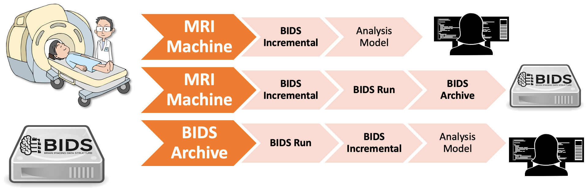
Three BIDS Workflows, With Classes
Notes:
My thesis focused on writing the code that would enable each of these workflows to be done simply and efficiently, and I'll spend the remainder of the presentation describing the classes I designed and implemented to enable these workflows.

Slide 12
Incremental Streaming:
BIDS Incremental

Slide 13
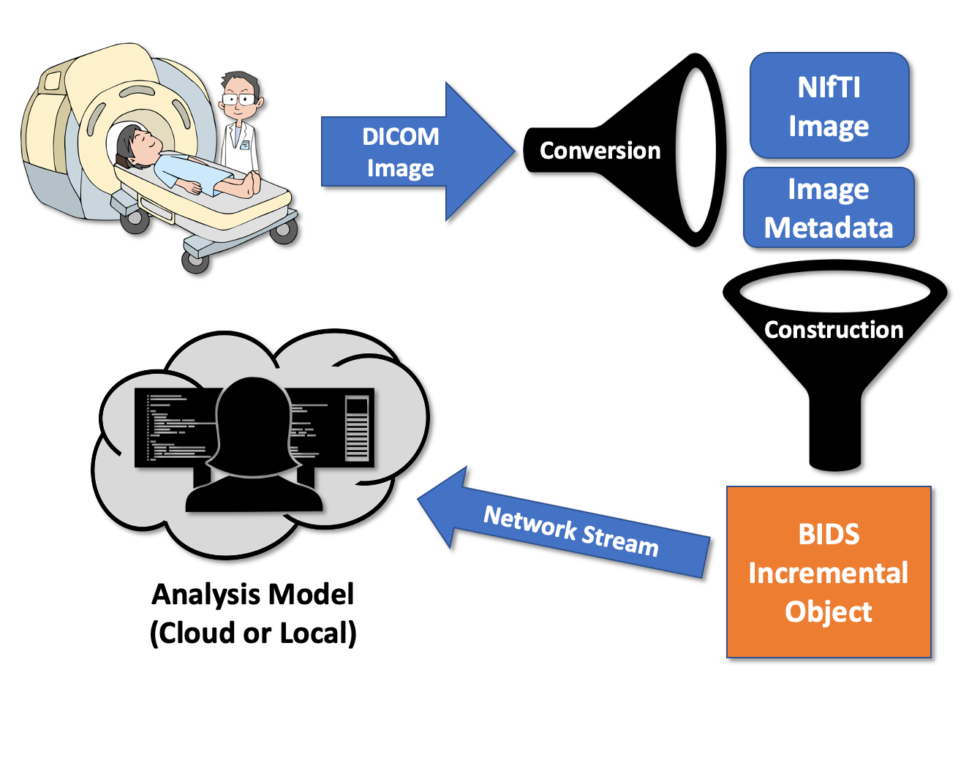
BIDS Incremental: Streaming BIDS Data
Key Properties
In-memory
Hold image, metadata
Write to disk
Serialize
Notes:
Key elements to take away is this data structure is in memory, holds an image and metadata, can write the data as a BIDS-formatted dataset to disk, and can be serialized for network transfer.

Slide 14

✅
✅
✅

Slide 15
Run Streaming:
BIDS Run

Slide 16
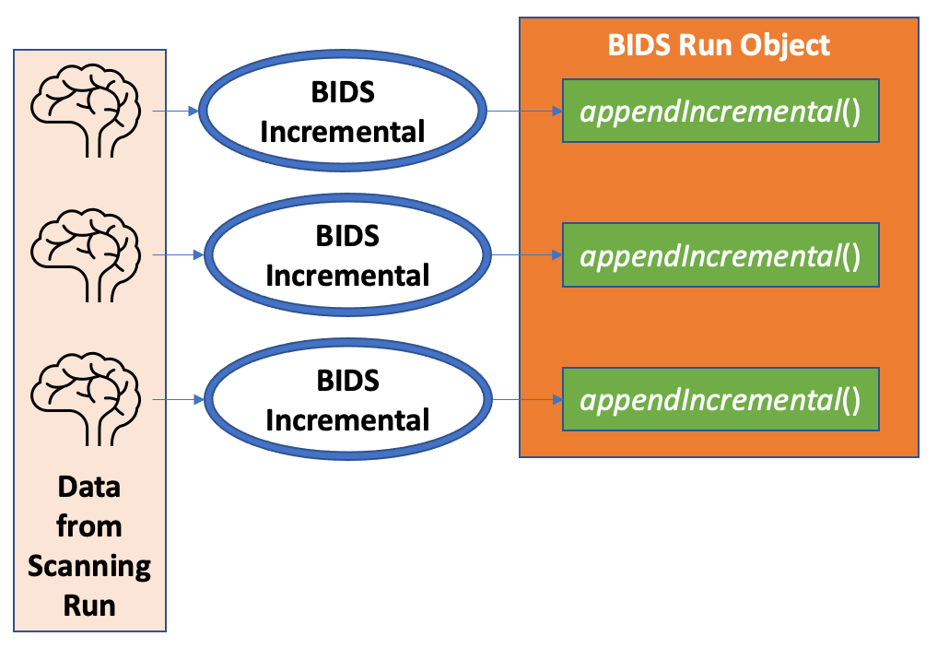
BIDS Run: Streaming Full Run of BIDS Data
Key Properties
In-memory
Many images
Deduplicated
Get, append Incrementals
Notes:
Deduplicated shared data

Slide 17
✅
✅
✅
✅
✅

Slide 18
✅
Stream
Data
From MRI
From Dataset
Append
Data
Store Brain Data In Dataset
Query
Data
Get Brain Data From Dataset
Notes:
We have 3 operations to enable: Stream, Query, and Modify
Stream:
Both from MRI and from an existing dataset. From an MRI is relatively straightforward, that's what we want to do when we're running an experiment. However, we also want to be able to stream from a dataset, as that enables us to re-do analyses after data collection, to test our analysis method before data collection, to run our analysis method on other real-time datasets, and to reproduce results that other scientists got.

Slide 19
Querying and Appending:
BIDS Archive
Notes:
It's not enough just to have a data structure that's BIDS compatible when streaming -- we need a way to add the streaming data to a permanent BIDS Archive on disk, and a way to use existing datasets as data sources.

Slide 20
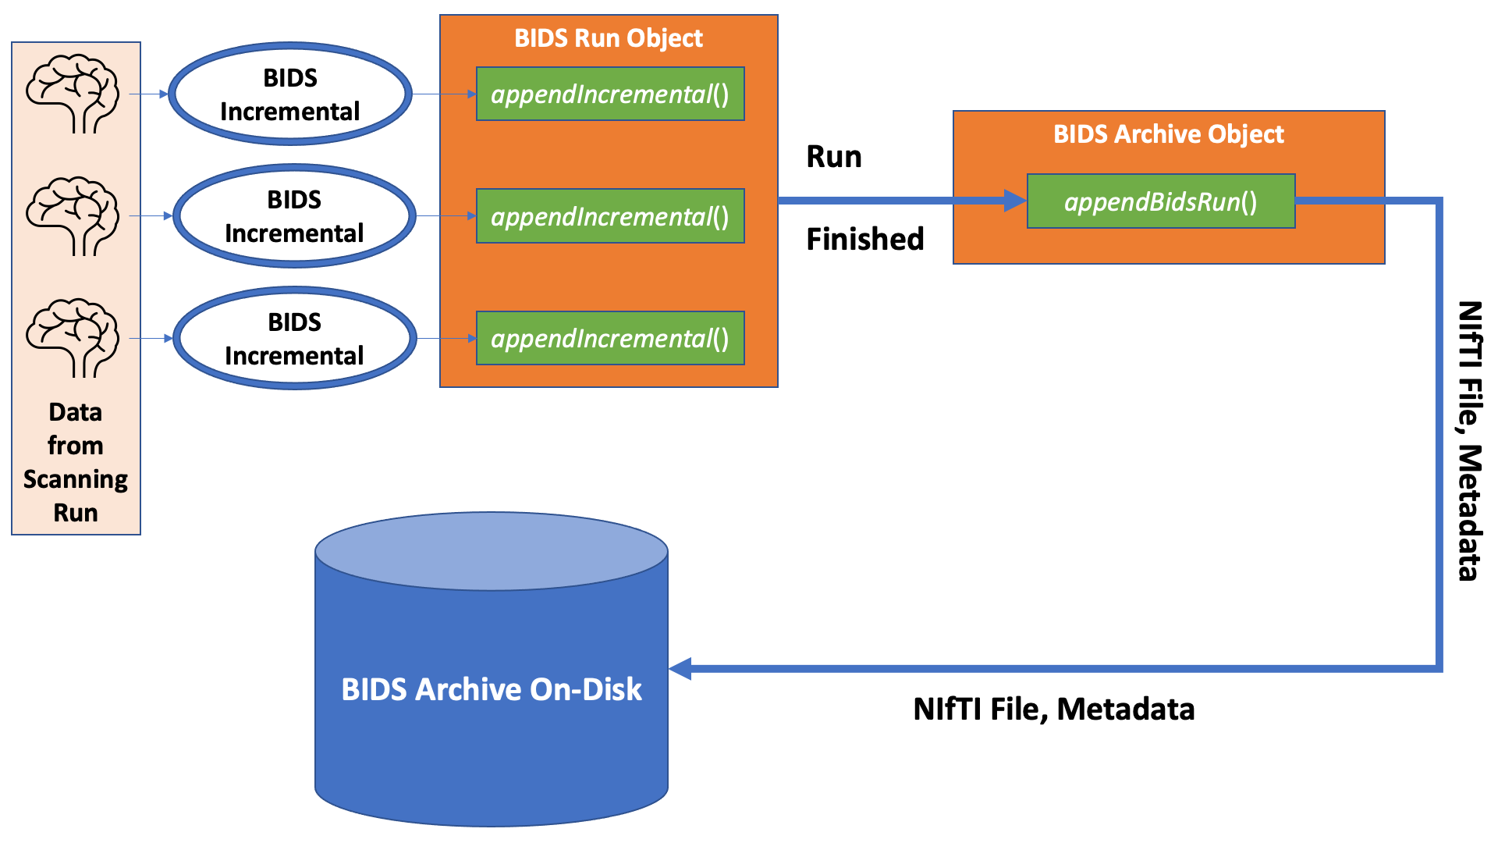
BIDS Archive: Querying and Appending to BIDS Datasets
Key Properties
Add BIDS Run
Get BIDS Run
Get images, metadata, etc.
Notes:
Add BIDS Run to dataset
Get BIDS Run from dataset
Retrieve images, events, metadata

Slide 21
✅
✅
✅
✅
✅
✅
✅

Slide 22
✅
Stream
Data
From MRI
From Dataset
✅
Append
Data
Store Brain Data In Dataset
✅
Query
Data
Get Brain Data From Dataset
Notes:
We have 3 operations to enable: Stream, Query, and Modify
Stream:
Both from MRI and from an existing dataset. From an MRI is relatively straightforward, that's what we want to do when we're running an experiment. However, we also want to be able to stream from a dataset, as that enables us to re-do analyses after data collection, to test our analysis method before data collection, to run our analysis method on other real-time datasets, and to reproduce results that other scientists got.

Slide 23
Performance Analysis

Slide 24
Test Dataset Details:
Subjects | 1
Tasks | 2
Runs | 2
Run Shape (x, y, z, t) | (84, 84, 52, 340)
Run File Size | ~500MB
Run Datatype | 32-bit Float
Notes:
Note that the data is often collected using 16bit signed integers, so these files are roughly twice the size of those files, given equivalent dimensions. This dataset was actually one of many that were tested, but due to its size, was the slowest, so I've selected it as an example of what a difficult dataset looks like and how well the system still is able to perform.
All of this was done using an AWS t3.large instance with 4vCPUs and 8GB of memory. (a "2.5GHz Intel Scalable Processor")

Slide 25
Relevant Workflow: BIDS Incremental Network Transfer

Slide 26
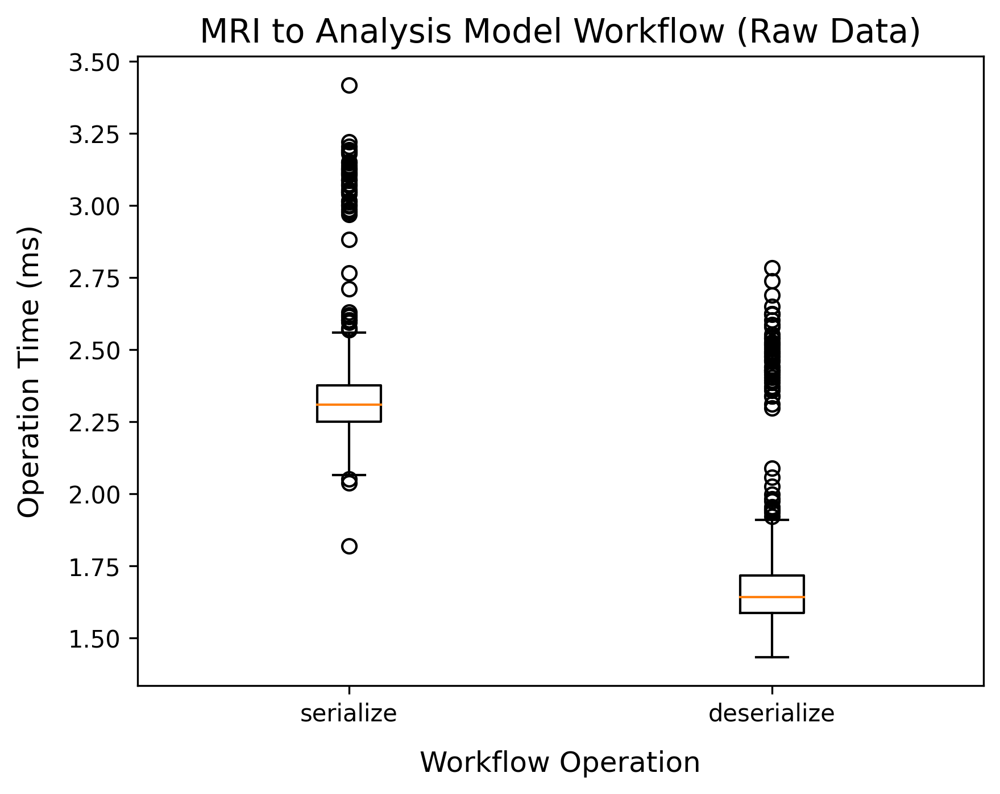
Workflow 1: BIDS Incremental Network Transfer

Slide 27
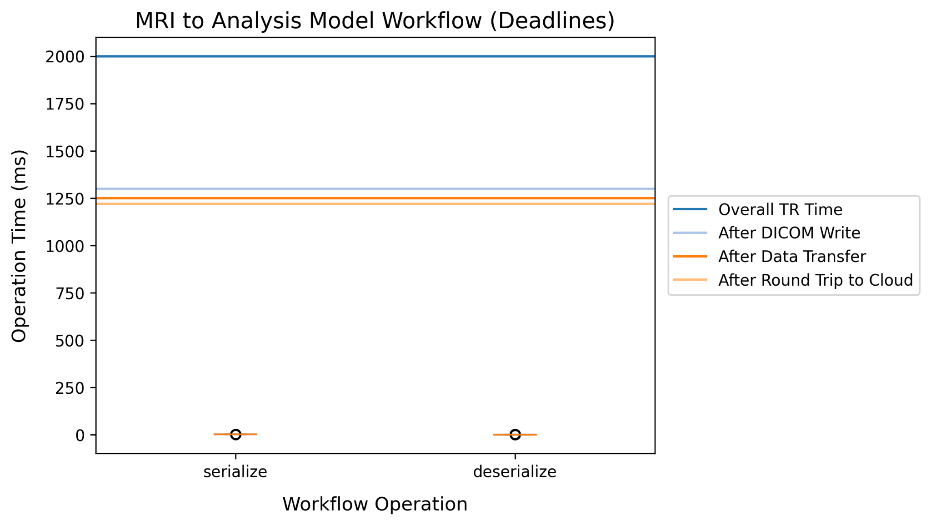
Workflow 1: Deadline Comparison

Slide 28
Relevant Workflow: Workflow 1 (Stream) with Store

Slide 29
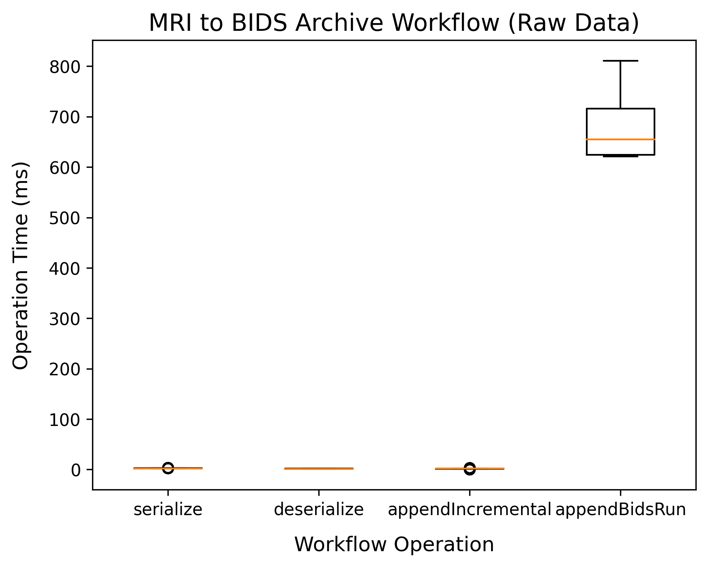
Workflow 2: Stream + Store

Slide 30
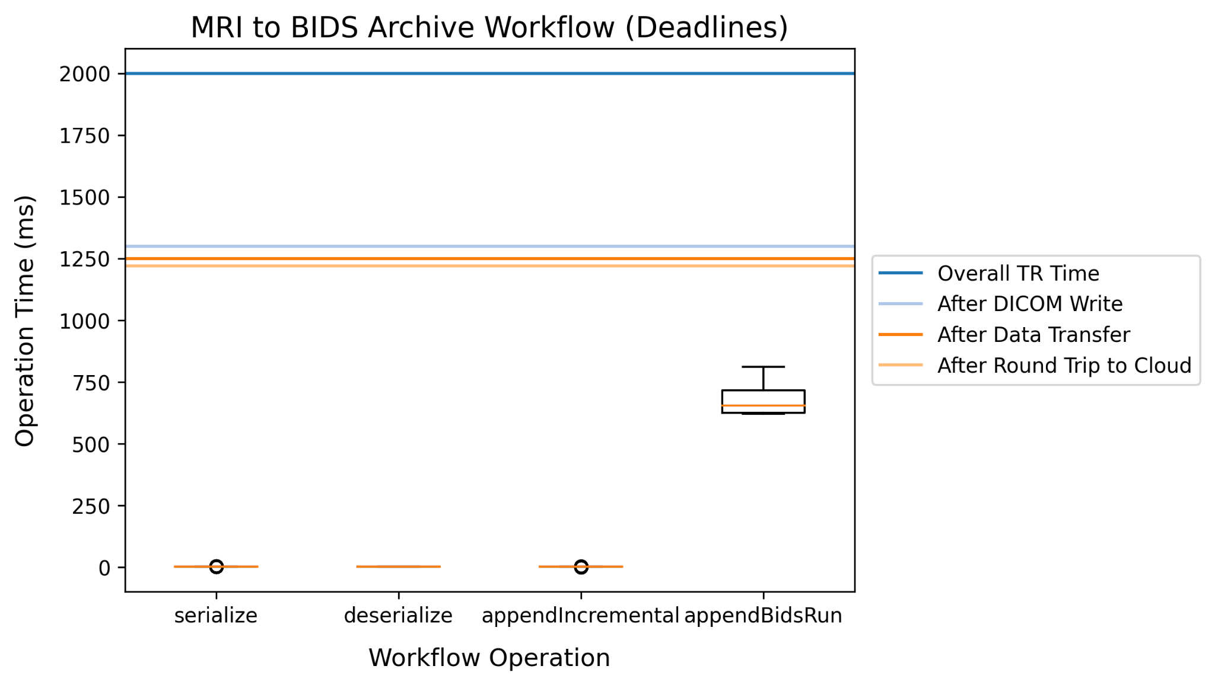
Workflow 2: Deadline Comparison

Slide 31
Relevant Workflow: Stream From Archive (Testing)

Slide 32
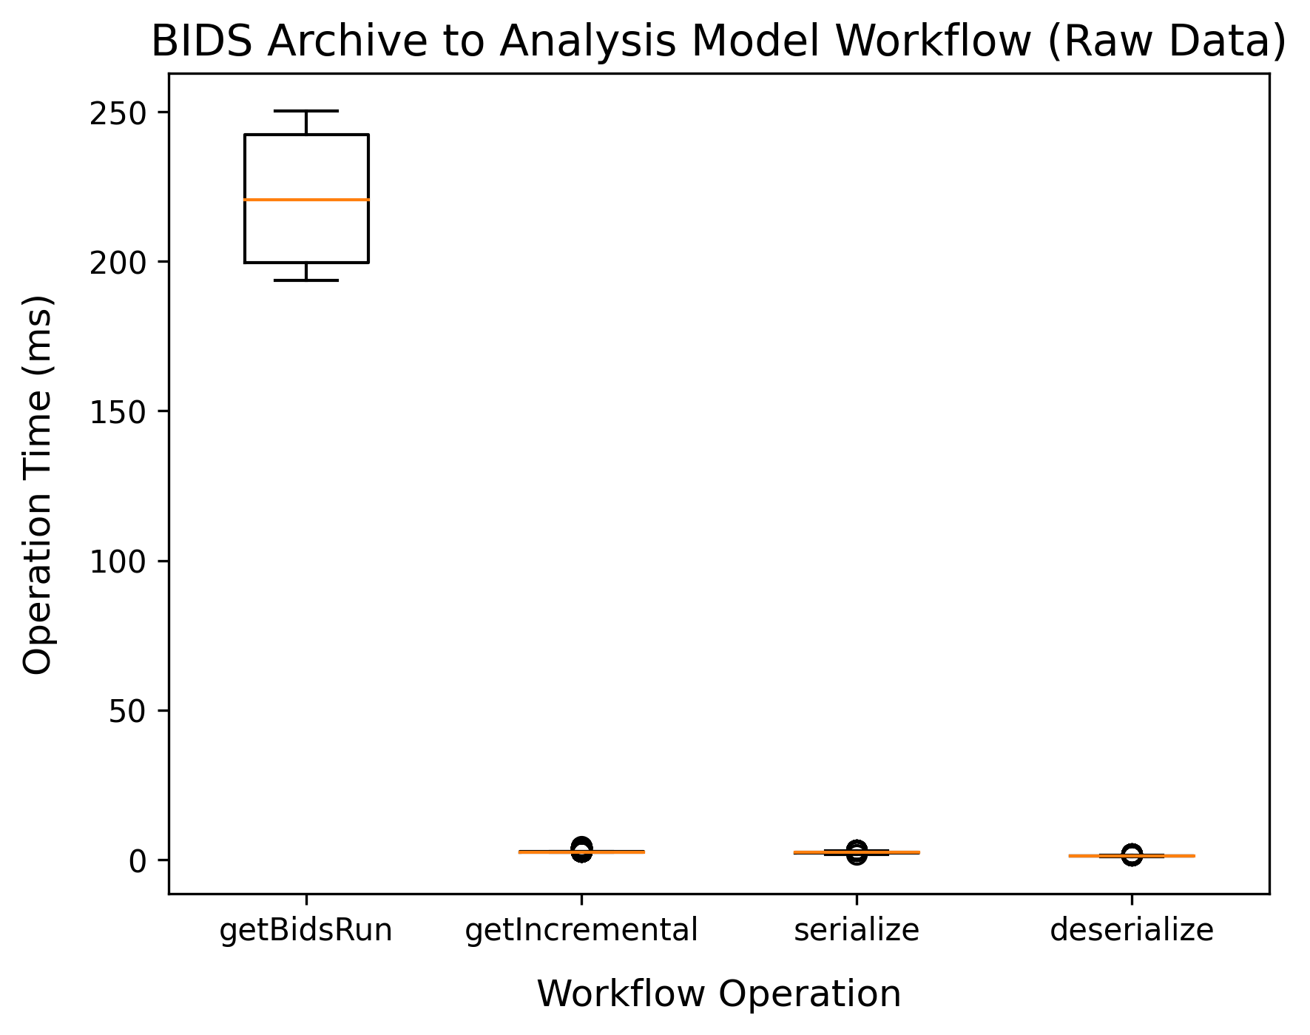
Workflow 3: Testing

Slide 33
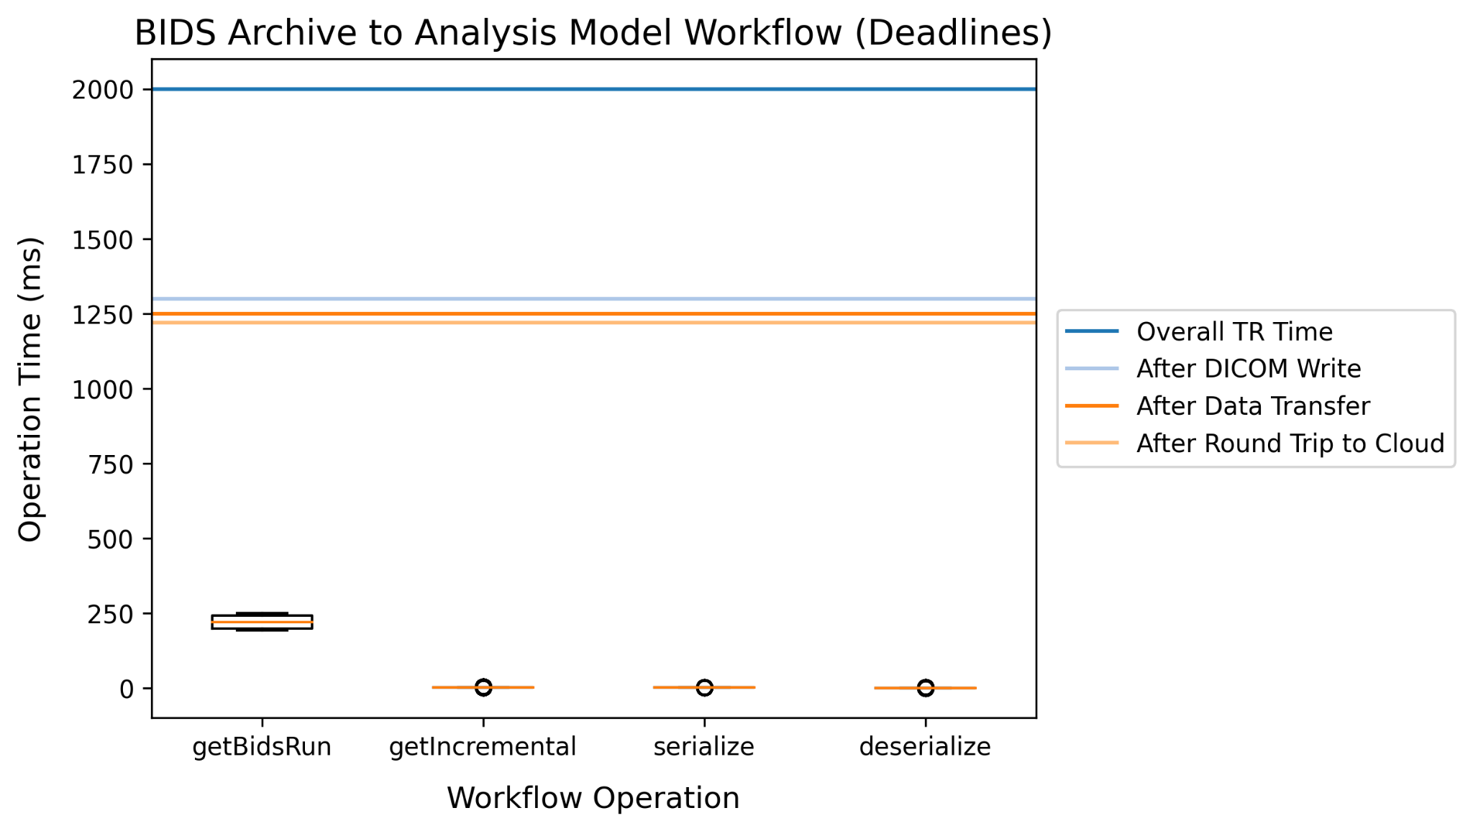
Workflow 3: Deadline Comparison

Slide 34
Workflow BIDS Compatibility
Task | BIDS Validator Error Count
BIDS Incremental writeToDisk output | 0
BIDS Archive after appendBidsRun | 0

Slide 35
Conclusion
Timing: Within deadline..................✅
Complexity: Clear classes.............✅
Collaboration: BIDS compliance...✅
BIDS compatible RT-Cloud..........✅
Live fMRI
Testing

