Slide 1



Towards Multiphase Clocking in Single-Flux Quantum Systems
Download manuscript
Rassul Bairamkulov and Giovanni De Micheli
Integrated Systems Laboratory, EPFL, Switzerland
January 24, 2024
Notes:
Do not reintroduce self if introduced by session chair

Slide 2

OUTLINE
Rapid Single-Flux Quantum
Gate-Level Pipelining
Phase Assignment
DFF Insertion
Results
Download manuscript
Notes:
Remove

Slide 3
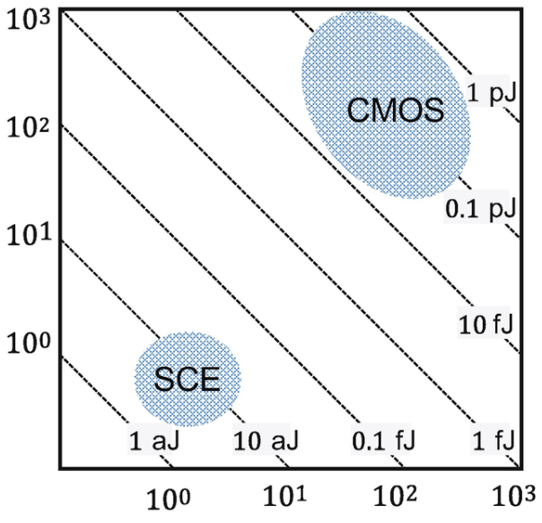
Rapid Single-Flux Quantum
Switching
power, µW
Invented in 1985 by K. Likharev and V. Semenov [1]
Superconductive technology
Cryogenic, 4.2 K
Based on SFQ pulses
Low-power
Hence low heat
Even considering refrigeration
World’s fastest digital technology
Record speed of 770 GHz [2]
Consistently achieving speeds above 10 GHz
Switching delay, ps
[1] K. K. Likharev and V. K. Semenov, RSFQ logic/memory family in IEEE TASC 1991
[2] W. Chen, et al. Rapid single flux quantum T-flip flop operating up to 770 GHz. IEEE TASC 1999.
[3] D. S. Holmes, et al. Energy-efficient superconducting computing—Power budgets and requirements. IEEE TASC 2013.
Notes:
mention pulse-based logic
mention that the plot is for single gate
Explain that presence/absence is 0/1
registers easy to do
inversion is hard
Explain gate compounding first
Traditionally - on safe side

Slide 4
RSFQ: Challenges
Fabrication technology
State of the art : 6k JJ/mm²
Compare to ~90M transistors/mm² (TSMC 7nm) [4]
Expensive memory
Poor density of inductor-based memory
Lack of compatible EDA tools
Gate-level pipelining
[4] E. Udin 2022, https://www.gizchina.com/2020/04/19/tsmc-3nm-details-announced-250-million-transistors-mm2-much-lower-power-consumption/

Slide 5
OUTLINE
Rapid Single-Flux Quantum
Gate-Level Pipelining
Phase Assignment
DFF Insertion
Results

Slide 6
Gate-Level Pipelining
Most SFQ gates are clocked
Equalize logic level of each fanin
Notes:
Do not say all gates
mention unclocked gates
For now all gates are clocked
all[most] gates
Mention that not voltage levels but SFQ pulses

Slide 7
Gate-Level Pipelining
Most SFQ gates are clocked
Equalize logic level of each fanin
s

Slide 8
Single-Phase Clocking
Path balancing with extra DFFs
s
Notes:
In general
clocking at every gate
needs sync input
I consider gate

Slide 9
SFQ Gate Timing
Asynchronous input
Synchronous output
Asynchronous input
Asynchronous output
Synchronous input
Asynchronous output
AS
AA
SA
m
s
Notes:
Add constraints

Slide 10
Asynchronous Gates
Replace AS gates with AA and SA gates
s
Notes:
In general
clocking at every gate
needs sync input
I consider gate

Slide 11
Asynchronous Gates
Replace AS gates with AA and SA gates
m
s
Notes:
In general
clocking at every gate
needs sync input
I consider gate

Slide 12
Asynchronous Gates
Replace AS gates with AA and SA gates
m
s
Notes:
In general
clocking at every gate
needs sync input
I consider gate

Slide 13
Asynchronous Gates
Replace AS gates with AA and SA gates
Fewer clock cycles
Fewer DFFs
m
s
Notes:
Remove the compounding - do not mention it

Slide 14
Multiphase Clocking
Utilize multiple clock signals
φ = 0
t
φ = 1
t
φ = 2
t
Single phase
t
Notes:
In general
clocking at every gate
needs sync input
I consider gate

Slide 15
Multiphase Clocking
Utilize multiple clock signals
ϕ = 0
t
ϕ = 1
t
ϕ = 2
t
Single phase
t
[5] X. Li, M. Pan, T. Liu, P. A. Beerel, “Multi-Phase Clocking for Multi-Threaded Gate-Level-Pipelined Superconductive Logic”, Proc. ISVLSI, 2022.
Notes:
In general
clocking at every gate
needs sync input
I consider gate

Slide 16
Multiphase Clocking
Trigger only some gates
Fewer DFFs → smaller overhead
ϕ=0
σ=0
ϕ=1
σ=1
ϕ=2
σ=2
ϕ=0
σ=3
ϕ=1
σ=4
s
[5] X. Li, M. Pan, T. Liu, P. A. Beerel, “Multi-Phase Clocking for Multi-Threaded Gate-Level-Pipelined Superconductive Logic”, Proc. ISVLSI, 2022.
Notes:
In general
clocking at every gate
needs sync input
I consider gate

Slide 17
Multiphase Clocking
Trigger only some gates
Fewer DFFs → smaller overhead
ϕ=0
σ=0
ϕ=1
σ=1
ϕ=2
σ=2
ϕ=0
σ=3
ϕ=1
σ=4
s
[5] X. Li, M. Pan, T. Liu, P. A. Beerel, “Multi-Phase Clocking for Multi-Threaded Gate-Level-Pipelined Superconductive Logic”, Proc. ISVLSI, 2022.
Notes:
In general
clocking at every gate
needs sync input
I consider gate

Slide 18
Multiphase Clocking
Trigger only some gates
Fewer DFFs → smaller overhead
ϕ=0
σ=0
ϕ=1
σ=1
ϕ=2
σ=2
ϕ=0
σ=3
ϕ=1
σ=4
s
[5] X. Li, M. Pan, T. Liu, P. A. Beerel, “Multi-Phase Clocking for Multi-Threaded Gate-Level-Pipelined Superconductive Logic”, Proc. ISVLSI, 2022.
Notes:
In general
clocking at every gate
needs sync input
I consider gate

Slide 19
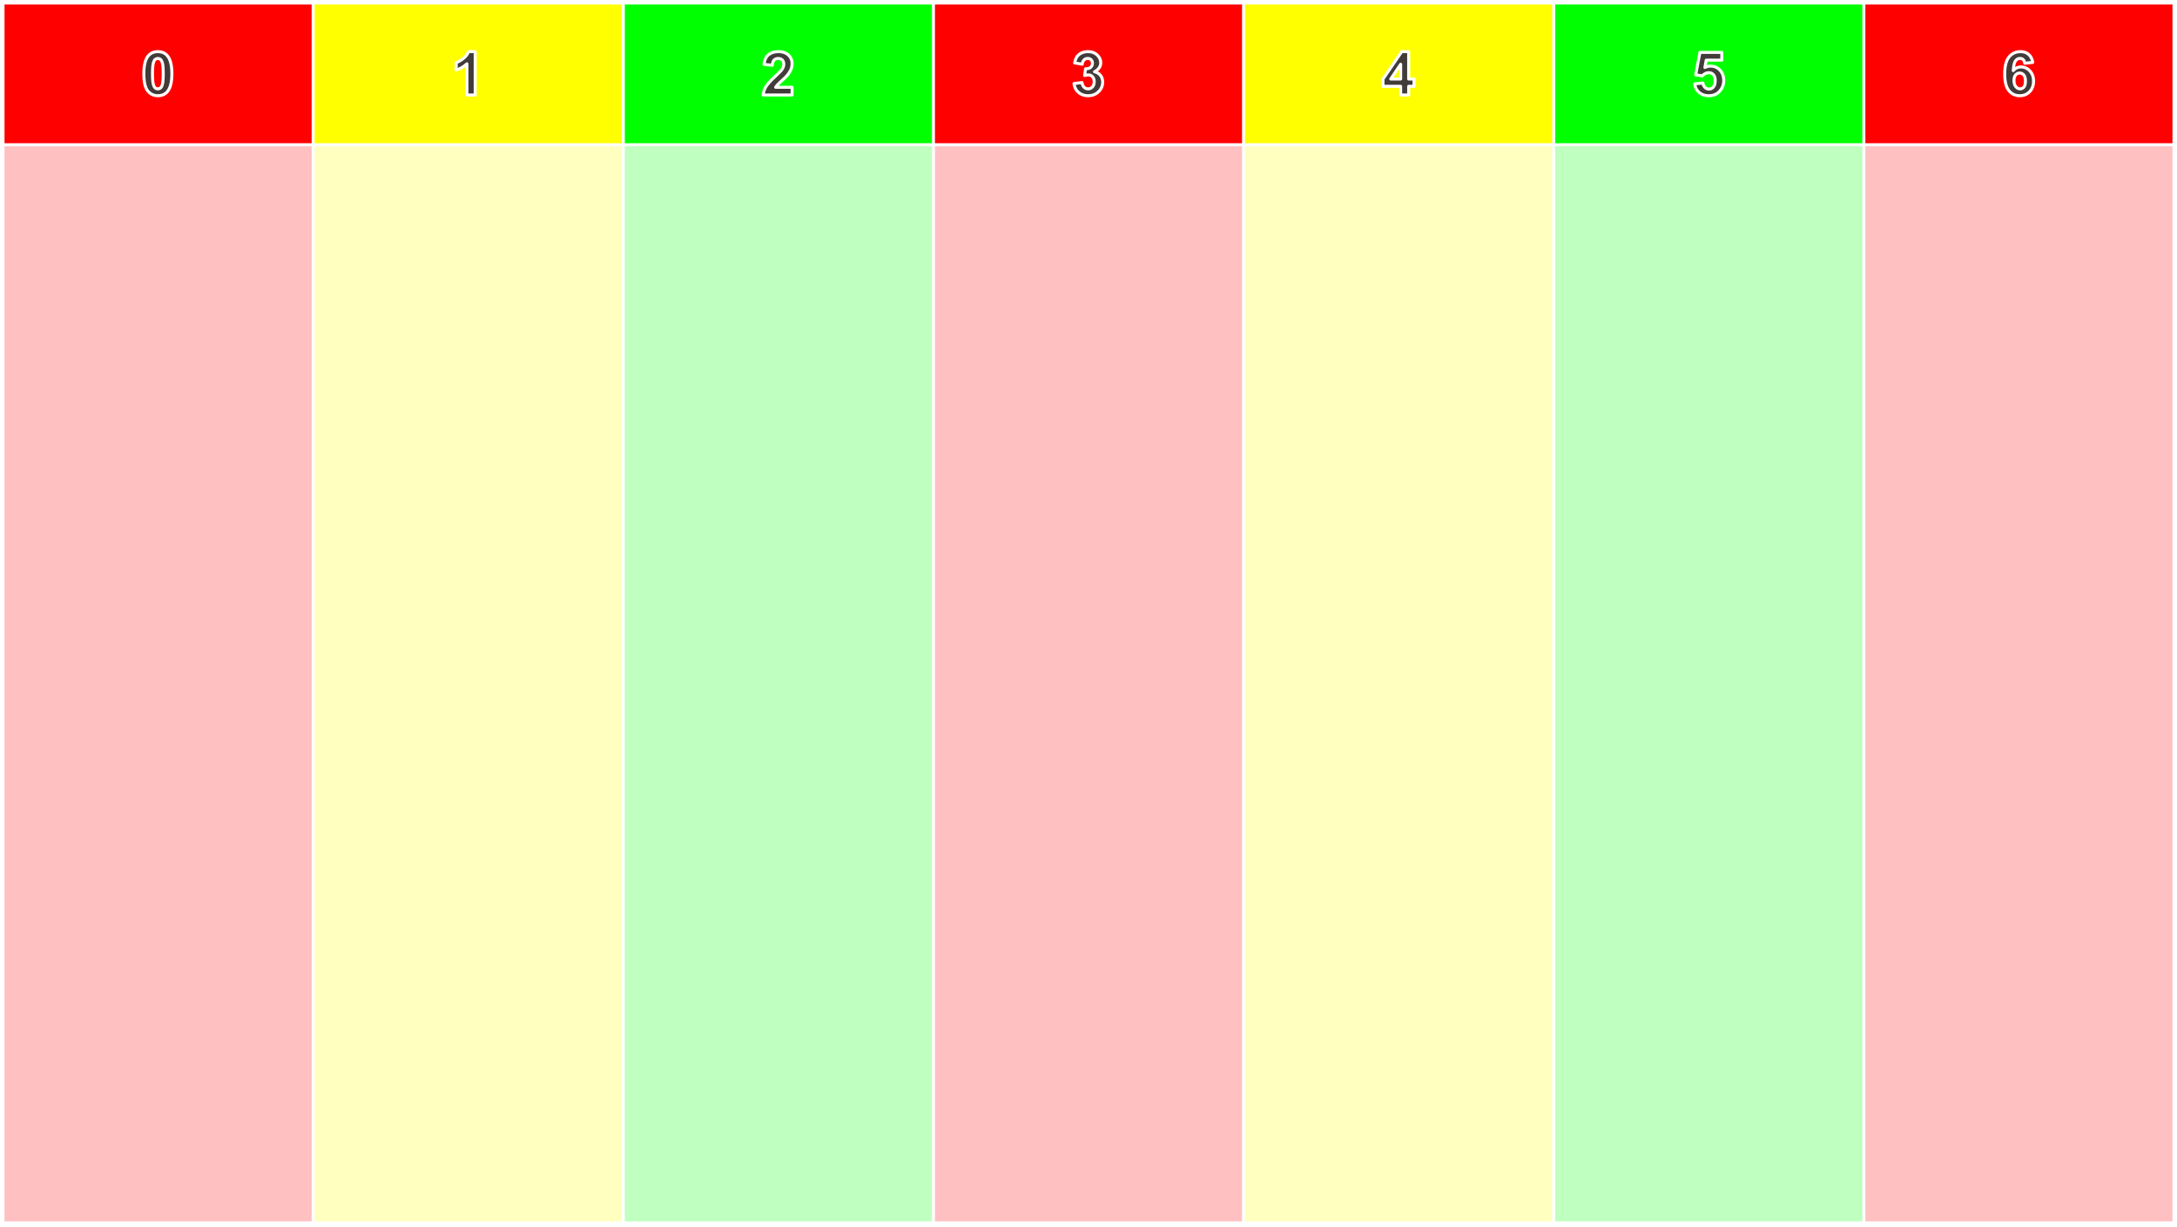
s

Slide 20
Multiphase SFQ Logic Synthesis
Logic network
SFQ network
Logic synthesis
Single-phase path balancing (DFF insertion)
Logic network
Multiphase compound SFQ network
Compound logic synthesis [6]
Phase assignment
Multiphase DFF insertion
[6] R. Bairamkulov, A. Tempia Calvino and G. De Micheli, "Synthesis of SFQ Circuits with Compound Gates," VLSI-SoC 2023.
Notes:
Keep in mind - may raise a question
Combine gates together - orthogonal to Multiplhase

Slide 21
OUTLINE
Rapid Single-Flux Quantum
Gate-Level Pipelining
Phase Assignment
DFF Insertion
Results

Slide 22
Phase Assignment as ILP
Assign stage of each gate
Use Integer-Linear Programming
Objective – minimize number of DFFs
Constraints – correct timing

Slide 23
a
b
a
b

Slide 24
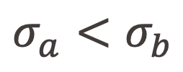
a
$$σ_{a}<σ_{b}$$
b
a
b

Slide 25
m
a
s

Slide 26
m
a
s

Slide 27
m
a
s

Slide 28


m
a
s
$$σ_{a}≤σ_{s}$$
$$σ_{m}≤σ_{a}$$

Slide 29

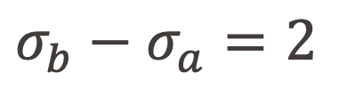
a
b
$$σ_{b}−σ_{a}=2$$
$$N=0$$

Slide 30
a
b
c
d

Slide 31
a
b
c
d

Slide 32
a
b
c
d

Slide 33
a
b
c
d

Slide 34
a
b
c
d

Slide 35
a
b
c
d

Slide 36
a
b
c
d

Slide 37
a
b
c
d

Slide 38
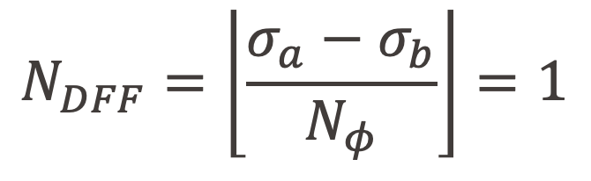
a
b
c
d
$$N_{DFF}=\left\lfloor \frac{σ_{a}−σ_{b}}{N_{φ}}\right\rfloor =1$$

Slide 39
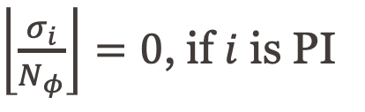
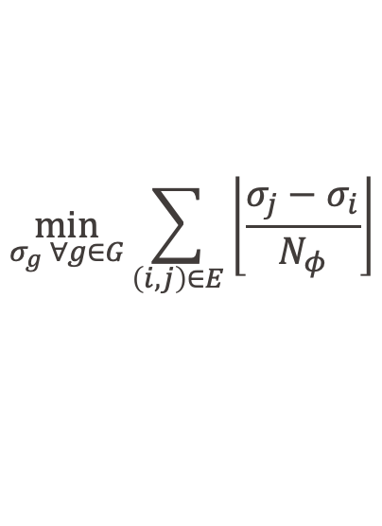
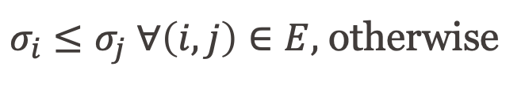
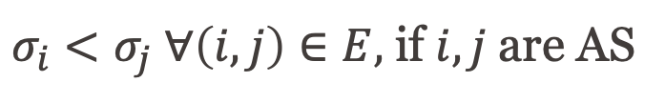
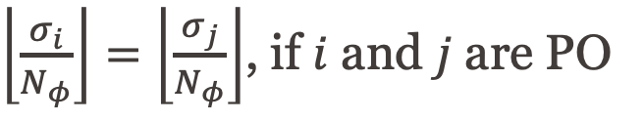
Phase Assignment
Formulate ILP
Objective – estimated number of DFFs
$$\min_{σ_{g} ∀g∈G}{\sum_{\left(i,j\right)∈E}{\left\lfloor \frac{σ_{j}−σ_{i}}{N_{φ}}\right\rfloor }}$$
Relative stage constraints
$σ_{i}<σ_{j} ∀\left(i,j\right)∈E,$ if $i,j$are AS
$σ_{i}≤σ_{j} ∀\left(i,j\right)∈E,$ otherwise
Primary input/output constraints
$\left\lfloor \frac{σ_{i}}{N_{φ}}\right\rfloor =0$, if $i$ is PI
$\left\lfloor \frac{σ_{i}}{N_{φ}}\right\rfloor =\left\lfloor \frac{σ_{j}}{N_{φ}}\right\rfloor$, if $i$ and $j$ are PO

Slide 40
OUTLINE
Rapid Single-Flux Quantum
Multiphase Clocking
Phase Assignment
DFF Insertion
Results

Slide 41
DFF Insertion
Stage of each gate is known
Insert DFFs to ensure correctness
0 | 1 | 2 | 3 | 4 | 5 | 6 | 7 | 8 | 9 | 10
A
G
D
F
B
E
C

Slide 42
Independent Paths
Set of edges bounded by AS/SA gates
DFFs in one independent path do not affect other independent paths
0 | 1 | 2 | 3 | 4 | 5 | 6 | 7 | 8 | 9 | 10
A
G
D
F
B
E
C

Slide 43
Independent Paths
Set of edges bounded by AS/SA gates
DFFs in one independent path do not affect other independent paths
0 | 1 | 2 | 3 | 4 | 5 | 6 | 7 | 8 | 9 | 10
A
G
D
F
B
E
C

Slide 44
Independent Paths
Set of edges bounded by AS/SA gates
DFFs in one independent path do not affect other independent paths
0 | 1 | 2 | 3 | 4 | 5 | 6 | 7 | 8 | 9 | 10
A
G
D
F
B
E
C

Slide 45
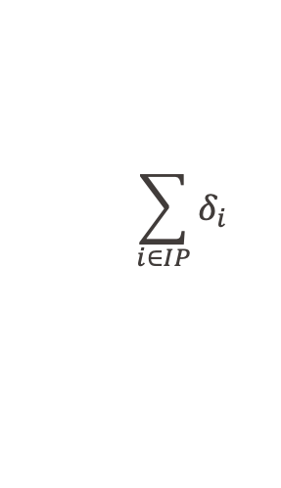
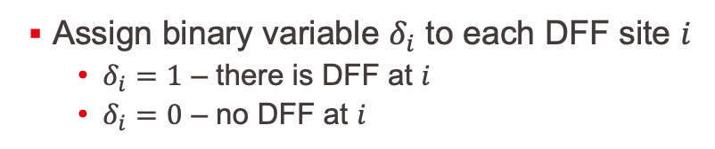
DFF Sites
$$\sum_{i∈IP}{δ_{i}}$$
Assign binary variable $δ_{i}$ to each DFF site $i$
$δ_{i}=1$ – there is DFF at $i$
$δ_{i}=0$ – no DFF at $i$
Minimize
Subject to constraints …
0 | 1 | 2 | 3 | 4 | 5 | 6 | 7 | 8 | 9 | 10
A
G
D
F
B
E
C

Slide 46

DFF before SA
SA gate must be preceded by DFF or a clocked gate
i.e., $δ_{i}=1$, if $i$ precedes SA gate
0 | 1 | 2 | 3 | 4 | 5 | 6 | 7 | 8 | 9 | 10
A
G
D
F
B
E
C

Slide 47

Long Path Constraint
Any path of length $N_{φ}$ should have a DFF
$δ_{1}+…+δ_{k}≥1$, if sites $1,…,k$ form a path of length $N_{phases}$
0 | 1 | 2 | 3 | 4 | 5 | 6 | 7 | 8 | 9 | 10
A
G
D
F
B
E
C

Slide 48
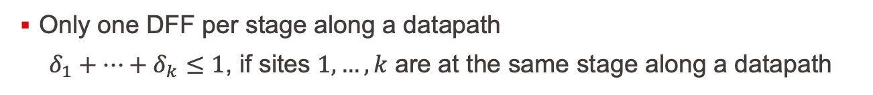
Placement Rules
Only one DFF per stage along a datapath
$δ_{1}+…+δ_{k}≤1$, if sites $1,…,k$ are at the same stage along a datapath
0 | 1 | 2 | 3 | 4 | 5 | 6 | 7 | 8 | 9 | 10
a
b
D
c
d
e
E
C

Slide 49

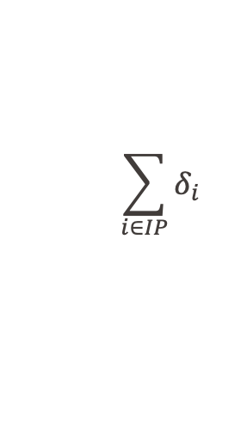
CP-SAT Problem
$δ_{i}=1$, if $i$ precedes AND gate
$$\sum_{i∈IP}{δ_{i}}$$
Minimize
Subject to:
$δ_{1}+…+δ_{k}≥1$, if sites $1,…,k$ form a path of length $N_{φ}$
$δ_{1}+…+δ_{k}≤1$, if sites $1,…,k$ are at the same stage along a datapath
0 | 1 | 2 | 3 | 4 | 5 | 6 | 7 | 8 | 9 | 10
A
G
D
F
B
E
C

Slide 50
OUTLINE
Rapid Single-Flux Quantum
Gate-Level Pipelining
Phase Assignment
DFF Insertion
Results

Slide 51
Experimental Setup
Logic optimization – mockturtle C++ library [7]
ILP/CP-SAT solver – Google OR-Tools [8]
EPFL, ISCAS85’ and ISCAS89’ benchmarks
Baselines
Dual clocking method (DCM) [9]
PBMap [10]
Gate Compounding (GC) [11]
[7] M. Soeken et al., “The EPFL Logic Synthesis Libraries,” arXiv:1805.05121v3, 2018
[8] L. Perron, “Operations Research and Constraint Programming at Google,” Proc. CP, 2011
[9] G. Pasandi and M. Pedram, “An Efficient Pipelined Architecture for Superconducting SFQ Logic Circuits Utilizing Dual Clocks,” IEEE TASC, 2020
[10] G. Pasandi and M. Pedram, “PBMap: A Path Balancing Technology Mapping Algorithm for SFQ Logic Circuits,” IEEE TASC, 2019
[11] R. Bairamkulov, A. Tempia Calvino, and G. De Micheli, “Synthesis of SFQ Circuits with Compound Gates,” Proc. VLSI-SoC, 2023

Slide 52
Results
Comparison against dual clocking method (DCM) [9] with 1/7 throughput
[9] G. Pasandi and M. Pedram, “An Efficient Pipelined Architecture for Superconducting SFQ Logic Circuits Utilizing Dual Clocks,” IEEE TASC, 2020

Slide 53
Results
Comparison against dual clocking method (DCM) [9] with 1/7 throughput
[9] G. Pasandi and M. Pedram, “An Efficient Pipelined Architecture for Superconducting SFQ Logic Circuits Utilizing Dual Clocks,” IEEE TASC, 2020

Slide 54
Results
Comparison against dual clocking method (DCM) [9] with 1/12 throughput
[9] G. Pasandi and M. Pedram, “An Efficient Pipelined Architecture for Superconducting SFQ Logic Circuits Utilizing Dual Clocks,” IEEE TASC, 2020

Slide 55
Results
Comparison against dual clocking method (DCM) [9] with 1/12 throughput
[9] G. Pasandi and M. Pedram, “An Efficient Pipelined Architecture for Superconducting SFQ Logic Circuits Utilizing Dual Clocks,” IEEE TASC, 2020

Slide 56
Results
Comparison against dual clocking method (DCM) [9] with 1/12 throughput
[9] G. Pasandi and M. Pedram, “An Efficient Pipelined Architecture for Superconducting SFQ Logic Circuits Utilizing Dual Clocks,” IEEE TASC, 2020

Slide 57
Results
2-phase clocking outperforms both GC and PBMap
Diminishing returns with more phases
Up to 2x area reduction vs. GC with 10 phases
Normalized area vs #phases

Slide 58
Summary
Multiphase clocking reduces path balancing overhead
We propose the framework for multiphase logic synthesis
Assign phases with ILP
Insert DFFs based on CP-SAT
Outperforms dual clocking with same throughput
2-phase clocking outperforms state-of-the-art single-phase techniques
Further area reduction with additional phases

Slide 59
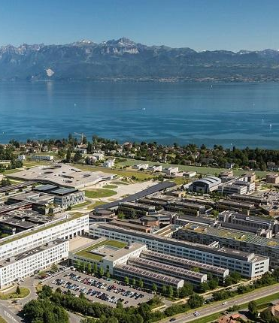
Thank you!
Check out our other works
Alain Herzog | EPFL Photographie

