Slide 1

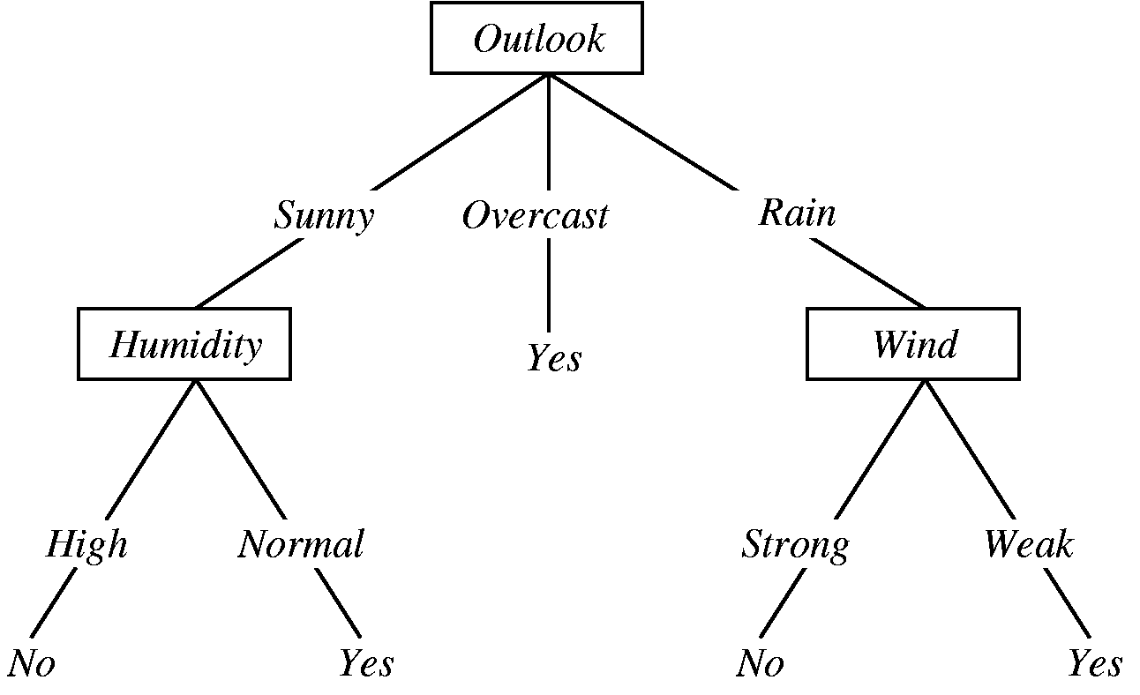
Decision Tree

Slide 2
Decision Tree
Supervised Learning technique for classification.
A decision tree leads you to a prediction by asking a series of questions on whether you belong to certain groups. Each question must only have 2 possible responses, such as “yes” versus “no”. You start at the top question, called the root node, then move through the tree branches according to which groups you belong to, until you reach a leaf node. The proportion of survivors at that leaf node would be your predicted chance of survival.
Boosting and random forest – Improve the performance

Slide 3
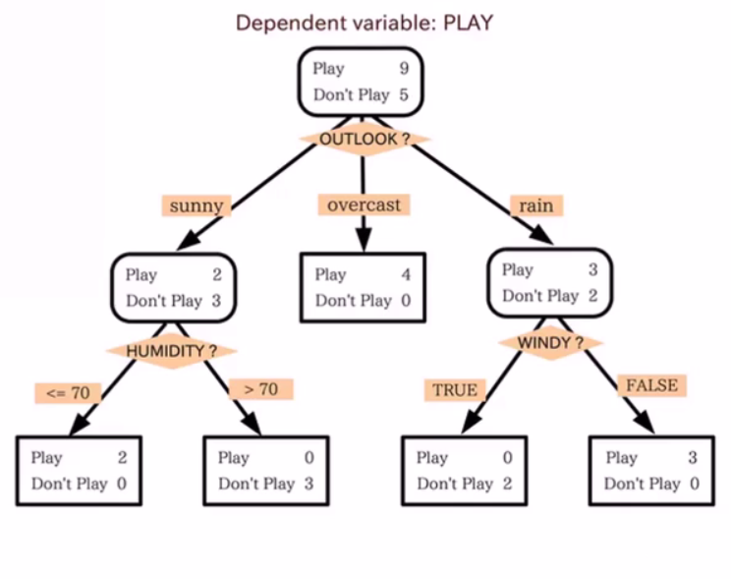
Decision Tree
You can construct a flowchart to help you decide a classification for something with machine learning.
This is called Decision Tree.

Slide 4
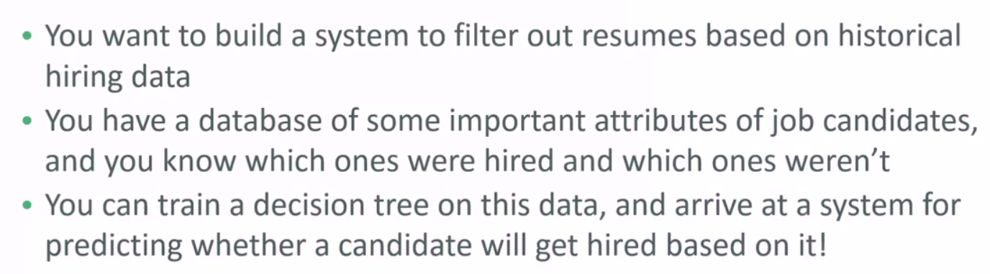
Decision Tree Example

Slide 5
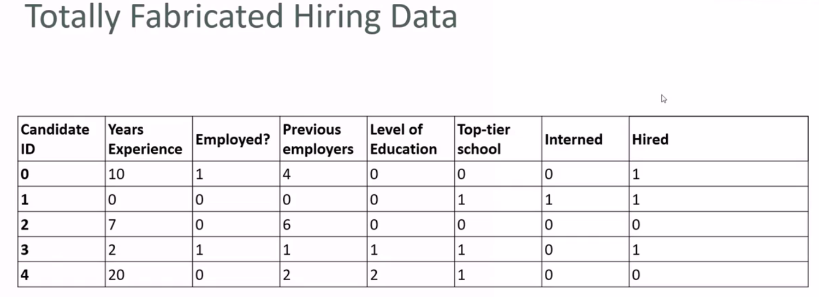

Slide 6
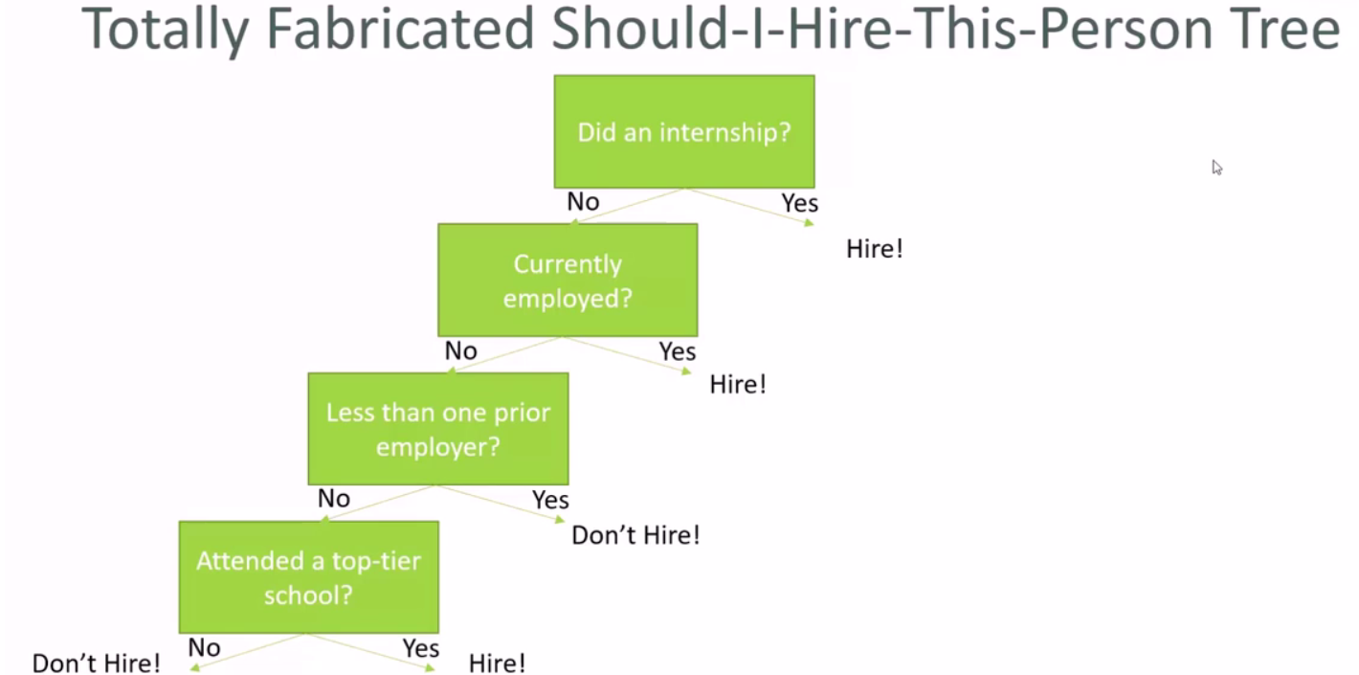

Slide 7
Decision Tree Types
Decision trees used in data mining are of two main types:
Classification tree analysis is when the predicted outcome is the class to which the data belongs.
Regression tree analysis is when the predicted outcome can be considered a real number (e.g. the price of a house, or a patient's length of stay in a hospital).
The term Classification And Regression Tree (CART) analysis is an umbrella term used to refer to both of the above procedures. Trees used for regression and trees used for classification have some similarities - but also some differences, such as the procedure used to determine where to split.

Slide 8
Decision Tree Types
Some techniques, often called ensemble methods, construct more than one decision tree:
Boosted trees Incrementally building an ensemble by training each new instance to emphasize the training instances previously mis-modeled. A typical example is AdaBoost. These can be used for regression-type and classification-type problems
Bootstrap aggregated (or bagged) decision trees, an early ensemble method, builds multiple decision trees by repeatedly resampling training data with replacement, and voting the trees for a consensus prediction.
A random forest classifier is a specific type of bootstrap aggregating

Slide 9
Ensemble Method
An ensemble method or ensemble learning algorithm consists of aggregating multiple outputs made by a diverse set of predictors to obtain better results. Formally, based on a set of “weak” learners we are trying to use a “strong” learner for our model. Therefore, the purpose of using ensemble methods is: to average out the outcome of individual predictions by diversifying the set of predictors, thus lowering the variance, to arrive at a powerful prediction model that reduces overfitting our training set.
In our case, a Random Forest (strong learner) is built as an ensemble of Decision Trees (weak learners) to perform different tasks such as regression and classification.

Slide 10
Random Forest
How are Random Forests trained?
Random Forests are trained via the bagging method. Bagging or Bootstrap Aggregating, consists of randomly sampling subsets of the training data, fitting a model to these smaller data sets, and aggregating the predictions. This method allows several instances to be used repeatedly for the training stage given that we are sampling with replacement. Tree bagging consists of sampling subsets of the training set, fitting a Decision Tree to each, and aggregating their result.

Slide 11
Random Forest
Let’s see now how to make predictions with Random Forests. Remember that in a Decision Tree a new instance goes from the root node to the bottom until it is classified in a leaf node. In the Random Forests algorithm, each new data point goes through the same process, but now it visits all the different trees in the ensemble, which were grown using random samples of both training data and features.

Slide 12
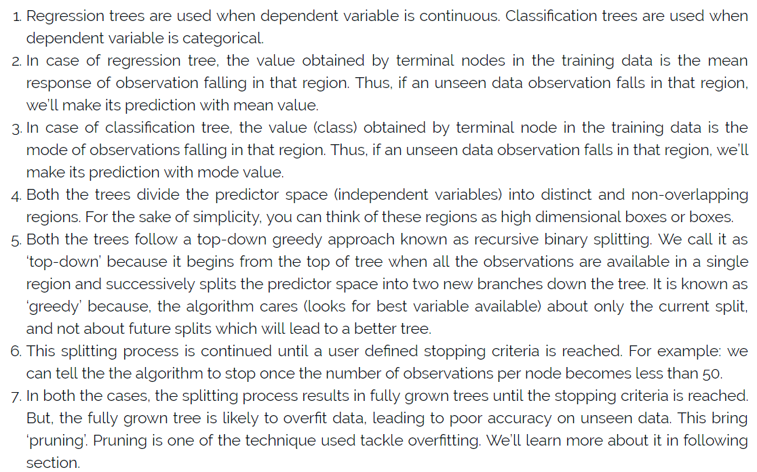
Random Tree Vs Classification Tree

Slide 13
Decision Tree in Depth
Decision trees are used for both classification and regression problems
Why Decision trees?
Decision tress often mimic the human level thinking so its so simple to understand the data and make some good interpretations.
Decision trees actually make you see the logic for the data to interpret(not like black box algorithms like SVM, KNN, etc..)

Slide 14
Decision Tree
So what is the decision tree??
A decision tree is a tree where each node represents a feature(attribute), each link(branch) represents a decision(rule) and each leaf represents an outcome(categorical or continuous value).
The whole idea is to create a tree like this for the entire data and process a single outcome at every leaf(or minimize the error in every leaf).

Slide 15
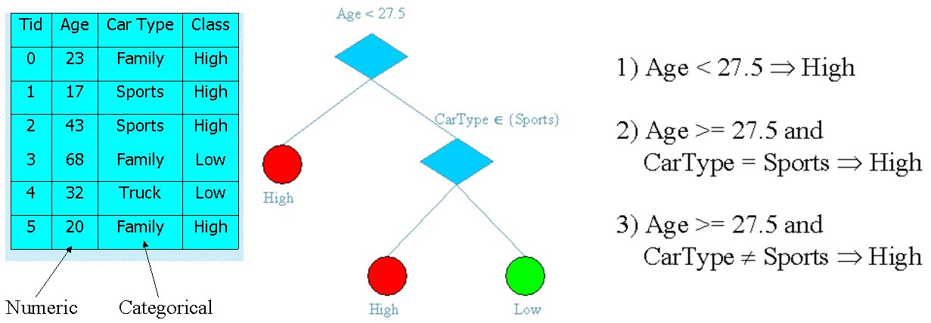
Decision Tree

Slide 16
Decision Tree
How to build this ?
There are couple of algorithms there to build a decision tree , we only talk about a few which are
CART (Classification and Regression Trees) → uses Gini Index(Classification) as metric.
ID3 (Iterative Dichotomiser 3) → uses Entropy function and Information gain as metrics.

Slide 17
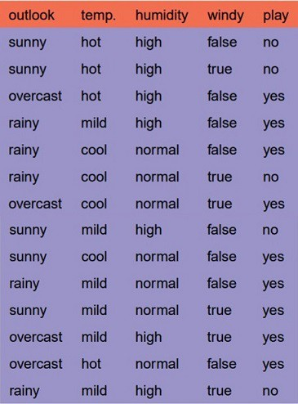
Decision Tree in Depth
Classification with using the ID3 algorithm.
Let’s just take a dataset in the machine learning world which is whether dataset(playing game Y or N based on whether condition).
We have four X values (outlook, temp, humidity and windy) being categorical and one y value (play Y or N) also being categorical.

Slide 18
Decision Tree in Depth
To create a tree, we need to have a root node first and we know that nodes are features/attributes(outlook, temp, humidity and windy)
so which one do we need to pick first ?
determine the attribute that best classifies the training data; use this attribute at the root of the tree. Repeat this process at for each branch.
This means we are performing top-down, greedy search through the space of possible decision trees.

Slide 19
Decision Tree in Depth
so how do we choose the best attribute?
use the attribute with the highest information gain in ID3
In order to define information gain precisely, we begin by defining a measure commonly used in information theory, called entropy that characterizes the (im)purity of an arbitrary collection of examples.

Slide 20
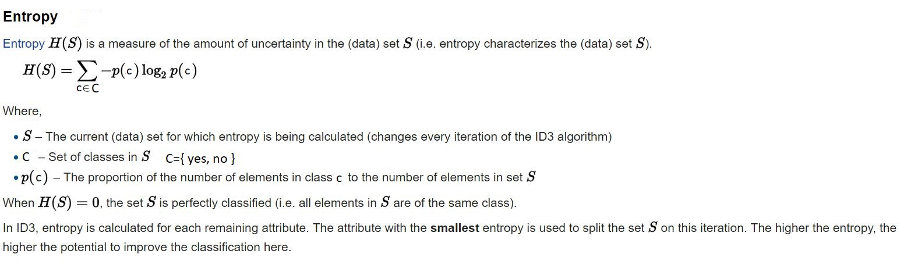
Decision Tree Entropy

Slide 21
Decision Tree in Depth
For a binary classification problem
If all examples are positive or all are negative then entropy will be zero i.e, low.
If half of the examples are of positive class and half are of negative class then entropy is one i.e, high.

Slide 22
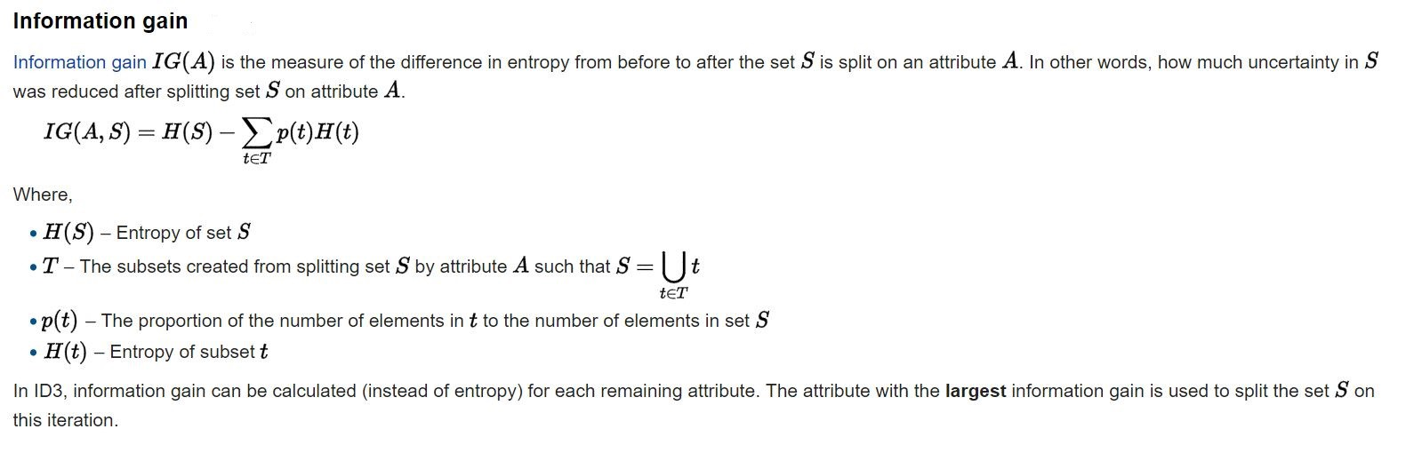
Decision Tree in Depth

Slide 23
Decision Tree in Depth
Lets apply these metrics to our dataset to split the data(getting the root node)
Steps:
1.compute the entropy for data-set
2.for every attribute/feature: 1.calculate entropy for all categorical values 2.take average information entropy for the current attribute 3.calculate gain for the current attribute
3. pick the highest gain attribute. 4. Repeat until we get the tree we desired.

Slide 24
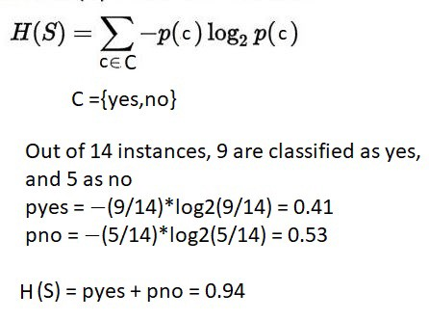
Decision Tree in Depth
Compute the entropy for the weather data set

Slide 25
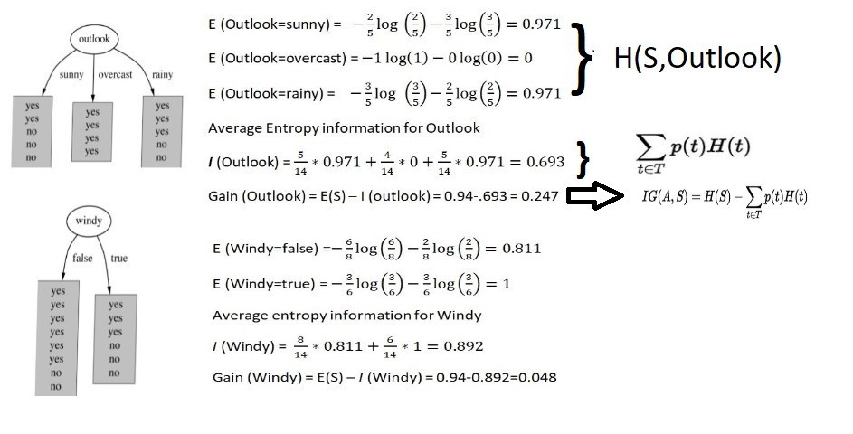
Decision Tree in Depth
For every feature calculate the entropy and information gain

Slide 26
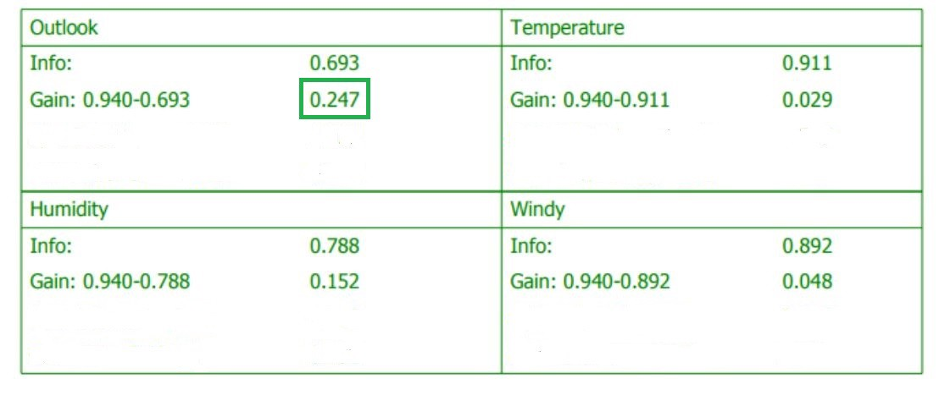
Decision Tree in Depth
Similarity we can calculate for other two attributes(Humidity and Temp).
Pick the highest gain attribute.

Slide 27
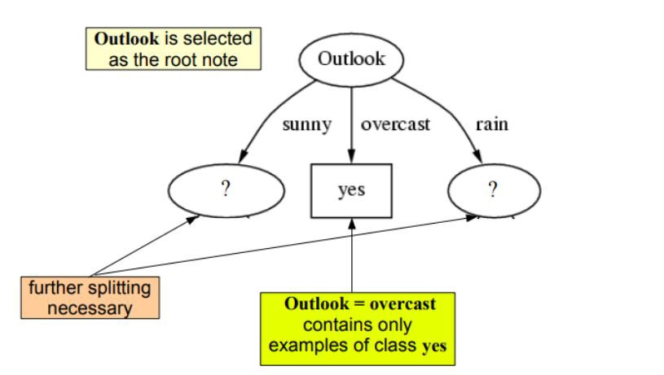
Decision Tree in Depth
So our root node is Outlook.

Slide 28
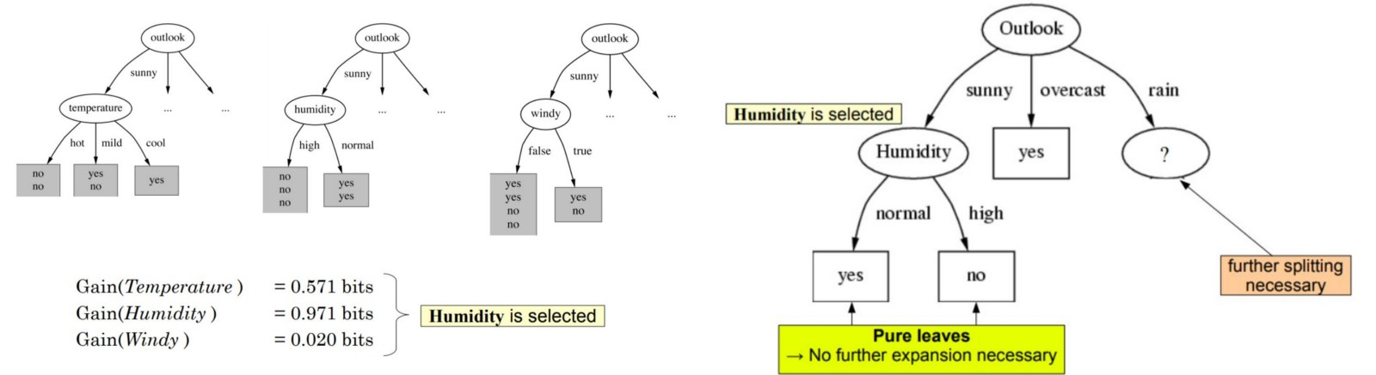
Decision Tree in Depth
Repeat the same thing for sub-trees till we get the tree.

Slide 29
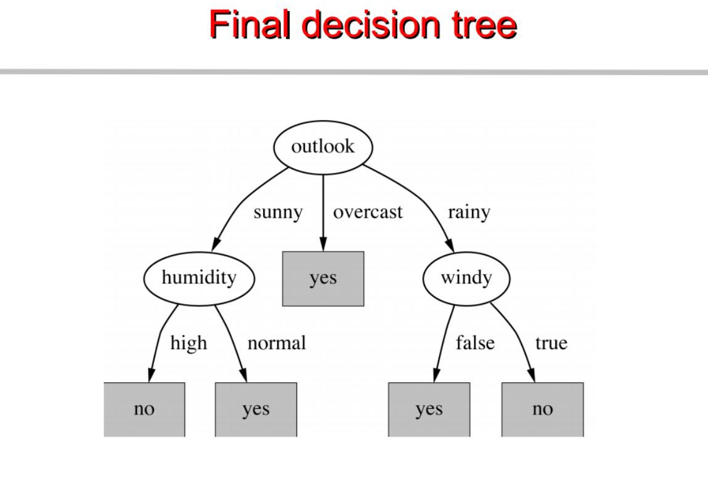
Decision Tree in Depth

Slide 30
Decision Tree in Depth
Classification with using the CART algorithm.
In CART we use Gini index as a metric,
We use the Gini Index as our cost function used to evaluate splits in the dataset.
our target variable is Binary variable which means it take two values (Yes and No). There can be 4 combinations.

Slide 31

Decision Tree in Depth
Actual=1 predicted 1 1 0 , 0,1, 0 0
P(Target=1).P(Target=1) + P(Target=1).P(Target=0) + P(Target=0).P(Target=1) + P(Target=0).P(Target=0) = 1
P(Target=1).P(Target=0) + P(Target=0).P(Target=1) = 1 — P^2(Target=0) — P^2(Target=1)
Gini Index for Binary Target variable is
=> 1 — P^2(Target=0) — P^2(Target=1)

Slide 32
Decision Tree in Depth
A Gini score gives an idea of how good a split is by how mixed the classes are in the two groups created by the split. A perfect separation results in a Gini score of 0, whereas the worst case split that results in 50/50 classes.
We calculate it for every row and split the data accordingly in our binary tree. We repeat this process recursively.
For Binary Target variable, Max Gini Index value :-
=> 1 — (1/2)^2 — (1/2)^2 => 1–2*(1/2)^2 => 1- 2*(1/4) => 1–0.5 => 0.5

Slide 33

Decision Tree In Depth
Similarly if Target Variable is categorical variable with multiple levels, the Gini Index will be still similar. If Target variable takes k different values, the Gini Index will be
Maximum value of Gini Index could be when all target values are equally distributed.
Similarly for Nominal variable with k level, the maximum value Gini Index is
=> 1–1/k

Slide 34
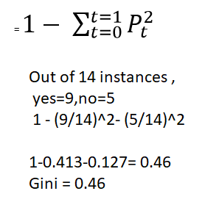
Decision Tree in Depth
Minimum value of Gini Index will be 0 when all observations belong to one label.
The calculations are similar to ID3 ,except the formula changes.
for example :compute gini index for dataset

Slide 35
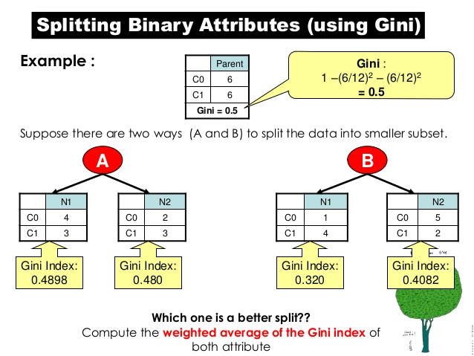
Decision Tree in Depth

Slide 36
Decision Tree Example - 2

Slide 37
Classification and Regression Trees
Gini Index.
Create Split.
Build a Tree.
Make a Prediction.

Slide 38
Gini Index
The Gini index is the name of the cost function used to evaluate splits in the dataset.
A split in the dataset involves one input attribute and one value for that attribute. It can be used to divide training patterns into two groups of rows.
A Gini score gives an idea of how good a split is by how mixed the classes are in the two groups created by the split. A perfect separation results in a Gini score of 0, whereas the worst case split that results in 50/50 classes in each group result in a Gini score of 0.5 (for a 2 class problem).

Slide 39
Gini Index
We have two groups of data with 2 rows in each group. The rows in the first group all belong to class 0 and the rows in the second group belong to class 1, so it’s a perfect split.
We first need to calculate the proportion of classes in each group.
proportion = count(class_value) / count(rows)
The proportions for this example would be:
group_1_class_0 = 2 / 2 = 1
group_1_class_1 = 0 / 2 = 0
group_2_class_0 = 0 / 2 = 0
group_2_class_1 = 2 / 2 = 1

Slide 40
Gini Index
Gini is then calculated for each child node as follows:
gini_index = sum(proportion * (1.0 - proportion))
gini_index = 1.0 - sum(proportion * proportion)
The Gini index for each group must then be weighted by the size of the group, relative to all of the samples in the parent, e.g. all samples that are currently being grouped.

Slide 41
Gini Index
We can add this weighting to the Gini calculation for a group as follows:
gini_index = (1.0 - sum(proportion * proportion)) * (group_size/total_samples)
In this example the Gini scores for each group are calculated as follows:
Gini(group_1) = (1 - (1*1 + 0*0)) * 2/4
Gini(group_1) = 0.0 * 0.5
Gini(group_1) = 0.0
Gini(group_2) = (1 - (0*0 + 1*1)) * 2/4
Gini(group_2) = 0.0 * 0.5
Gini(group_2) = 0.0

Slide 42
Gini Index
The scores are then added across each child node at the split point to give a final Gini score for the split point that can be compared to other candidate split points.
The Gini for this split point would then be calculated as 0.0 + 0.0 or a perfect Gini score of 0.0.

Slide 43
Create Split
A split is comprised of an attribute in the dataset and a value.
We can summarize this as the index of an attribute to split and the value by which to split rows on that attribute. This is just a useful shorthand for indexing into rows of data.
Creating a split involves three parts, the first we have already looked at which is calculating the Gini score. The remaining two parts are:
Splitting a Dataset.
Evaluating All Splits.

Slide 44
Create Split
Splitting a Dataset
Splitting a dataset means separating a dataset into two lists of rows given the index of an attribute and a split value for that attribute.
Once we have the two groups, we can then use our Gini score above to evaluate the cost of the split.
Splitting a dataset involves iterating over each row, checking if the attribute value is below or above the split value and assigning it to the left or right group respectively.

Slide 45
Create Split
Evaluating All Splits
With the Gini function above and the test split function we now have everything we need to evaluate splits.
Given a dataset, we must check every value on each attribute as a candidate split, evaluate the cost of the split and find the best possible split we could make.
Once the best split is found, we can use it as a node in our decision tree.
This is an exhaustive and greedy algorithm.

Slide 46
Create Split
We will use a dictionary to represent a node in the decision tree as we can store data by name. When selecting the best split and using it as a new node for the tree we will store the index of the chosen attribute, the value of that attribute by which to split and the two groups of data split by the chosen split point.
Each group of data is its own small dataset of just those rows assigned to the left or right group by the splitting process. You can imagine how we might split each group again, recursively as we build out our decision tree.
So build a function get_split() that implements this procedure.

Slide 47
Create Split
It iterates over each attribute (except the class value) and then each value for that attribute, splitting and evaluating splits as it goes.
The best split is recorded and then returned after all checks are complete.

Slide 48
Build a Tree
Creating the root node of the tree is easy.
We can call the get_split() function using the entire dataset.
Adding more nodes to our tree is more interesting.
Building a tree may be divided into 3 main parts:
Terminal Nodes.
Recursive Splitting.
Building a Tree.

Slide 49
Build a Tree
Terminal Nodes
We need to decide when to stop growing a tree.
We can do that using the depth and the number of rows that the node is responsible for in the training dataset.
Maximum Tree Depth. This is the maximum number of nodes from the root node of the tree. Once a maximum depth of the tree is met, we must stop splitting adding new nodes. Deeper trees are more complex and are more likely to overfit the training data.
Minimum Node Records. This is the minimum number of training patterns that a given node is responsible for. Once at or below this minimum, we must stop splitting and adding new nodes. Nodes that account for too few training patterns are expected to be too specific and are likely to overfit the training data.

Slide 50
Build a Tree
These two approaches will be user-specified arguments to our tree building procedure.
There is one more condition. It is possible to choose a split in which all rows belong to one group. In this case, we will be unable to continue splitting and adding child nodes as we will have no records to split on one side or another.
Now we have some ideas of when to stop growing the tree. When we do stop growing at a given point, that node is called a terminal node and is used to make a final prediction.
This is done by taking the group of rows assigned to that node and selecting the most common class value in the group. This will be used to make predictions.

Slide 51
Build a Tree
Recursive Splitting
We know how and when to create terminal nodes, now we can build our tree.
Building a decision tree involves calling the get_split() function over and over again on the groups created for each node.
New nodes added to an existing node are called child nodes. A node may have zero children (a terminal node), one child (one side makes a prediction directly) or two child nodes. We will refer to the child nodes as left and right in the dictionary representation of a given node.
Once a node is created, we can create child nodes recursively on each group of data from the split by calling the same function again.

Slide 52
Build Tree
Build a function split() that implements this recursive procedure. It will take a node as an argument as well as the maximum depth, minimum number of patterns in a node and the current depth of a node.
You can imagine how this might be first called passing in the root node and the depth of 1.

Slide 53
Build a Tree
Firstly, the two groups of data split by the node are extracted for use and deleted from the node. As we work on these groups the node no longer requires access to these data.
Next, we check if either left or right group of rows is empty and if so we create a terminal node using what records we do have.
We then check if we have reached our maximum depth and if so we create a terminal node.
We then process the left child, creating a terminal node if the group of rows is too small, otherwise creating and adding the left node in a depth first fashion until the bottom of the tree is reached on this branch.
The right side is then processed in the same manner, as we rise back up the constructed tree to the root.

Slide 54
Build a Tree
Building a Tree
We can now put all of the pieces together.
Building the tree involves creating the root node and calling the split() function that then calls itself recursively to build out the whole tree.
Create a build_tree() function that implements this procedure.

Slide 55
Make a Prediction
Making predictions with a decision tree involves navigating the tree with the specifically provided row of data.
Again, we can implement this using a recursive function, where the same prediction routine is called again with the left or the right child nodes, depending on how the split affects the provided data.
We must check if a child node is either a terminal value to be returned as the prediction, or if it is a dictionary node containing another level of the tree to be considered.

Slide 56
Bagging Prediction
Make a prediction with a list of bagged trees responsible for making a prediction with each decision tree and combining the predictions into a single return value.
This is achieved by selecting the most common prediction from the list of predictions made by the bagged trees.

