Slide 1
Data Munging
Also known as ‘Data Wrangling’
Before understanding what is data munging, we’ll take example of a dummy dataset.

Slide 2
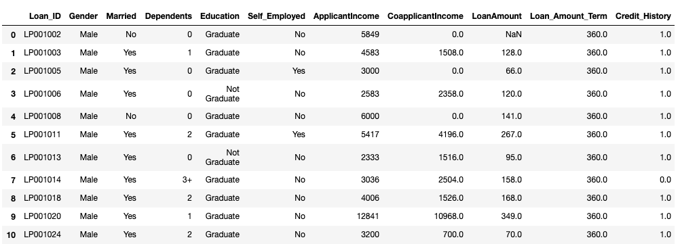
Let’s look at some data!

Slide 3
Summary of numerical fields
If we start exploring our data using df.describe(), we will see that:
LoanAmount has (614 – 592) 22 missing values.
Loan_Amount_Term has (614 – 600) 14 missing values.
Credit_History has (614 – 564) 50 missing values.
About 84% applicants have a credit_history.
The ApplicantIncome & CoapplicantIncome distribution seems to be in line

Slide 4
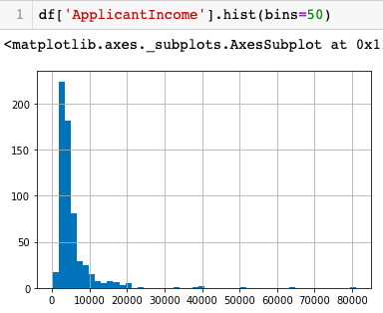
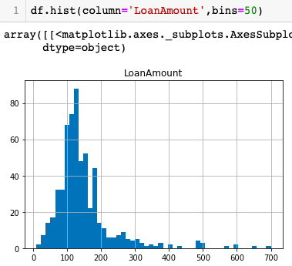
Distribution Analysis

Slide 5
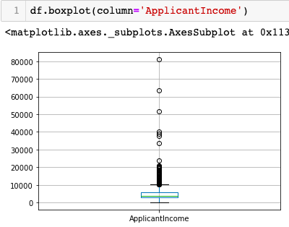
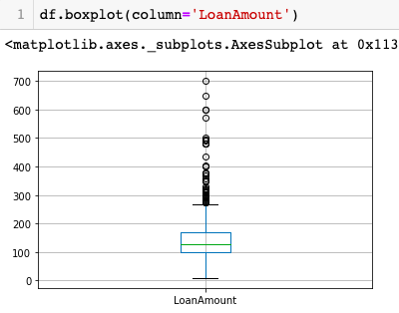
Distribution Analysis

Slide 6
Data Munging
While our exploration of the data, we found a few problems in the data set, which needs to be solved before the data is ready for a good model. This exercise is typically referred as “Data Munging”. Here are the problems, we are already aware of:
There are missing values in some variables. We should estimate those values wisely depending on the amount of missing values and the expected importance of variables.
While looking at the distributions, we saw that ApplicantIncome and LoanAmount seemed to contain extreme values at either end. Though they might make intuitive sense, but should be treated appropriately.

Slide 7
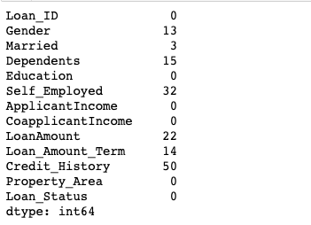
Checking missing values in the dataset
If we look more clearly at our data, we will get to know that there are many rows where data is missing.

Slide 8
How to fill missing values in LoanAmount?
There are numerous ways to fill the missing values –
The simplest being replacement by mean, median, mode or a specific value
df['LoanAmount'].fillna(df['LoanAmount'].mean(), inplace=True)
df['Gender'].fillna(df['Gender'].mode()[0], inplace=True)
df['Self_Employed'].fillna('No',inplace=True)
The other extreme could be to build a supervised learning model to predict loan amount on the basis of other variables

Slide 9
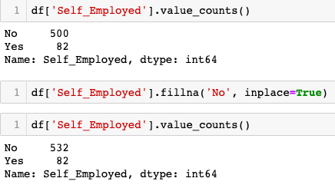
Before filling in missing values!
We have to ensure that each of Self_Employed and Education variables should not have a missing values.

Slide 10
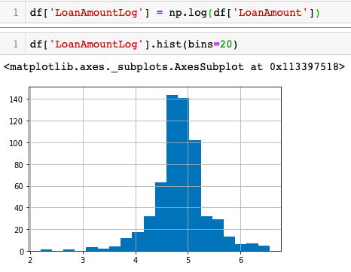
Treat extreme values in LoanAmount

Slide 11
Data Pre-processing vs Data Wrangling
Data Pre-processing is performed before Data Wrangling. Data is prepared after receiving it from the data source. Data Cleaning or any aggregation of data is performed. It is executed once.
For example, we have data where one attribute has three variables, and we have to convert them into three attributes and delete the special characters from them. It is the concept that is performed before applying any iterative model and will be executed once in the project.

Slide 12
Data Pre-processing vs Data Wrangling
On the other hand, Data Wrangling is performed during the iterative analysis and model building. The conceptual view of the dataset changes as different models are applied to achieve good analytic model.
For example, we have data containing 30 attributes where two attributes are used to compute another attribute, and that computed feature is used for further analysis. In this way, the data could be changed according to the requirement of the applied model.

Slide 13
Data Preprocessing
Data preprocessing is a technique which is used to transform the raw data in a useful and efficient format.
Step 1. Data Cleaning:
Ignore the tuples where data is missing, or
Fill the missing values (like we have done already!)
Step 2. Data Transformation
Standardization or Normalization - It is done in order to scale the data values in a specified range (-1.0 to 1.0 or 0.0 to 1.0)
Attribute Selection - In this strategy, new attributes are constructed from the given set of attributes to help the mining process.
Label Encoding - We need to encode text values in numerical form

Slide 14
Data Preprocessing
Step 3. Data Reduction - While working with huge volume of data, analysis becomes harder. So, we use data reduction techniques which aims to increase the storage efficiency and reduce data storage and analysis costs.
Attribute Subset Selection - The highly relevant attributes should be used, rest all can be discarded.
predictor_var = ['Credit_History’]
predictor_var = ['Credit_History','Education','Married','Self_Employed','Property_Area’]
predictor_var = ['TotalIncome_log','LoanAmountLog','Credit_History','Dependents’, 'Property_Area']
Dimensionality Reduction - This reduces the size of data by using encoding mechanisms. The two effective methods of dimensionality reduction are - Wavelet transforms and PCA (Principal Componenet Analysis).

Slide 15
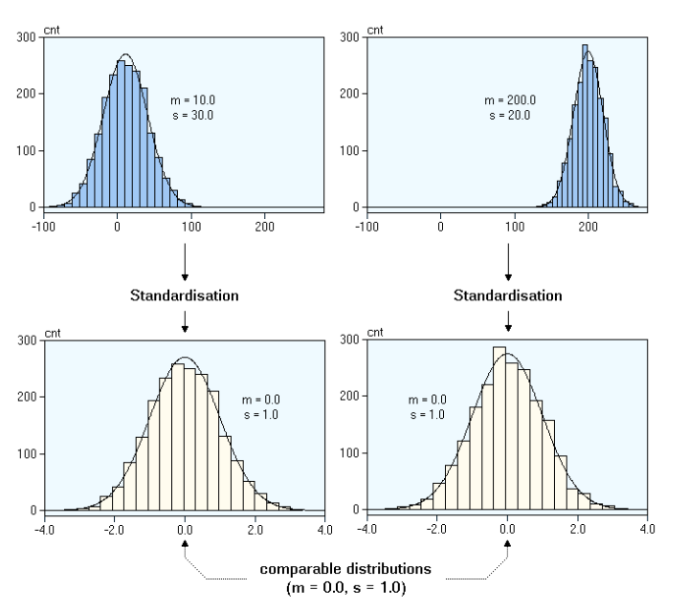
What happens during Standardization?

Slide 16

Normalization
Data is rescaled such that any specific z will now be 0 ≤ z ≤ 1, and is done through this formula:
Normalization makes training less sensitive to the scale of features, so we can better solve for coefficients.

Slide 17
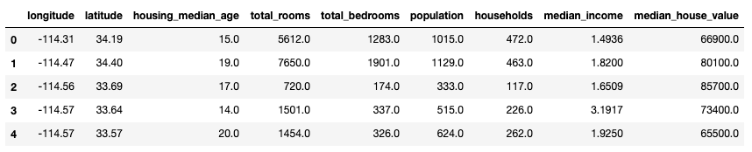
Why would we normalize in the first place?
Consider the dataset of housing prices in California, which have features such as the number of bedrooms and the median household income. Each have different units and scales.

Slide 18
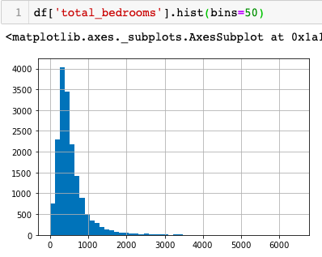
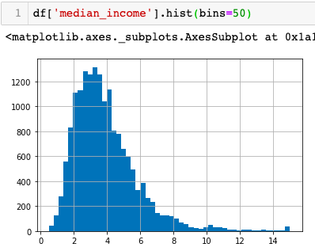
Why would we normalize in the first place?

Slide 19
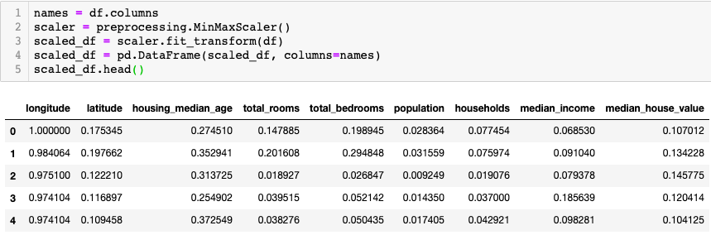
Why would we normalize in the first place?

Slide 20
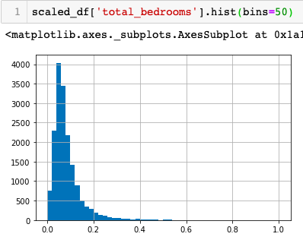
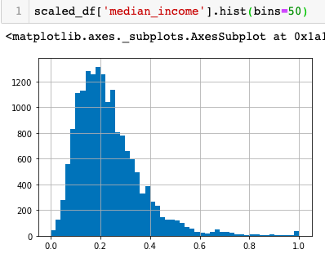
Why would we normalize in the first place?

Slide 21
But wait..
Sometimes you might not want to normalize your data.
The data provided is proportional, so normalizing might not provide correct estimators. Or, the scale between your data features does matters so you want to keep in your dataset.
So you need to understand what type of data is needed by your model - is it better to have the input values centred around 0 (standardization) or between 0 and 1 (normalization).

Slide 22
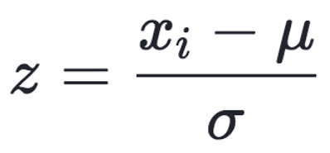
Standardization
Data is rescaled such that μ = 0 and 𝛔 = 1, and is done through this formula:
Compare features that have different units or scales.

Slide 23
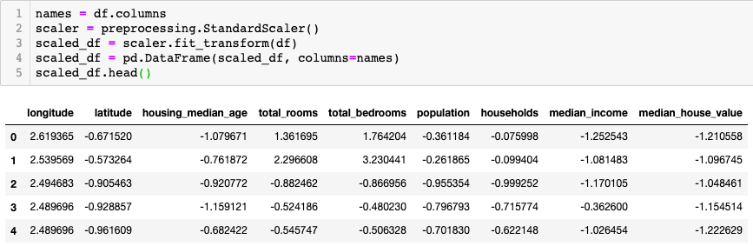
Standardization

Slide 24
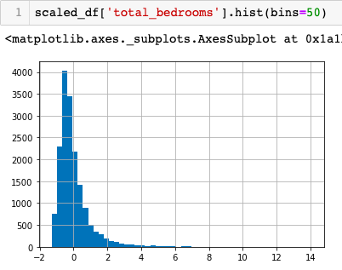
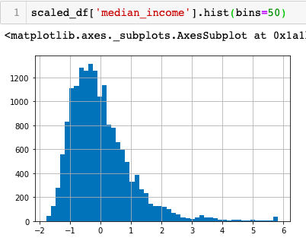
Standardization

Slide 25
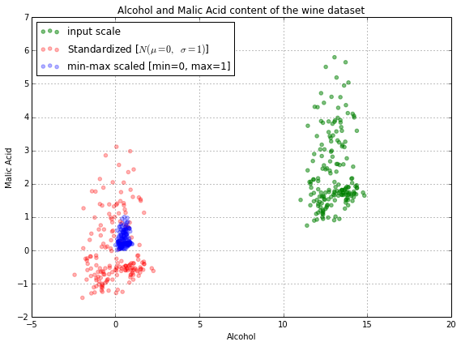
Normalization vs Standardization

Slide 26
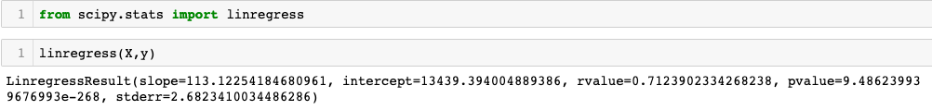
R-Value and P-Value
R-square value tells you how much variation is explained by your model. So 0.1 R-square means that your model explains 10% of variation within the data. The greater R-square the better the model.
Whereas p-value tells you about "fit of the model”. So if the p-value is less than the significance level (usually 0.05) then your model fits the data well.

Slide 27
R-Value and P-Value
Thus you have four scenarios:
low R-square and low p-value (p-value <= 0.05) -> means that your model doesn't explain much of variation of the data but it is significant (better than not having a model)
low R-square and high p-value (p-value > 0.05) -> means that your model doesn't explain much of variation of the data and it is not significant (worst scenario)
high R-square and low p-value -> means your model explains a lot of variation within the data and is significant (best scenario)
high R-square and high p-value -> means that your model explains a lot of variation within the data but is not significant (model is worthless)

Slide 28
Regularization
One of the major aspects of training your machine learning model is avoiding overfitting.
The model will have a low accuracy if it is overfitting, i.e., accuracy score will come out to be nearby 100% for the training data but for unseen data, model is not going to perform so well.
This happens because your model is trying too hard to capture the noise in your training dataset. By noise we mean the data points that don’t really represent the true properties of your data, but random chance.
An overfitted model performs well on training data but fails to generalize.

Slide 29
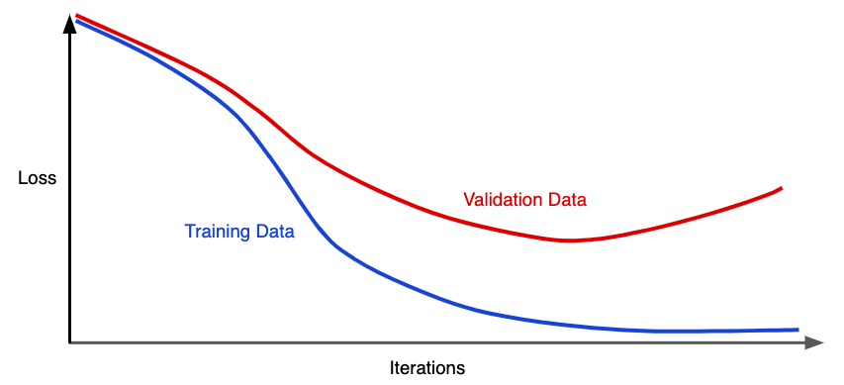
Regularization
Figure shows a model in which training loss gradually decreases, but validation loss eventually goes up. In other words, model is overfitting to the data in the training set.
We could prevent overfitting by penalizing complex models, a principle called regularization.
In other words, instead of simply aiming to minimize loss, we’ll try to minimize loss & complexity.

Slide 30
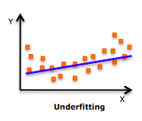
Why do we need regularization?
Let’s consider an example here, we have 10 students in a classroom. We intend to train a model based on their past score to predict their future score. There are 5 females and 5 males in the class. The average score of females is 80 whereas that of males is 60. The overall average of the class is 70.
Now, there are several ways to make the prediction:
Predict the score as 70 for the entire class.

Slide 31
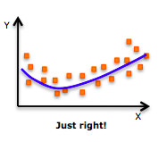
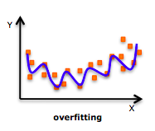
Why do we need regularization?
Predict score of males = 80 and females = 60.
This a simplistic model which might
give a better estimate than the first one.
Now let’s try to overkill the problem.
We can use the roll number of students to
make a prediction and say that every student
will exactly score same marks as last time.
Now, this is unlikely to be true and
we have reached such granular level that
we can go seriously wrong.

Slide 32
Why do we need regularization?
The trend in these graphs looks like a quadratic trend over independent variable X. A higher degree polynomial might have a very high accuracy on the train population but is expected to fail badly on test dataset.

Slide 33
Methods to avoid over-fitting!
Cross-validation – We leave one sample as in-time validation and rest for training the model.
Early stopping – It provides guidance as to how many iterations can be run before the model begins to over-fit.
Pruning – It is used extensively while building decision tree models. It simply removes the nodes which add little or negligible predictive power for the problem in hand.
Regularization – It introduces a cost term for bringing in more features with the objective function. It does so by pushing the coefficients for many variables to zero and hence reduces cost term.

Slide 34
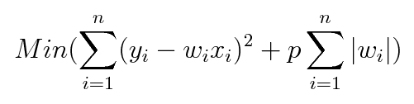
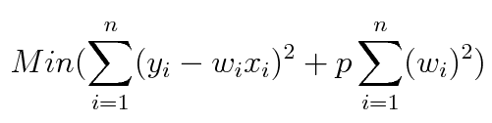
Types of regularization
L1 Regularization or Lasso Regularization – It adds a penalty to the error function. The penalty is the sum of the absolute values of weights.
L2 Regularization or Ridge Regularization – It also adds a penalty to the error function. But the penalty here is the sum of the squared values of weights.
p or lambda is the tuning parameter which decides how much we want to penalize the model.

Slide 35
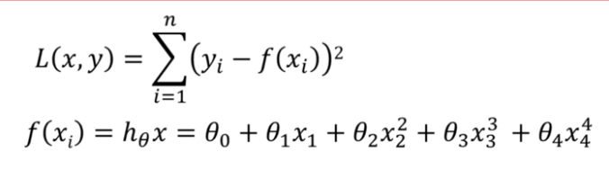
How penalizing the loss function helps simplify the model?
Loss function is the sum of squared difference between the actual value and the predicted value

Slide 36
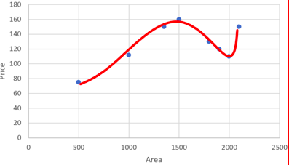
How penalizing the loss function helps simplify the model?
As the degree of the input features increases the model becomes complex and tries to fit all the data points as shown.

Slide 37
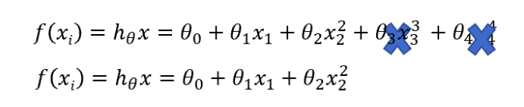
How penalizing the loss function helps simplify the model?
When we penalize the weights θ_3 and θ_4 and make them too small, very close to zero. It makes those terms negligible and helps simplify the model.
Regularization works on assumption that smaller weights generate simpler model and thus helps avoid overfitting.

Slide 38
What if the input variables have an impact on the output?
To ensure we take into account the input variables, we penalize all the weights by making them small. This also makes the model simpler and less prone to overfitting

Slide 39
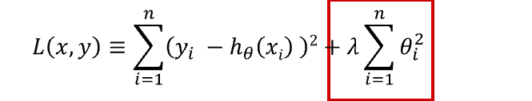
We have added the regularization term to the sum of squared differences between the actual value and predicted value. Regularization term keeps the weights small making the model simpler and avoiding overfitting.
λ or p is the penalty term or regularization parameter which determines how much to penalizes the weights.

Slide 40
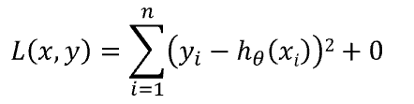

What is the right value for λ ?
When λ is zero then the regularization term becomes zero. We are back to the original Loss function.
When λ is large, we penalize the weights and they become close to zero. This results in a very simple model having a high bias or is underfitting.

Slide 41
What is the right value for λ ?
It is somewhere in between 0 and a large value. We need to find an optimal value of λ so that the generalization error is small.
A simple approach would be try different values of λ on a subsample of data, understand variability of the loss function and then use it on the entire dataset.

Slide 42
Let’s take an example!
We want to predict the ACT score of a student. For the prediction we use student’s GPA score. This model fails to predict the ACT score as the model is too simple and hence has a high bias.
We now start to add more features that may have an influence on student’s ACT score - attendance percentage, average grades in middle school and junior high, BMI, average sleep duration. We see that model has started to get too complex with more input features.

Slide 43
L1 Regularization or Lasso Regularization
In L1 Regularization, we shrink the parameters to zero. When input features have weights closer to zero, we get a sparse solution.
In Sparse solution majority of the input features have zero weights and very few features have non zero weights.
To predict ACT score not all input features have the same influence on the prediction. GPA score has a higher influence on ACT score than BMI of the student.
L1 Regularization will assign a zero weight to BMI of the student as it does not have a significant impact on prediction. GPA score will have a non zero weight as it is very useful in predicting the ACT score.

Slide 44
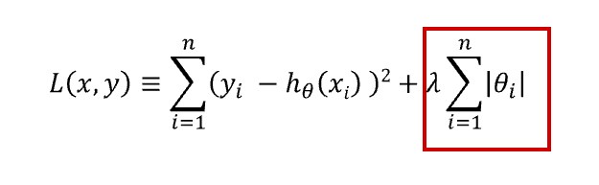
L1 Regularization or Lasso Regularization
L1 regularization does feature selection. It does this by assigning insignificant input features with zero weight and useful features with a non zero weight.
In L1 regularization we penalize the absolute value of the weights.

Slide 45
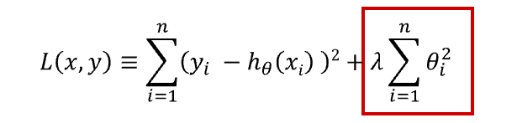
L2 Regularization or Ridge Regularization
In L2 regularization, regularization term is the sum of square of all feature weights as shown
L2 regularization forces the weights to be small but does not make them zero and hence, does not generate a sparse solution.

Slide 46
L2 Regularization or Ridge Regularization
L2 is not robust to outliers as square terms blows up the error differences of the outliers but the regularization term tries to fix it by penalizing the weights
Ridge regression performs better when all the input features influence the output and all weights are of roughly equal size

Slide 47
L1 Regularization
penalizes sum of absolute value of weights
has a sparse solution
has multiple solutions
has built in feature selection
is robust to outliers
generates model that are simple and interpretable but cannot learn complex patterns

Slide 48
L2 Regularization
penalizes sum of square weights
has a non sparse solution
has one solution
has no feature selection
is not robust to outliers
gives better prediction when output variable is a function of all input features
is able to learn complex data patterns

Slide 49
Elastic net regularization
We see that both L1 and L2 regularization have their own strengths and weakness.
Elastic net regularization is a combination of both L1 and L2 regularization.

Slide 50
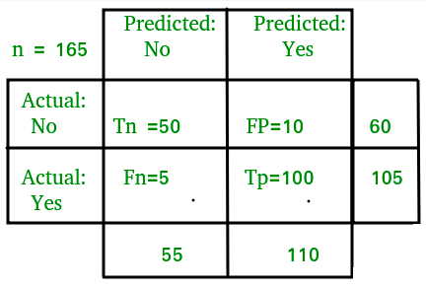
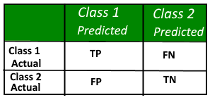
Confusion Matrix
A confusion matrix is a table that is often used to describe the performance of a classification model. It allows the visualization of the performance of an algorithm.
The number of correct and incorrect predictions are summarized with count values and broken down by each class.

Slide 51


Classification - Accuracy
Accuracy is the fraction of predictions our model got right.
For binary classification, accuracy can also be calculated in terms of positives and negatives as follows:
Where TP = True Positives, TN = True Negatives, FP = False Positives, and FN = False Negatives

Slide 52
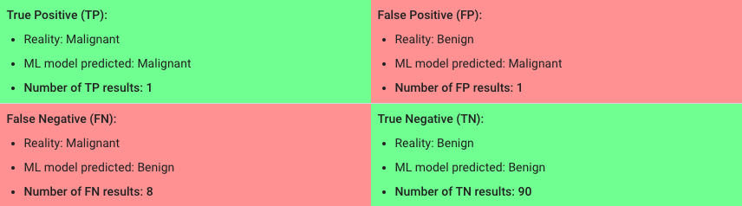

Classification - Accuracy
Let's try calculating accuracy for the model that classified 100 tumors as malignant (the positive class) or benign (the negative class):

Slide 53
Classification - Accuracy
Accuracy comes out to 0.91, or 91% (91 correct predictions out of 100 total examples). That means our tumor classifier is doing a great job of identifying malignancies, right?
Actually, let's do a closer analysis
Of the 100 tumor examples, 91 are benign (90 TNs and 1 FP) and 9 are malignant (1 TP and 8 FNs).
Of the 91 benign tumors, the model correctly identifies 90 as benign. That's good. However, of the 9 malignant tumors, the model only correctly identifies 1 as malignant—a terrible outcome, as 8 out of 9 malignancies go undiagnosed!

Slide 54
Classification - Accuracy
While 91% accuracy may seem good at first glance, another tumour-classifier model that always predicts benign would achieve the exact same accuracy (91/100 correct predictions) on our examples. In other words, our model is no better than one that has zero predictive ability to distinguish malignant tumours from benign tumours.
Accuracy alone doesn't tell the full story when you're working with a class-imbalanced data set, where there is a significant disparity between the number of positive and negative labels.
We have two better metrics for evaluating class-imbalanced problems: precision and recall.

Slide 55


Precision
To get the value of precision we divide the total number of correctly classified positive examples by the total number of predicted positive examples. High Precision indicates an example labelled as positive is indeed positive
Our model has a precision of 0.5—in other words, when it predicts a tumour is malignant, it is correct 50% of the time.

Slide 56


Recall
Recall can be defined as the ratio of the total number of correctly classified positive examples divide to the total number of positive examples. High Recall indicates the class is correctly recognized
Our model has a recall of 0.11—in other words, it correctly identifies 11% of all malignant tumors.

Slide 57
Precision and Recall: A Tug of War
To fully evaluate the effectiveness of a model, you must examine both precision and recall.
Unfortunately, precision and recall are often in tension. That is, improving precision typically reduces recall and vice versa.
Let’s explore this notion by looking at an email classification model.

Slide 58
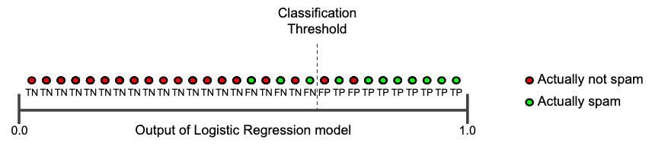
Precision and Recall: A Tug of War
Those to the right of the classification threshold are classified as "spam", while those to the left are classified as "not spam."

Slide 59


Let's calculate precision and recall
Precision measures the percentage of emails flagged as spam that were correctly classified
Recall measures the percentage of actual spam emails that were correctly classified

Slide 60
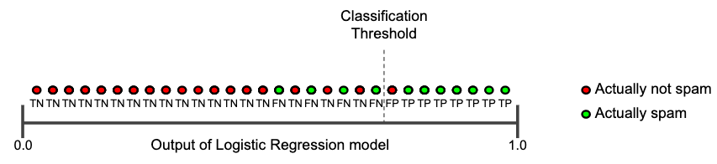
Increasing classification threshold
The number of false positives decreases, but false negatives increase. As a result, precision increases, while recall decreases.

Slide 61
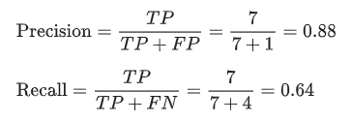
Increasing classification threshold
Low recall, high precision: This shows that we miss a lot of positive examples (high FN) but those we predict as positive are indeed positive (low FP)

Slide 62
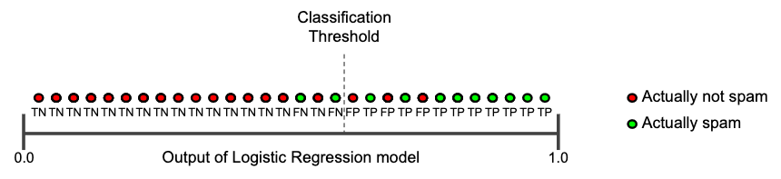
Decreasing classification threshold
False positives increase, and false negatives decrease. As a result, this time, precision decreases and recall increases.

Slide 63
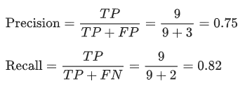
Decreasing classification threshold
High recall, low precision: This means that most of the positive examples are correctly recognized (low FN) but there are a lot of false positives.

Slide 64

F-measure
Since we have two measures (Precision and Recall) it helps to have a measurement that represents both of them.
We calculate an F-measure which uses Harmonic Mean in place of Arithmetic Mean as it punishes the extreme values more. The F-Measure will always be nearer to the smaller value of Precision or Recall.

Slide 65
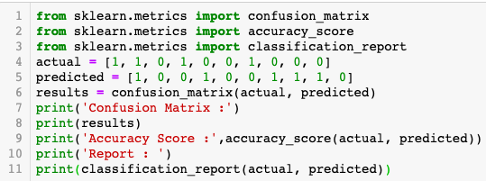
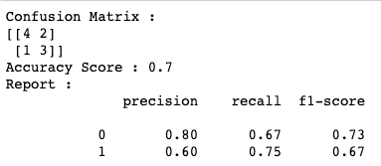

Slide 66
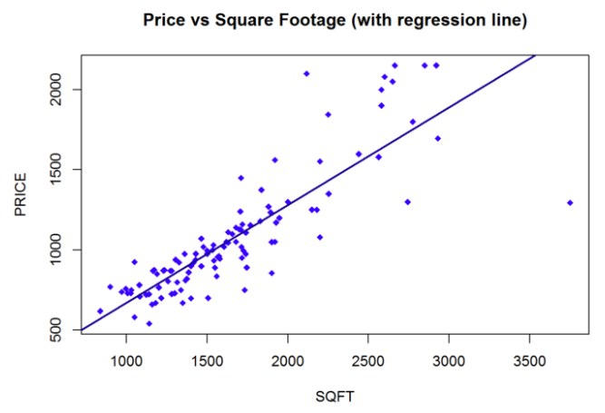
Overfitting vs. Underfitting
Let’s create our own simple dataset with x-values (features) and y-values (labels). An important part adding random noise to the labels.
In any real-world process, whether natural or man-made, the data does not exactly fit to a trend.
In the house price example, the trend between area and price is linear, but the prices do not lie exactly on a line because of other factors influencing house prices.

Slide 67
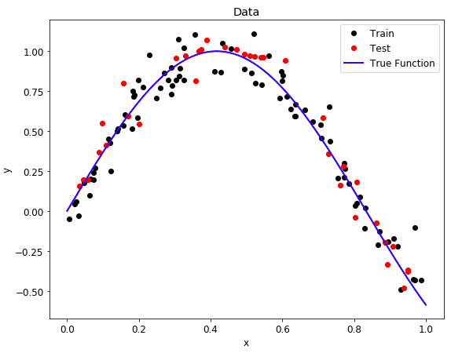
Overfitting vs. Underfitting
Our data similarly has a trend (which we call the true function) and random noise to make it more realistic.
After creating the data, we split it into random training and testing sets.
In this case, 70% of the data is used for training and 30% for testing. The graph shows the data we will explore.
During training, we want our model to learn the true function without being “distracted” by the noise.

Slide 68

Overfitting vs. Underfitting
We will use an extension of linear regression called polynomial regression to learn the relationship between x and y.
Polynomial regression, where the inputs are raised to different powers, is still considered a form of “linear” regression even though the graph does not form a straight line
A straight line is a polynomial of degree 1 while a parabola has 2 degrees.

Slide 69
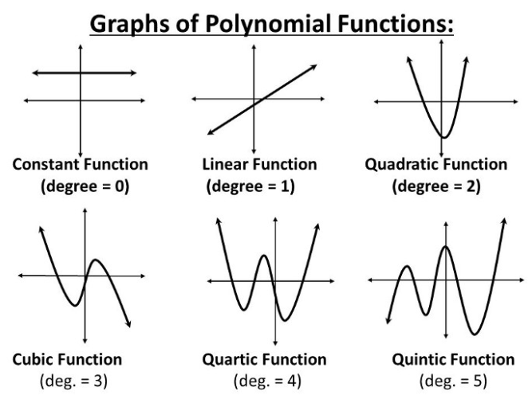

Slide 70
Overfitting vs. Underfitting
The problem of Overfitting & Underfitting finally appears when we talk about the polynomial degree.
The degree represents how much flexibility is in the model, with a higher power allowing the model freedom to hit as many data points as possible.
An underfit model will be less flexible and cannot account for the data. The best way to understand the issue is to take a look at models demonstrating both situations.

Slide 71
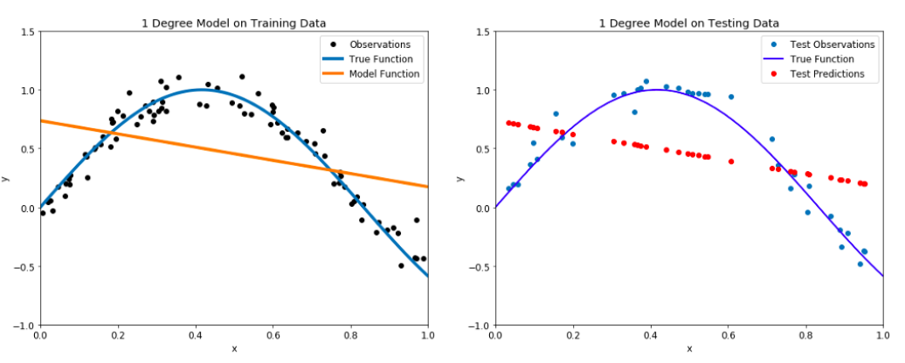
Overfitting vs. Underfitting

Slide 72
Overfitting vs. Underfitting
Our model passes straight through the training set with no regard for the data!
This is because an underfit model has low variance and high bias.
Variance refers to how much the model is dependent on the training data.
Instead, the model has high bias, which means it makes a strong assumption about the data.
For this example, the assumption is that the data is linear, which is evidently quite wrong.
When the model makes test predictions, the bias leads it to make inaccurate estimates.

Slide 73
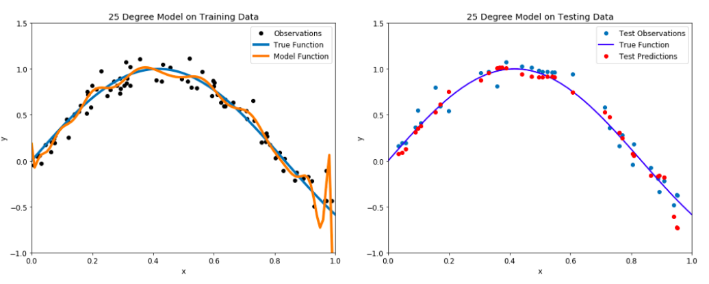
Overfitting vs. Underfitting

Slide 74
Overfitting vs. Underfitting
With such a high degree of flexibility, the model does its best to account for every single training point.
This is a model with a high variance, because it will change significantly depending on the training data.
The predictions on the test set are better than the one degree model, but the twenty five degree model still does not learn the relationship because it essentially memorizes the training data and the noise.

Slide 75
Validation
We need some sort of pre-test to use for model optimization and evaluate. This pre-test is known as a validation set.
A basic approach would be to use a validation set in addition to the training and testing set.
This presents a few problems though: we could just end up overfitting to the validation set and we would have less training data.
A smarter implementation of the validation concept is k-fold cross-validation.

Slide 76
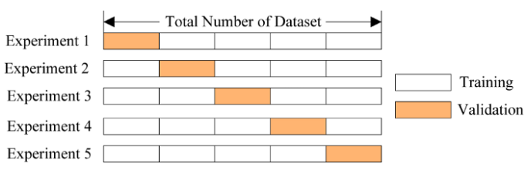
Validation
We split the training set into a number of subsets, called folds.
Let’s use five folds as an example.
We perform a series of train and evaluate cycles where each time we train on 4 of the folds and test on the 5th, called the hold-out set. We repeat this cycle 5 times, each time using a different fold for evaluation. At the end, we average the scores for each of the folds to determine the overall performance of a given model.

Slide 77
Validation
For our problem, we can use cross-validation to select the best model by creating models with a range of different degrees, and evaluate each one using 5-fold cross-validation.
The model with the lowest cross-validation score will perform best on the testing data and will achieve a balance between underfitting and overfitting.
Let’s use models with degrees from 1 to 40 to cover a wide range. To compare models, we compute the mean-squared error

Slide 78

A model with 4 degrees appears to be optimal. To test out the results, we can make a 4-degree model and view the training and testing predictions.

Slide 79

Validation

Slide 80
Verification
To verify we have the optimal model, we can also plot what are known as training and testing curves.
A model that is underfit will have high training and high testing error while an overfit model will have extremely low training error but a high testing error.

Slide 81

To verify we have the optimal model, we can also plot what are known as training and testing curves.
A model that is underfit will have high training and high testing error while an overfit model will have extremely low training error but a high testing error.

Slide 82
Ensemble Methods
Ensemble methods are meta-algorithms that combine several machine learning techniques into one predictive model in order to decrease variance (bagging), bias (boosting), or improve predictions (stacking).
Ensemble methods can be divided into two groups:
Sequential
Parallel

Slide 83
Sequential Ensemble Methods
sequential ensemble methods where the base learners are generated sequentially (e.g. AdaBoost).
The basic motivation of sequential methods is to exploit the dependence between the base learners. The overall performance can be boosted by weighing previously mislabeled examples with higher weight.

Slide 84
Parallel Ensemble Methods
parallel ensemble methods where the base learners are generated in parallel (e.g. Random Forest).
The basic motivation of parallel methods is to exploit independence between the base learners since the error can be reduced dramatically by averaging.

Slide 85
Bagging
In the Bootstrap Aggregating algorithm, the first step involves creating multiple models.
These models are generated using the same algorithm with random sub-samples of the using bootstrap sampling method.
If you want to create a sub-dataset with m elements, you should select a random element from the original dataset m times. And if the goal is generating n dataset, you follow this step n times.
At the end, we have n datasets where the number of elements in each dataset is m.

Slide 86
Bagging
The second step in bagging is aggregating the generated models.
Well known methods, such as voting and averaging, are used for this purpose.
For example, Random Forestalgorithm uses the bagging technique with some differences. Random Forest uses random feature selection, and the base algorithm of it is a decision tree algorithm.

Slide 87

We can study bagging in the context of classification on the Iris dataset.
We can choose two base estimators: a decision tree and a k-NN classifier.
Figure shows the learned decision boundary of the base estimators as well as their bagging ensembles.

Slide 88

Bagging
The figure shows how the test accuracy improves with the size of the ensemble. We can see the accuracy increases until approximately 10 base estimators and beyond 10 only increases computational complexity without accuracy gains.
We can also see the learning curves for the bagging tree ensemble. The smallest gap between training and test errors occurs at around 80% of the training set size.

Slide 89

Random Forests
A commonly used class of ensemble algorithms are forests of randomized trees.
In random forests, each tree in the ensemble is built from a sample from the training set. In addition, instead of using all the features, a random subset of features is selected, further randomizing the tree.

Slide 90

TF-IDF Transformer Usage
Below we have 5 toy documents. We are going to use this toy dataset to compute the TF-IDF scores of words in these documents.
We also import the necessary modules here which include TfidfTransformer and CountVectorizer.

Slide 91



TF-IDF Transformer Usage
In order to start using TfidfTransformer you will first have to create a CountVectorizer to count the number of words (term frequency)
We should have 5 rows (5 docs) and 16 columns (16 unique words, minus single character words)

Slide 92




TF-IDF Transformer Usage
Now we are going to compute the IDF values by calling tfidf_transformer.fit() on the word counts.

Slide 93
TF-IDF Transformer Usage
Notice that the words ‘mouse’ and ‘the’ have the lowest IDF values. This is expected as these words appear in each and every document in our collection. The lower the IDF value of a word, the less unique it is to any particular document.
Once you have the IDF values, you can now compute the tf-idf scores for any document or set of documents using tfidf_transformer.transform()

Slide 94


TF-IDF Transformer Usage
Tf-idf scores of first document:
The more common the word across documents, the lower its score and the more unique a word is to our first document (e.g. ‘had’ and ‘tiny’) the higher the score.

Slide 95
TF-IDF Vectorizer Usage
With Tfidfvectorizer you compute the word counts, idf and tf-idf values all at once using tfidf_vectorizer.fit_transform()

Slide 96
TF-IDF Transformer vs. TF-IDF Vectorizer
With Tfidftransformer you will systematically compute word counts using CountVectorizer and then compute the Inverse Document Frequency (IDF) values and only then compute the Tf-idf scores.
With Tfidfvectorizer on the contrary, you will do all three steps at once. Under the hood, it computes the word counts, IDF values, and Tf-idf scores all using the same dataset.

Slide 97
Clustering
Clustering is the task of dividing the population or data with similar traits and assign them into clusters.
Let’s understand this with an example. Suppose, you are the head of a rental store and wish to understand preferences of your customers to scale up your business.
Is it possible for you to look at details of each customer and devise a unique business strategy for each one of them? Definitely not.
But, what you can do is to cluster all of your costumers into say 10 groups based on their purchasing habits and use a separate strategy for costumers in each of these 10 groups. And this is what we call clustering.

Slide 98
Types of clustering algorithms
Connectivity models: As the name suggests, these models are based on the notion that the data points closer in data space exhibit more similarity to each other than the data points lying farther away.
These models can follow two approaches.
In the first approach, they start with classifying all data points into separate clusters & then aggregating them as the distance decreases.
In the second approach, all data points are classified as a single cluster and then partitioned as the distance increases.
These models are very easy to interpret but lacks scalability for handling big datasets. Examples of these models are hierarchical clustering algorithm and its variants.

Slide 99
Types of clustering algorithms
Centroid models: These are iterative clustering algorithms in which the notion of similarity is derived by the closeness of a data point to the centroid of the clusters.
K-Means clustering algorithm is a popular algorithm that falls into this category. In these models, the no. of clusters required at the end have to be mentioned beforehand, which makes it important to have prior knowledge of the dataset.

Slide 100
Types of clustering algorithms
Density Models: These models search the data space for areas of varied density of data points in the data space.
It isolates various different density regions and assign the data points within these regions in the same cluster.
Popular examples of density models are DBSCAN and OPTICS.

Slide 101

K Means Clustering
K means is an iterative clustering algorithm that aims to find local maxima in each iteration.
This algorithm works in these 5 steps :
Specify the desired number of clusters K : Let us choose k=2 for these 5 data points in 2-D space.
Randomly assign each data point to a cluster : Let’s assign three points in cluster 1 shown using red color and two points in cluster 2 shown using grey color.

Slide 102

K Means Clustering
3. Compute cluster centroids : The centroid of data points in the red cluster is shown using red cross and those in grey cluster using grey cross.

Slide 103

K Means Clustering
4. Re-assign each point to the closest cluster

Slide 104

K Means Clustering
5. Re-compute cluster centroids
Repeat steps 4 and 5 until no improvements are possible.
When there will be no further switching of data points between two clusters for two successive repeats, it will mark the termination of the algorithm.

Slide 105
K Means Clustering
6. Repeat steps 4 and 5 until no improvements are possible : Similarly, we’ll repeat the 4th and 5th steps until we’ll reach global optima. When there will be no further switching of data points between two clusters for two successive repeats. It will mark the termination of the algorithm if not explicitly mentioned.

Slide 106
Ways of deciding K in clustering
Direct methods: consists of optimizing a criterion, such as the within cluster sums of squares or the average silhouette. The corresponding methods are named elbow and silhouette methods, respectively.
Statistical testing methods: consists of comparing evidence against null hypothesis. An example is the gap statistic.
Another popular solution consists of inspecting the dendrogram produced using hierarchical clustering to see if it suggests a particular number of clusters.

Slide 107
Elbow method
The basic idea behind partitioning methods, such as k-means clustering, is to define clusters such that the total intra-cluster variation [or total within-cluster sum of square (WSS)] is minimized.
The Elbow method looks at the total WSS as a function of the number of clusters: One should choose a number of clusters so that adding another cluster doesn’t improve much better the total WSS.

Slide 108

Elbow method
Compute k-means clustering for different values of k. For instance, by varying k from 1 to 10 clusters.
For each k, calculate the total within-cluster sum of square (wss).
Plot the curve of wss according to the number of clusters k.
The location of a bend (knee) in the plot is considered as an indicator of the appropriate number of clusters.
Elbow method: 4 clusters solution suggested

Slide 109
Average silhouette method
It measures the quality of a clustering. That is, it determines how well each object lies within its cluster.
Average silhouette method computes the average silhouette of observations for different values of k. The optimal number of clusters k is the one that maximize the average silhouette over a range of possible values for k.

Slide 110

Average silhouette method
Compute k-means clustering for different values of k. For instance, by varying k from 1 to 10 clusters.
For each k, calculate the average silhouette of observations (avg.sil).
Plot the curve of avg.sil according to the number of clusters k.
The location of the maximum avg.sil is considered as the appropriate number of clusters.
Silhouette method: 2 clusters solution suggested

Slide 111

Hierarchical Clustering
Hierarchical clustering, as the name suggests is an algorithm that builds hierarchy of clusters. This algorithm starts with all the data points assigned to a cluster of their own. Then two nearest clusters are merged into the same cluster. In the end, this algorithm terminates when there is only a single cluster left.
The results of hierarchical clustering can be shown using dendrogram.

Slide 112
Hierarchical Clustering
At the bottom, we start with 25 data points, each assigned to separate clusters. Two closest clusters are then merged till we have just one cluster at the top. The height in the dendrogram at which two clusters are merged represents the distance between two clusters in the data space.
The decision of merging two clusters is taken on the basis of closeness of these clusters. There are multiple metrics for deciding the closeness of two clusters:
Euclidean distance
Squared Euclidean distance
Manhattan distance
Maximum distance

Slide 113

Hierarchical Clustering
The best choice of the no. of clusters is the no. of vertical lines in the dendrogram cut by a horizontal line that can transverse the maximum distance vertically without intersecting a cluster.
In the example, the best choice of no. of clusters will be 4 as the red horizontal line in the dendrogram covers maximum vertical distance AB.

Slide 114
Diff. b/w K Means and Hierarchical clustering
Hierarchical clustering can’t handle big data well but K Means clustering can. This is because the time complexity of K Means is linear i.e. O(n) while that of hierarchical is quadratic i.e. O(n²).
In K Means clustering, since we start with random choice of clusters, the results produced by running the algorithm multiple times might differ. While results are reproducible in Hierarchical clustering.
K Means clustering requires prior knowledge of K i.e. no. of clusters you want to divide your data into. But, you can stop at whatever number of clusters you find appropriate in hierarchical clustering by interpreting the dendrogram

