Slide 1


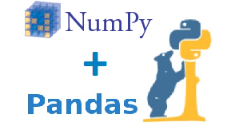



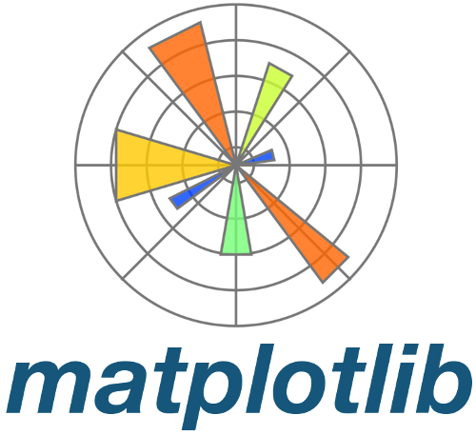

Machine Learning with Python Programming
By - Ravi

Slide 2

What is Machine Learning ?

Slide 3
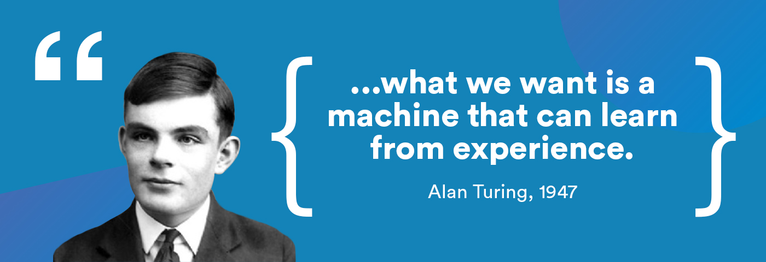
What is Machine Learning

Slide 4
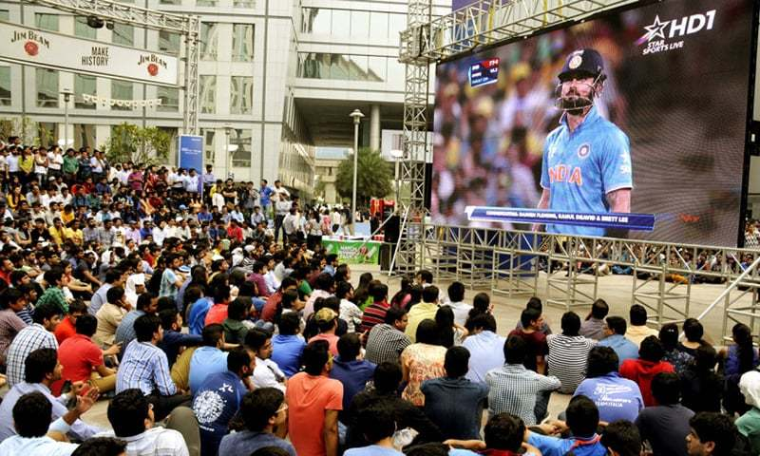
India needs 8 runs to win with 10 wickets in hand
And 36 balls are remaining

Slide 5

India will either :
Win OR Loss

Slide 6

But the question is how can you be so sure ?
How can you do prediction ?
How can you be so confident about the outcome ?

Slide 7
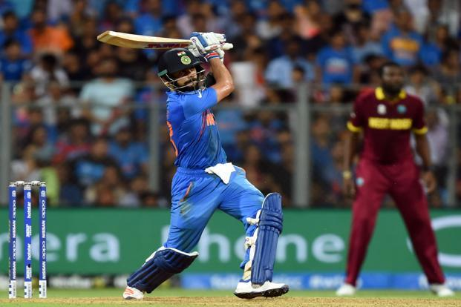
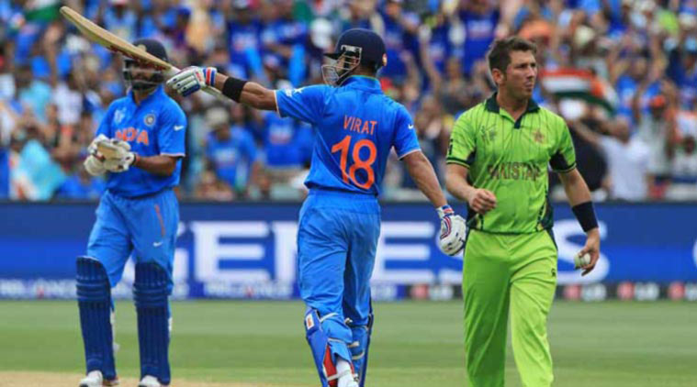

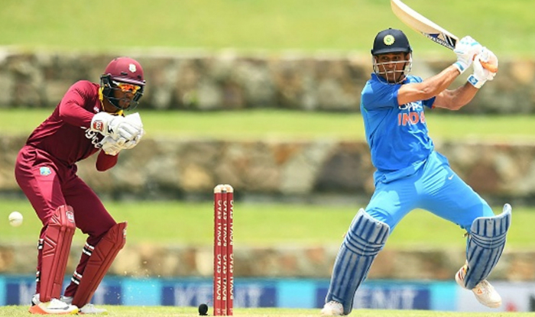
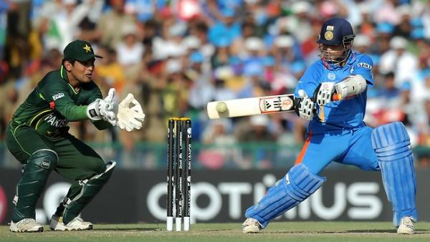
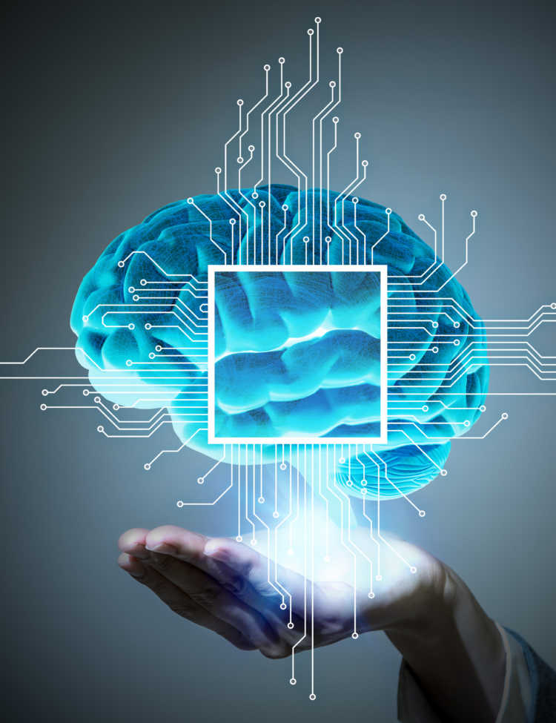
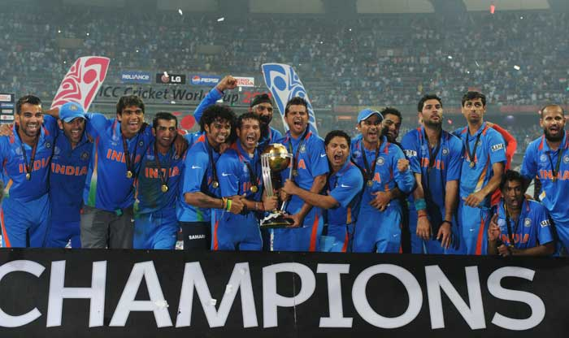
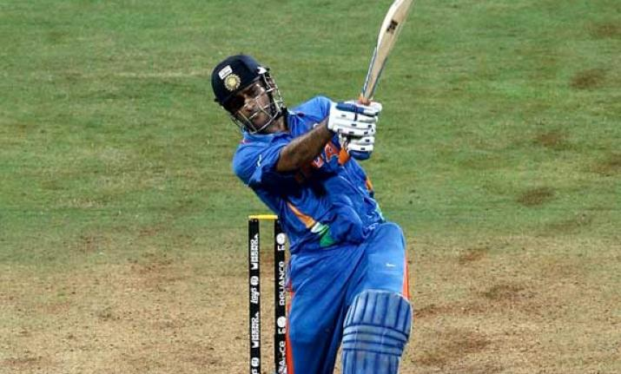

Slide 8


What if computer do this for you ?
May I Help You ?
To do that we need to
train our machines…
It means we need to share
our experiences with machines

Slide 9

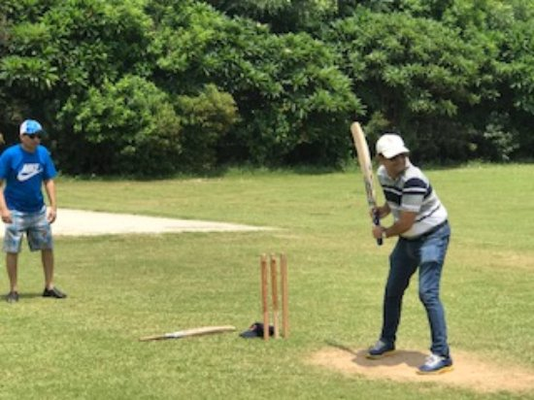
But wait, how a machine can learn from past experiences of human.
Because humans have memory in different form. We can learn from videos, images or playing the game by our self.

Slide 10

So how machines will learn, let’s see
Step – 1 : We will collect the data of previous matches in form of numbers.
Step – 2 : Store that data in some file like excel or any other format.
Step – 3 : Now our machines can read that data easily.
So that’s how machines will get the data

Slide 11
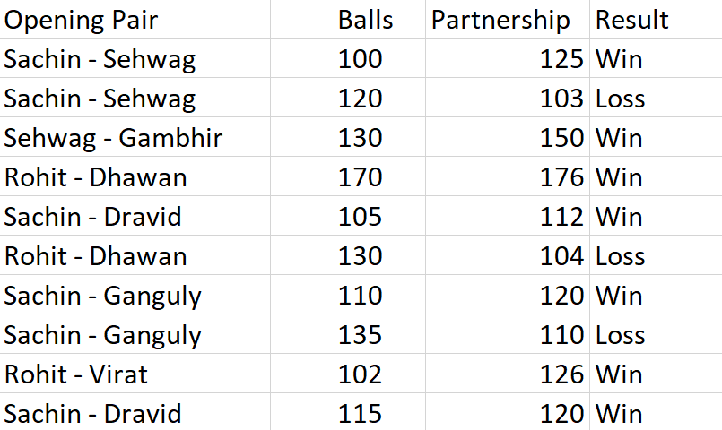
Suppose we collected this type of data

Slide 12

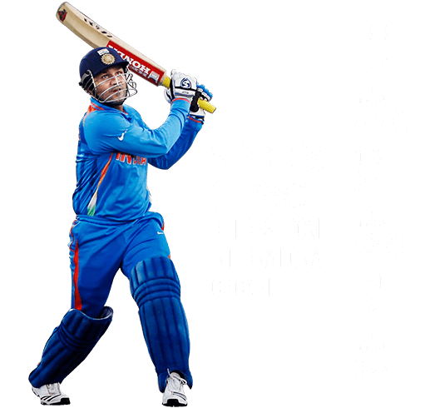
After looking at the data :
Now our machine will learn that whenever the opening pair of India build partnership of more than 100 runs in less balls, there is a chance of more than 80% that India wins the match.

Slide 13
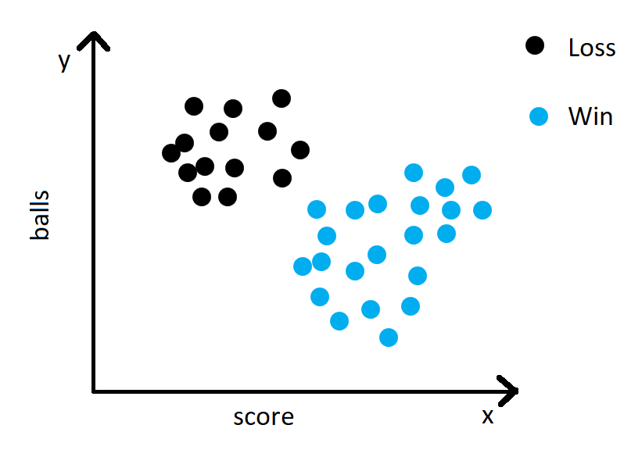
Let’s plot this on graph

Slide 14
Let’s plot this on graph

Slide 15
Let’s plot this on graph
New Input

Slide 16
Let’s plot this on graph
New Input

Slide 17
Let’s plot this on graph
New Input

Slide 18
Let’s plot this on graph
New Input

Slide 19
Let’s plot this on graph
New Input

Slide 20
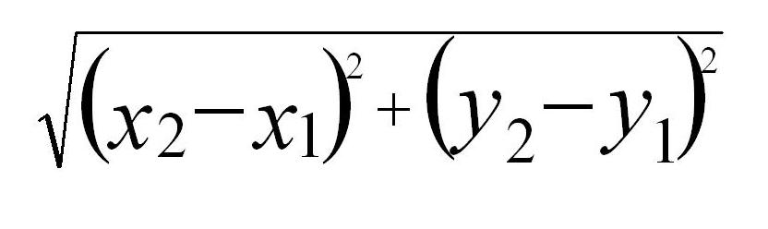
Let’s plot this on graph
K-NEAREST NEIGHBORS
New Input

Slide 21
Machine Learning is
A type of artificial intelligence
Used to allow machines to learn from experiences like human
An idea to build algorithms that can receive input data and use some math to predict an output value.

Slide 22
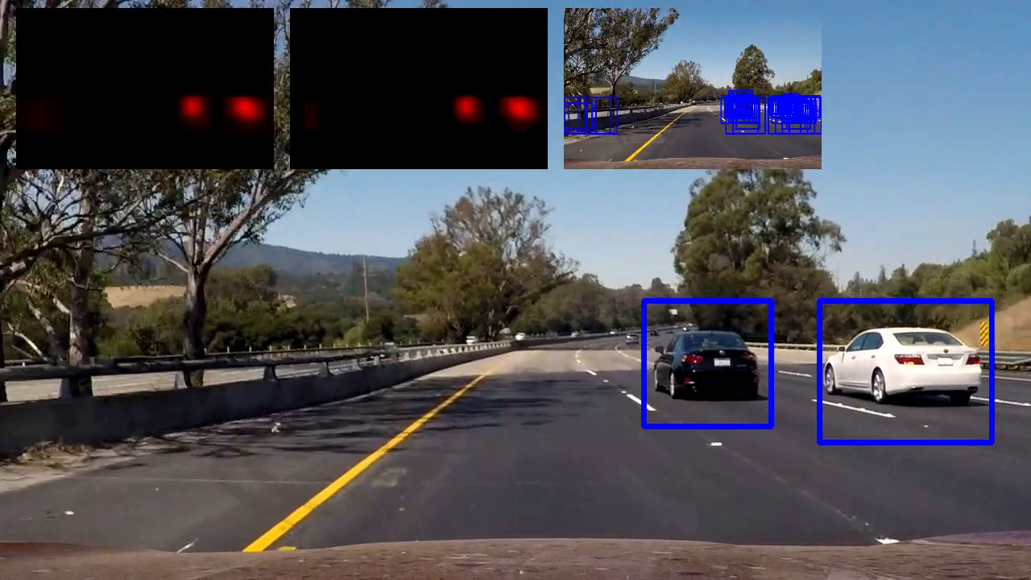

Slide 23
Types of Machine Learning
Supervised Learning
Unsupervised Learning
Reinforcement Learning
Semi-Supervised Learning

Slide 24
Supervised Learning

Slide 25
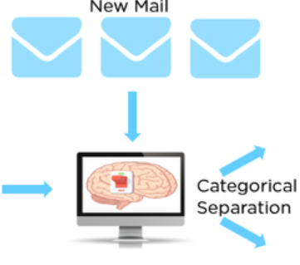

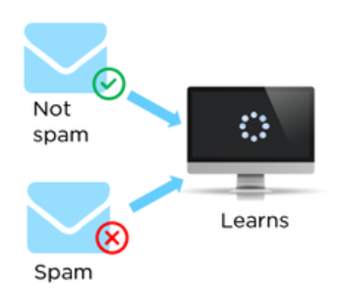
Here the machine was already aware of the target that what spam mail looks like. We provided emails data with their respective labels that it is spam or not

Slide 26
Unsupervised Learning

Slide 27



Clustering Algorithm
Male
Model Training
Data without labels
(Unknown Outputs)
Female
Here the machine was not aware of the target. Data is without labels. Here we do clustering to group the similar type of data together.

