Slide 1


Programming
By :- Ravi

Slide 2
R Programming
R is a free and open source software programming language and software environment for statistical computing and graphics.
Much of the system is itself written in the R dialect of the S programming language.
The R language is widely used among statisticians and data miners for developing statistical software and data analysis.

Slide 3
Little Bit History of R
R is an implementation of the S programming language combined with lexical scoping semantics inspired by Scheme. S was created by John Chambers in 1976, while at Bell Labs.
R was created by Ross Ihaka and Robert Gentleman at the University of Auckland, New Zealand, and is currently developed by the R Development Core Team.
The project was conceived in 1992, with an initial version released in 1995 and a stable beta version in 2000.

Slide 4
Understanding Basic Data Types in R
Everything in R is an object.
Basic Data Types in R :
character
numeric (real or decimal)
integer
logical
complex

Slide 5
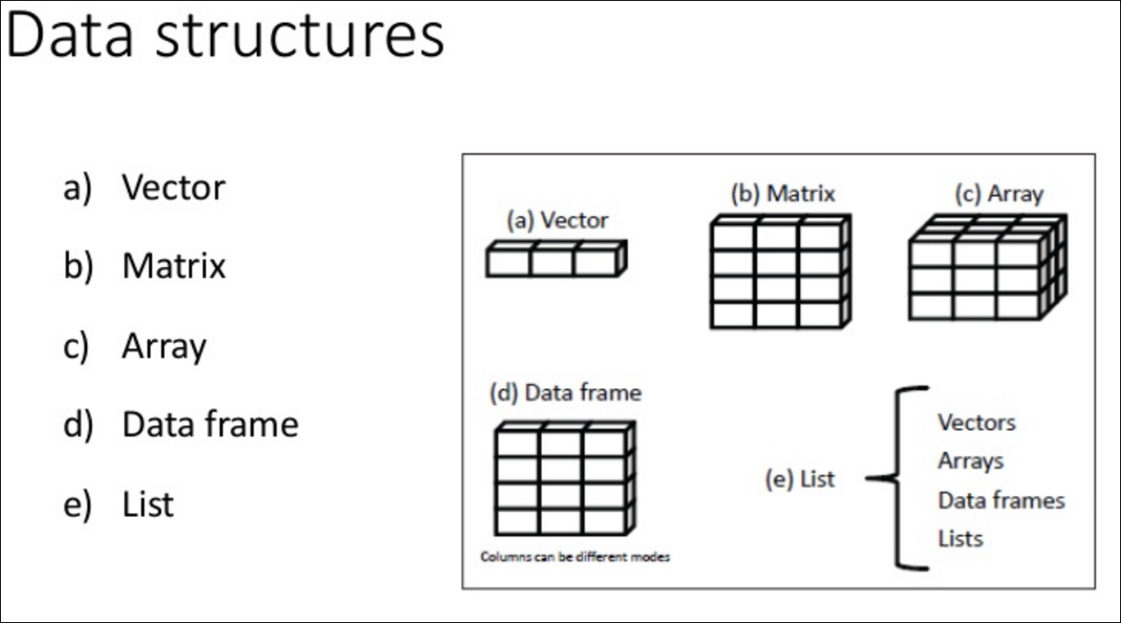

Slide 6
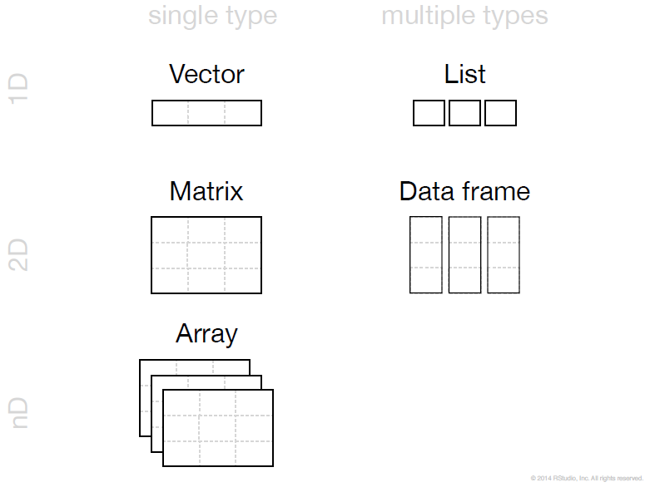

Slide 7
Statistical Features
R and its libraries implement a wide variety of statistical and graphical techniques :-
linear and nonlinear modeling.
classical statistical tests
time-series analysis
classification
clustering

Slide 8
Ggplot 2
What Is The Grammar Of Graphics?
The basic idea: independently specify plot building blocks and combine them to create just about any kind of graphical display you want. Building blocks of a graph include:
data
aesthetic mapping
geometric object
statistical transformations
scales
coordinate system
position adjustments
faceting

Slide 9
Why GGPlot2 ?
Advantages of ggplot2
consistent underlying gramma of graphics
plot specification at a high level of abstraction
very flexible
theme system for polishing plot appearance
mature and complete graphics system
many users, active mailing list

Slide 10
GGPlot2
Understanding the Ggplot Syntax
The syntax for constructing ggplots could be puzzling if you are a beginner or work primarily with base graphics. The main difference is that, unlike base graphics, ggplot works with dataframes and not individual vectors. All the data needed to make the plot is typically be contained within the dataframe supplied to the ggplot() itself or can be supplied to respective geoms. More on that later.
The second noticeable feature is that you can keep enhancing the plot by adding more layers (and themes) to an existing plot created using the ggplot().

Slide 11
ggplot 2 vs Base Graphics
Compared to base graphics, ggplot
is more verbose for simple / canned graphics
is less verbose for complex / custom graphics
does not have methods (data should always be in a data.frame)

Slide 12
Statistical inference
Statistical inference is the art of generating conclusions about the distribution of the data. A data scientist is often exposed to question that can only be answered scientifically. Therefore, statistical inference is a strategy to test whether a hypothesis is true, i.e. validated by the data.
A common strategy to assess hypothesis is to conduct a t-test. A t-test can tell whether two groups have the same mean. A t-test is also called a Student Test. A t-test can be estimated for:
A single vector (i.e., one-sample t-test)
Two vectors from the same sample group (i.e., paired t-test).

Slide 13
Hypothesis Testing
The main purpose of statistics is to test a hypothesis. For example, you might run an experiment and find that a certain drug is effective at treating headaches. But if you can’t repeat that experiment, no one will take your results seriously.
What is a Hypothesis?
A hypothesis is an educated guess about something in the world around you. It should be testable, either by experiment or observation.

Slide 14
Hypothesis Testing
A new medicine you think might work.
A way of teaching you think might be better.
A possible location of new species

Slide 15
What is a Hypothesis Statement?
If you are going to propose a hypothesis, it’s customary to write a statement. Your statement will look like this: “If I…(do this to an independent variable)….then (this will happen to the dependent variable).” For example:
If I (decrease the amount of water given to herbs) then (the herbs will increase in size).
If I (hit more runs in first 10 overs) then (it might make us win easily)
If I (study in night rather than day) then (it might result in good marks)

Slide 16
What is a Hypothesis Statement?
A good hypothesis statement should:
Include an “if” and “then” statement (according to the University of California).
Include both the independent and dependent variables.
Be testable by experiment, survey or other scientifically sound technique.
Be based on information in prior research (either yours or someone else’s).
Have design criteria (for engineering or programming projects).

Slide 17
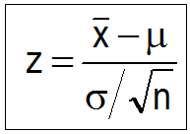
What is Hypothesis Testing?
Hypothesis testing in statistics is a way for you to test the results of a survey or experiment to see if you have meaningful results. You’re basically testing whether your results are valid by figuring out the odds that your results have happened by chance. If your results may have happened by chance, the experiment won’t be repeatable and so has little use.

Slide 18
What is Hypothesis Testing?
Hypothesis testing can be one of the most confusing aspects for people, mostly because before you can even perform a test, you have to know what your null hypothesis is. Often, those tricky word problems that you are faced with can be difficult to decipher. But it’s easier than you think; all you need to do is:
Figure out your null hypothesis,
State your null hypothesis,
Choose what kind of test you need to perform,
Either support or reject the null hypothesis.

Slide 19
What is the Null Hypothesis?
If you trace back the history of science, the null hypothesis is always the accepted fact. Simple examples of null hypotheses that are generally accepted as being true are:
DNA is shaped like a double helix.
There are 8 planets in the solar system (excluding Pluto).
Taking Vioxx can increase your risk of heart problems (a drug now taken off the market).

Slide 20
How to State the Null Hypothesis?
You won’t be required to actually perform a real experiment or survey in elementary statistics (or even disprove a fact like “Pluto is a planet”!), so you’ll be given word problems from real-life situations. You’ll need to figure out what your hypothesis is from the problem. This can be a little trickier than just figuring out what the accepted fact is. With word problems, you are looking to find a fact that is nullifiable (i.e. something you can reject).

Slide 21
Rejecting the null hypothesis
Few years ago, we believed that there were 9 planets in the solar system. Pluto was demoted as a planet in 2006. The null hypothesis of “Pluto is a planet” was replaced by “Pluto is not a planet.” Of course, rejecting the null hypothesis isn’t always that easy — the hard part is usually figuring out what your null hypothesis is in the first place.

Slide 22
One Sample Hypothesis Testing Example
A principal at a certain school claims that the students in his school are above average intelligence. A random sample of thirty students IQ scores have a mean score of 112. Is there sufficient evidence to support the principal’s claim? The mean population IQ is 100 with a standard deviation of 15.
Step 1: State the Null hypothesis. The accepted fact is that the population mean is 100, so: H₀: μ=100.

Slide 23
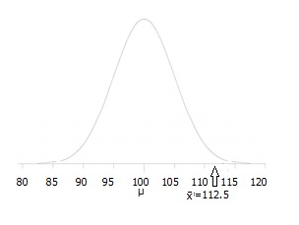
Step 2: State the Alternate Hypothesis. The claim is that the students have above average IQ scores, so: H₁: μ > 100. The fact that we are looking for scores “greater than” a certain point means that this is a one-tailed test.
Step 3: Draw a picture to help you visualize the problem.

Slide 24
Step 4: State the alpha level. If you aren’t given an alpha level, use 5% (0.05).
Step 5: Find the rejection region area (given by your alpha level above) from the z-table. An area of .05 is equal to a z-score of 1.645.
Step 6: Find the test statistic using this formula.
For this set of data: z= (112.5-100) / (15/√30)=4.56.
Step 6: If Step 6 is greater than Step 5, reject the null hypothesis. If it’s less than Step 5, you cannot reject the null hypothesis. In this case, it is greater (4.56 > 1.645), so you can reject the null.

Slide 25
T-test
One of the most common tests in statistics is the t-test, used to determine whether the means of two groups are equal to each other. The assumption for the test is that both groups are sampled from normal distributions with equal variances. The null hypothesis is that the two means are equal, and the alternative is that they are not. It is known that under the null hypothesis, we can calculate a t-statistic that will follow a t-distribution with n1 + n2 - 2 degrees of freedom.

Slide 26
What is t-test?
The basic idea behind a t-test is to use statistic to evaluate two contrary hypotheses:
H0: NULL hypothesis: The average is the same as the sample used
H3: True hypothesis: The average is different from the sample used
The t-test is commonly used with small sample sizes. To perform a t-test, you need to assume normality of the data.

Slide 27
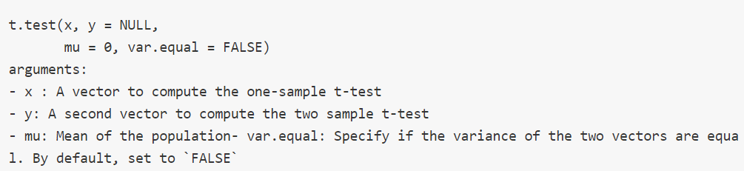
Syntax of t-test in R

Slide 28

One-sample t-test
The t-test, or student's test, compares the mean of a vector against a theoretical mean,
The formula used to compute the t-test is:
The sample mean(x̄).
The population mean(μ).
The sample standard deviation(s).
Number of observations(n).

Slide 29
One-sample t-test
To evaluate the statistical significance of the t-test, you need to compute the p-value. The p-value ranges from 0 to 1, and is interpreted as follow:
A p-value lower than 0.05 means you are strongly confident to reject the null hypothesis, thus H3 is accepted.
A p-value higher than 0.05 indicates that you don't have enough evidences to reject the null hypothesis.
You can construct the pvalue by looking at the corresponding absolute value of the t-test in the Student distribution with a degrees of freedom equals to df = n - 1

Slide 30
One Sample T Test Example
Sample question: your company wants to improve sales. Past sales data indicate that the average sale was $100 per transaction. After training your sales force, recent sales data (taken from a sample of 25 salesmen) indicates an average sale of $130, with a standard deviation of $15. Did the training work? Test your hypothesis at a 5% alpha level.
Step 1: Write your null hypothesis statement (How to state a null hypothesis). The accepted hypothesis is that there is no difference in sales, so: H₀: μ = $100.

Slide 31
Step 2: Write your alternate hypothesis. This is the one you’re testing. You think that there is a difference (that the mean sales increased), so: H₁: μ > $100.
Step 3: Identify the following pieces of information you’ll need to calculate the test statistic. The question should give you these items:
The sample mean(x̄). This is given in the question as $130.
The population mean(μ). Given as $100 (from past data).
The sample standard deviation(s) = $15.
Number of observations(n) = 25.
Step 4: Insert the items from above into the t score formula.

Slide 32
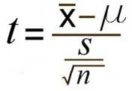
t = (130 – 100) / ((15 / √(25)) t = (30 / 3) = 10 This is your calculated t-value.
Step 5: Find the t-table value. You need two values to find this:
The alpha level: given as 5% in the question.
The degrees of freedom, which is the number of items in the sample (n) minus 1: 25 – 1 = 24.
Look up 24 degrees of freedom in the left column and 0.05 in the top row. The intersection is 1.711.This is your one-tailed critical t-value.
What this critical value means is that we would expect most values to fall under 1.711. If our calculated t-value (from Step 4) falls within this range, the null hypothesis is likely true.

Slide 33
Step 5: Compare Step 4 to Step 5. The value from Step 4 does not fall into the range calculated in Step 5, so we can reject the null hypothesis. The value of 10 falls into the rejection region (the left tail).
In other words, it’s highly likely that the mean sale is greater. The sales training was probably a success.

Slide 34
Apriori Market Basket Analysis / Association Rules

Slide 35
Apriori
Apriori Algorithm
With the quick growth in e-commerce applications, there is an accumulation vast quantity of data in months not in years. Data Mining, also known as Knowledge Discovery in Databases(KDD), to find anomalies, correlations, patterns, and trends to predict outcomes.
Apriori algorithm is a classical algorithm in data mining. It is used for mining frequent itemsets and relevant association rules. It is devised to operate on a database containing a lot of transactions, for instance, items brought by customers in a store.

Slide 36
Apriori
It is very important for effective Market Basket Analysis and it helps the customers in purchasing their items with more ease which increases the sales of the markets. It has also been used in the field of healthcare for the detection of adverse drug reactions. It produces association rules that indicates what all combinations of medications and patient characteristics lead to ADRs.

