Slide 1


Programming
By :- Ravi

Slide 2
R Programming
R is a free and open source software programming language and software environment for statistical computing and graphics.
Much of the system is itself written in the R dialect of the S programming language.
The R language is widely used among statisticians and data miners for developing statistical software and data analysis.

Slide 3
Little Bit History of R
R is an implementation of the S programming language combined with lexical scoping semantics inspired by Scheme. S was created by John Chambers in 1976, while at Bell Labs.
R was created by Ross Ihaka and Robert Gentleman at the University of Auckland, New Zealand, and is currently developed by the R Development Core Team.
The project was conceived in 1992, with an initial version released in 1995 and a stable beta version in 2000.

Slide 4
Understanding Basic Data Types in R
Everything in R is an object.
Basic Data Types in R :
character
numeric (real or decimal)
integer
logical
complex

Slide 5
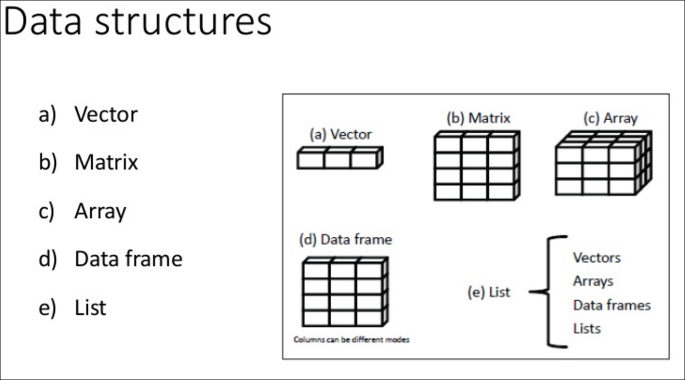

Slide 6
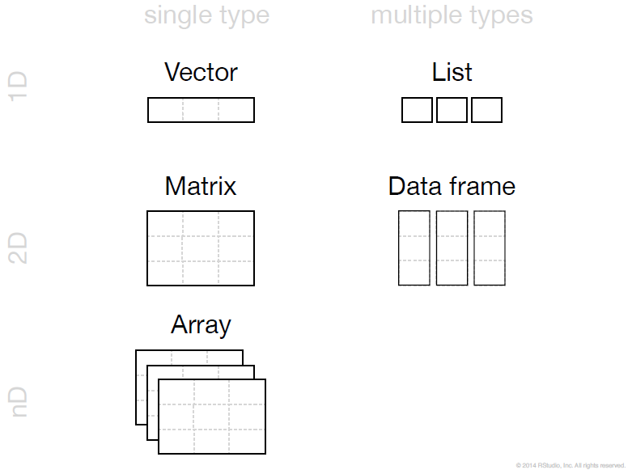

Slide 7
Statistical Features
R and its libraries implement a wide variety of statistical and graphical techniques :-
linear and nonlinear modeling.
classical statistical tests
time-series analysis
classification
clustering

Slide 8
Ggplot 2
What Is The Grammar Of Graphics?
The basic idea: independently specify plot building blocks and combine them to create just about any kind of graphical display you want. Building blocks of a graph include:
data
aesthetic mapping
geometric object
statistical transformations
scales
coordinate system
position adjustments
faceting

Slide 9
Why GGPlot2 ?
Advantages of ggplot2
consistent underlying gramma of graphics
plot specification at a high level of abstraction
very flexible
theme system for polishing plot appearance
mature and complete graphics system
many users, active mailing list

Slide 10
GGPlot2
Understanding the Ggplot Syntax
The syntax for constructing ggplots could be puzzling if you are a beginner or work primarily with base graphics. The main difference is that, unlike base graphics, ggplot works with dataframes and not individual vectors. All the data needed to make the plot is typically be contained within the dataframe supplied to the ggplot() itself or can be supplied to respective geoms. More on that later.
The second noticeable feature is that you can keep enhancing the plot by adding more layers (and themes) to an existing plot created using the ggplot().

Slide 11
ggplot 2 vs Base Graphics
Compared to base graphics, ggplot
is more verbose for simple / canned graphics
is less verbose for complex / custom graphics
does not have methods (data should always be in a data.frame)

Slide 12
Regular Expressions
What are Regular Expressions ? When do you use them ?
What is String Manipulation ?
List of String Manipulation Functions
List of Regular Expression Commands
Metacharacters
Sequences
Quantifiers
Character Classes
POSIX character classes
Practice Examples on Regular Expressions

Slide 13
Regular Expressions
Regular Expressions (regex) are a set of pattern matching commands used to detect string sequences in a large text data. These commands are designed to match a family (alphanumeric, digits, words) of text which makes then versatile enough to handle any text / string class.
In short, using regular expressions you can get more out of text data while writing shorter codes.
For example, let's say you've scraped some data from the web. The data contains the log time of users. You want to extract log time. But, the data is really messy. It is contaminated with html div(s), javascript functions, and what not! In such situations, you should use regular expressions.

Slide 14
String Manipulation
As the name suggests, string manipulation comprises a series of functions used to extract information from text variables. In machine learning, these functions are being widely used for doing feature engineering, i.e., to create new features out of existing string features. In R, we have packages such as stringr and stringi which are loaded with all string manipulation functions.
In addition, R also comprises several base functions for string manipulations. These functions are designed to complement regular expressions.

Slide 15
String Manipulation
The practical differences between string manipulation functions and regular expressions are
We use string manipulation functions to do simple tasks such as splitting a string, extracting the first three letters, etc.. We use regular expressions to do more complicated tasks such as extract email IDs or date from a set of text.
String manipulation functions are designed to respond in a certain way. They don't deviate from their natural behavior. Whereas, we can customize regular expressions in any way we want.

Slide 16
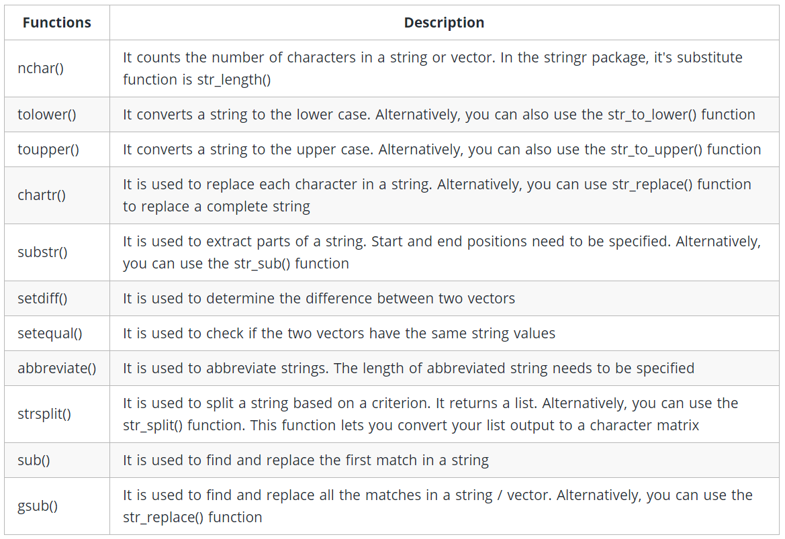

Slide 17
stringr
#count number of characters str_length(string)
#convert to lower str_to_lower(string)
#convert to upper str_to_upper(string)
#replace strings str_replace_all(string = string, pattern = c("City"),replacement = "state") #this is case sentitive
#extract parts of string `substr(x = string,start = 5,stop = 11)

Slide 18
stringr
#extract angeles str_sub(string = string, start = 5, end = 11)
#get difference between two vectors setdiff(c("monday","tuesday","wednesday"),c("monday","thursday","friday"))
#check if strings are equal setequal(c("monday","tuesday","thursday"),c("monday","tuesday","wednesday"))
#abbreviate strings abbreviate(c("monday","tuesday","wednesday"),minlength = 3)
#split strings str_split(string = c("ID-101","ID-102","ID-103","ID-104"),pattern = "-",simplify = T)
#find and replace first match sub(pattern = "L",replacement = "B",x = string,ignore.case = T)
#find and replace all matches gsub(pattern = "Los",replacement = "Bos",x = string,ignore.case = T)

Slide 19
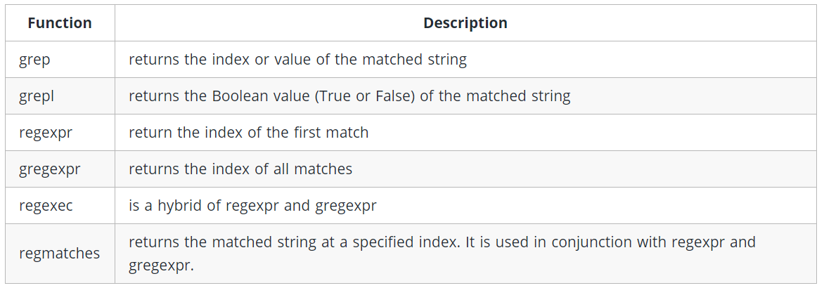
List of Regular Expression Commands

Slide 20
Regular Expressions in R
Regular expressions in R can be divided into 5 categories:
Metacharacters
Sequences
Quantifiers
Character Classes
POSIX character classes

Slide 21
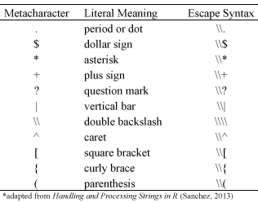
Metacharacters
Metacharacters comprises a set of special operators which regex doesn't capture. Metacharacters consist of non-alphanumeric symbols such as:
. \\\ | ( ) [ { $ * + ?
To match metacharacters in R you need to escape them with a double backslash “\\”. The following displays the general escape syntax for the most common metacharacters:

Slide 22
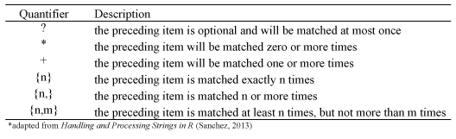
Quantifiers
When we want to match a certain number of characters that meet a certain criteria we can apply quantifiers to our pattern searches. The quantifiers we can use are:

Slide 23
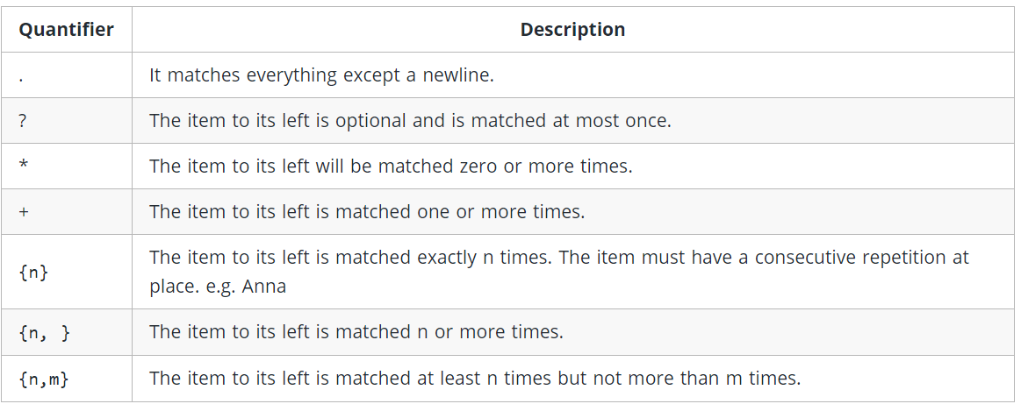
Quantifiers

Slide 24
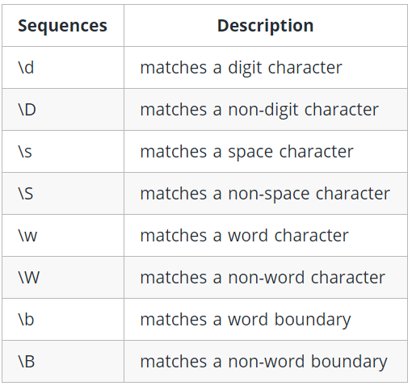
Sequences
As the name suggests, sequences contain special characters used to describe a pattern in a given string. To match a sequence of characters we can apply short-hand notation which captures the fundamental types of sequences. Following are the commonly used sequences in R:

Slide 25
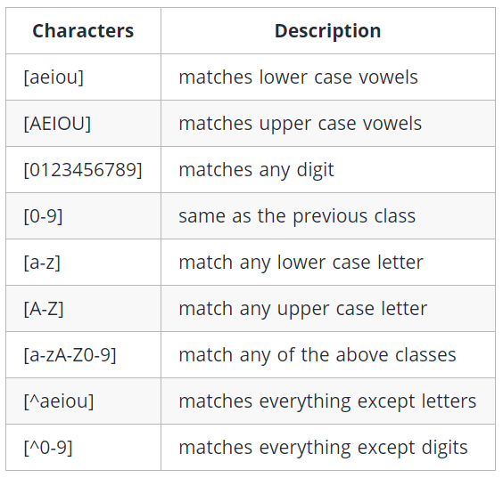
Character Class
To match one of several characters in a specified set we can enclose the characters of concern with square brackets [ ]. In addition, to match any characters not in a specified character set we can include the caret ^ at the beginning of the set within the brackets. The following displays the general syntax for common character classes but these can be altered easily

Slide 26
POSIX Character Class
In R, these classes can be identified as enclosed within a double square bracket ([[ ]]). They work like character classes. A caret ahead of an expression negates the expression value.
Closely related to regex character classes are POSIX character classes which are expressed in double brackets [[ ]].

Slide 27
Statistical inference
Statistical inference is the art of generating conclusions about the distribution of the data. A data scientist is often exposed to question that can only be answered scientifically. Therefore, statistical inference is a strategy to test whether a hypothesis is true, i.e. validated by the data.
A common strategy to assess hypothesis is to conduct a t-test. A t-test can tell whether two groups have the same mean. A t-test is also called a Student Test. A t-test can be estimated for:
A single vector (i.e., one-sample t-test)
Two vectors from the same sample group (i.e., paired t-test).

Slide 28
Hypothesis Testing
The main purpose of statistics is to test a hypothesis. For example, you might run an experiment and find that a certain drug is effective at treating headaches. But if you can’t repeat that experiment, no one will take your results seriously.
What is a Hypothesis?
A hypothesis is an educated guess about something in the world around you. It should be testable, either by experiment or observation.

Slide 29
Hypothesis Testing
A new medicine you think might work.
A way of teaching you think might be better.
A possible location of new species

Slide 30
What is a Hypothesis Statement?
If you are going to propose a hypothesis, it’s customary to write a statement. Your statement will look like this: “If I…(do this to an independent variable)….then (this will happen to the dependent variable).” For example:
If I (decrease the amount of water given to herbs) then (the herbs will increase in size).
If I (hit more runs in first 10 overs) then (it might make us win easily)
If I (study in night rather than day) then (it might result in good marks)

Slide 31
What is a Hypothesis Statement?
A good hypothesis statement should:
Include an “if” and “then” statement (according to the University of California).
Include both the independent and dependent variables.
Be testable by experiment, survey or other scientifically sound technique.
Be based on information in prior research (either yours or someone else’s).
Have design criteria (for engineering or programming projects).

Slide 32
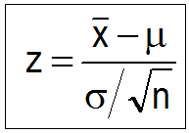
What is Hypothesis Testing?
Hypothesis testing in statistics is a way for you to test the results of a survey or experiment to see if you have meaningful results. You’re basically testing whether your results are valid by figuring out the odds that your results have happened by chance. If your results may have happened by chance, the experiment won’t be repeatable and so has little use.

Slide 33
What is Hypothesis Testing?
Hypothesis testing can be one of the most confusing aspects for people, mostly because before you can even perform a test, you have to know what your null hypothesis is. Often, those tricky word problems that you are faced with can be difficult to decipher. But it’s easier than you think; all you need to do is:
Figure out your null hypothesis,
State your null hypothesis,
Choose what kind of test you need to perform,
Either support or reject the null hypothesis.

Slide 34
What is the Null Hypothesis?
If you trace back the history of science, the null hypothesis is always the accepted fact. Simple examples of null hypotheses that are generally accepted as being true are:
DNA is shaped like a double helix.
There are 8 planets in the solar system (excluding Pluto).
Taking Vioxx can increase your risk of heart problems (a drug now taken off the market).

Slide 35
How to State the Null Hypothesis?
You won’t be required to actually perform a real experiment or survey in elementary statistics (or even disprove a fact like “Pluto is a planet”!), so you’ll be given word problems from real-life situations. You’ll need to figure out what your hypothesis is from the problem. This can be a little trickier than just figuring out what the accepted fact is. With word problems, you are looking to find a fact that is nullifiable (i.e. something you can reject).

Slide 36
Rejecting the null hypothesis
Few years ago, we believed that there were 9 planets in the solar system. Pluto was demoted as a planet in 2006. The null hypothesis of “Pluto is a planet” was replaced by “Pluto is not a planet.” Of course, rejecting the null hypothesis isn’t always that easy — the hard part is usually figuring out what your null hypothesis is in the first place.

Slide 37
One Sample Hypothesis Testing Example
A principal at a certain school claims that the students in his school are above average intelligence. A random sample of thirty students IQ scores have a mean score of 112. Is there sufficient evidence to support the principal’s claim? The mean population IQ is 100 with a standard deviation of 15.
Step 1: State the Null hypothesis. The accepted fact is that the population mean is 100, so: H₀: μ=100.

Slide 38
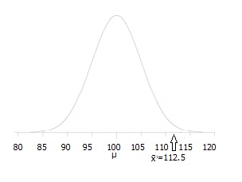
Step 2: State the Alternate Hypothesis. The claim is that the students have above average IQ scores, so: H₁: μ > 100. The fact that we are looking for scores “greater than” a certain point means that this is a one-tailed test.
Step 3: Draw a picture to help you visualize the problem.

Slide 39
Step 4: State the alpha level. If you aren’t given an alpha level, use 5% (0.05).
Step 5: Find the rejection region area (given by your alpha level above) from the z-table. An area of .05 is equal to a z-score of 1.645.
Step 6: Find the test statistic using this formula.
For this set of data: z= (112.5-100) / (15/√30)=4.56.
Step 6: If Step 6 is greater than Step 5, reject the null hypothesis. If it’s less than Step 5, you cannot reject the null hypothesis. In this case, it is greater (4.56 > 1.645), so you can reject the null.

Slide 40
T-test
One of the most common tests in statistics is the t-test, used to determine whether the means of two groups are equal to each other. The assumption for the test is that both groups are sampled from normal distributions with equal variances. The null hypothesis is that the two means are equal, and the alternative is that they are not. It is known that under the null hypothesis, we can calculate a t-statistic that will follow a t-distribution with n1 + n2 - 2 degrees of freedom.

Slide 41
What is t-test?
The basic idea behind a t-test is to use statistic to evaluate two contrary hypotheses:
H0: NULL hypothesis: The average is the same as the sample used
H3: True hypothesis: The average is different from the sample used
The t-test is commonly used with small sample sizes. To perform a t-test, you need to assume normality of the data.

Slide 42
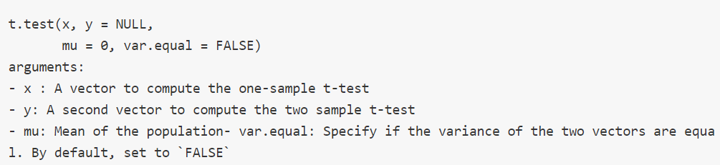
Syntax of t-test in R

Slide 43

One-sample t-test
The t-test, or student's test, compares the mean of a vector against a theoretical mean,
The formula used to compute the t-test is:
The sample mean(x̄).
The population mean(μ).
The sample standard deviation(s).
Number of observations(n).

Slide 44
One-sample t-test
To evaluate the statistical significance of the t-test, you need to compute the p-value. The p-value ranges from 0 to 1, and is interpreted as follow:
A p-value lower than 0.05 means you are strongly confident to reject the null hypothesis, thus H3 is accepted.
A p-value higher than 0.05 indicates that you don't have enough evidences to reject the null hypothesis.
You can construct the pvalue by looking at the corresponding absolute value of the t-test in the Student distribution with a degrees of freedom equals to df = n - 1

Slide 45
One Sample T Test Example
Sample question: your company wants to improve sales. Past sales data indicate that the average sale was $100 per transaction. After training your sales force, recent sales data (taken from a sample of 25 salesmen) indicates an average sale of $130, with a standard deviation of $15. Did the training work? Test your hypothesis at a 5% alpha level.
Step 1: Write your null hypothesis statement (How to state a null hypothesis). The accepted hypothesis is that there is no difference in sales, so: H₀: μ = $100.

Slide 46
Step 2: Write your alternate hypothesis. This is the one you’re testing. You think that there is a difference (that the mean sales increased), so: H₁: μ > $100.
Step 3: Identify the following pieces of information you’ll need to calculate the test statistic. The question should give you these items:
The sample mean(x̄). This is given in the question as $130.
The population mean(μ). Given as $100 (from past data).
The sample standard deviation(s) = $15.
Number of observations(n) = 25.
Step 4: Insert the items from above into the t score formula.

Slide 47
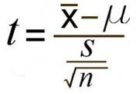
t = (130 – 100) / ((15 / √(25)) t = (30 / 3) = 10 This is your calculated t-value.
Step 5: Find the t-table value. You need two values to find this:
The alpha level: given as 5% in the question.
The degrees of freedom, which is the number of items in the sample (n) minus 1: 25 – 1 = 24.
Look up 24 degrees of freedom in the left column and 0.05 in the top row. The intersection is 1.711.This is your one-tailed critical t-value.
What this critical value means is that we would expect most values to fall under 1.711. If our calculated t-value (from Step 4) falls within this range, the null hypothesis is likely true.

Slide 48
Step 5: Compare Step 4 to Step 5. The value from Step 4 does not fall into the range calculated in Step 5, so we can reject the null hypothesis. The value of 10 falls into the rejection region (the left tail).
In other words, it’s highly likely that the mean sale is greater. The sales training was probably a success.

Slide 49
Apriori Market Basket Analysis / Association Rules

Slide 50
Apriori
Apriori Algorithm
With the quick growth in e-commerce applications, there is an accumulation vast quantity of data in months not in years. Data Mining, also known as Knowledge Discovery in Databases(KDD), to find anomalies, correlations, patterns, and trends to predict outcomes.
Apriori algorithm is a classical algorithm in data mining. It is used for mining frequent itemsets and relevant association rules. It is devised to operate on a database containing a lot of transactions, for instance, items brought by customers in a store.

Slide 51
Apriori
It is very important for effective Market Basket Analysis and it helps the customers in purchasing their items with more ease which increases the sales of the markets. It has also been used in the field of healthcare for the detection of adverse drug reactions. It produces association rules that indicates what all combinations of medications and patient characteristics lead to ADRs.

