Slide 1

Introduction to Machine Learning

Slide 2
What is Machine Learning?
“Learning is any process by which a system improves performance from experience.”
- Herbert Simon
Definition by Tom Mitchell (1998):
Machine Learning is the study of algorithms that
improve their performance P
at some task T
with experience E.
A well-defined learning task is given by <P, T, E>.
3

Slide 3
Traditional Programming
Data Program
Computer
Output
Machine Learning
Data Output
Computer
Program
4
Slide credit: Pedro Domingos

Slide 4
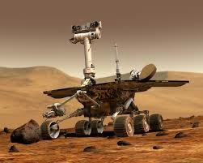
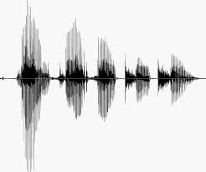
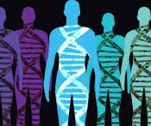
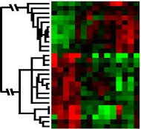
When Do We Use Machine Learning?
ML is used when:
Human expertise does not exist (navigating on Mars)
Humans can’t explain their expertise (speech recognition)
Models must be customized (personalized medicine)
Models are based on huge amounts of data (genomics)
Learning isn’t always useful:
There is no need to “learn” to calculate payroll
Based on slide by E. Alpaydin
5

Slide 5
What We Talk About When We Talk About“Learning”
Learning general models from a data of particular examples
Data is cheap and abundant (data warehouses, data marts); knowledge is expensive and scarce.
Example in retail: Customer transactions to consumer behavior:
People who bought “Da Vinci Code” also bought “The Five People You Meet in Heaven” (www.amazon.com)
Build a model that is a good and useful approximation to the data.

Slide 6
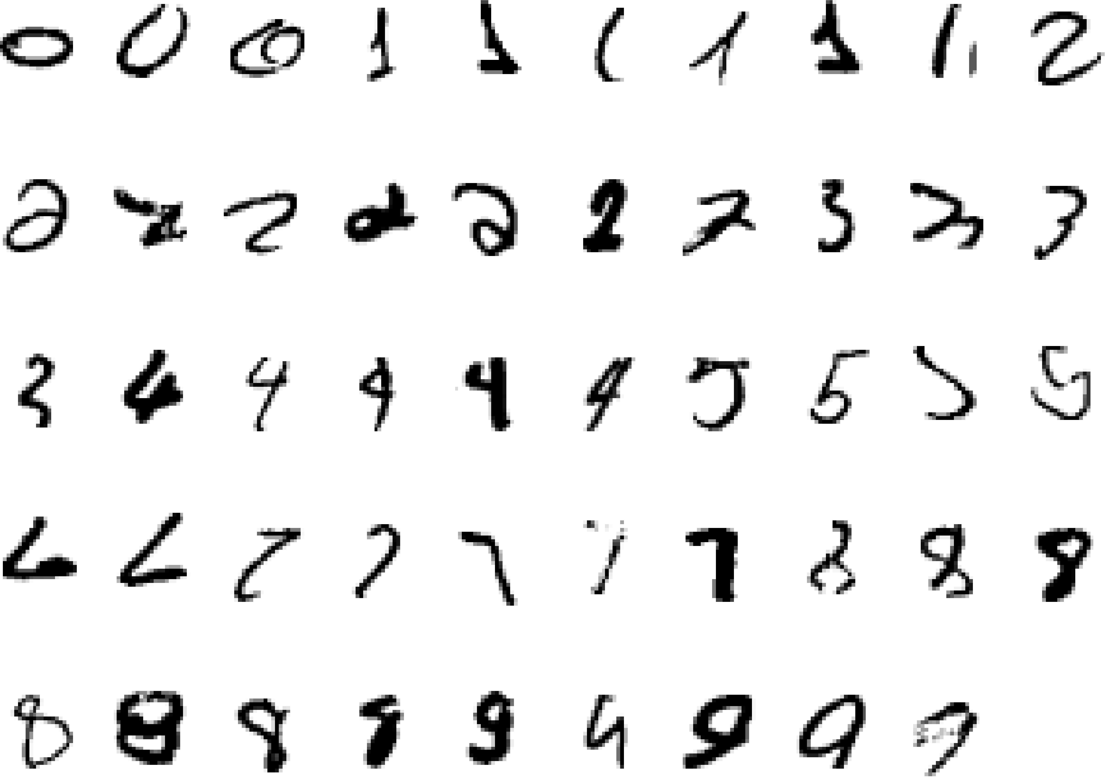
A classic example of a task that requires machine learning: It is very hard to say what makes a 2
6
Slide credit: Geoffrey Hinton

Slide 7
Some more examples of tasks that are best solved by using a learning algorithm
Recognizing patterns:
Facial identities or facial expressions
Handwritten or spoken words
Medical images
Generating patterns:
Generating images or motion sequences
Recognizing anomalies:
Unusual credit card transactions
Unusual patterns of sensor readings in a nuclear power plant
Prediction:
Future stock prices or currency exchange rates
7
Slide credit: Geoffrey Hinton

Slide 8
“AI 101” … an overview of artificial intelligence and machine learning relevant to ROI
ARTIFICIAL INTELLIGENCE
Logic reasoning
Natural Language
Processing
Computer Vision
Robotics
Computer systems simulate human intelligence processes, including: learning, reasoning, self-correction.
“Cognitive computing” find solutions in complex situations where answers may be ambiguous and uncertain.
Strong vs. Weak AI
MACHINE LEARNING
Virtual Assistants
Email Spam & Malware Filtering
Product Recommendation
Self-driving cars
Computer systems that learn by generalizing data examples without relying on rules-based programming.
Supervised, Unsupervised, and Reinforcement Learning
DEEP LEARNING
Automatic Machine Translation
Object Classification in Photos
Image Caption Generation
Automatic Game Playing
Large neural networks and huge amounts of data create hierarchy of models which allows computer to learn complicated concepts by building them out of simpler ones.
University of North Carolina at Charlotte - North Carolina State University - Fayetteville State University
Confidential Information. For Limited Distribution as Appropriate.

Slide 9
“AI 101” … an overview of artificial intelligence and machine learning relevant to ROI
Roadmap for Building Machine Learning Systems
Labels
Training Dataset
Learning Algorithm
Final Model
New Data
Labels
Validation Dataset
Raw Data
Test Dataset
Labels
Preprocessing
Learning
Evaluation
Prediction
Feature Extraction & Scaling
Feature Selection
Dimensionality Reduction
Sampling
Model Selection
Cross-Validation
Performance Metrics
Hyperparameter Optimization
University of North Carolina at Charlotte - North Carolina State University - Fayetteville State University
Confidential Information. For Limited Distribution as Appropriate.

Slide 10
Sample Applications
Web search
Computational biology
Finance
E-commerce
Space exploration
Robotics
Information extraction
Social networks
Debugging software
[Your favorite area]
8
Slide credit: Pedro Domingos

Slide 11
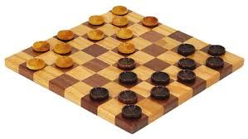
Samuel’s Checkers-Player
“Machine Learning: Field of study that gives computers the ability to learn without being explicitly programmed.” -Arthur Samuel (1959)
9

Slide 12
Defining the Learning Task
Improve on task T, with respect to performance metric P, based on experience E
T: Playing checkers
P: Percentage of games won against an arbitrary opponent E: Playing practice games against itself
T: Recognizing hand-written words
P: Percentage of words correctly classified
E: Database of human-labeled images of handwritten words
T: Driving on four-lane highways using vision sensors
P: Average distance traveled before a human-judged error
E: A sequence of images and steering commands recorded while observing a human driver.
T: Categorize email messages as spam or legitimate. P: Percentage of email messages correctly classified. E: Database of emails, some with human-given labels
Slide credit: Ray Mooney

Slide 13
State of the Art Applications of Machine Learning

Slide 14
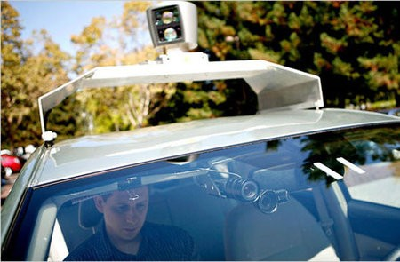
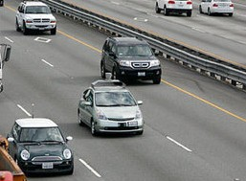
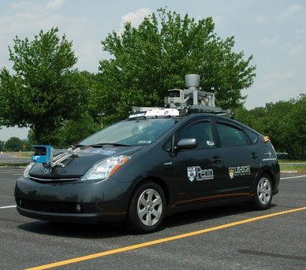
Autonomous Cars
Nevada made it legal for autonomous cars to drive on roads in June 2011
As of 2013, four states (Nevada, Florida, California, and Michigan) have legalized autonomous cars
Penn’s Autonomous Car →
(Ben Franklin Racing Team)
12

Slide 15
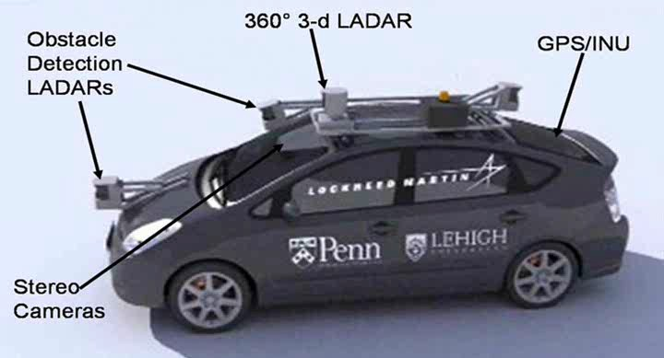
Autonomous Car Sensors
13

Slide 16
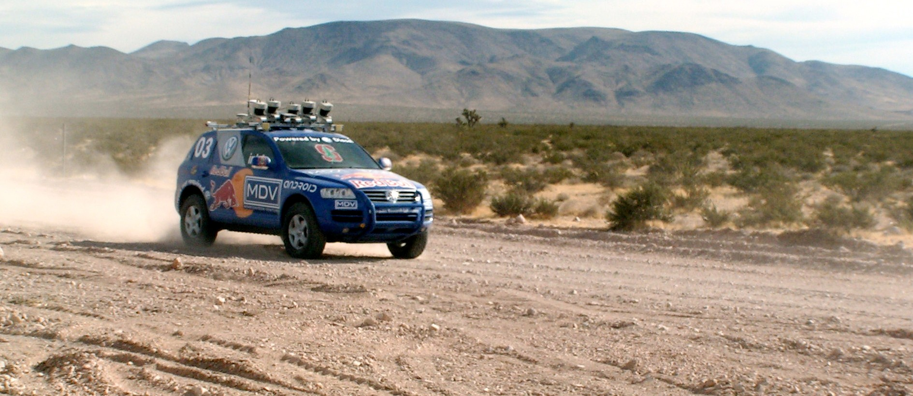
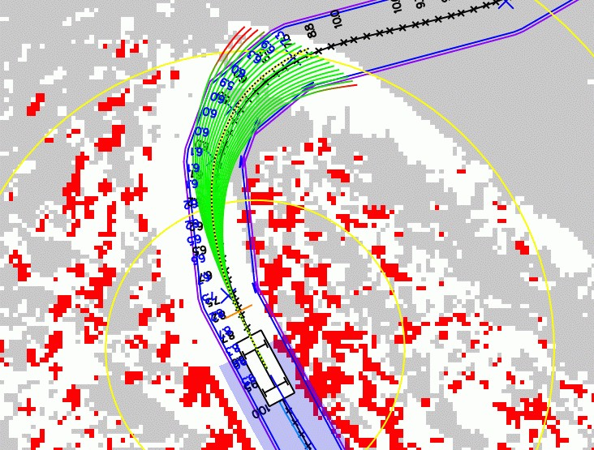
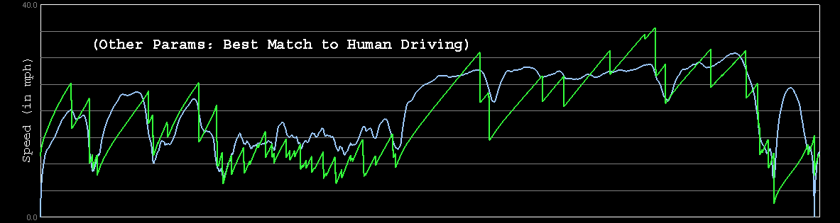
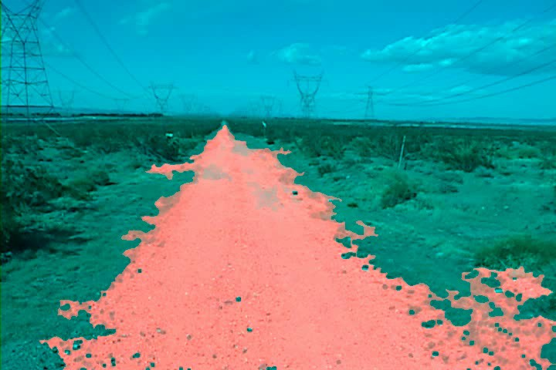
Autonomous Car Technology
Path Planning
Laser Terrain Mapping
Learning from Human Drivers
Sebastian
Adaptive Vision
Stanley
Images and movies taken from Sebastian Thrun’s multimedia w¹e⁴bsite.

Slide 17


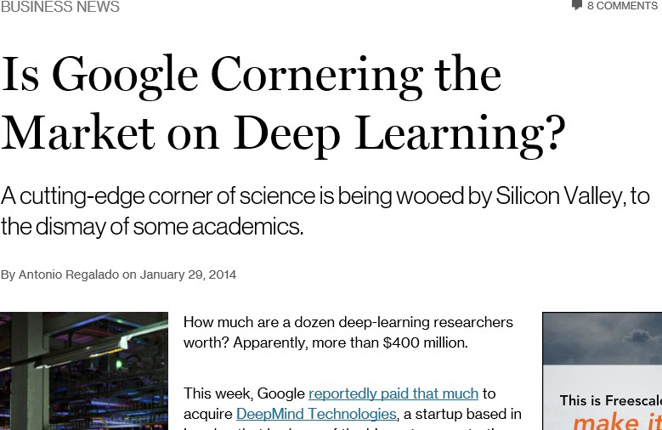
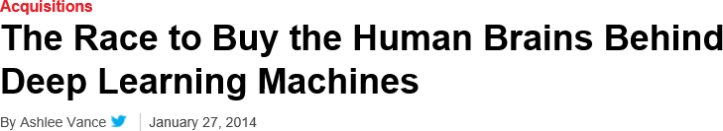
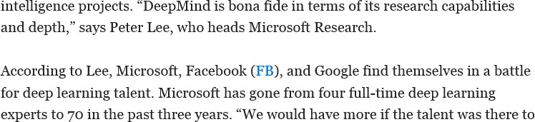
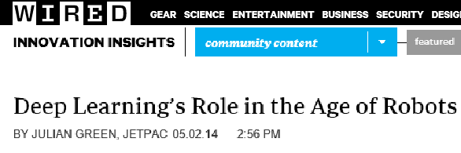
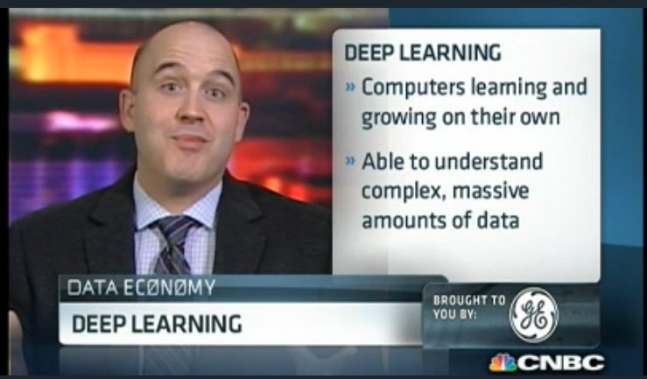
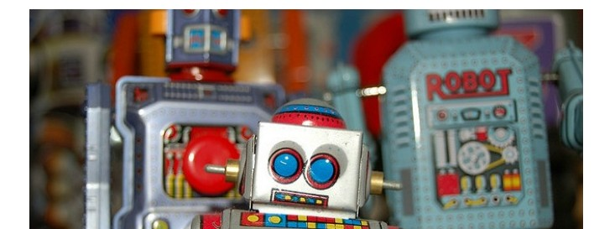
Deep Learning in the Headlines
15

Slide 18
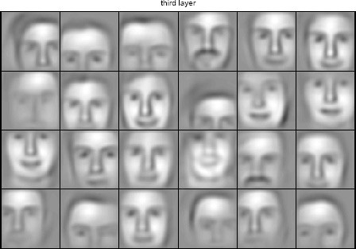
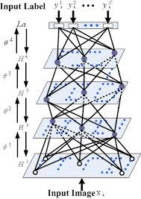

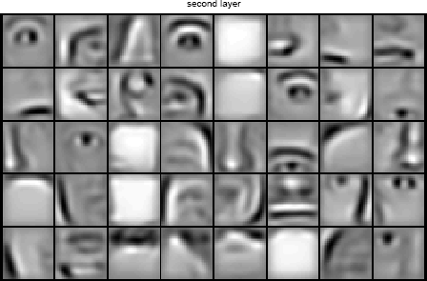


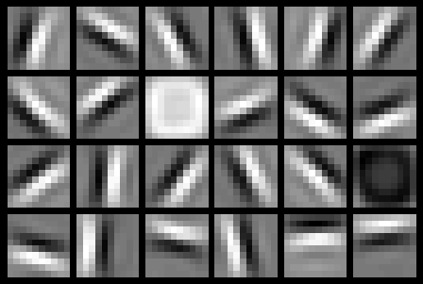
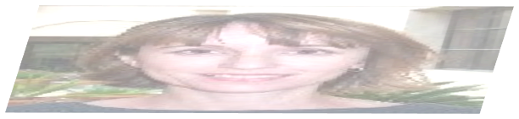



Deep Belief Net on Face Images
object models
object parts (combination of edges)
edges
pixels
Based on materials by Andrew Ng
16

Slide 19
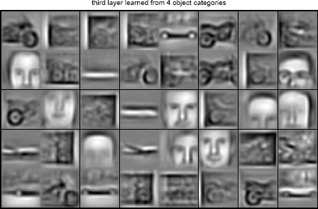
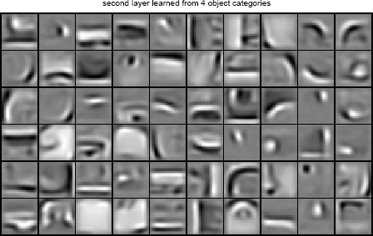
Training on Multiple Objects
Trained on 4 classes (cars, faces, motorbikes, airplanes).
Second layer: Shared-features and object-specific features.
Third layer: More specific features.
Slide credit: Andrew Ng

Slide 20
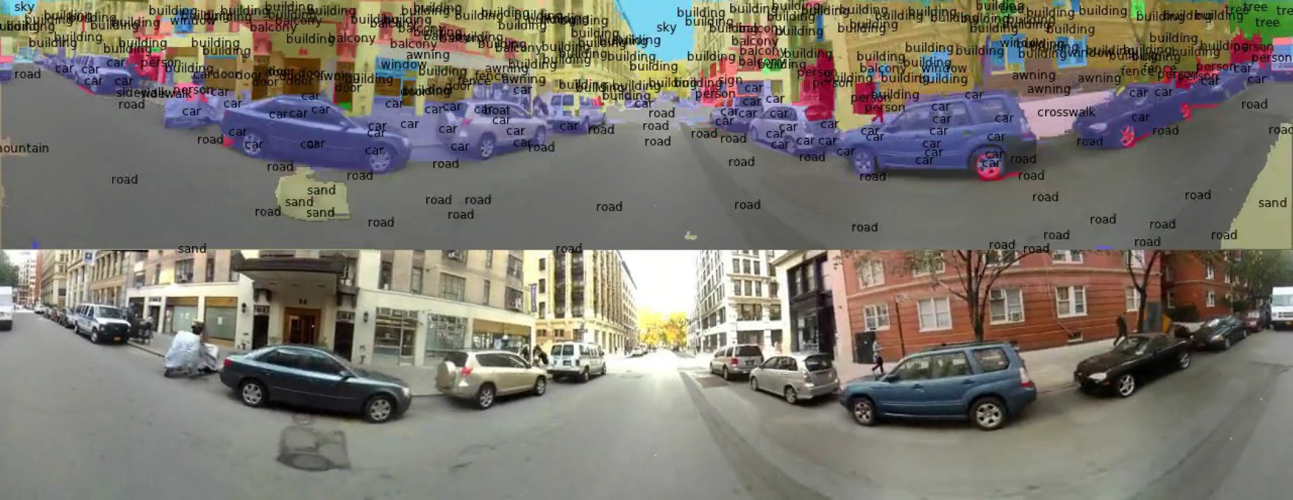
Scene Labeling via Deep Learning
[Farabet et al. ICML 2012, PAMI 2013]
19

Slide 21
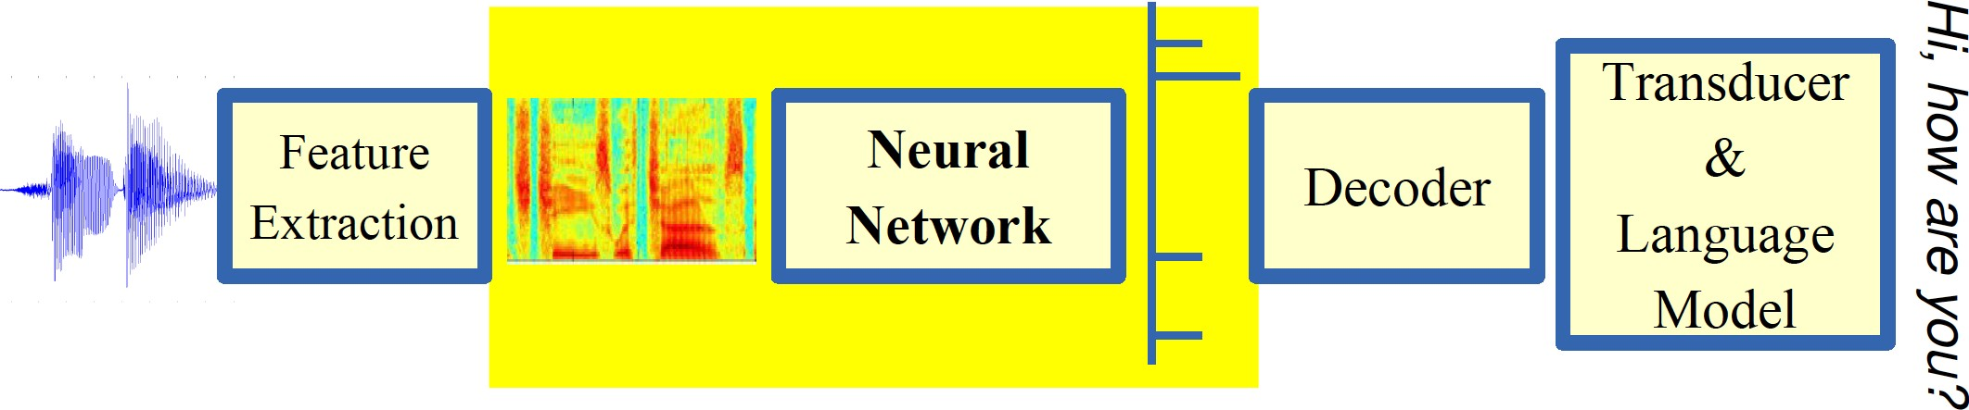
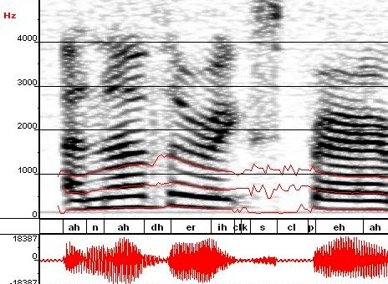
Machine Learning in Automatic Speech Recognition
A Typical Speech Recognition System
ML used to predict of phone states from the sound spectrogram
Deep learning has state-of-the-art results
# Hidden Layers | 1 | 2 | 4 | 8 | 10 | 12
Word Error Rate % | 16.0 | 12.8 | 11.4 | 10.9 | 11.0 | 11.1
Baseline GMM performance = 15.4%
[Zeiler et al. “On rectified linear units for speech recognition” ICASSP 2013]
21

Slide 22
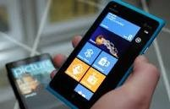
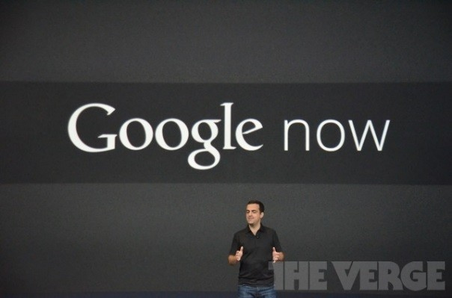
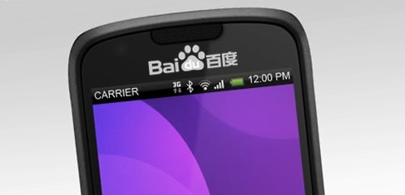
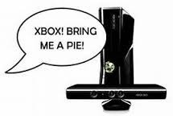


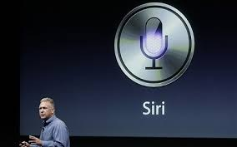
Impact of Deep Learning in Speech Technology
22
Slide credit: Li Deng, MS Research

Slide 23
Types of Learning
23

Slide 24
Supervised Learning
Classification
Regression
Unsupervised Learning
Reinforcement Learning

Slide 25
Supervised Learning: Uses
Prediction of future cases: Use the rule to predict the output for future inputs
Knowledge extraction: The rule is easy to understand
Compression: The rule is simpler than the data it explains
Outlier detection: Exceptions that are not covered by the rule, e.g., fraud

Slide 26
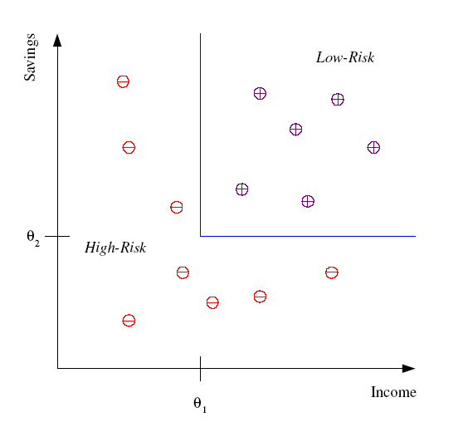
Classification
Example: Credit scoring
Differentiating between low-risk and high-risk customers from their income and savings
Discriminant: IF income > θ₁ AND savings > θ₂
THEN low-risk ELSE high-risk

Slide 27
Classification: Applications
Pattern recognition
Face recognition: Pose, lighting, occlusion (glasses, beard), make-up, hair style
Character recognition: Different handwriting styles.
Speech recognition: Temporal dependency.
Use of a dictionary or the syntax of the language.
Sensor fusion: Combine multiple modalities; eg, visual (lip image) and acoustic for speech
Medical diagnosis: From symptoms to illnesses
...

Slide 28








Face Recognition
Training examples of a person
Test images
AT&T Laboratories, Cambridge UK
http://www.uk.research.att.com/facedatabase.html

Slide 29
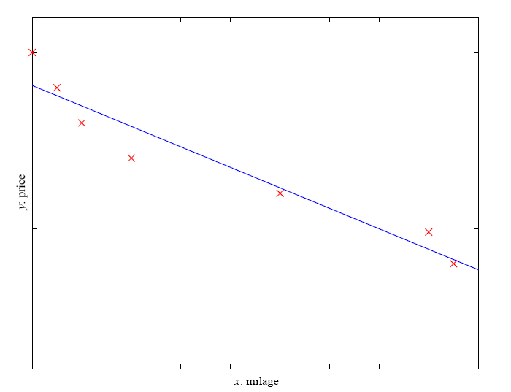
Regression
Example: Price of a used car
x : car attributes
y : price
y = g (x | θ )
g ( ) model,
θ parameters
y = wx+w₀

Slide 30
Regression Applications
Navigating a car: Angle of the steering wheel (CMU NavLab)
Kinematics of a robot arm
(x,y)
α₁= g₁(x,y)
α₂= g₂(x,y)
α₂
α₁
Response surface design

Slide 31
Unsupervised Learning
Learning “what normally happens”
No output
Clustering: Grouping similar instances
Example applications
Customer segmentation in CRM
Image compression: Color quantization
Bioinformatics: Learning motifs

Slide 32

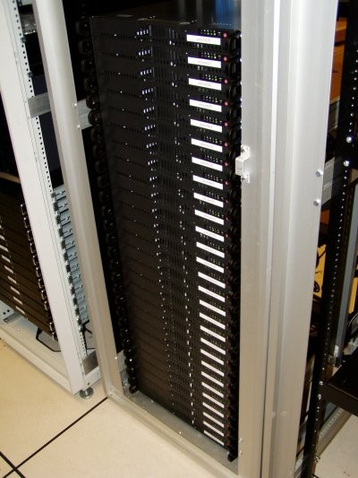
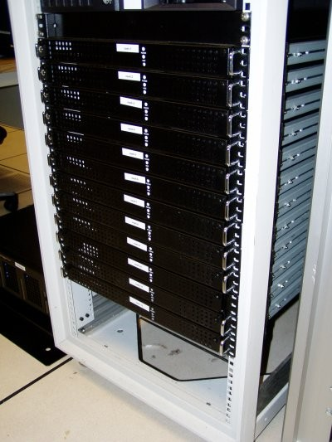




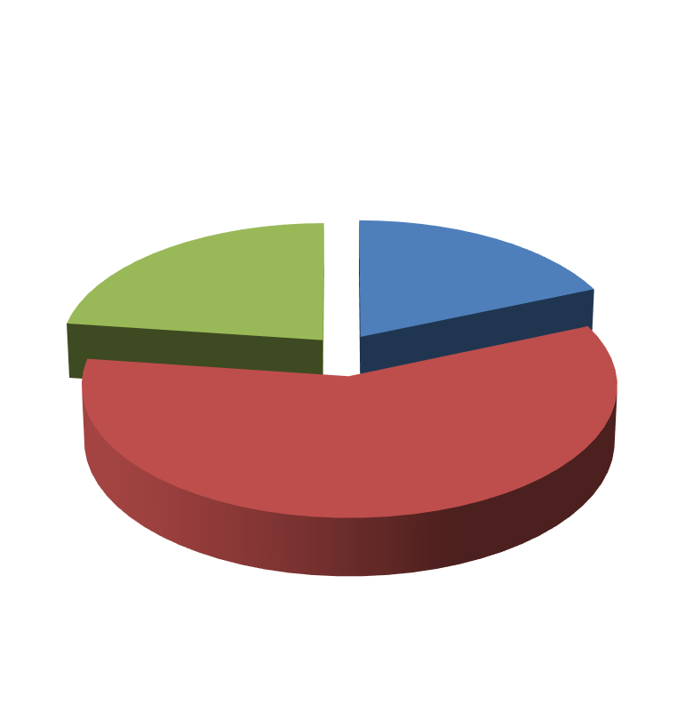

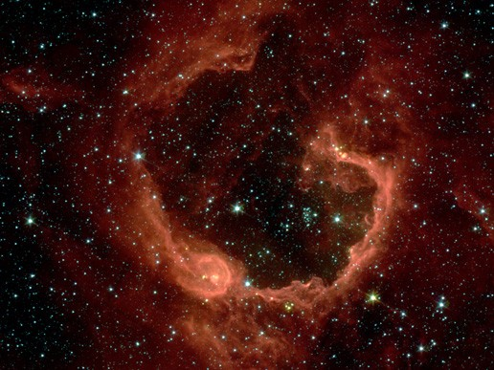


Unsupervised Learning
Organize computing clusters
Social network analysis
Market segmentation
Slide credit: Andrew Ng
Image credit: NASA/JPL-Caltech/E. Churchwell (Univ. of Wisconsin, Madison)
Astronomical data analysis
33

Slide 33
Reinforcement Learning
Given a sequence of states and actions with (delayed) rewards, output a policy
Policy is a mapping from states → actions that tells you what to do in a given state
Examples:
Credit assignment problem
Game playing
Robot in a maze
Balance a pole on your hand

Slide 34
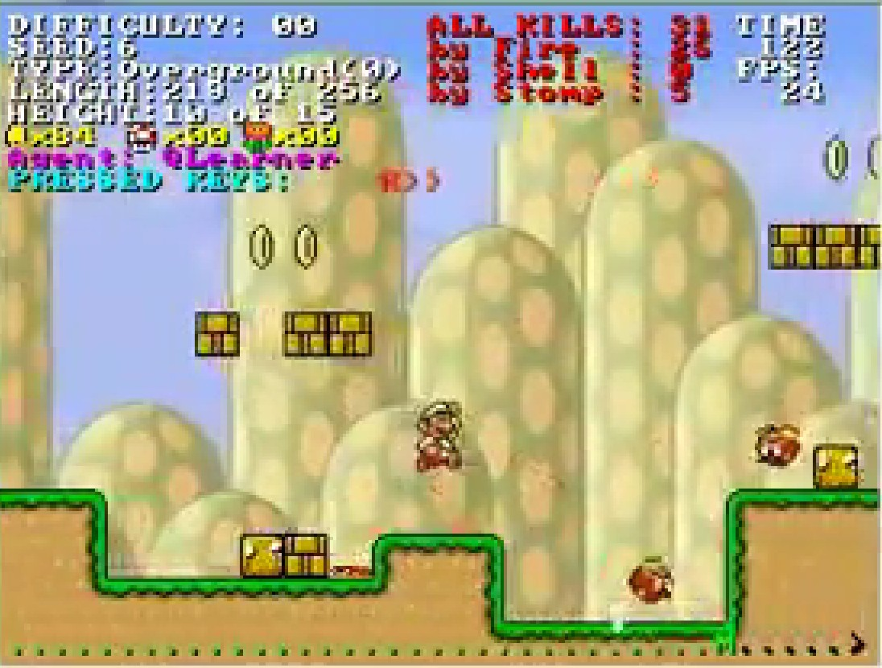
Reinforcement Learning
https://www.youtube.com/watch?v=4cgWya-wjgY
38

Slide 35
Framing a Learning Problem

Slide 36






Designing a Learning System
Choose the training experience
Choose exactly what is to be learned
– i.e. the target function
Choose how to represent the target function
Choose a learning algorithm to infer the target function from the experience
Training data
Learner
Environment/ Experience
Knowledge
Testing data
Performance Element
41
Based on slide by Ray Mooney

Slide 37
Training vs. Test Distribution
We generally assume that the training and test examples are independently drawn from the same overall distribution of data
– We call this “i.i.d” which stands for “independent and identically distributed”
If examples are not independent, requires
collective classification
If test distribution is different, requires
transfer learning
Slide credit: Ray Mooney
42

Slide 38
ML in a Nutshell
Tens of thousands of machine learning algorithms
Hundreds new every year
Every ML algorithm has three components:
Representation
Optimization
Evaluation
43
Slide credit: Pedro Domingos

Slide 39
Various Function Representations
Numerical functions
Linear regression
Neural networks
Support vector machines
Symbolic functions
Decision trees
Rules in propositional logic
Rules in first-order predicate logic
Instance-based functions
Nearest-neighbor
Case-based
Probabilistic Graphical Models
Naïve Bayes
Bayesian networks
Hidden-Markov Models (HMMs)
Probabilistic Context Free Grammars (PCFGs)
Markov networks
Slide credit: Ray Mooney

Slide 40
Various Search/Optimization Algorithms
Gradient descent
Perceptron
Backpropagation
Dynamic Programming
HMM Learning
PCFG Learning
Divide and Conquer
Decision tree induction
Rule learning
Evolutionary Computation
Genetic Algorithms (GAs)
Genetic Programming (GP)
Neuro-evolution
Slide credit: Ray Mooney

Slide 41
Evaluation
Accuracy
Precision and recall
Squared error
Likelihood
Posterior probability
Cost / Utility
Margin
Entropy
K-L divergence
etc.
47
Slide credit: Pedro Domingos

Slide 42


ML in Practice
Understand domain, prior knowledge, and goals
Data integration, selection, cleaning, pre-processing, etc.
Learn models
Interpret results
Consolidate and deploy discovered knowledge
Loop
48
Based on a slide by Pedro Domingos

Slide 43
A Brief History of Machine Learning
50

Slide 44
History of Machine Learning
1950s
Samuel’s checker player
Selfridge’s Pandemonium
1960s:
Neural networks: Perceptron
Pattern recognition
Learning in the limit theory
Minsky and Papert prove limitations of Perceptron
1970s:
Symbolic concept induction
Winston’s arch learner
Expert systems and the knowledge acquisition bottleneck
Quinlan’s ID3
Michalski’s AQ and soybean diagnosis
Scientific discovery with BACON
Mathematical discovery with AM
Slide credit: Ray Mooney

Slide 45
History of Machine Learning (cont.)
1980s:
Advanced decision tree and rule learning
Explanation-based Learning (EBL)
Learning and planning and problem solving
Utility problem
Analogy
Cognitive architectures
Resurgence of neural networks (connectionism, backpropagation)
Valiant’s PAC Learning Theory
Focus on experimental methodology
1990s
Data mining
Adaptive software agents and web applications
Text learning
Reinforcement learning (RL)
Inductive Logic Programming (ILP)
Ensembles: Bagging, Boosting, and Stacking
Bayes Net learning
Slide credit: Ray Mooney

Slide 46
History of Machine Learning (cont.)
2000s
Support vector machines & kernel methods
Graphical models
Statistical relational learning
Transfer learning
Sequence labeling
Collective classification and structured outputs
Computer Systems Applications (Compilers, Debugging, Graphics, Security)
E-mail management
Personalized assistants that learn
Learning in robotics and vision
2010s
Deep learning systems
Learning for big data
Bayesian methods
Multi-task & lifelong learning
Applications to vision, speech, social networks, learning to read, etc.
– ???
Based on slide by Ray Mooney

