Slide 1



G I T - C R M

Slide 2


Genesis Information Technology
“GIT is a technological hub, we give your project the ultimate platform it needs to be scalable and successful. ”

Slide 3
Abstract:
The main objective of the GIT-CMS software is to design a system to keep the order of a customer in a systematic way to maintain considerable information of the users, Customer Orders and Customer details for the DDTECH organization.

Slide 4
Description
GIT-CMS Call Center Management System is an increasingly important skill as the use of call centers becomes a popular method of centralizing information services, streamlining order taking and providing valuable customer support.
This system (GIT-CMS) is useful to the organization, it contains the necessary information of the customer and their phone Numbers, their services also.

Slide 5
EXISTING SYSTEM:
The existing system is the manual order taking system on a various type like notepad, excel sheets and on diskdrives.
Here the employees needs to be very careful while noting the order on notepads, excel sheets and on disk drives.
There is no sharing is possible in manual setup which exist if the data is in the form of paper or notepads.

Slide 6
EXISTING SYSTEM:
The manual system gives us very less security for saving data; some data may be lost due to mismanagement.
Searching of particular information is very critical it takes lot of time.
It is very critical to maintain manually call records of customers, because call center receives huge no of calls per a day.
It is a tedious job to maintain different customers are asking different service details, normally solve these queries are not possible. Automated system is needed.

Slide 7
PROPOSED SYSTEM:
The development of GIT-CMS which is the new system contains the following activities, which try to automate the entire process keeping in the view of database integration approach.
User Friendliness is provided in the application with various controls provided by system Rich User Interface.
The GIT-CMS makes the overall customer relations and order taking much easier and flexible for the agents.
The GIT-CMS will also saves every agent logs to evaluate performance.

Slide 8
PROPOSED SYSTEM:
The user information can be stored in centralized database which can be maintained by the GIT-CMS.
There will be huge number customers who calls for order so GIT-CMS will store every customer data like name, number, address and last order details in a centralized database so Agent easily fetch the customer information for next order.
GIT-CMS can give the good security for user information because data is not in client machine.

Slide 9
PROPOSED SYSTEM:
It can be accessed over the Intranet.
Authentication is provided for this application only registered Users can access.
The automated system (GIT-CMS) will provide to the customers for reliable services.
The speed and accuracy of this system will improve more and more.

Slide 10
Technology
Database : Oracle Express Edition 11.2.0.2
Application : JAVA 8
Elastix : 5
Asterisk : 11

Slide 11
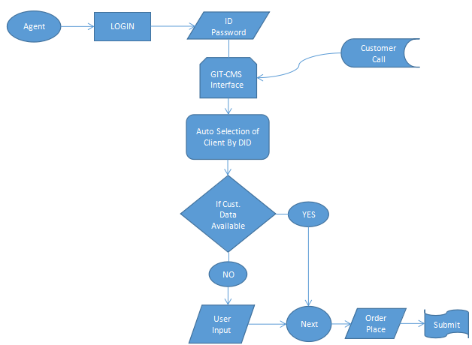
DFD

