Slide 1
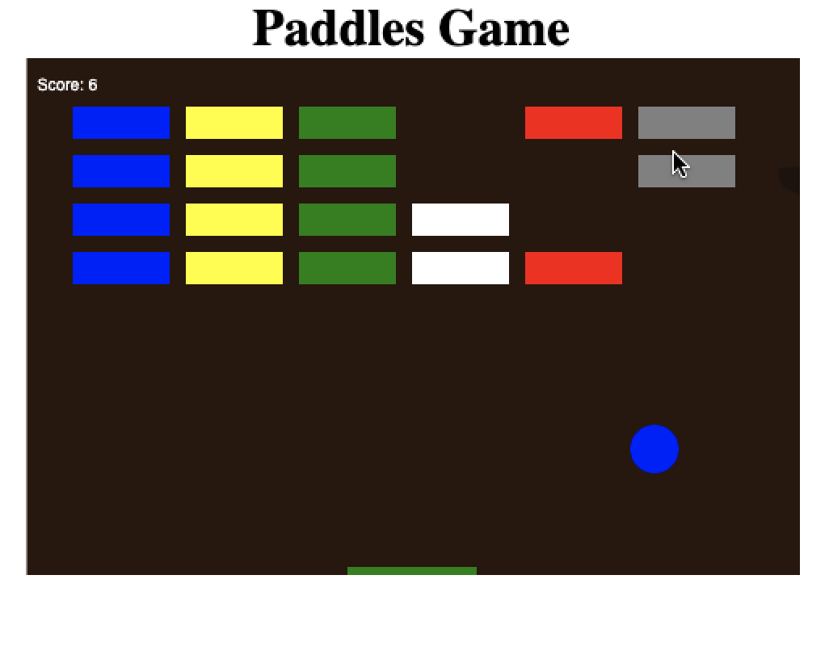
Paddles game

Slide 2
Introduction
<!DOCTYPE html>
<html>
<head>
<meta charset="utf-8" />
<title>Paddles Project</title>
<style>
* { padding: 0; margin: 0; }
h1{width: 100%;text-align: center;}
canvas { background: rgb(235, 163, 7); display: block; margin: 0 auto; }
</style>
</head>
<body>
<h1>Paddles Game</h1>
<canvas id="gameCanvas" width="480" height="320"></canvas>
<script>
// JavaScript code
</script>
</body>
</html>
Css canvas style
Declare canvas

Slide 3
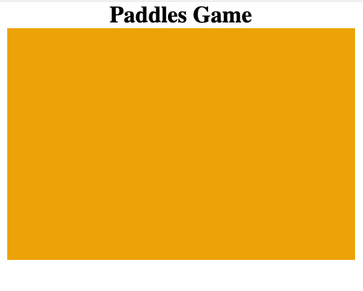
Phase 1

Slide 4
Phase 2
<script>
var canvas = document.getElementById("gameCanvas");
var ctx = canvas.getContext("2d");
ctx.beginPath();
ctx.rect(100, 50, 70, 90);
ctx.fillStyle = "#aabbcc";
ctx.fill();
ctx.closePath();
</script>
Get reference to canvas
Start path
Fill color
Finish path

Slide 5
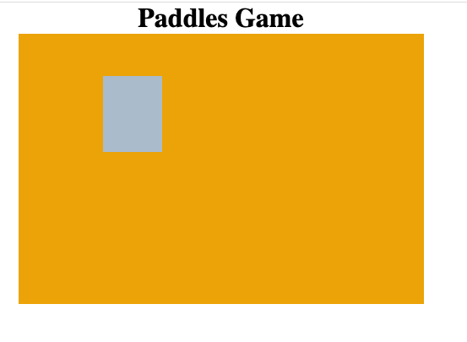
Phase 2

Slide 6
Phase 3
var canvas = document.getElementById("gameCanvas");
var ctx = canvas.getContext("2d");
ctx.beginPath();
ctx.rect(100, 50, 70, 90);
ctx.fillStyle = "#aabbcc";
ctx.fill();
ctx.closePath();
ctx.beginPath();
ctx.arc(300, 150, 50, 0, Math.PI*2, false);
ctx.fillStyle = "blue";
ctx.fill();
ctx.closePath();
X, y, w, h
Draw circle : x,y ,r , 2pi

Slide 7
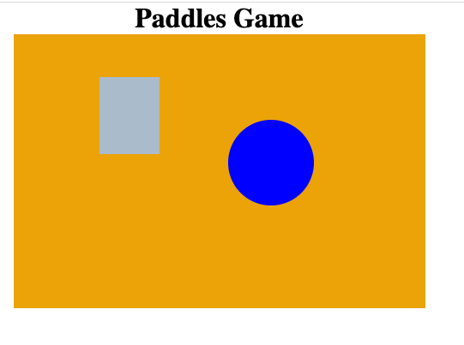
Phase 3

Slide 8
Phase 4
ctx.beginPath();
ctx.rect(10, 10, 200, 30);
ctx.strokeStyle = "rgba(100, 40, 255, 0.5)";//
ctx.fillStyle = "rgba(240, 40, 255, 0.5)"
ctx.fill();
ctx.stroke();
ctx.closePath();

Slide 9
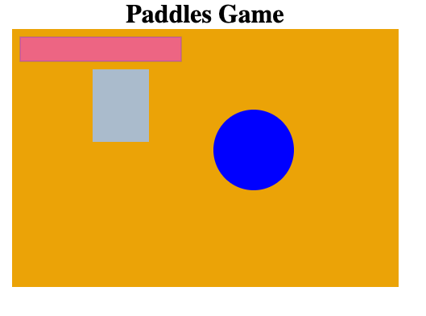
Phase 4

Slide 10
Phase 5
var canvas = document.getElementById("gameCanvas");
var ctx = canvas.getContext("2d");
var x = canvas.width/2;
var y = canvas.height-50;
var deltax = 3;
function drawBall() {
ctx.beginPath();
ctx.arc(x, y, 10, 0, Math.PI*2);
ctx.fillStyle = "blue";
ctx.fill();
ctx.closePath();
}
function draw() {
ctx.clearRect(0, 0, canvas.width, canvas.height);
drawBall();
x += deltax;
}
setInterval(draw, 10);
Move on x
Calling draw each 10/1000 seconds

Slide 11
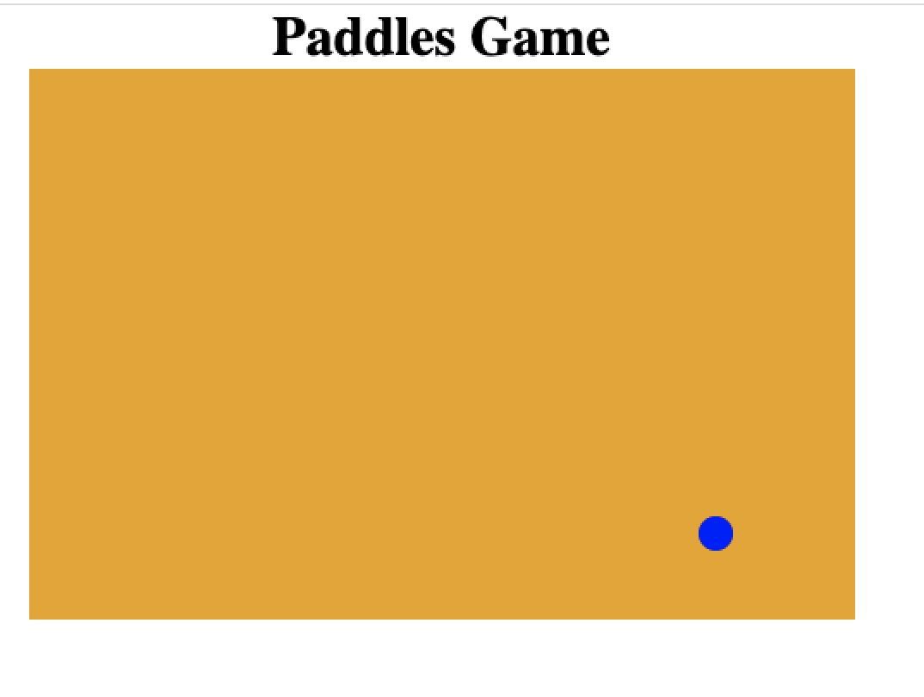
Phase 5 - Move the Ball

Slide 12
Phase 6 Left and Right
function draw() {
ctx.clearRect(0, 0, canvas.width, canvas.height);
drawBall();
x += deltax;
if(x + deltax > canvas.width-r || x + deltax < r) {
deltax = -deltax;
}
}
If the ball out of canvas bounds than change the direction of the ball

Slide 13
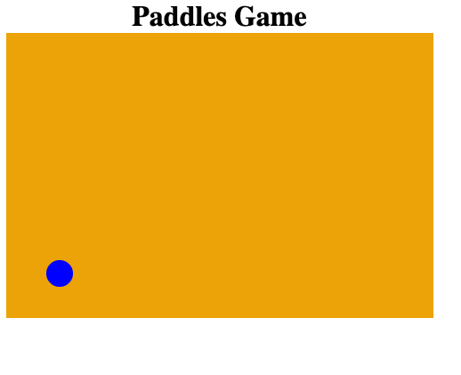
Phase 6 Left and Right

Slide 14
Phase 7 Left, Right, Up, Down
function draw() {
ctx.clearRect(0, 0, canvas.width, canvas.height);
drawBall();
x += deltax;
y += deltay;
if(x + deltax > canvas.width-r || x + deltax < r) {
deltax = -deltax;
}
if(y + deltay > canvas.height-r || y + deltay < r) {
deltay = -deltay;
}
}
If the ball out of canvas bounds than change the direction of the ball
If the ball out of canvas bounds than change the direction of the ball

Slide 15
Phase 7 Left, Right, Up, Down

Slide 16
Phase 8 Draw Paddle
function drawPaddle() {
ctx.beginPath();
ctx.rect(paddleX, canvas.height-paddleHeight, paddleWidth, paddleHeight);
ctx.fillStyle = "green";
ctx.fill();
ctx.closePath();
}
Drawing paddle on ground

Slide 17
Phase 8 Draw Paddle
function draw() {
ctx.clearRect(0, 0, canvas.width, canvas.height);
drawBall();
drawPaddle();
x += deltax;
y += deltay;
if(x + deltax > canvas.width-r || x + deltax < r) {
deltax = -deltax;
}
if(y + deltay > canvas.height-r || y + deltay < r) {
deltay = -deltay;
}
}
Call drawPaddle

Slide 18
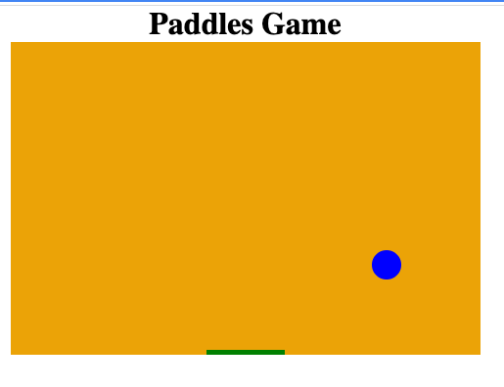
Phase 8 Draw Paddle
Paddle

Slide 19
Phase 9 Move Paddle
var canvas = document.getElementById("gameCanvas");
var ctx = canvas.getContext("2d");
var x = canvas.width/2;
var y = canvas.height-50;
var r = 15
var deltax = 3;
var deltay = 3;
var paddleHeight = 5;
var paddleWidth = 80;
var paddleX = (canvas.width-paddleWidth)/2;
var right = false;
var left = false;
document.addEventListener("keydown", keyDownHandler, false);
document.addEventListener("keyup", keyUpHandler, false);

Slide 20
Phase 9 Move Paddle
Listen to user input keyboard
function keyDownHandler(e) {
if(e.key == "Right" || e.key == "ArrowRight") {
right = true;
}
else if(e.key == "Left" || e.key == "ArrowLeft") {
left = true;
}
}
function keyUpHandler(e) {
if(e.key == "Right" || e.key == "ArrowRight") {
right = false;
}
else if(e.key == "Left" || e.key == "ArrowLeft") {
left = false;
}
}
Listen to user release keyboard

Slide 21
Phase 9 Move Paddle
function movePaddle(){
if(right) {
paddleX += 5;
if (paddleX + paddleWidth > canvas.width){
paddleX = canvas.width - paddleWidth;
}
}
else if(left){
paddleX -= 5;
if (paddleX < 0){
paddleX = 0;
}
}
}
Move the paddled if user press on left or right keyboard

Slide 22
Phase 9 Move Paddle
function drawBall() {
ctx.beginPath();
ctx.arc(x, y, r, 0, Math.PI*2);
ctx.fillStyle = "blue";
ctx.fill();
ctx.closePath();
}
function drawPaddle() {
ctx.beginPath();
ctx.rect(paddleX, canvas.height-paddleHeight, paddleWidth, paddleHeight);
ctx.fillStyle = "green";
ctx.fill();
ctx.closePath();
movePaddle()
}

Slide 23
Phase 9 Move Paddle
function draw() {
ctx.clearRect(0, 0, canvas.width, canvas.height);
drawBall();
drawPaddle();
x += deltax;
y += deltay;
if(x + deltax > canvas.width-r || x + deltax < r) {
deltax = -deltax;
}
if(y + deltay > canvas.height-r || y + deltay < r) {
deltay = -deltay;
}
}
setInterval(draw, 10);

Slide 24
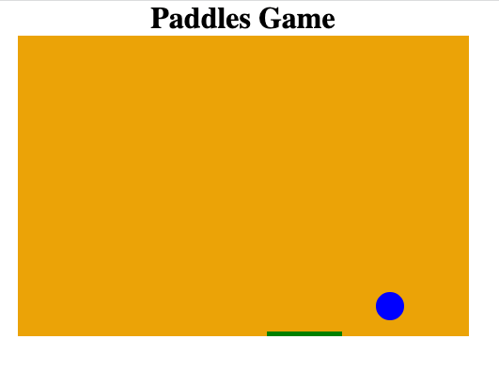
Phase 9 Move Paddle

Slide 25
Phase 10 Draw Sprites
//sprites
var numOfRows = 4;
var numOfColumns = 6;
var widthOfsprite = 60;
var heighOfsprite = 20;
var marginBetweensprite = 10;
var offsetTop = 30;
var offsetLeft = 30;
var sprites = [];
for(var i=0; i<numOfColumns; i++) {
sprites[i] = [];
for(var j=0; j<numOfRows; j++) {
sprites[i][j] = { x: 0, y: 0 };
}
}
Array of sprites
Create instance of sprites according to number of columns and number of rows

Slide 26
Phase 10 Draw Sprites
function drawsprites() {
for(var i=0; i<numOfColumns; i++) {
for(var j=0; j<numOfRows; j++) {
var spriteX = (i*(widthOfsprite+marginBetweensprite))+offsetLeft;
var spriteY = (j*(heighOfsprite+marginBetweensprite))+offsetTop;
sprites[i][j].x = spriteX;
sprites[i][j].y = spriteY;
ctx.beginPath();
ctx.rect(spriteX, spriteY, widthOfsprite, heighOfsprite);
ctx.fillStyle = randomColor(i);
ctx.fill();
ctx.closePath();
}
}
}
Draw columns * rows sprites

Slide 27
Phase 10 Draw Sprites
function randomColor(i){
var arr = ["blue", "yellow", "green","white","red", "gray"]
return arr[i]
}

Slide 28
Phase 10 Draw Sprites
function draw() {
ctx.clearRect(0, 0, canvas.width, canvas.height);
drawBall();
drawPaddle();
drawsprites();
x += deltax;
y += deltay;
if(x + deltax > canvas.width-r || x + deltax < r) {
deltax = -deltax;
}
if(y + deltay > canvas.height-r || y + deltay < r) {
deltay = -deltay;
}
}

Slide 29
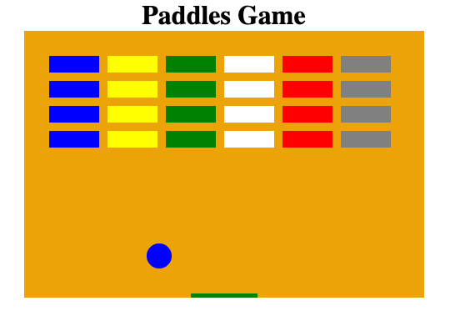
Phase 10 Draw Sprites

Slide 30
Phase 11 - Collision Detected
function draw() {
ctx.clearRect(0, 0, canvas.width, canvas.height);
drawBall();
drawPaddle();
drawsprites();
collisionDetection();
x += deltax;
y += deltay;
if(x + deltax > canvas.width-r || x + deltax < r) {
deltax = -deltax;
}
if(y + deltay > canvas.height-r || y + deltay < r) {
deltay = -deltay;
}
}
Call collision

Slide 31
Phase 11 - Collision Detected
function collisionDetection() {
for (var i = 0; i < numOfColumns; i++) {
for (var j = 0; j < numOfRows; j++) {
var s = sprites[i][j];
if (s.drawsprite == 1) {
if (x > s.x && x < s.x + widthOfsprite && y > s.y && y < s.y + heighOfsprite) {
deltay = -deltay;
s.drawsprite = 0;
}
}
}
}
}
Detect if the ball has collision with the sprite

Slide 32
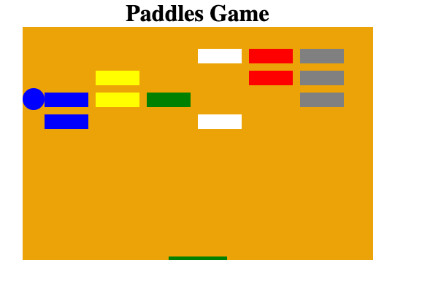
Phase 11 Draw Sprites

Slide 33
Phase 12 - Game Over
function gameover(){
alert("GAME OVER");
document.location.reload();
clearInterval(interval);
}

Slide 34
Phase 12 - Game Over
function draw() {
ctx.clearRect(0, 0, canvas.width, canvas.height);
drawBall();
drawPaddle();
drawsprites();
collisionDetection();
if(x + deltax > canvas.width-r || x + deltax < r) {
deltax = -deltax;
}
if(y + deltay < r) {
deltay = -deltay;
}
else if(y + deltay > canvas.height-r) {
if(x > paddleX && x < paddleX + paddleWidth) {
deltay = -deltay;
}
else{
gameover()
}
}
Calling game over

Slide 35
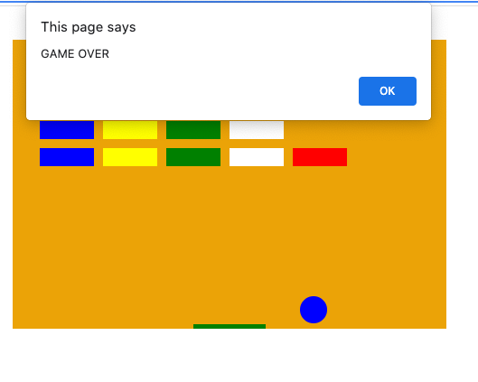
Phase 12 Game Over

Slide 36
Phase 13 - Points
//sprites
var numOfRows = 4;
var numOfColumns = 6;
var widthOfsprite = 60;
var heighOfsprite = 20;
var marginBetweensprite = 10;
var offsetTop = 30;
var offsetLeft = 30;
var points = 0;
var sprites = [];
Declare on point=0

Slide 37
Phase 13 - Points
function collisionDetection() {
for (var i = 0; i < numOfColumns; i++) {
for (var j = 0; j < numOfRows; j++) {
var s = sprites[i][j];
if (s.drawsprite == 1) {
if (x > s.x && x < s.x + widthOfsprite && y > s.y && y < s.y + heighOfsprite) {
deltay = -deltay;
s.drawsprite = 0;
points++;
if(points == numOfColumns*numOfRows) {
alert("YOU WIN!");
document.location.reload();
clearInterval(interval);
}
}
}
}
}
}
If user finishes with all sprites

Slide 38
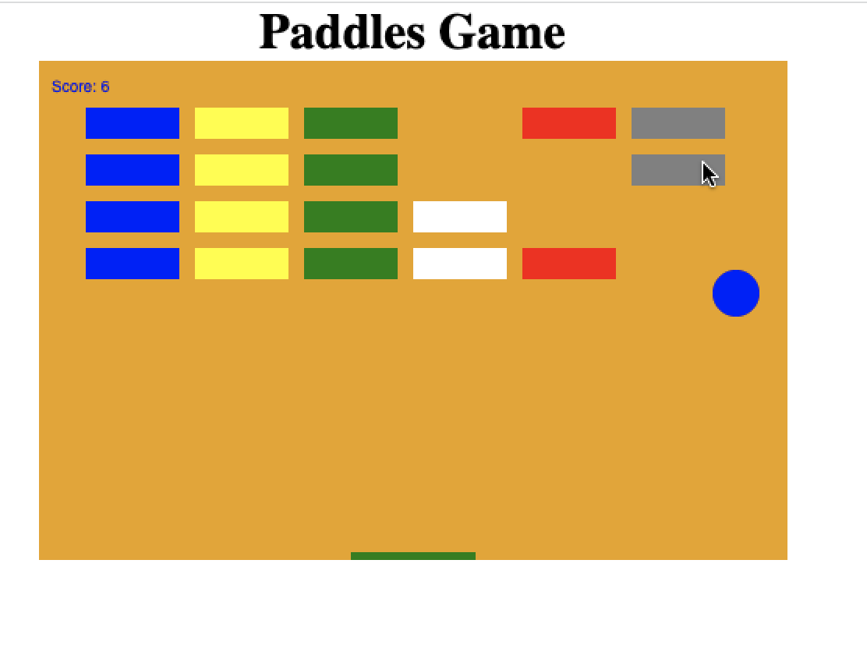
Phase 13 Game Over

Slide 39
Phase 14 Background
<style>
* { padding: 0; margin: 0; }
h1{width: 100%;text-align: center;}
canvas { background: rgb(235, 163, 7); display: block; margin: 0 auto;
background: url('back.png')}
</style>
Select background and add to css style

