Slide 1
Referentials in Anatomist

Slide 2
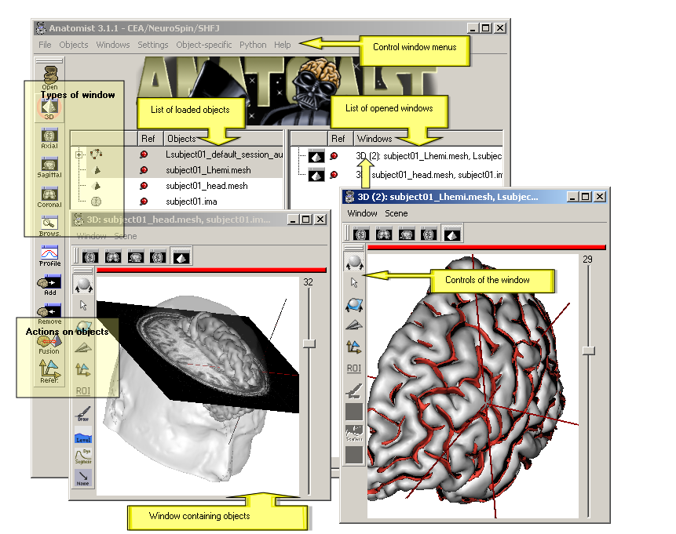

Anatomist
Visualization of several types of objects : image, volume (3D, 4D), mesh, graph (sulci, ROI)
Management of coordinate systems and transformations
Possibility of building complex 3D scenes with several objects (merging, superimposing...).
A lot of tools : color palettes, region of interest module, manual registration

Slide 3
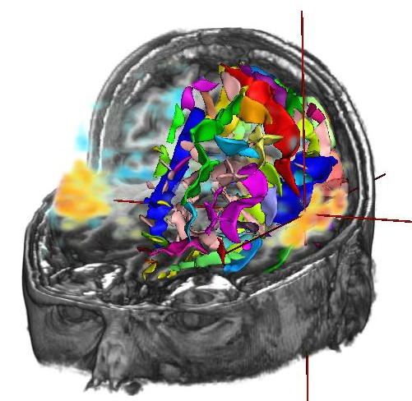
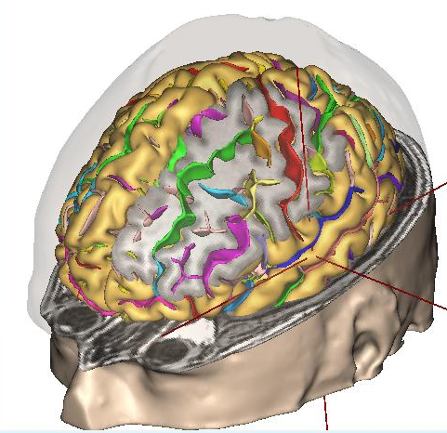
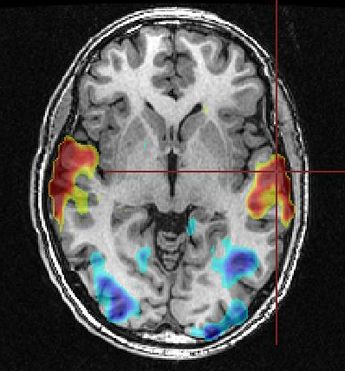
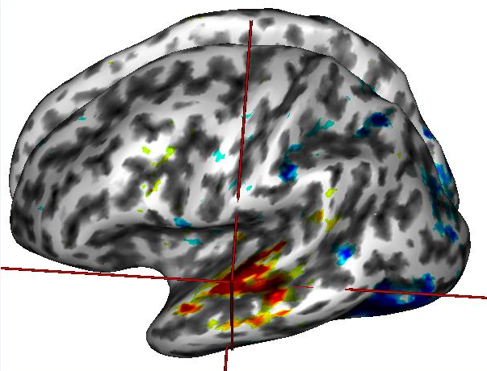
Anatomist features
Volume rendering
Cut mesh
2D fusion
3D fusion

Slide 4
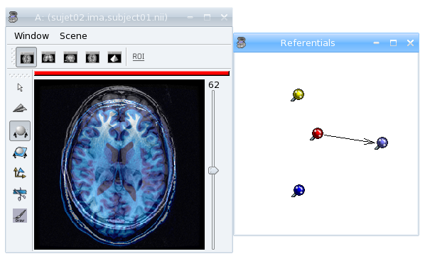
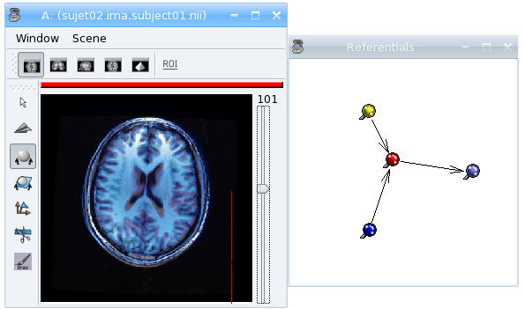


Handling referentials
Different subjects, acquisitions -> different referentials
Transformation : changes coordinates system from one referential to another

Slide 5


Anatomist / SPM referentials
Anatomist default referential
      X axis: right to left
      Y axis: front to back
      Z axis: top to bottom
      origin: the center of the first voxel: in the top, right, front corner
Radiological convention by default
X
Z
Y

Slide 6
Anatomist / SPM referentials
SPM default referential
        X axis: left to right
        Y axis: back to front
        Z axis: bottom to top
        origin: the center of image.
Neurological convention
Y
Z
X

Slide 7

Superimposing anatomical and functional MRI
SPM Anatomy normalization
    transformation matrix in a matlab file (.mat)
    can be converted to Anatomist transformation (.trm) with Brainvisa process tools -> converters -> SPM sn3d to AIMS transformation converter
Normalized fMRI data
    Nifti format contains transformation information
    Anatomist option : apply SPM/Nifti builtin referential
    Be careful : SPM generally doesn't indicate the destination of the transformation, so we have to add the information in Anatomist referential window.

Slide 8
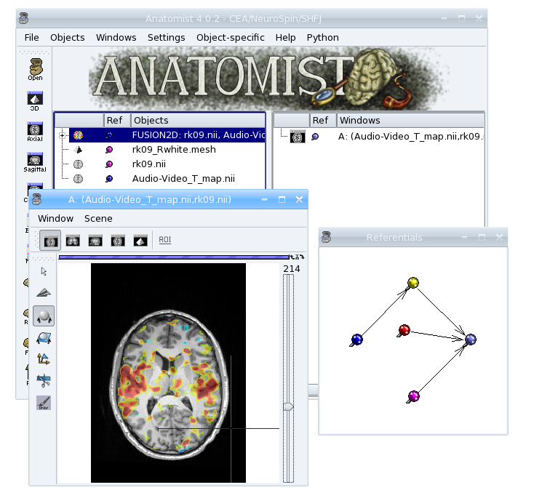
Superimposing anatomical and functional MRI

