Slide 1
Programming within BrainVISA project

Slide 2

What is the BrainVISA project ?
Complete development environement
RedMine based forge
Integration of various programming languages
Multiplatform programming
Documentation management
Packaging and distribution

Slide 3
Typical structure of a BrainVISA project
BrainVISA
BrainVISA toolbox
Python wrapping
Python library
C++ programs
C++ library

Slide 4
General plan
Part I – Introduction
Part II – Programming with BrainVISA
Part III – Programming with Anatomist
Part IV – Programming with Aims in Python
Part V – A complete example

Slide 5
Part I - Introduction

Slide 6
Part I – Introduction
User environements
How to start with Python ?
Useful modules
Exercises

Slide 7
User environements
Shell
  Mainly used to launch command lines
Python
  To be used only if IPython is not available
IPython
  Should be the main development environment
BrainVISA
  IPython plus BrainVISA specific extensions
Text editor
  Linux: kate or gedit

Slide 8

How to start with Python ?
Tutorial
  http://docs.python.org/tutorial/
Introduction to Python for Science
  http://gael-varoquaux.info/python4science.pdf
Some videos
  http://www.archive.org/search.php?query=SciPy%202009%20tutorial
In french
  http://dakarlug.org/pat/scientifique/html/index.html

Slide 9
Useful modules
Standard Python modules (not included by default)
  SciPy, NumPy
  Matplotlib
  PyQt
BrainVISA project modules
  soma, aims
  anatomist
  brainvisa

Slide 10
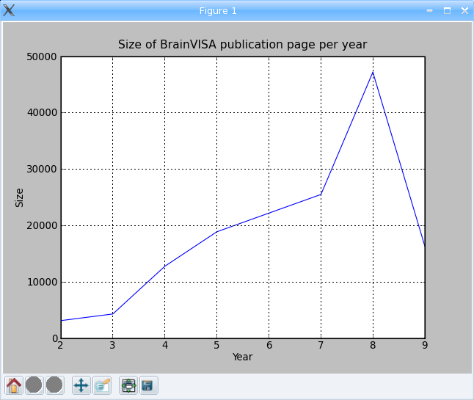
Exercises
PBV_1: Count the number of occurrences of "BrainVISA" in web page http://brainvisa.info
PBV_2: Show a diagram representing the size of BrainVISA bibliography pages between 2002 and 2009
import urllib
occurences = 0
file = urllib.urlopen( 'http://brainvisa.info/' )
for line in file:
occurences = occurences + line.count( 'brainvisa' )
print occurences
import urllib
from pylab import *
url = 'http://brainvisa.info/biblio/en/Year/200%d.html'
years = range( 2, 10 )
values = [ len( urllib.urlopen( url % year ).read() ) for year in years ]
plot( years, values, linewidth=1.0)
ylabel('Size')
xlabel('Year')
title('Size of BrainVISA publication page per year')
grid(True)
show()

Slide 11
Part II – Programming with BrainVISA

Slide 12
Part II – Programming with BrainVISA
II.1 – Processes
II.2 – Databases and Ontologies
II.3 – Toolboxes

Slide 13
II.1 – Processes

Slide 14
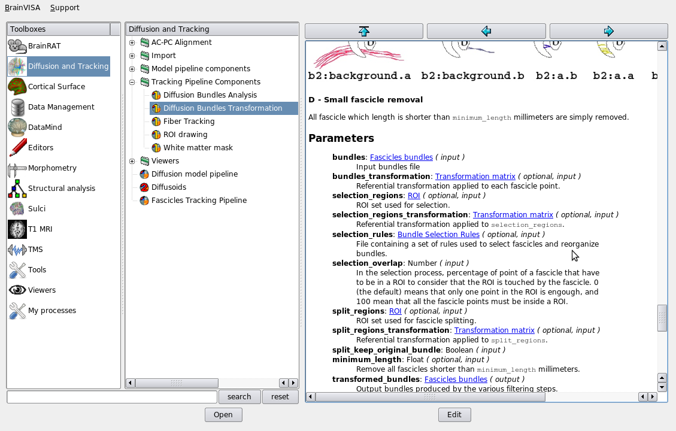
BrainVISA main concepts
Process
directory
Process
Documentation
Toolbox
Ontology

Slide 15
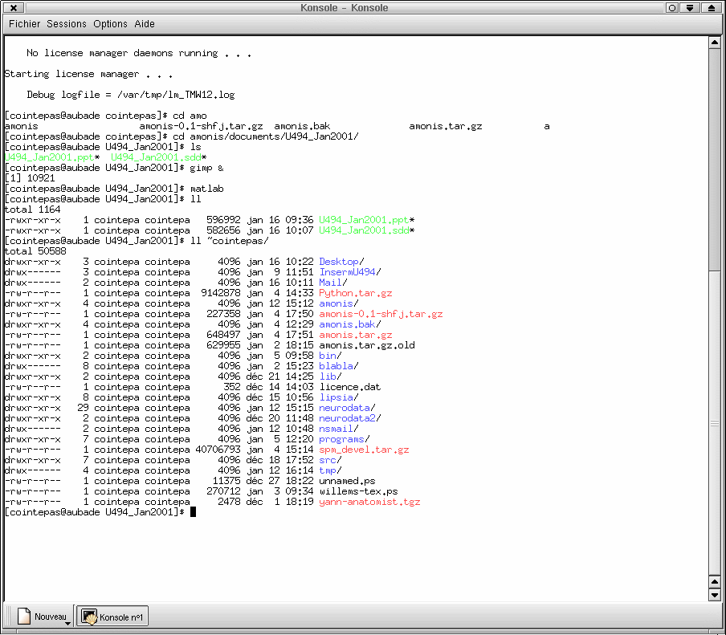
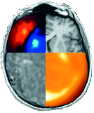
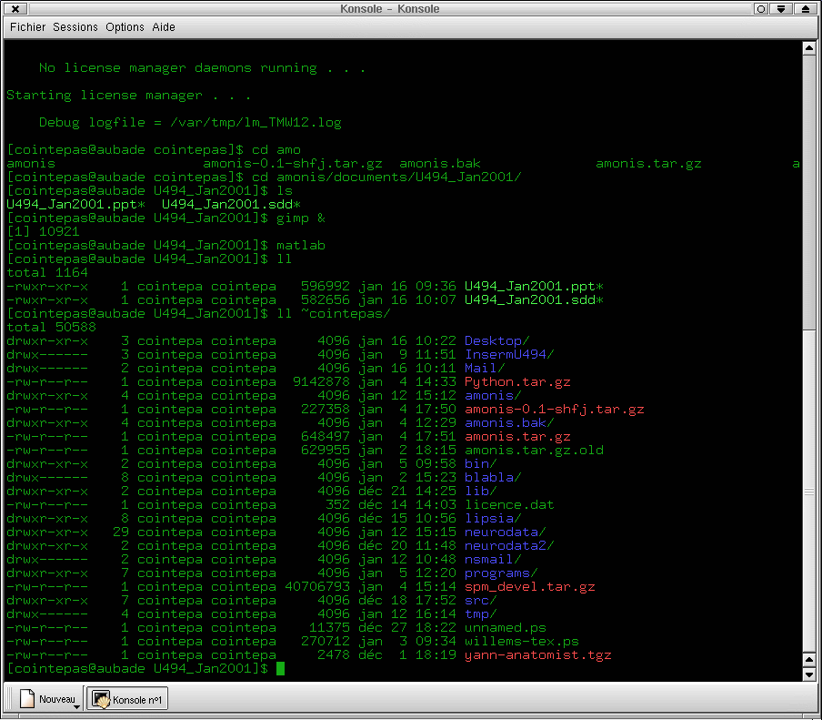
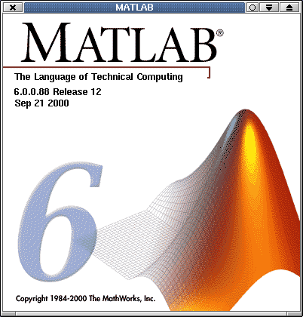
What is a process ?
A process is an interface between BrainVISA and another software
Reusable component. For instance, a process can call other processes.
Python file containing one main function
BrainVISA
Process
Process
Process

Slide 16
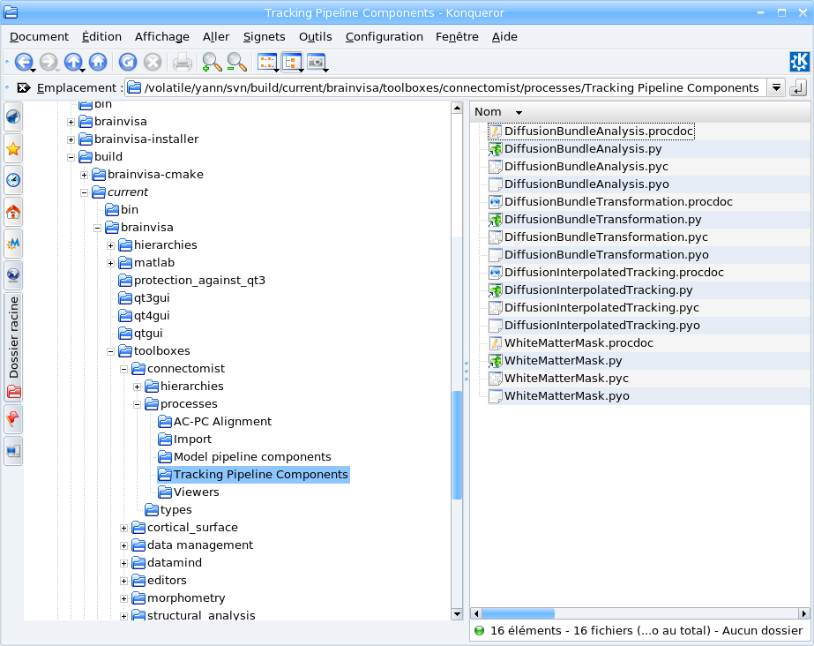
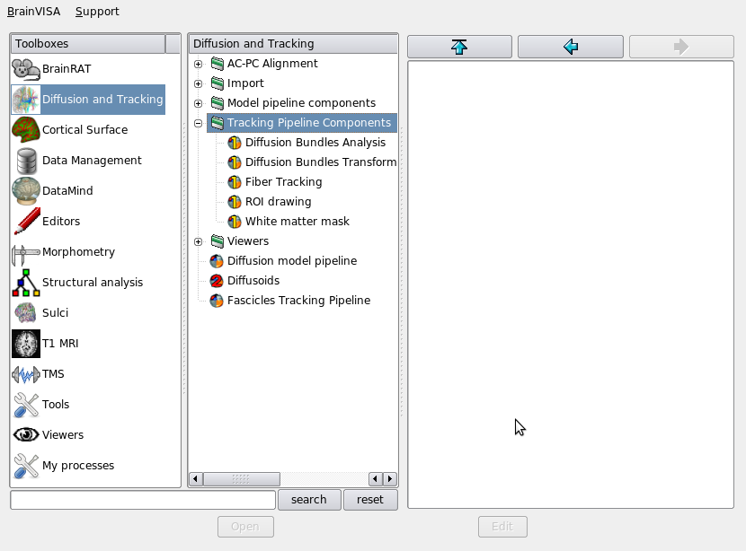
How to create a new process ?
Create a file with .py extension in a toolbox processes directory
Shortcut to a process
from another toolbox

Slide 17
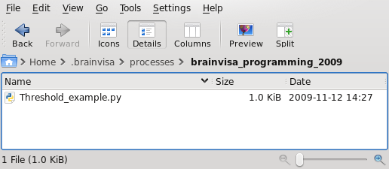
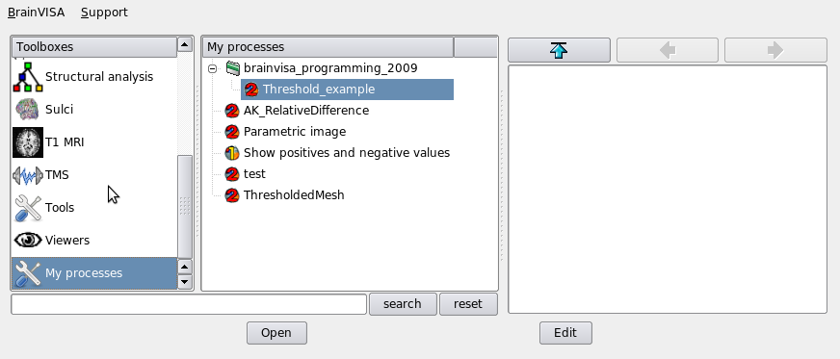
Special toolbox: My processes
Located in user directory
  Linux & Mac: $HOME/.brainvisa
  Windows XP: C:\Documents and Settings\<login>\.brainvisa
  Windows VISTA: C:\Users\<login>\.brainvisa
Behave like a regular toolbox
directory
process

Slide 18
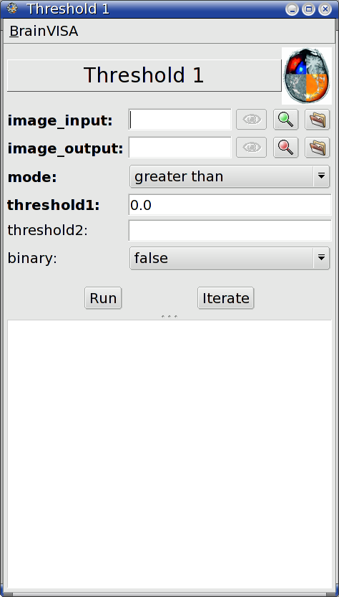
Structure of a BrainVISA process
# -*- coding: utf-8 -*-
from neuroProcesses import *
signature = Signature(
'image_input', ReadDiskItem(
'4D Volume',
[ 'NIFTI-1 image', 'SPM image', 'DICOM image', 'GIS image' ] ),
'image_output', WriteDiskItem(
'4D Volume',
'Aims writable volume formats' ),
'mode', Choice ( ( 'less than', 'lt' ),
( 'less or equal', 'le' ),
( 'greater than', 'gt' ),
( 'greater or equal', 'ge' ),
( 'equal', 'eq' ),
( 'different', 'di' ),
( 'between', 'be' ),
( 'outside', 'ou' ) ),
'threshold1', Float(),
'threshold2', Float(),
'binary', Boolean(),
)
def initialization( self ):
self.setOptional( 'threshold2', 'binary' )
self.binary = 0
self.threshold1=0
self.mode='gt'
def execution( self, context ):
command = [ 'AimsThreshold',
'-i', self.image_input,
'-o', self.image_output,
'-m', self.mode,
'-t', self.threshold1 ]
if self.threshold2:
command += [ '-u', self.threshold2]
if self.binary:
command += [ '-b']
context.system( *command )
header
signature
initialization
body

Slide 19
Header of a BrainVISA process
Example of BrainVISA process header
# -*- coding: utf-8 -*-
from neuroProcesses import *
name = 'Human readable error'
userLevel = 0
roles = ( 'viewer', )
def validation( self ):
try:
import my_package.my_module
except:
raise ValidationError('my_module is not installed')
0 = Visible to everybody
1 = Invisible to basic users
2 = Invisible to basic and
advanced users
Possible roles:
viewer
editor
converter
importer

Slide 20
Signature of a BrainVISA process (1/2)
Defines the parameters of a process
signature = Signature( parameter_list )
  parameter_list ← name, type, name, type, …
  Parameter types:
    String()
    Number(), Float(), Integer()
    Boolean()
    Choice( <value>, ( <label>, <value> ), … )
    ReadDiskItem( type, formats )
    WriteDiskItem( type, formats )

Slide 21
Signature of a BrainVISA process (2/2)
Example of signature for a thresholding process
signature = Signature(
'image_input', ReadDiskItem(
'4D Volume',
[ 'NIFTI-1 image', 'SPM image', 'DICOM image', 'GIS image' ] ),
'image_output', WriteDiskItem(
'4D Volume',
'Aims writable volume formats' ),
'mode', Choice ( ( 'less than', 'lt' ),
( 'less or equal', 'le' ),
( 'greater than', 'gt' ),
( 'greater or equal', 'ge' ),
( 'equal', 'eq' ),
( 'different', 'di' ),
( 'between', 'be' ),
( 'outside', 'ou' ) ),
'threshold1', Float(),
'threshold2', Float(),
'binary', Boolean(),
)

Slide 22
BrainVISA process initialization
Initialization example
def initialization( self ):
self.binary = 0
self.threshold1=0
self.mode='gt'
self.setOptional( 'threshold2', 'binary' )
self.linkParameters( 'threshold2', 'threshold1' )
eNode = SerialExecutionNode( self.name,
parameterized=self )
eNode.addChild( 'correction',
ProcessExecutionNode( 'DiffusionEPICorrection',
optional=True, selected=True ) )
eNode.addChild( 'create_mask',
ProcessExecutionNode( 'DiffusionT2BrainMask',
optional=True, selected=True ) )
Parameters initialization
Optional parameters
Linked parameters
Pipeline
creation

Slide 23
The real work : the process body
Python function
def execution( self, context ):
command = [ 'AimsThreshold',
'-i', self.image_input,
'-o', self.image_output,
'-m', self.mode,
'-t', self.threshold1 ]
if self.threshold2:
command += [ '-u', self.threshold2]
if self.binary:
command += [ '-b']
context.system( *command )
self : get parameters values
Execution context:
Manage interactions with system and user in a controlled and context dependent way
  write, warning, error : prints a message.
  log : writes a message in the BrainVISA log file.
  ask, dialog : asks a question to the user.
  temporary : creates a temporary file.
  system: call a system command.
  runProcess : runs a process.
  matlab : calls a Matlab command.

Slide 24
Exercises
PBV_3: create a process taking an image and a threshold and writing a binary image containing all voxels greater than threshold.
PBV_4: create a process that takes a binary image and create a 3D mesh from this image.
PBV_5: create a process combining PBV_3 and PBV_4. Input is image and threshold, output is mesh. Thresholded image is only used internally in a temporary file.
PBV_6: create a process that display an image and a mesh in the same Anatomist window

Slide 25
Advanced process programming
Pipeline: combination of existing processes
Customized parameter links
Dynamic signature
Customization of graphical interface

Slide 26
Exercises
PBV_7: create a pipeline process chaining PBV_5 and PBV_6. This pipeline should create a mesh from a thresholded image and show the results in an Anatomist window.

Slide 27
II.2 – Databases and Ontologies

Slide 28
Why using BrainVISA databases ?
Define a shared data organization
Reuse data from people who left the lab
Share data with people from other labs
Make links between data
  Find the head mesh corresponding to this MRI scan
Automation of data processing

Slide 29
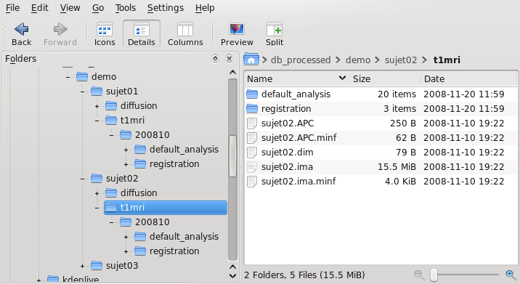
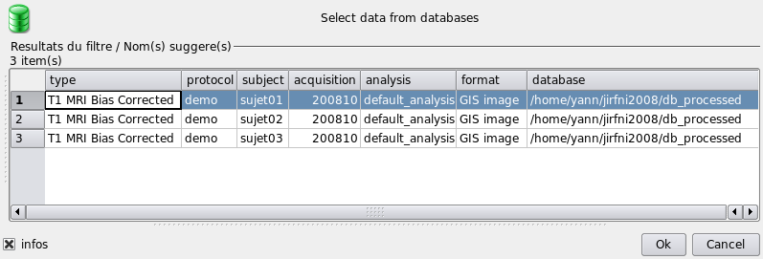
What is a BrainVISA database ?
What is a BrainVISA database ?
  A directory containing data files that are organized in a hierarchy that follows an ontology
  A relational database built from an ontology and allowing to make efficient selection requests on data files.
Two ways of seeing the same data connected together by a common ontology
bijection

Slide 30
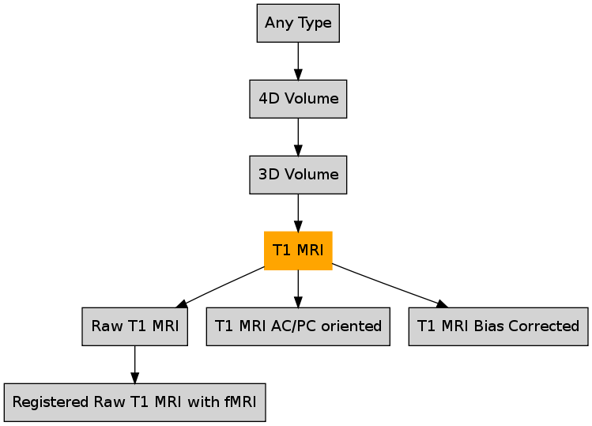
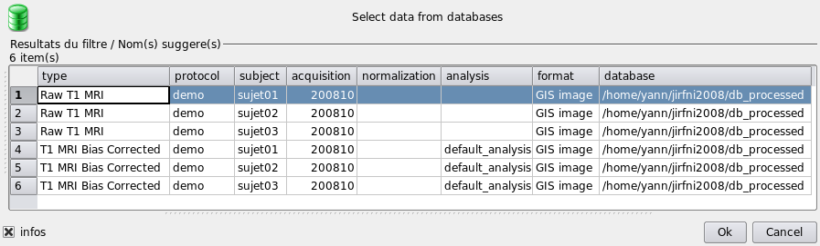
What is a BrainVISA ontology ?
Hierarchy of types
Raw T1 MRI
protocol
subject
acquisition
normalization
T1 MRI Bias Corrected:
protocol
subject
acquisition
analysis
T1 MRI:
protocol
subject
acquisition
normalization
analysis
Attributes
Data selection from databases rely only on ontology

Slide 31
BrainVISA database hierarchy
bijection
Raw T1 MRI:
{protocol}/{subject}/t1mri/{acquisition}/<subject>
{protocol}/{subject}/t1mri/{acquisition}/normalized_{normalization}_<subject>
T1 MRI Bias Corrected:
{protocol}/{subject}/t1mri/{acquisition}/{analysis}/nobias_<subject>

Slide 32
Customization of a BrainVISA database
Create types in <toolbox>/types/*.py
include( 'builtin' )
include( 'anatomy' )
FileType( 'T1 MRI Bias Corrected', 'T1 MRI' )
Format( 'BrainVISA Gyri Model', "f|*.gyr" )
FileType( 'Gyri Model', 'Any Type', 'BrainVISA Gyri Model' )
Add hierarchy rules in <toolbox>/hierarchies/brainvisa-3.1.0/*.py
include( 'base' )
insert( {protocol}/{subject}/t1mri/{acquisition}/{analysis}',
'nobias_<subject>', SetType( 'T1 MRI Bias Corrected' ),
)

Slide 33
Exercises
PBV_8: Create a new type: "Mesh from Threshold"
PBV_9: Create a new hierarchy entry for "Mesh from Threshold" with the same key attributes as "Fractional Anisotropy"
PBV_10: Create a process that create a mesh of type "Mesh from Threshold" from a thresholded "Fractional Anisotropy" image. Include a link between input image and output mesh.
PBV_11: Create a viewer for "Mesh from threshold" that display the mesh with the corresponding FA image.

Slide 34
II.3 – Toolboxes

Slide 35
What is a BrainVISA toolbox ?
A set of BrainVISA extensions
Processes
Ontology
Documentation

Slide 36
Why creating a toolbox ?
Organize processes according to a topic
Distribute BrainVISA extensions

Slide 37
Licensing of a BrainVISA toolbox
BrainVISA is in CeCill v2 (i.e. GPL)
Therefore a BrainVISA toolbox must be in GPL
However, processing libraries can have any licence as long as they do not rely on BrainVISA and can be distributed separately
Example: T1 MRI Segmentation Toolbox
BrainVISA
t1mri-gpl
t1mri-private

Slide 38
Toolbox creation
Create a new <name> directory in toolboxes directory
Put processes in processes directory
Put ontology extensions in types and hierarchies directories
Create a configuration file: <name>.py
  userName = 'User will see this name'
  icon = file path of the icon that will reprensent the toolbox in graphical interface. Optional, there is a default icon.
  description : tooltip for the toolbox (default is the name of the toolbox)

Slide 39
Creating links between toolboxes
The same process can appear in several toolboxes
Links are stored in a minf file: <name>.minf
Example :
  Diffusion importation processes from Diffusion & tracking toolbox
  These processes are also in Data management toolbox
BrainVISA interface can be used to create this file

Slide 40
Packaging and distribution of a toolbox
Structure of BrainVISA package directory:
  bin : executables
  brainvisa/toolboxes : BrainVISA toolboxes
  include : C/C++ headers
  lib : dynamic libraries
  python : Python libraries
  share : shared data and documentation
Create an archive that adds files to the existing structure

Slide 41
Exercises
PBV_12: Create a package containing BrainVISA extensions corresponding to exercises PBV_8, PBV_9 (ontology), PBV_10 (process) and PBV_11 (viewer)

Slide 42
Part IIII – Programming with Anatomist

Slide 43

Anatomist tutorial – programming part
Tutorial about Anatomist python API:
http://brainvisa.info/doc/anatomist/ana_training/en/html/ch08.html

Slide 44

Exercises
ExAna_1: display left hemisphere sulci + left white matter mesh + T1 anatomy axial slice + green and transparent head mesh
  Tip: left hemisphere sulci file is subject01/sulci/Lsubject01_default_session_auto.arg
ExAna_2: make a fusion of contrast activations (Audio-Video_T_map.nii) with the 2 white matter meshes + transparent head mesh + a sagittal slice of the brain mask in blue
  Tip: use « Fusion3DMethod »

Slide 45
Part IV – Programming with Aims in Python

Slide 46
AIMS tutorial – programming part
Tutorial about AIMS python API:
http://brainvisa.info/doc/aimsdata/aims_training/en/html/ch10.html

Slide 47
Part V – A complete example

Slide 48
Exercises
Part 1: Create a BrainVISA process to compute the coordinates of the maximum using aims
from neuroProcesses import *
import neuroConfig
from brainvisa import anatomist
import numpy
signature = Signature(
'image', ReadDiskItem( '4D Volume', 'Aims readable volume formats' ),
)
def execution( self, context ):
# Read input image
aims_image = aims.read( self.image.fullPath() )
# Compute coordinate of maximum voxel with Python
aims_max_coordinate = ( 0, 0, 0, 0 )
maximum = image.at( 0, 0, 0, 0 )
for t in xrange( image.getSizeT() ):
for z in xrange( image.getSizeZ() ):
for y in xrange( image.getSizeY() ):
for x in xrange( image.getSizeX() ):
v = aims_image.at( x, y, z, t )
if v > maximum:
maximum = v
aims_max_coordinate = ( x, y, z, t )
context.write( 'Aims says max is', maximum, 'at', aims_max_coordinate )

Slide 49
Exercises
Part 2: Use numpy to process maximum coordinates
from neuroProcesses import *
import neuroConfig
from brainvisa import anatomist
import numpy
signature = Signature(
'image', ReadDiskItem( '4D Volume', 'Aims readable volume formats' ),
)
def execution( self, context ):
# Read input image
aims_image = aims.read( self.image.fullPath() )
numpy_matrix = numpy.array(aims_image, copy = False )
numpy_max_coordinate = numpy.unravel_index( numpy_matrix.argmax(), numpy_matrix.shape )
context.write( 'Numpy says max is', aims_image.at( *numpy_max_coordinate ),
'at', numpy_max_coordinate )

Slide 50
Exercises
Part 3: Add read of a spherical mesh of size 100 located in standard BrainVISA directory and write it in a temporary file
aims_sphere = aims.read( os.path.join( neuroConfig.dataPath[0].directory,
'standardmeshes', 'ico100_7.mesh') )
# Change the size of the sphere and center it on image maximum
voxel_size = aims_image.header()[ 'voxel_size' ]
for vertex in aims_sphere.vertex():
vertex *= self.sphere_size / 100.0
vertex[ 0 ] += aims_max_coordinate[ 0 ] * voxel_size[ 0 ]
vertex[ 1 ] += aims_max_coordinate[ 1 ] * voxel_size[ 1 ]
vertex[ 2 ] += aims_max_coordinate[ 2 ] * voxel_size[ 2 ]
# Create a temporary file name for the modified sphere
diskitem_sphere = context.temporary( 'Mesh Mesh' )
# Write the modified sphere in temporary file
aims.write( aims_sphere, diskitem_sphere.fullPath() )

Slide 51
Exercises
Part 4: Create a texture on the sphere that takes the value from an interpolator for each point of the sphere and save it in a temporary file
# Create an interpolator on the image to be able to get a value for any millimeter coordinate
interpolator = aims.getLinearInterpolator( aims_image )
# Create a texture on the sphere that takes the value from the interpolator
# for each point of the sphere
vertices_count = aims_sphere.vertex().size()
aims_texture = aims.Texture_FLOAT( vertices_count )
for i in xrange( vertices_count ):
aims_texture[ i ] = interpolator.value( *aims_sphere.vertex()[ i ] )
# Write the created texture to a temporary file
diskitem_texture = context.temporary( 'Texture' )
aims_time_texture = aims.TimeTexture_FLOAT()
aims_time_texture[ 0 ] = aims_texture
aims.write( aims_time_texture, diskitem_texture.fullPath() )

Slide 52
Exercises
Part 5: Open anatomist and visualize the textured sphere at the maximum of the image
# Open Anatomist
a = anatomist.Anatomist()
# Load sphere in anatomist from temporary file
aSphere = a.loadObject( diskitem_sphere.fullPath() )
# Load sphere texture in anatomist from temporary file
aTexture = a.loadObject( diskitem_texture.fullPath() )
# Fusion sphere and texture to create a textured object
aTexturedSphere = a.fusionObjects( (aSphere, aTexture), 'FusionTexSurfMethod' )
# Load image in anatomist
aImage = a.loadObject( self.image.fullPath() )
# Create an Axial window
aWindow = a.createWindow( 'Axial' )
# Display textured sphere and image in window
aWindow.addObjects( (aTexturedSphere, aImage) )
# Move Anatomist cursor to the center of the voxel with maximum value
aWindow.moveLinkedCursor( ( aims_max_coordinate[ 0 ] * voxel_size[ 0 ],
aims_max_coordinate[ 1 ] * voxel_size[ 1 ],
aims_max_coordinate[ 2 ] * voxel_size[ 2 ] ) )

Slide 53
Exercises
Part 6: finalize the process to not destroy python objects used
# Return objects that must not be destroyed immediately
return [ aTexturedSphere, aImage, aWindow ]

Slide 54

Thank you for your attention

