Slide 1

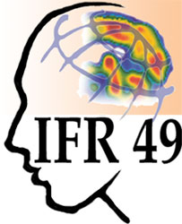






BrainVISA : an operating system
for Neuroimaging

Slide 2
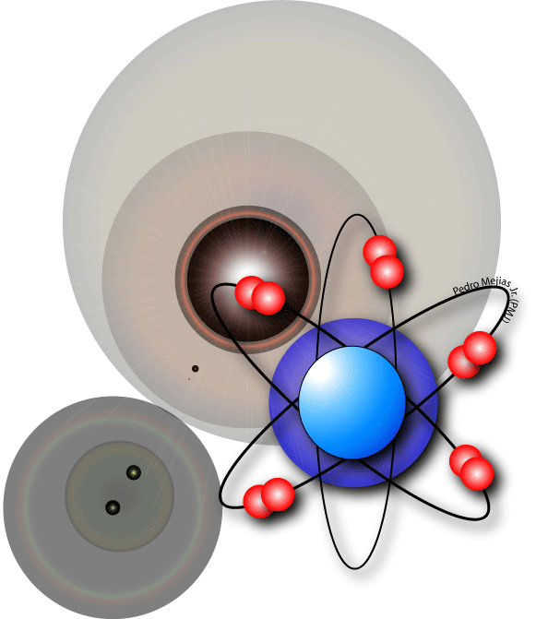
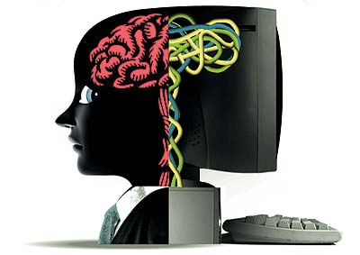
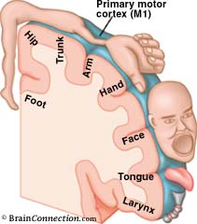
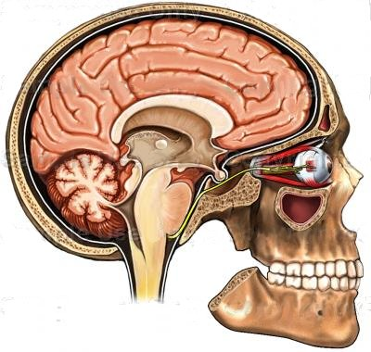
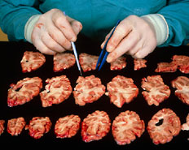
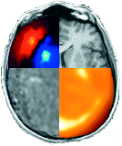
Why BrainVISA ?
Image processing pipeline
Acquisition
Artificial vision
Analysis
Applications
Physicsts
Biologists
Methodologists
Cogniticians
Clinicians
BrainVISA
software A
software B
software C
software D
software E

Slide 3
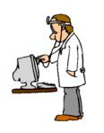

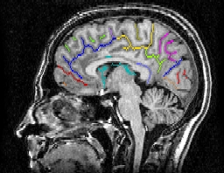
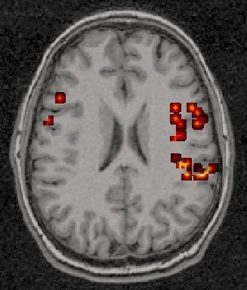
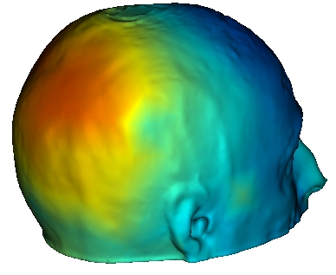
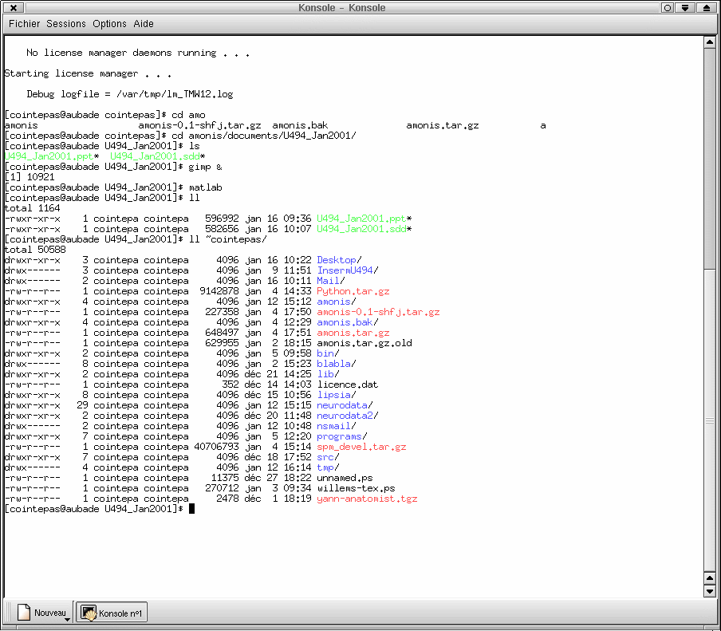
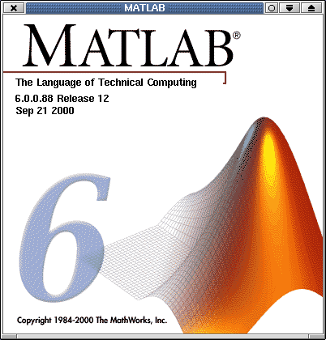
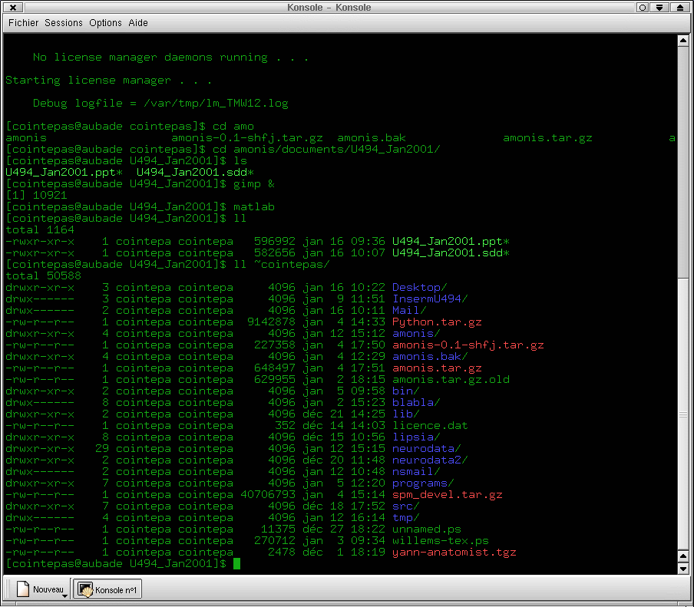
Overview of BrainVISA architecture
User interface
Toolboxes
users
Data
management
Software
management
methodologists
Control
programmers
Data
Softwares

Slide 4
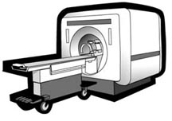
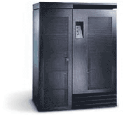

Our objective with BrainVISA
Physicists
Biologists
Methodologists
Cogniticians
Clinicians
Exam prescription
anatomical MRI
functional MRI
Data organization
diffusion MRI
BrainVISA
Interactive visualization
MEG / EEG
Histology
Programming environement
Nuclear imaging
intranet / internet
scanner
servers
software

Slide 5
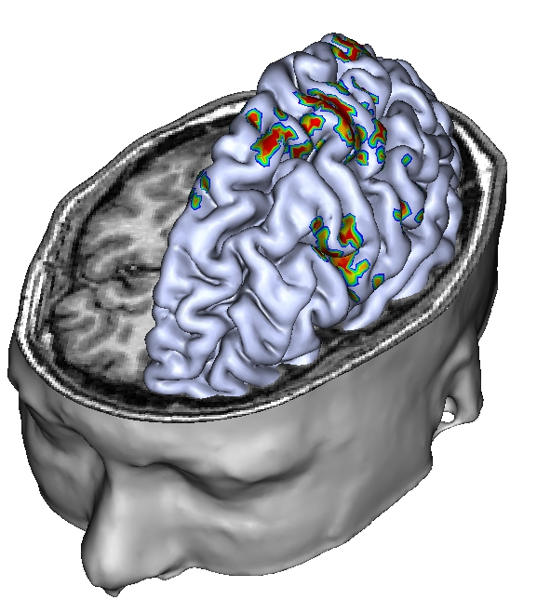
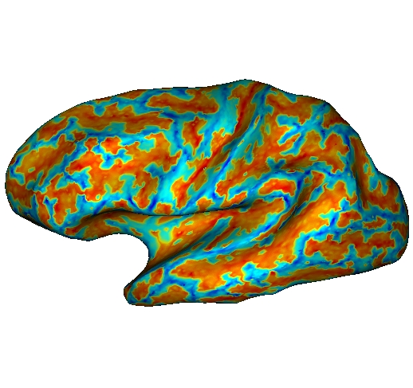
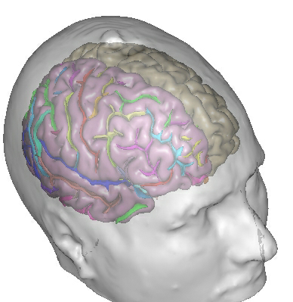
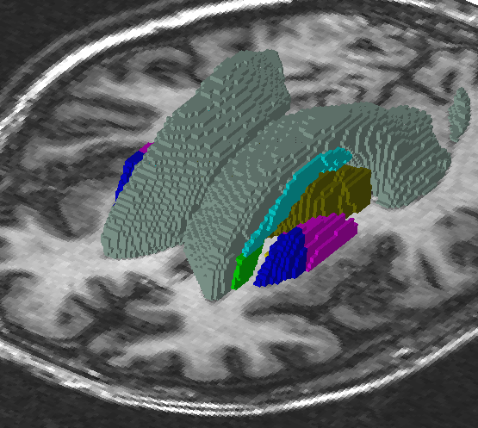
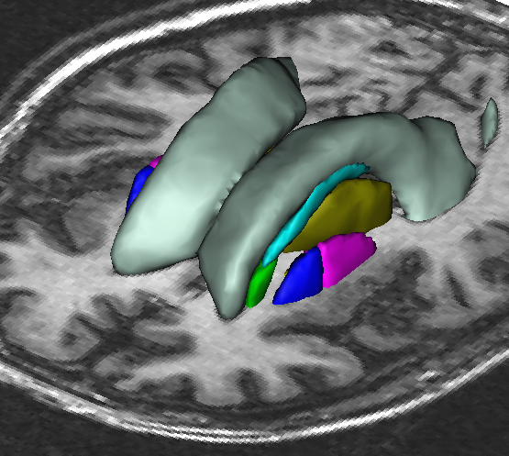
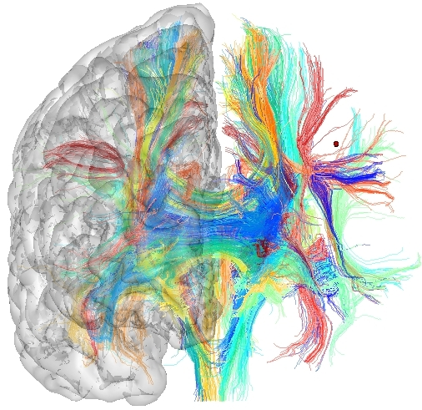
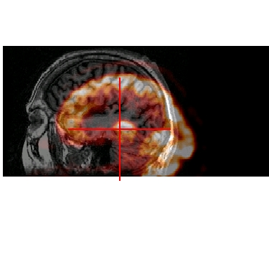
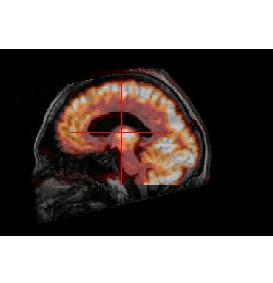
BrainVISA toolboxes (1)
surface analysis
multimodal interactive
visualization
anatomy segmentation
and sulci identification
3D ROI
drawing
DTI analysis and
fiber tracking
registration

Slide 6
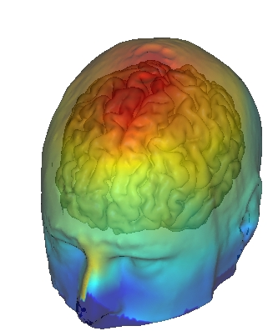
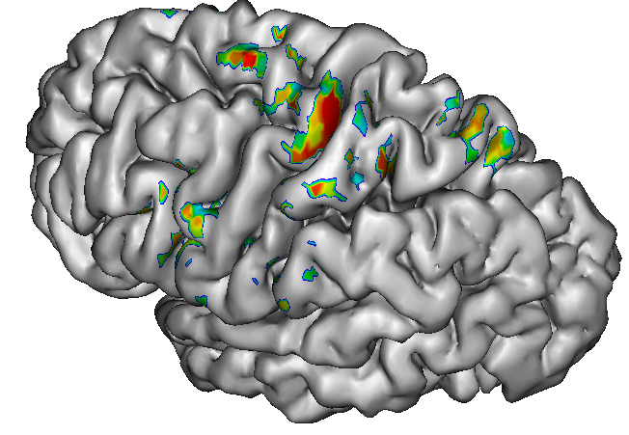
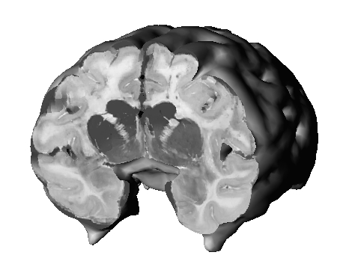
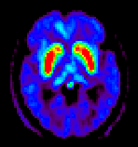
BrainVISA toolboxes (2)
functionnal MRI
MEG / EEG
histology
nuclear imaging
TMS

Slide 7
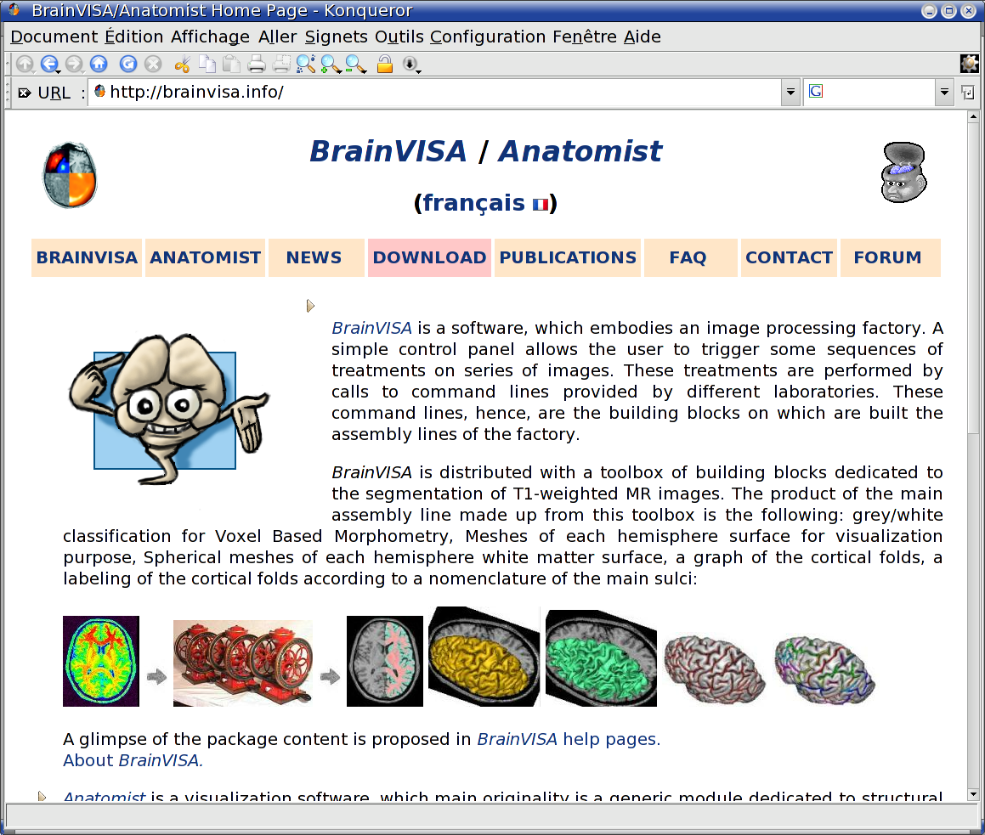
BrainVISA web site: http://brainvisa.info

Slide 8
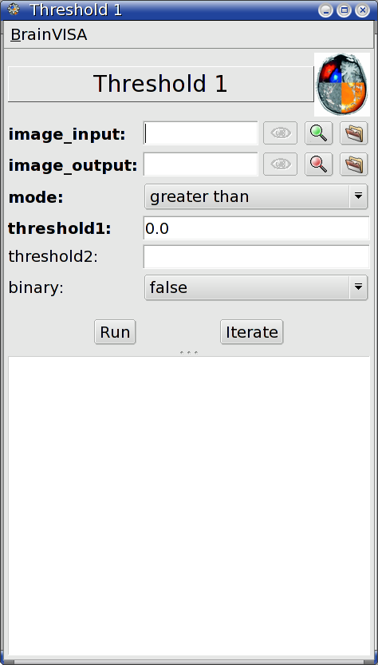
Example of BrainVISA process
signature = Signature(
'image_input', ReadDiskItem(
'4D Volume',
[ 'SPM image', 'DICOM image', 'GIS image' ] ),
'image_output', WriteDiskItem(
'4D Volume',
[ 'SPM image', 'DICOM image', 'GIS image' ] ),
'mode', Choice ( ( 'less than', 'lt' ),
( 'less or equal', 'le' ),
( 'greater than', 'gt' ),
( 'greater or equal', 'ge' ),
( 'equal', 'eq' ),
( 'different', 'di' ),
( 'between', 'be' ),
( 'outside', 'ou' ) ),
'threshold1', Float(),
'threshold2', Float(),
'binary', Boolean(),
)
def initialization( self ):
self.setOptional('threshold2', 'binary')
self.binary = 0
self.threshold1=0
self.mode='gt'
def execution( self, context ):
command = [ 'AimsThreshold',
'-i', self.image_input,
'-o', self.image_output,
'-m', self.mode,
'-t', self.threshold1 ]
if self.threshold2 is not None :
command += [ '-u', self.threshold2]
if self.binary:
command += [ '-b']
context.system( *command )
signature
initialization
body

Slide 9
Data organization
database directory
autism
parkinson
protocol
bond-007
number-6
leonardo-1452-1519
subjet
anatomy
anatomy
anatomy
category
segment
segment
segment
diffusion
diffusion
functional
}
{
Type: T1 MRI
Format: SPM
bond-007.hdr
bond-007.img
nobias_bond-007.dim
nobias_bond-007.ima
}
{
Type: Bias corrected T1 MRI
Format: GIS
data
}
{
brain_bond-007.hdr
brain_bond-007.img
Lcortex_bond-007.hdr
Lcortex_bond-007.img
Type: Brain Mask
Format: SPM
}
{
Type: Left hemisphere cortex
Format: SPM

Slide 10
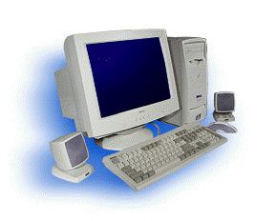
Future database system
user
abstract
database layer
database implementations
File System
Relational Database
System
Network Distributed
Data

Slide 11
Database abstraction layer

Slide 12
Database abstraction layer

Slide 13
Example of user Python code
# Get an acces to one repository
db = openDatabase( databaseURL )
# Iterate on of all the data of type ‘T1 MRI’ in the database
# that are in the protocol ‘test’ and the project ‘demo’
for item in db.select( type=’T1 MRI’, project=’demo’, protocol=’test’ ):
# Item is a dictionary-like structure for properties access
for property in item:
print property, ‘=’, item[ property ]
# Retrieve the file(s) (and directorie(s) if any) from the virtual
# directory system and convert it to NIFTI format (if necessary).
files = item.getLocalFiles( format=’NIFTI’ )
niftiFileName = files[ 0 ]
# Read the image and do something with it
...

