Slide 1
BrainVISA advanced Training
Introduction

Slide 2
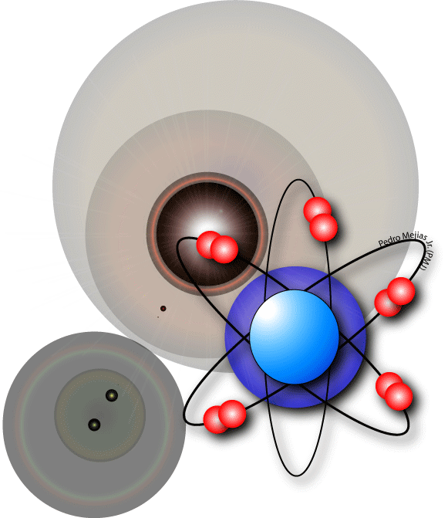
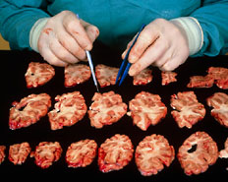
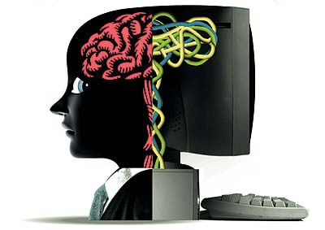
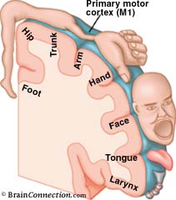
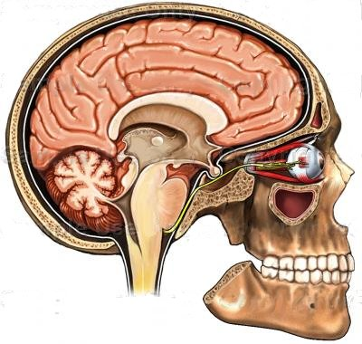
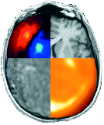
What is BrainVISA ?
Modular and customizable software platform built to host heterogeneous tools dedicated to neuroimaging research
Aim : help sharing neuroimaging data and processing tools.
Free and open-source software -> extensible
Image processing pipeline
Acquisition
Artificial vision
Analysis
Applications
Physicsts
Biologists
Methodologists
Cogniticians
Clinicians
BrainVISA
software A
software B
software C
software D
software E

Slide 3

Outline
Overview of BrainVISA package
  Anatomist
  BrainVISA
  Command lines
BrainVISA toolboxes
Starting with BrainVISA
Documentation & Help
Installation
Exercises

Slide 4
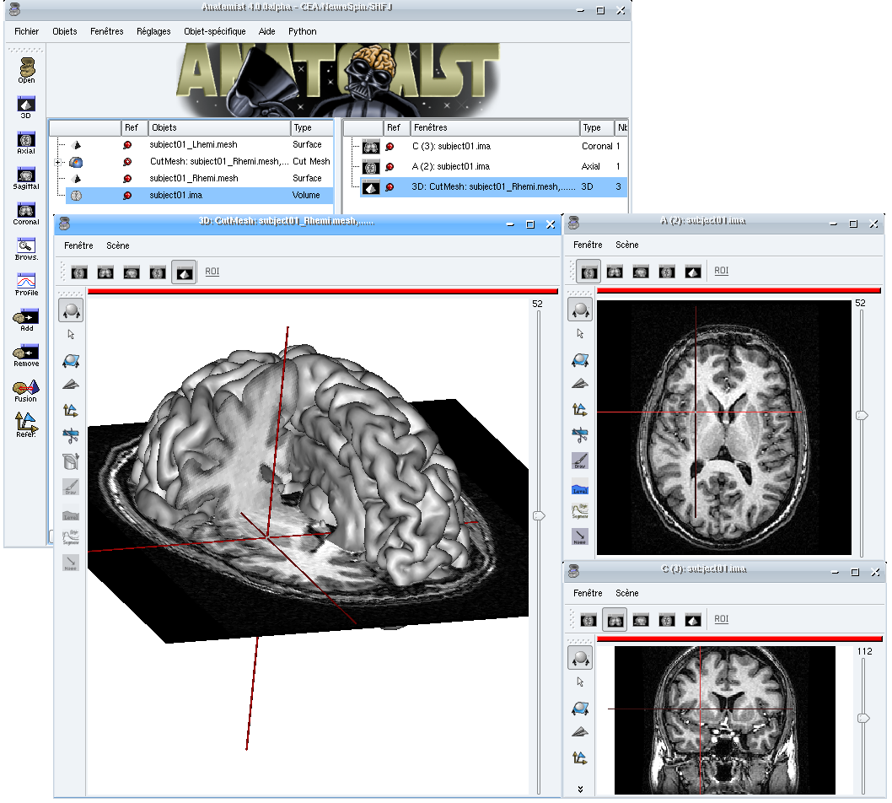
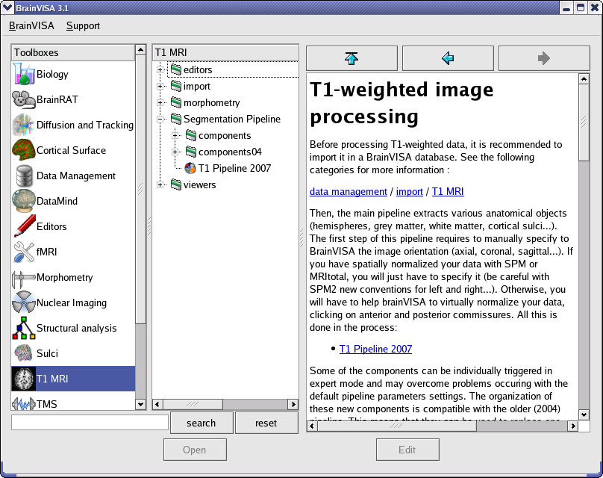

Overview of BrainVISA package
Available for free download on http://brainvisa.info
Linux, Windows XP, and MacOS versions
Anatomist
BrainVISA
Aims Commands
$AimsSubVolume -i diff_data.ima -o t2.ima -t 0 -T 0
$AimsThreshold -i voronoi_lesson1.ima -o hemi_only.ima -m lt -t 3
$AimsGraphConvert -i label_image.ima -o label_graphe.arg –bucket ...

Slide 5
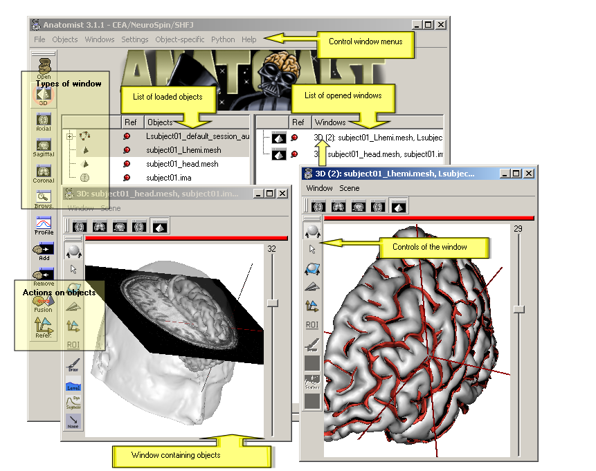
Anatomist
Visualization of several types of objects : image, volume (3D, 4D), mesh, graph (sulci, ROI)
Management of coordinate systems and transformations
Possibility of building complex 3D scenes with several objects (merging, superimposing...).
A lot of tools : color palettes, region of interest module, manual registration

Slide 6
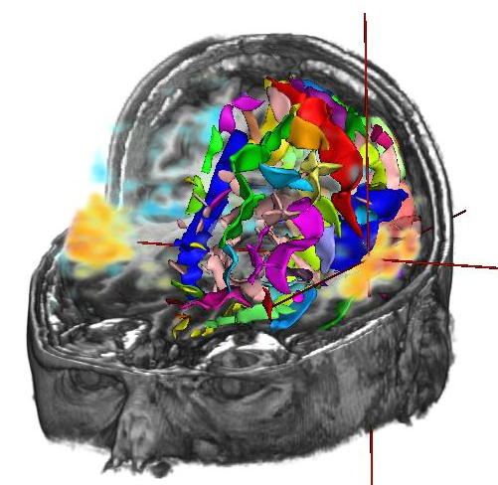
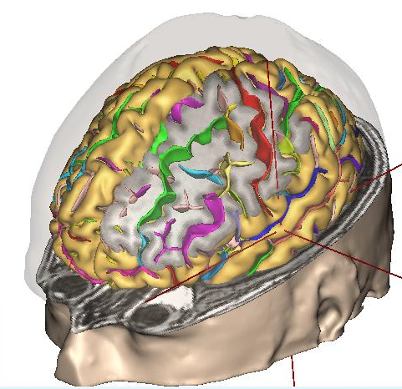
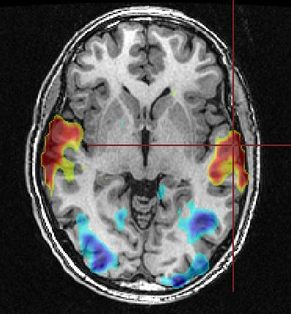
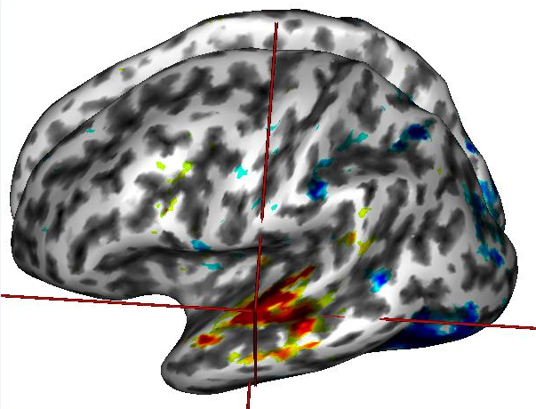
Anatomist features
Volume rendering
Cut mesh
2D fusion
3D fusion

Slide 7
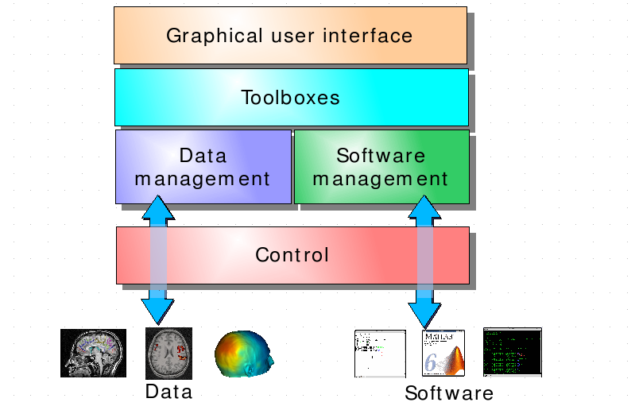
BrainVISA features
Data management system allows database sharing
Harmonization of communcations between different software
Interactive visualization of multimodal data
Automatic generation of graphical user interface
Workflow monitoring : processes, pipelines, iterations

Slide 8

Aims Commands
Commands for many purposes
File information and conversion: AimsFileInfo, AimsFileConvert, AimsGraphConvert, AimsSetMinf, AimsAttributedViewer
Cut / cat / merge and other simple operations: AimsTCat, AimsSubVolume, AimsOverVolume, AimsFlip, AimsMerge2RGB, AimsSplitRGB, AimsGraphMerge, AimsMergeLabel
Simple, basic processing: AimsThreshold, AimsAverage, AimsMassCenter, AimsMeshArea
Coordinates transformations: AimsComposeTransformation, AimsInvertTransformation, AimsGraphExtractTransformation
Labels selection (ROI): AimsLabelSelector, AimsSelectLabel
Mathematical morphology: AimsErosion, AimsDilation, AimsOpening, AimsClosing, AimsVoronoi, AimsChamferDistanceMap, etc.
Statistics on ROI and images: AimsRoiFeatures, AimsVoiStat.
Mesh operation: AimsMeshGenerate, AimsMeshCut
Inline help with --help option
List of all commands on brainvisa website
http://brainvisa.info/doc/documents-3.1/shfjcommands/commands.html
Python API enables to write scripts to handle data (volume, mesh, texture, graph...)

Slide 9
BrainVISA toolboxes
Currently, there are 17 application toolboxes among which 12 are developped by IFR49 teams.

Slide 10
    T1 MRI, Sulci and Morphometry
First tools developped in BrainVISA
Anatomical T1 MRI processing
  T1MRI -> Segmentation Pipeline -> T1 Pipeline 2007
  Cortex and white matter segmentation
  hemispheres and cerebellum separation
  meshes building
  cortical sulci segmentation
  automatic identification of cortical sulci
Sulci toolbox : sulci recognition processes, recognition models creation tools (to learn a model from a database of manually identified brains)
Morphometry toolbox : measurements on identified sulci or named ROIs (size, length, depth, barycenter position, orientation...)

Slide 11
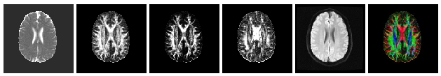
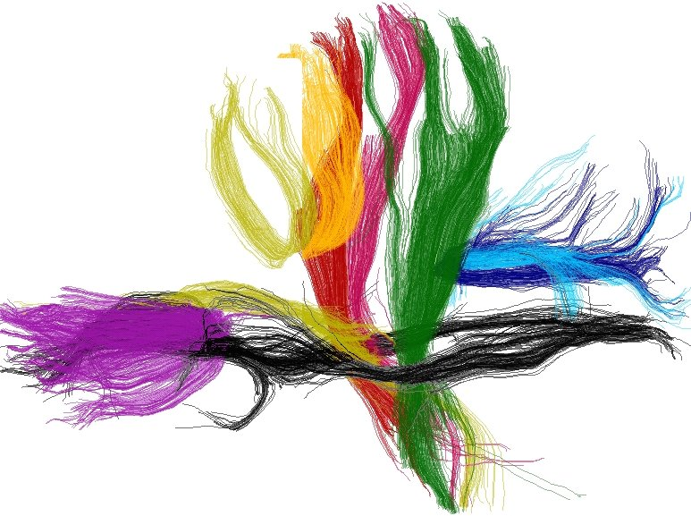
    Diffusion and Tracking
DWI data processing :
  Echoplanar distorsions correction
  Diffusion model creation (DTI or Q-Ball)
  Diffusion maps (ADC, FA, VR...)
  Fibers tracking and reconstruction
  Analysis of white matter fibers
2 main pipelines :
  Diffusion model pipeline
  Fascicles Tracking Pipeline

Slide 12
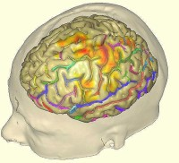
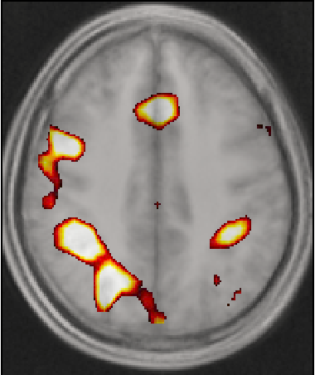
    fMRI
Aim : to ease neuroimaging studies involving both structural and functional modalities and/or large cohorts, for which automated database management is critical.
Original algorithms developed at Neurospin/LNAO, INRIA Saclay/Parietal and partners to do univariate analyses a la SPM and less conventional multivariate analyses.
Features
  Pre-prossessings using SPM or FSL
  First level analysis (intra-subject)
  Group analysis (inter-subject)
  Advanced visualization tools using Anatomist

Slide 13


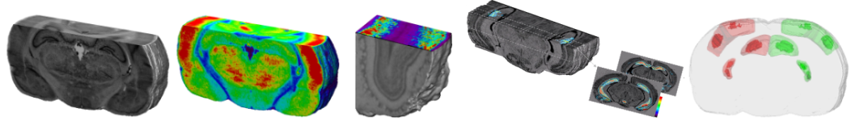
    BrainRAT
Aim : Process histological and autoradiographic sections (rodents and monkeys) using 3D information.
BrainRAT results from collaborative work of image processing methodologists and biologists of MIRCen.
Features :
  optimized digitization
  3D reconstruction of volume based on a reliable registration method
  analysis

Slide 14
    BrainVISA toolboxes
Cortical surface: processing surface-based data. Developed by researchers from the LSIS lab (Marseille).
  build a coordinate system constrained by sulci on a cortical surface
  tools for morphometric study of cortical sulci surfaces
  Surface-based functional data processing
Datamind: analysing features over multidimensional arrays. Classification, data mining...
Nuclear Imaging: processing of Positron Emission Tomography images. Developped in the SHFJ.
TMS: Transcranial magnetic stimulation toolbox provides tools helping positioning a stimulation target in a subject specific referential.
Tools: internal toolbox containing common image processing tools like threshloding, resampling, linear combination, conversion...

Slide 15
    External toolboxes
MEEG: MEG / EEG signals processing. Developed on the MEG/EEG Salpêtrière platform, by the LENA lab. Source localization, visualization and statistical analysis.http://cogimage.dsi.cnrs.fr/logiciels/index.htm
Stereotaxy: help electrode implantation surgery planning by computing stereotaxic coordinates for a target in the brain. Developed in the Pitié-Salpêtrière hospital.
SACHA: automatic segmentation of the hippocampus and the amygdala from clinical MRI scans.
Odyssée: visualization and analysis of diffusion MRI data. Developed at INRIA Sophia Antipolis.
RIC: processes to compute cortical thickness maps, gyrification index, sulcal length and depth, and also NIFTI and NEMA formats converters. Developed by P. Kochunov (Health Science Center at University of Texas). http://ric.uthscsa.edu/personalpages/petr/genetics.html

Slide 16
Starting with BrainVISA
Run the program by tiping brainvisa in a terminal
Processes organized by toolbox
Graphical user interface

Slide 17
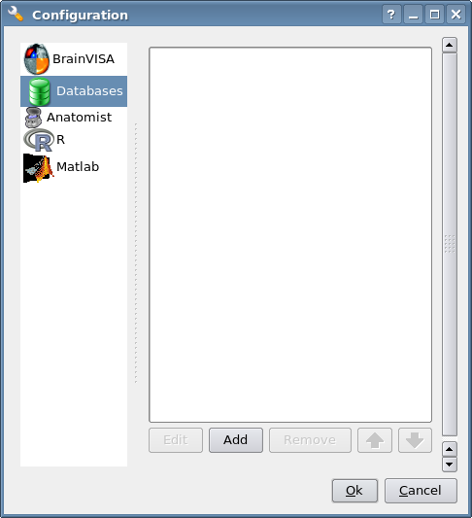
First step : define a database
A directory where all data written by BrainVISA will be stored.
BrainVISA database is organized to store information in addition to the data files : protocol, subject, modality, acquisition, analysis...
Data management toolbox : visualization, update, conversion, importation
Menu BrainVISA -> Preferences -> Databases -> Add

Slide 18

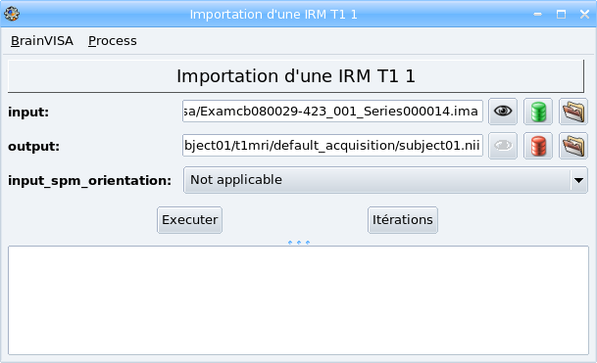
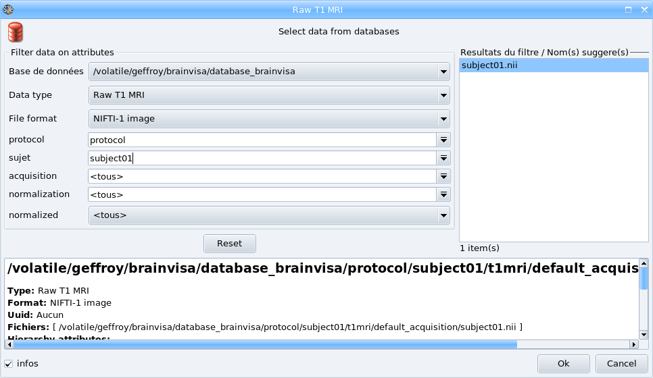
Second step : Import data
Import data to process in your BrainVISA database : you enter information about data with . BrainVISA copy it in the database.
Different importation processes exist according the type of data (T1 MRI, Diffusion MRI, fMRI...)

Slide 19

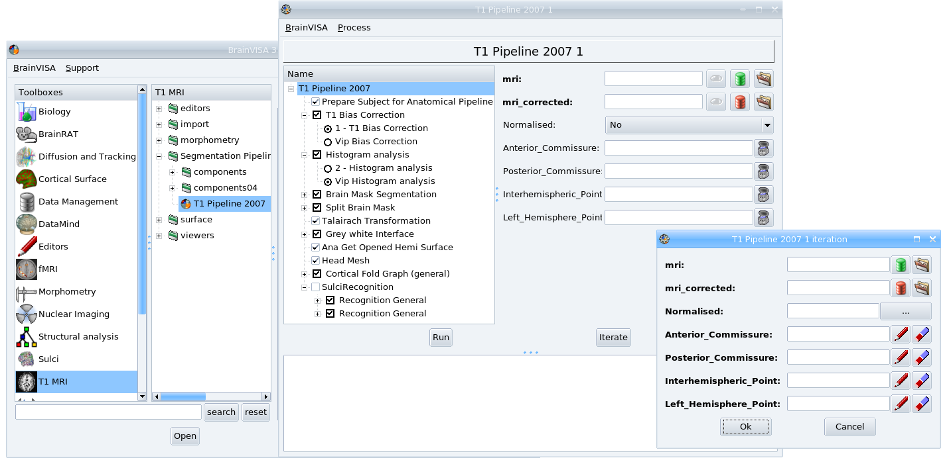
Process data
Select a process and open it (double click or open button)
Enter input parameters by selecting them in the database using the button
BrainVISA automatically complete as many parameters as possible. Output data will be written in the database.
Data visualization with
Iteration of a process on several data.
Execution log : Menu BrainVISA -> Show log
Pipeline : set of processes (serie, choices)

Slide 20
Documentation & Help
Manuals and tutorials available on BrainVISA website : http://brainvisa.info/documentation.html
Document of the JIRFNI 2008 training course about Anatomist and BrainVISA with associated data.
http://brainvisa.info/doc/jirfni_bv-2008/jirfni_bv_training/fr/html/index.html
http://brainvisa.info/downloadpage.html#data
Inline BrainVISA documentation about toolboxes and processes in the right panel of BrainVISA main window
Forum to ask questions : http://brainvisa.info/forum/

Slide 21
Installation
Steps to install:
  Download an archive according to the system on: http://brainvisa.info/downloadpage.html
  Uncompress the file
  Go into the created directory
  Execute the setup file
  Run the executable « BrainVISA »
Installation instructions available in a README file
Visualization problems can occur on some computers because of the 3D graphical card. Solutions can be found on the forum.
http://brainvisa.info/forum/viewtopic.php?f=6&t=1131&p=3880

Slide 22
Exercise
Run BrainVISA
/tsi/medikit/tp-data/brainvisa/BrainVISA
Create a new empty database in
/scratch/<login>/<databaseName>
Import a Raw T1 MRI
/tsi/medikit/tp-data/brainvisa/data_unprocessed/sujet01/anatomy/sujet01.ima
Browse the database with the DatabaseBrowser process.
Visualize data.
Anatomist tutorial : http://brainvisa.info/doc/anatomist-3.2/ana_training/en/html/index.html

