Slide 1
Morphologist Pipeline
BrainVISA T1 MRI Toolbox

Slide 2
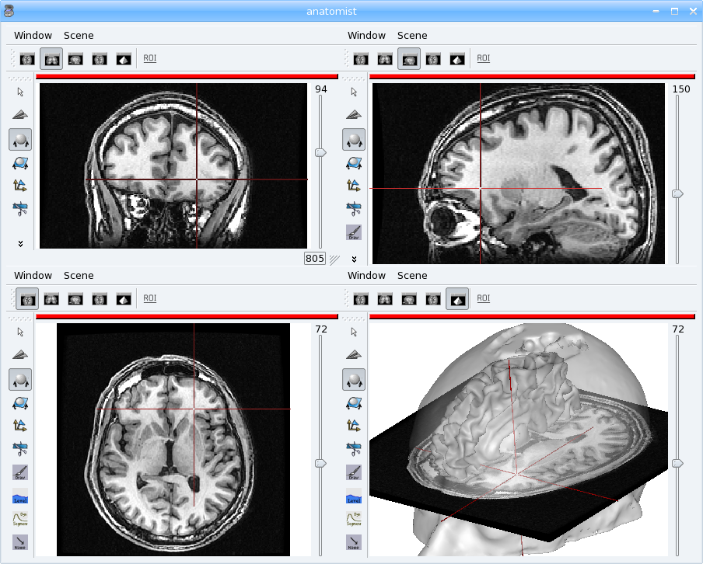

Human brain T1 MRI image
T1 weighted image
Anatomical image
Contrast enable to distinguish tissue: values in white matter > gray matter > CSF

Slide 3
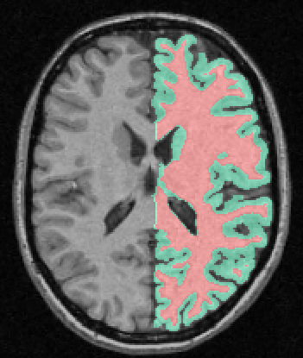
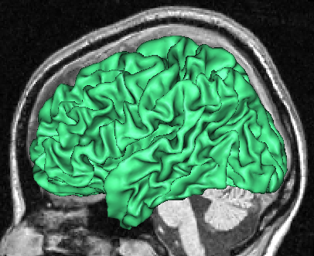
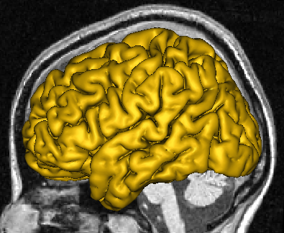
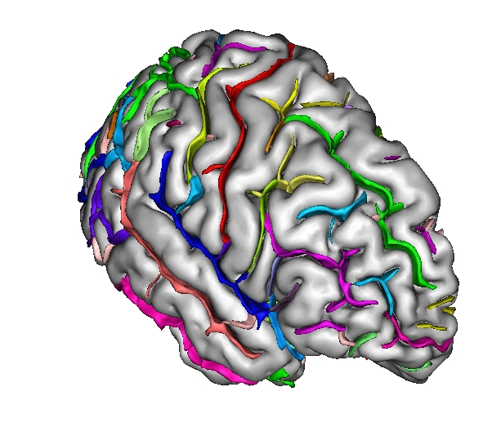
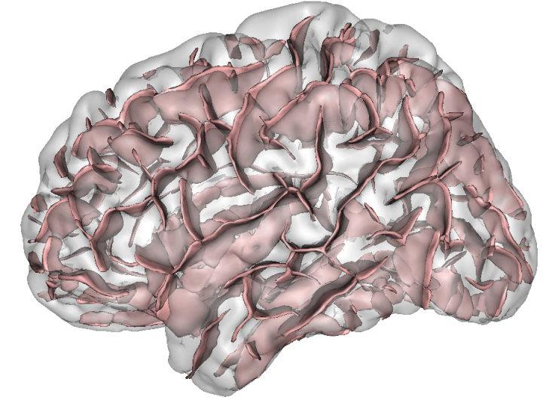

T1 MRI processing
BrainVISA T1 pipeline
Grey white matter
segmentation
White matter mesh
Grey matter mesh
Automatically identified sulci
Cortical folds graph

Slide 4
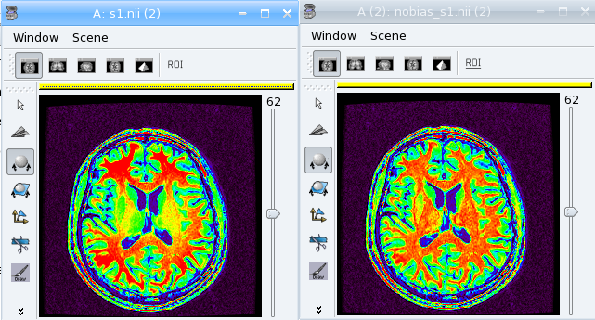


Bias correction
Spatial bias correction in usual MR images
Values in raw image not only depend on the tissue but also on the localization in the field of view => need to be corrected before segmentation
Entropy minimization for automatic correction of intensity non uniformity, J.-F. Mangin, MMBIA (Math. Methods in Biomed. Image Analysis), Hilton Head Island, South Carolina, IEEE Press 162-169, 2000

Slide 5
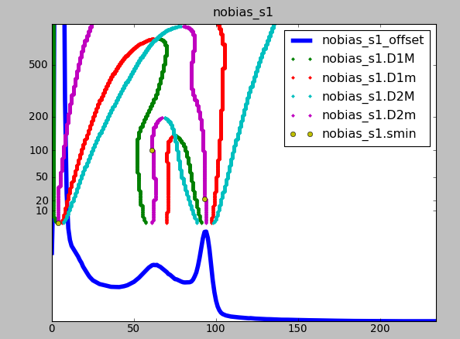
Histogram analysis
Analyse a T1-weighted histogram to estimate grey/white statistics
The histogram shape is variable : 3-5 peaks (background, grey, white, CSF, fat)
Robust brain segmentation using histogram scale-space analysis and mathematical morphology, J.-F. Mangin, O. Coulon, and V. Frouin MICCAI, MIT, LNCS-1496, Springer Verlag 1230-1241, 1998

Slide 6
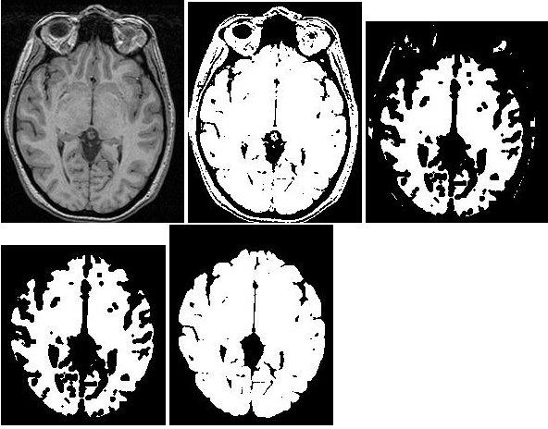
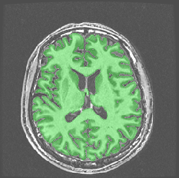
Brain mask segmentation
Computes a binary mask of the brain from a bias corrected T1-weighted image
thresholding – erosion - dilatation
Robust brain segmentation using histogram scale-space analysis and mathematical morphology, J.-F. Mangin, O. Coulon, and V. Frouin MICCAI, MIT, LNCS-1496, Springer Verlag 1230-1241, 1998

Slide 7
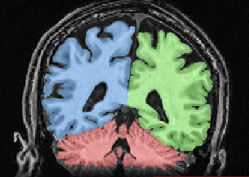
Segmentation
Split Brain Mask: three parts: hemispheres + cerebellum/stem
Grey / White interface
Grey white matter segmentation
White matter mesh

Slide 8
Cortical folds
Structural representation of the sulci folds: surfaces going inside the folds and neighbouring information.
Automatic recognition of sulci. Several methods exist:
  Abstract Neural Network (ANN) recognition
  Statistical Probabilistic Anatomy Map (SPAM) recognition
  M. Perrot, D. Rivière, A. Tucholka, and J.-F. Mangin. Joint Bayesian Cortical Sulci Recognition and Spatial Normalization. In Proc. 21th IPMI, LNCS-5636, Williamsburg, VA, pages 176-187, July 2009
Automatically identified sulci
Cortical folds graph

