Slide 1
Research Portfolio
Genetics, Cognition, and Neurodevelopmental Disorders Joey W. Trampush, Ph.D.

Slide 2
Hello …

Slide 3
Research Focus Areas
Core Research Domains
Neuropsychology
Child, Adolescent, and Adult ADHD Diagnosis & Treatment
Psychiatric Genetics
Cognitive Genomics
Neurodevelopment
Methodological Expertise
Genome-wide Association Studies (GWAS)
Systematic Reviews
Clinical Guidelines Development
Neuropsychological Assessment
Data Science
Language Learning Models (LLMs)

Slide 4
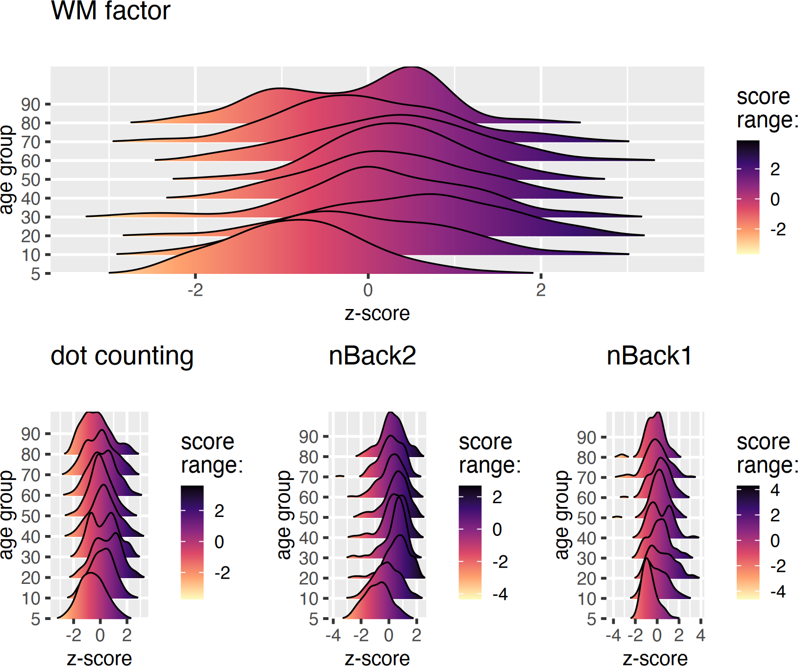
RDoC Cognitive Systems GWAS (R03 MH123787)
Project Goals:
Investigate latent molecular genetic architecture of working memory
Use existing COGENT consortium data
Identify genome-wide allelic variation
Focus on causal, not just correlational relationships

Slide 5
Early Development & Brain Function (R01 DK110793)
Collaboration with CHLA

Slide 6
Research Focus:
Impact of early feeding practices
Human milk oligosaccharides (HMOs)
Effects on obesity development
Brain development trajectories
Longitudinal design
Multi-modal assessment
Developmental outcomes
Clinical implications

Slide 7
AHRQ Adult ADHD Review Project (75Q80120D00009)
Co-funded by the FDA
Focus on diagnosis and treatment
Evidence-based guidelines
Treatment recommendations
Child & adolescent ADHD project completed last year

Slide 8
CAR-T Cell Therapy & Neurotoxicity
R01 Collaboration with CHLA
Project Overview

Slide 9
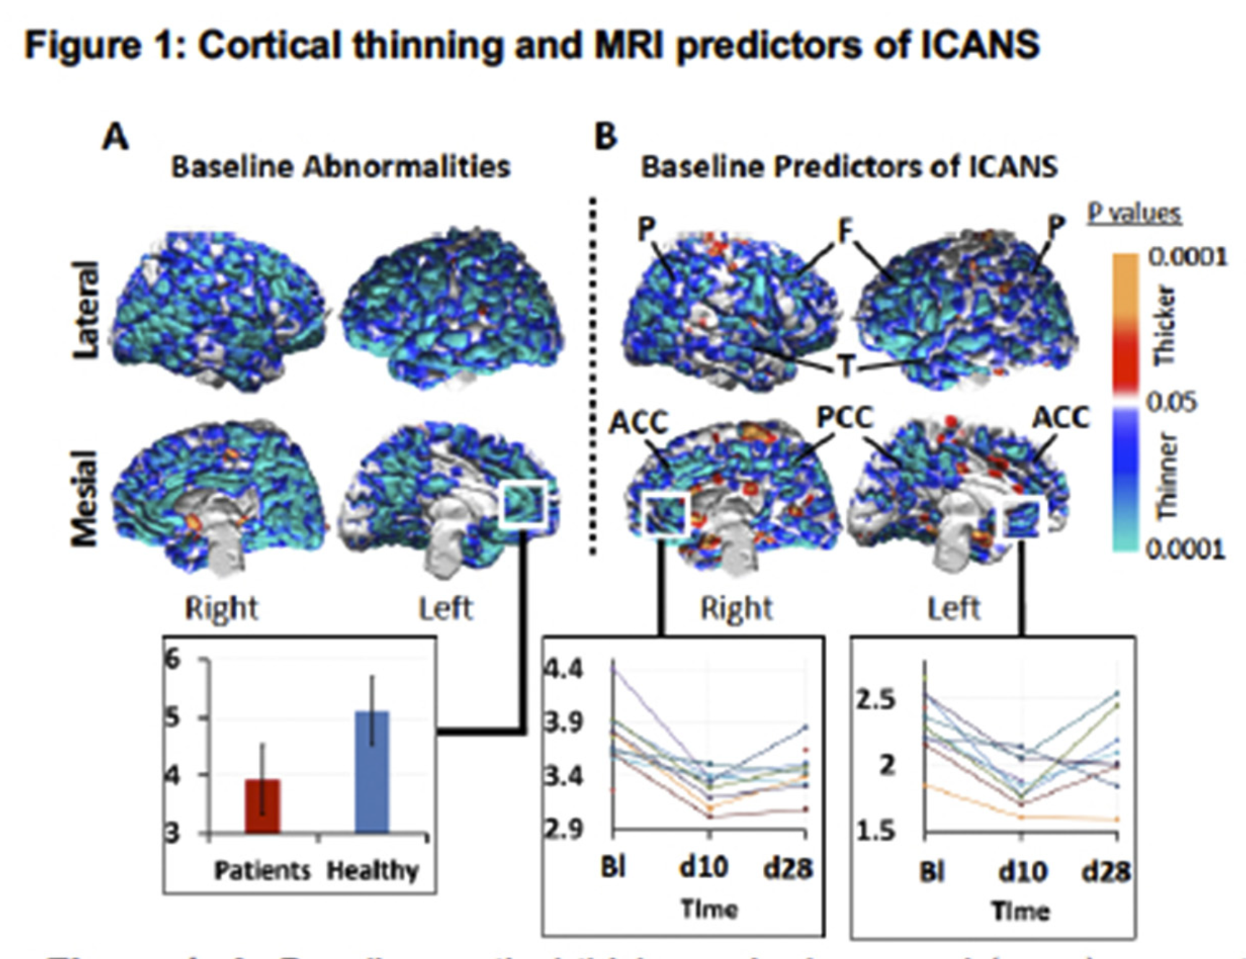
ICANS Research Study:
Investigating neurotoxicity in CAR-T therapy
80 pediatric ALL patients (5-21 years)
Longitudinal assessment design
Multi-modal brain & immune measures

Slide 10
Hippocampal Stimulation & Memory
Predicting Surgical Outcomes
PI: Brian Lee, MD, PhD
Study Overview
Three key questions:
WHERE to stimulate in hippocampus?
WHEN during memory tasks?
HOW (stimulation parameters)?

Slide 11
Data Science
Focus on reproducible research
R, some Python
Quarto, Typst
GitHub Repos
Adult templates for neuropsych
Adult templates for neuropsych
Adult templates for neuropsychneurotyp-forensic
Neuropsych reports

Slide 12
Large-Scale Biobank Data
UK Biobank
ABCD Study
23andMe
Many others

Slide 13
Language Learning Models (LLM)
Application to Neuropsychological Evaluation
Developing LLM to process neurocognitive and behavioral data from evaluations that otherwise take several hours.
Summarization using Chain of Density

Slide 14
Integration & Clinical Impact
How these projects work together:
Genetic architecture → Treatment targets
Early development → Prevention strategies
Clinical guidelines → Evidence-based care
Translational potential → Improved outcomes

Slide 15
Future Directions
Research Goals:
Expand genetic findings
Identify biomarkers
Develop interventions
Improve diagnostics
Clinical Applications:
Personalized medicine
Early intervention
Treatment optimization
Outcome prediction

Slide 16
Thank you!!

