Slide 1
Graphs
DSA

Slide 2
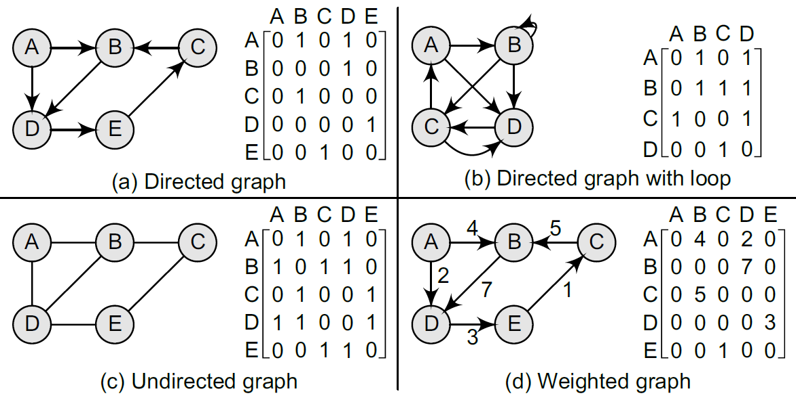
Adjacency Matrix

Slide 3
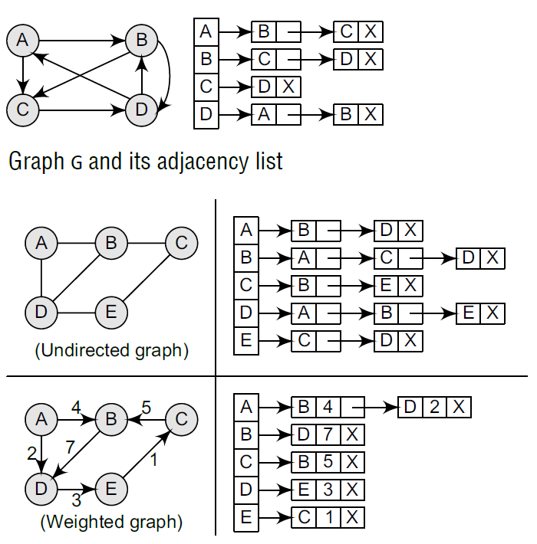
Adjacency List

Slide 4
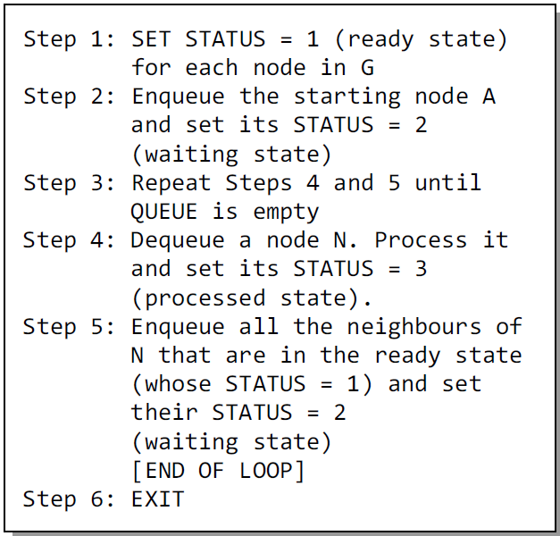
BFS
Algo

Slide 5
BFS
Program

Slide 6
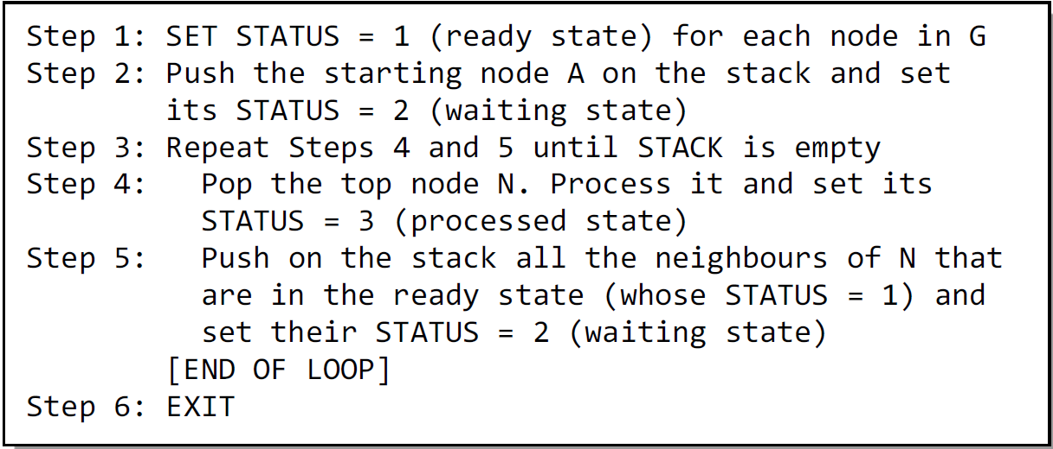
DFS
Algo

Slide 7
DFS
Program

Slide 8
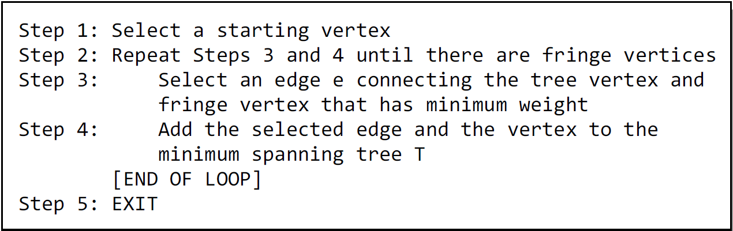
Minimum Spanning Tree
Prim’s Algorithm
Algo

Slide 9
Minimum Spanning Tree
Prim’s Algorithm
Program

Slide 10
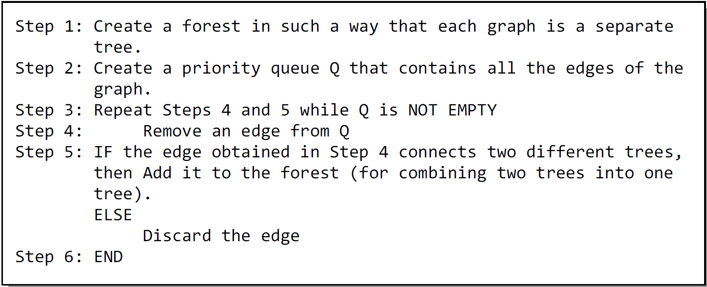
Minimum Spanning Tree
Kruskal’s Algorithm
Algo

Slide 11
Minimum Spanning Tree
Kruskal’s Algorithm
Program

