Slide 1
Cloud computing to do more
W. Trimble
Argonne Soils Workshop

Slide 2
Cloud computing to do more
W. Trimble
2014 Argonne Soils Workshop
Saturday afternoon—really, guys?

Slide 3
What problems does this solve?
“The classroom problem” everyone clicks “submit at the same time-> crashes servers
Data too big to process on your laptop.
Campus cluster is down for maintenance
Data analysis takes too long on one computer.

Slide 4
What is cloud computing?
(for scientists)
You can “rent” access to computers and disk space from a commercial provider of same.
This provides you with a way to scale your computation for “burst” periods, without investing in hardware.
Or you can just use a bigger, faster computer.
(I will demonstrate.)

Slide 5
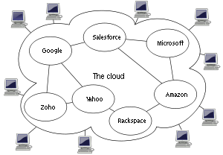
Why “cloud”?!
…because the diagram that CS people use to represent abstract compute resources looks like a cloud.

Slide 6
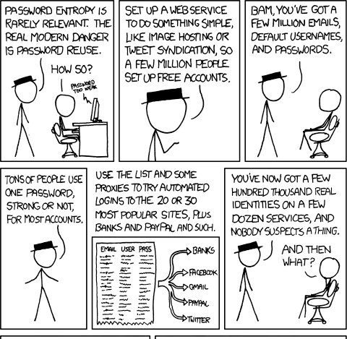
http://xkcd.com/792

Slide 7

Amazon is a major cloud computing provider
Did you know they rent computers!?
Rumors are that it’s more lucrative than their book selling division…

Slide 8
Terms
EC2 – Elastic Cloud Computing, computer rental from Amazon.
EBS – Elastic Block Storage, virtual hard drive rental from Amazon.

Slide 9
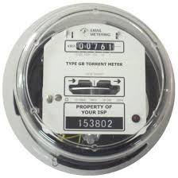
Some quick calculations:
1 small machine, / yr:
1.7gb of RAM, a ~1.0 GHz single-core CPU, 160gb of local disk.
$.06 / hr
8760 hrs / year
=> ~$525/ year.
~a somewhat effective server replacement.

Slide 10
1 high-memory quadruple extra-large instance / yr:
68.4 gb of RAM, 8 core @ ~3.2 GHz, 1.7tb of local disk.
$1.64 / hr
8760 hrs / year
=> $14,400 / year

Slide 11
20 high-CPU extra large machines, for a day:
7gb of RAM, 8 x 2.5 GHz CPUs, 1.7tb of local disk.
$0.58 / hr
24 hrs / day
20 machines
=> ~$278/ day.

Slide 12

Why is EC2 so expensive??
They cover all hardware, power, air conditioning and network costs.
That’s actually way more expensive than you think. (Talk to your sysadmin or HPC person…)
They do not operate at 100% capacity,
They want to make $$.

Slide 13
What are we using it for?
Teaching workshops and classes.
Running MG-RAST, RAST, and assembly rast with kBase backends.
Scientific computing workhorses without the sysadmins
Automated testing on clean machines with known software install.

Slide 14
Today’s tutorials
Log in to a new (blank) machine from Amazon. (We have provided these for you).
Install NCBI BLAST
Download & format some databases
Run BLAST
Produce an excel spreadsheet of best hits
…
Run 2-way BLAST (ecoli x ecoli strains)
Calculate reciprocal best hits
Produce an excel spreadsheet of putative orthologs

Slide 15
Today’s tutorials
Get some short-read data onto our instance
Download a reference sequence
Run short-read aligner BWA
Visualize the result
This is a tool for when your data is bigger than your laptop, or for when your campus cluster is down.

