Slide 1

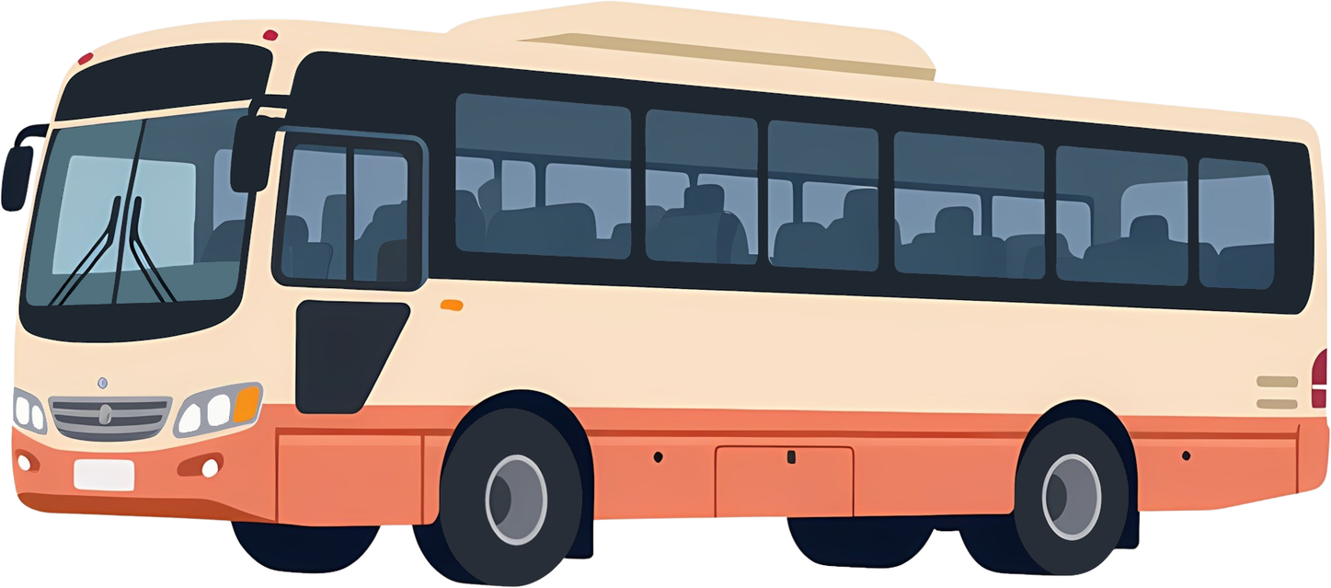
Sustainable Public Transport Assistant Using AI/ML
1M1B AI for Sustainability Virtual Internship
Presented By: K.Brajesh Sheguware
Department: II BCA
College Name: Kamaraj College, Thoothukudi-628002

Slide 2


Primary SDG 11
Sustainable Cities and Communities
Improve urban mobility
Enhance public transportation
Reduce traffic congestion
Secondary SDG 13
Climate Action
Reduce carbon emissions
Promote eco-friendly transportation
Support sustainable development
SDG Alignment

Slide 3

Problem Statement
Urban transportation systems frequently experience delays due to:
Traffic congestion
Adverse weather conditions
Public events and holidays
Peak-hour passenger demand
These delays reduce commuter satisfaction and encourage the use of private vehicles, leading to:
Increased traffic congestion
Higher fuel consumption
Increased carbon emissions
An intelligent AI-based solution is required to predict delays and improve travel planning.

Slide 4

Project Objectives
Main Objectives
Predict public transport delays using AI/ML.
Analyze factors affecting transportation delays.
Improve commuter travel planning.
Encourage public transport usage.
Reduce traffic congestion and carbon emissions.
Support sustainable urban transportation.

Slide 5
Dataset Information
Dataset Used
Public Transport Delays with Weather & Events
Dataset Features
Transport Type
Route Information
Scheduled Arrival Time
Delay Duration
Weather Conditions
Traffic Congestion
Public Events
Holiday Information
Peak Hour Data
Target Variable
Delayed (0/1)

Slide 6

Proposed Solution
The Sustainable Public Transport Assistant uses AI and Machine Learning to:
Analyze transportation data
Predict transport delays
Identify traffic and weather impacts
Generate travel recommendations
Improve public transport efficiency
The system helps commuters make informed travel decisions and supports sustainable transportation.

Slide 7

Exploratory Data Analysis (EDA)
Data Preprocessing
Missing Value Handling
Duplicate Removal
Data Cleaning
Feature Encoding
EDA Performed
Delay Distribution Analysis
Weather Impact Analysis
Traffic Congestion Analysis
Peak Hour Analysis
Transport Type Analysis
Correlation Analysis
Visualization Tools
Histograms
Bar Charts
Box Plots
Heatmaps
Scatter Plots

Slide 8

Machine Learning Models
Classification Models
Logistic Regression
Predicts whether transport will be delayed.
Decision Tree
Identifies delay-causing factors.
Random Forest
Provides accurate delay predictions.
Target Variable
Delayed = 0 or 1

Slide 9
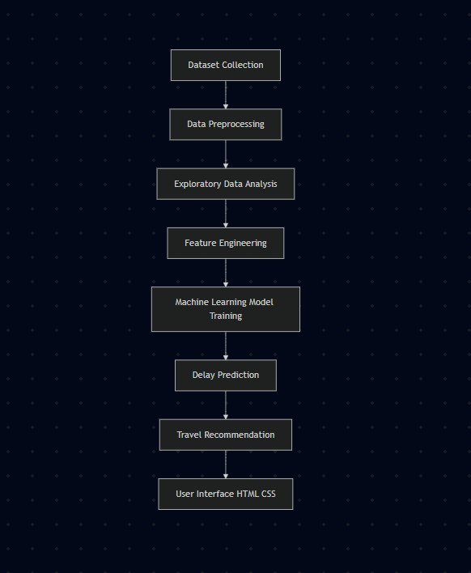
WORK FLOW

Slide 10
Responsible AI Considerations
Fairness
The model avoids bias by using transportation-related data only.
Transparency
Prediction methods and results can be explained to users.
Privacy
No personal or sensitive user information is collected.
Ethical Use
The system is designed solely for transportation planning and sustainability purposes.

Slide 11
Expected Impact
Environmental Impact
Reduced carbon emissions
Lower fuel consumption
Improved air quality
Social Impact
Better commuter experience
Reduced waiting time
Increased public transport reliability
Economic Impact
Reduced transportation costs
Improved operational efficiency

Slide 12
Development Tools
Google Colab
VS Code
Programming Language
Python
Libraries Used
Pandas
NumPy
Matplotlib
Seaborn
Scikit-Learn
Frontend
HTML
CSS
Tools and Technologies

Slide 13
Prototype / Demo
User Inputs
Transport Type (Bus / Train / Metro / Tram)
Weather Condition
Traffic Congestion Level
Peak Hour Status
Route Information
AI Processing
Data Analysis
Delay Prediction Model
Traffic Impact Analysis
Weather Impact Analysis
System Output
Predicted Delay Time
Delay Probability
Traffic Status
Travel Recommendation

Slide 14
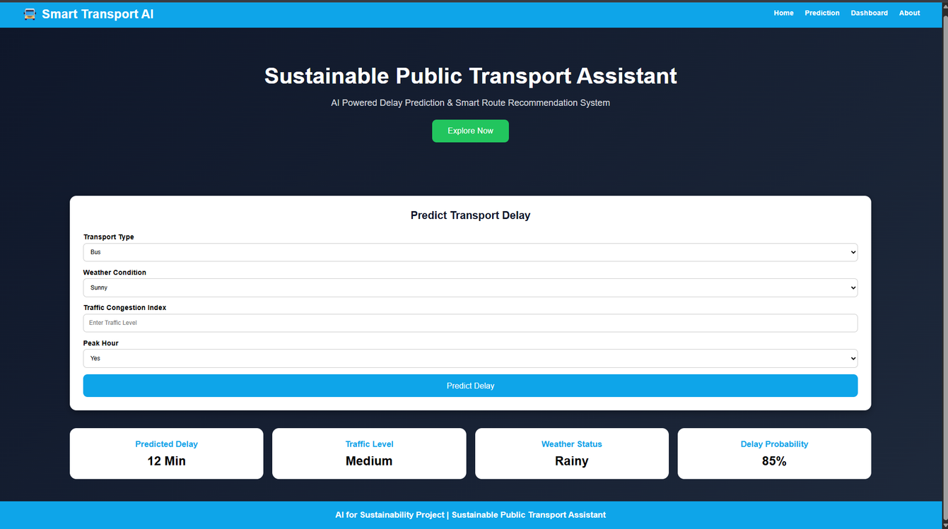
WORK FLOW
User Interface Features
✅ Smart Delay Prediction
✅ Real-Time Travel Insights
✅ Weather-Based Analysis
✅ Traffic Congestion Monitoring
✅ Sustainable Travel Recommendations

Slide 15
Conclusion
The Sustainable Public Transport Assistant demonstrates how Artificial Intelligence and Machine Learning can be used to improve public transportation systems.
By predicting delays and providing intelligent travel insights, the project:
Enhances commuter experience
Encourages sustainable transportation
Reduces environmental impact
Supports smart and sustainable cities
"Using AI for a Smarter, Greener, and More Sustainable Future."

Slide 16
Thank You
Presented by
K. Brajesh Sheguware

