Slide 1
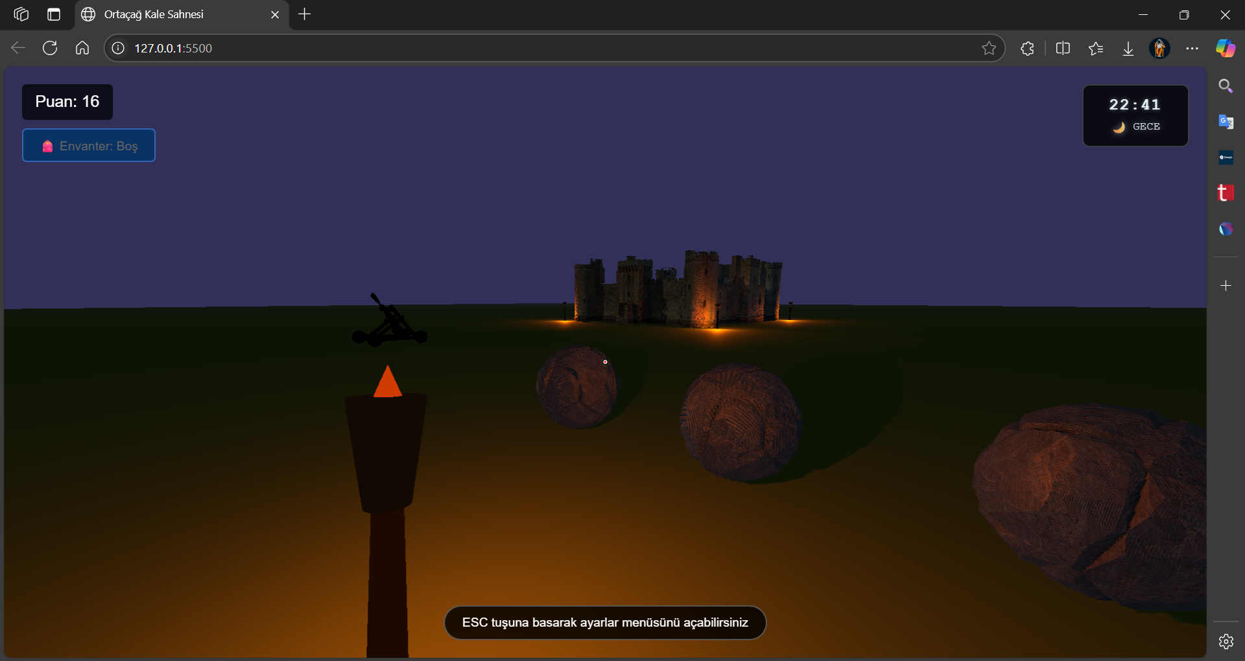
Project Name: Medieval Castle Scene
Course: CENG376 - Computer Graphics Team Members:
Burak Çetin (22118080032)
İsmail Görkem Ulaş (21118080007)
https://github.com/brakcetin/medieval_castle_scene.git

Slide 2
1. Introduction & Project Purpose
Project Purpose
Create an interactive 3D castle scene using WebGL and Three.js
Enable browser-based exploration without plugins
Simulate a historical medieval environment
Showcase key 3D graphics concepts: camera, lighting, object loading
Technologies
WebGL for rendering
Three.js for scene setup
GLB models for 3D assets
JavaScript & HTML5 for interaction logic

Slide 3
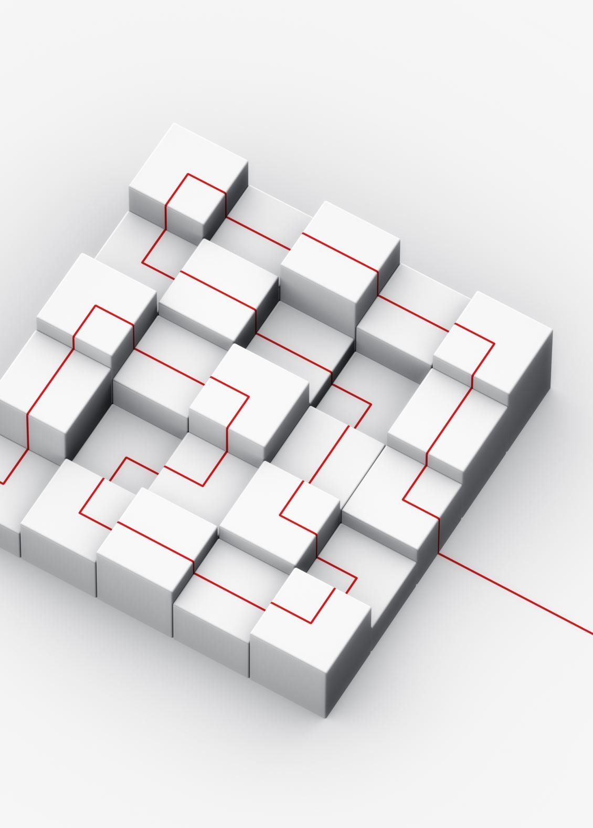
2. Technical Architecture
Technologies & Structure
Three.js used to simplify WebGL development
WebGL provides direct access to GPU for real-time 3D rendering
Object-oriented structure with modular scene and asset management
Smooth updates via requestAnimationFrame() loop
Diagram
Browser → Three.js → WebGL → GPU

Slide 4
3. Scene Construction & Camera Setup
Technologies Used:
Three.js, GLTFLoader, dat.GUI, HTML/CSS/JS, PointerLock, HTML5 Audio
Model Assets: Castle, Catapult, Torch, Stones
UI Components: Power bar, Score panel, ESC menu

Slide 5
3. Scene Construction & Camera Setup
How We Built the Scene
We used Three.js to set up the scene, camera, and renderer
The scene includes our castle model, lights, and objects placed in 3D space
Everything is organized in a scene graph for easy management
Our Camera Setup
We used a Perspective Camera to create a more realistic 3D look
Field of View: 75°, which feels natural to the human eye
Camera adjusts to the screen size (aspect ratio)
Near/Far view range: 0.1 to 1000 units
Y-axis is up, matching common 3D standards
Performance Tips
The scene runs at ~60 frames per second
Uses requestAnimationFrame() for smooth rendering
Depth buffer helps show which objects are in front or behind
Optimized with frustum culling to skip off-screen objects

Slide 6
4. Advanced Lighting & Shadow System
Directional Light
– Simulates sunlight
– Casts long, realistic shadows
– Main light source in the scene
Ambient Light
– Provides soft overall illumination
– Prevents fully dark areas
– Doesn’t cast shadows
Point Lights (Torches)
– Adds warm, localized lighting
– Lights surrounding objects
– Each casts shadows dynamically
Realistic Shadow Rendering
PCFSoftShadowMap for smooth, soft shadows
Shadow resolution: 1024×1024
Shadow camera frustum adjusted for quality
Shadow bias: -0.0005
Normal bias: 0.02
Prevents artifacts like shadow acne and peter panning

Slide 7

5. 3D Model Loading
How Models Are Loaded
Used GLTFLoader to load .glb 3D models
GLB format includes geometry, materials, and more in one file
Models managed via a custom AssetLoader class
Optimization Features
Caching prevents reloading the same model
Cloning used for repeating objects (e.g. stones)
Models are scaled and positioned after loading
A loading screen is shown during asset initialization

Slide 8
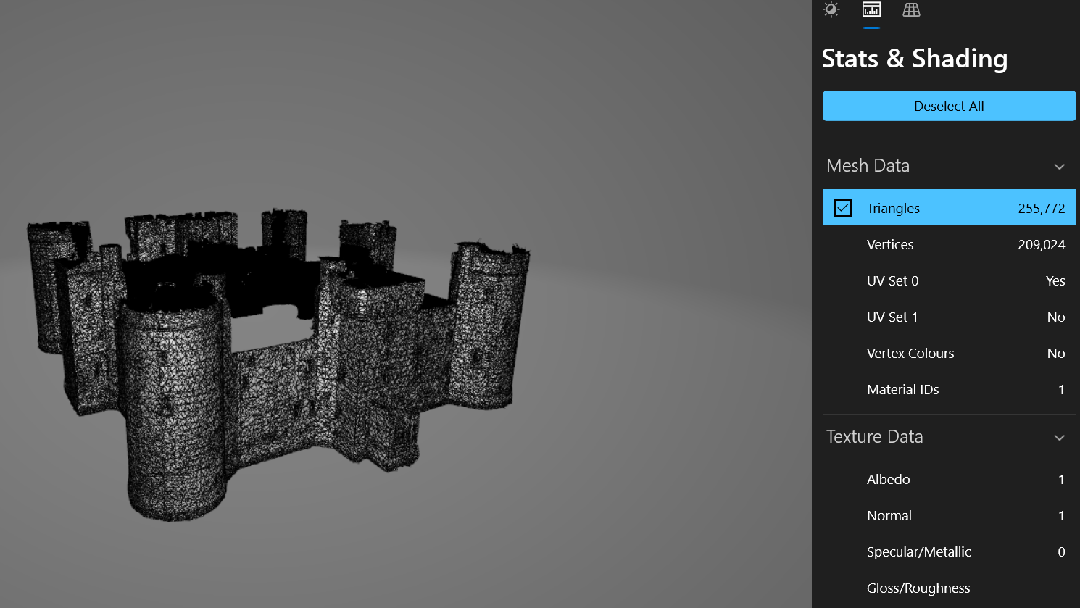
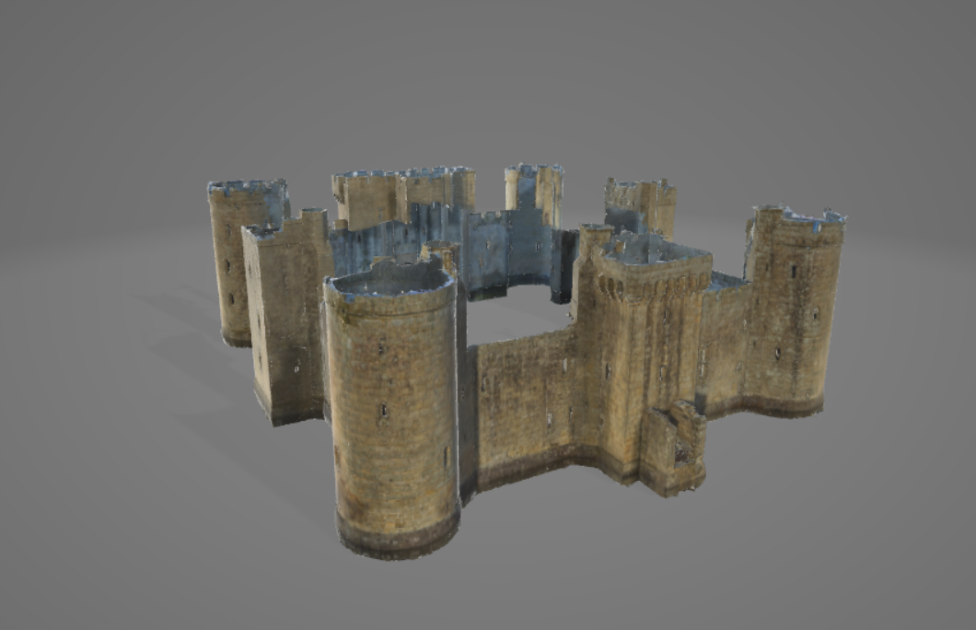
5.1. Model Assets
Model Assets: Castle

Slide 9
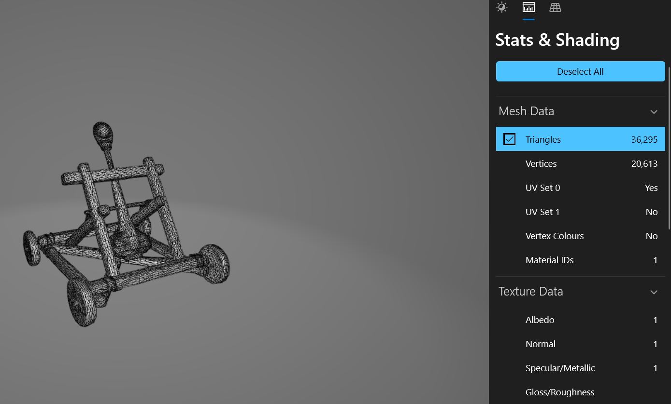
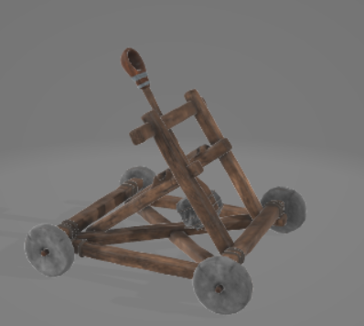
5.1. Model Assets
Model Assets: Catapult

Slide 10
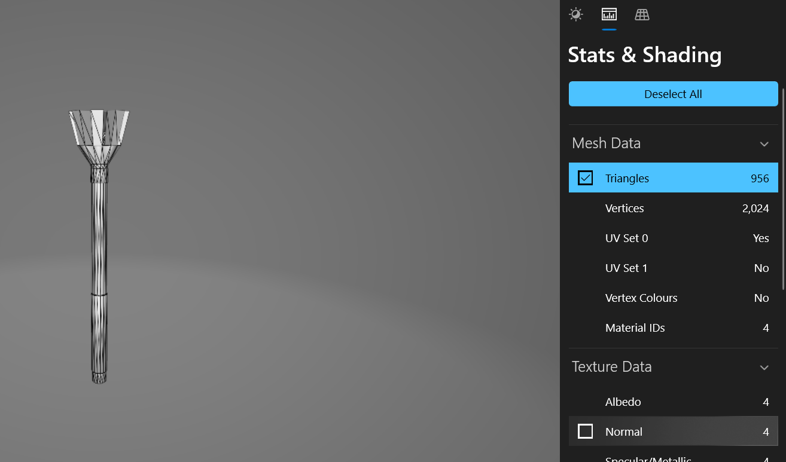
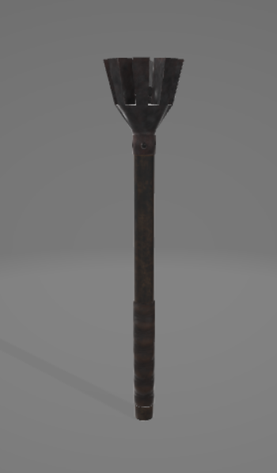
5.1. Model Assets
Model Assets: Torch

Slide 11
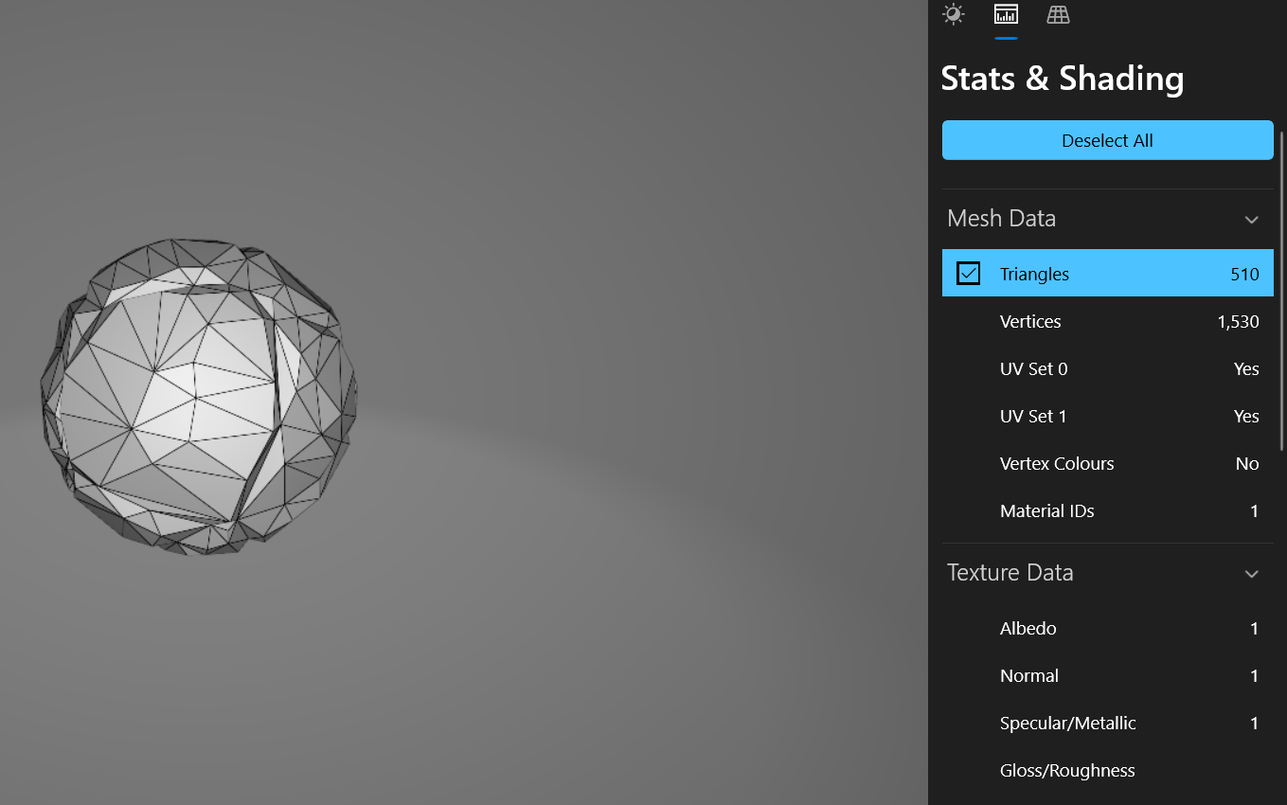
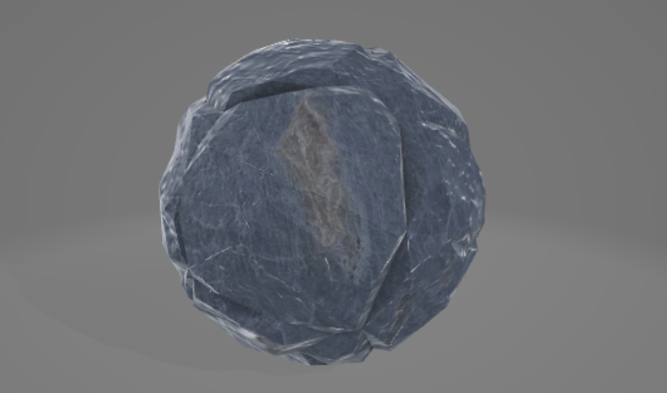
5.1. Model Assets
Model Assets: Stones

Slide 12
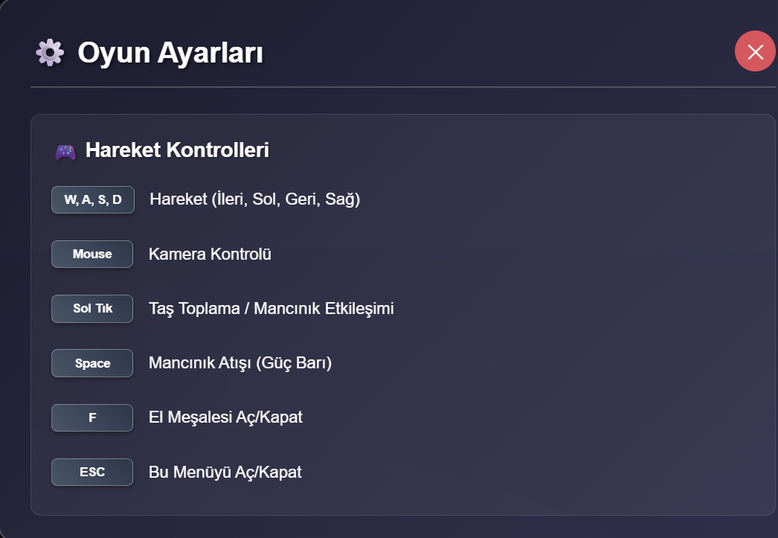
6. User Interaction Design
Control System
WASD keys for player movement
Mouse movement to rotate the camera
Uses Pointer Lock API for immersive control
Object Interaction
Raycasting detects what the user points at
Enables clicking/interacting with objects like torches or stones
Based on camera position and cursor direction

Slide 13
7. Interactive Objects
Torch Interaction
Torches respond to mouse clicks
Toggle light on/off dynamically
Affects scene lighting in real time
Catapult & Physics
Stones can be collected and launched
Launch strength varies by input
Simple physics with gravity and step-based motion
Implemented with vector math and Euler integration

Slide 14

8. Audio System
Audio Features
Managed via a custom SoundManager class
Uses WebAudio API for sound playback
Sounds triggered by interactions (e.g. catapult fire, stone impact)
How It Works
AudioLoader loads sound files
Supports one-shot and looping audio
Volume and playback handled programmatically
Enhances realism and feedback during interactions

Slide 15

9. Challenges & Solutions
Key Challenges
Shadow rendering caused early FPS drops
Memory leaks from repeated model loading
Realistic torch flickering impacted performance
Solutions Implemented
Tuned shadow map size and camera frustum
Used object pooling to reuse assets
Cleaned up unused objects to free memory
Balanced visual effects with real-time performance

Slide 16
10. Conclusion
Summary
Created a fully interactive 3D medieval castle scene in the browser
Applied core Computer Graphics concepts using WebGL and Three.js
Integrated realistic lighting, responsive controls, and basic physics
Focused on performance optimization for smooth rendering
Demonstrated the power of modern web-based 3D rendering

Slide 17
11. Live Demonstration
Demo Highlights
Explore the 3D castle using WASD + mouse
Toggle torches to see dynamic lighting
Collect and launch stones with the catapult
Observe real-time physics and smooth frame rate
GitHub: https://github.com/brakcetin/medieval_castle_scene.git

Slide 18
11. References
[1] Khronos Group. (n.d.). glTF Overview. GitHub. https://github.com/KhronosGroup/glTF
[2] dataarts. (n.d.). dat.GUI. GitHub. https://github.com/dataarts/dat.gui
[3] Mozilla Contributors. (n.d.). HTMLAudioElement. MDN Web Docs. https://developer.mozilla.org/en-US/docs/Web/API/HTMLAudioElement
[4] Three.js Developers. (n.d.). Three.js Documentation. https://threejs.org/docs/

