Slide 1

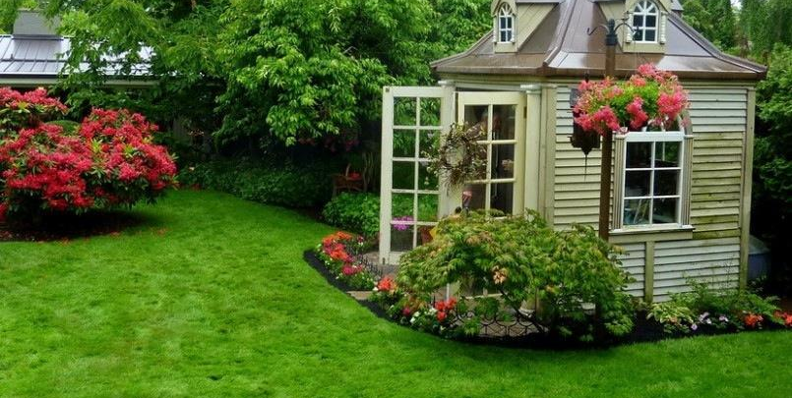
P442 TEAM PROJECT
GARDEN PLANT MONITOR
Ching Yuen Ng Brian Rak

Slide 2
Goals
Create an autonomous garden system
Make the system capable of watering plants more precisely and effectively than humans
Make the garden data available from inside the home
Allow the garden to be completely self-sustaining by running on solar

Slide 3
Project Overview
Delivered
Created an autonomous gardening system
Undelivered
Allow the garden to be completely self-sustaining by running on solar
Make the system capable of watering plants more precisely and effectively than humans
Make the garden data available from inside the home

Slide 4
Checklist
Gather temperature/moisture data from plants at periodic interval
Turn on water supply if needed
Send data wirelessly to indoor device
Graph the data using the LCD display
Manage power states when not in use
Use solar power to be self-sustaining

Slide 5
Project Details Overview
Delivered
Gather temperature/moisture data from plants at periodic interval
Undelivered
Use solar power to be self-sustaining
Turn on water supply if needed
Send data wirelessly to indoor device
Graph the data using the LCD display
Manage power states when not in use

Slide 6
Block Diagram
Nordic
RTC
SPI3
LCD
Wireless
Water Pump Motor
LSE
STM32
SPI2
DMA
Nordic
SPI3
Bust/boost
Regulator
DAC
STM32
Moisture Sensor
Lithium
Battery
Solar charger
Solar panel
Solar Power Supply

Slide 7
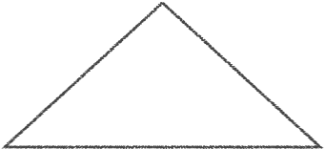





DEV1
LCD DISPLAY
IN HOUSE
GARDEN
WIRELESS
WATER
PUMP
DEV2
YARD

Slide 8
Profile Requirements Review
Solar panel should be placed outside or near window
Solar panel receives approximately 10 hours of sun
Only the solar panel, moisture sensor, and pump should be exposed to water/moisture
Water pump attached to a tank of water that is assumed to be always full or near-full
Moisture sensor remains in the bottom of the plant with no maintenance needed
STM32f30x standby mode will be used when possible to conserve power
The stm32 with LCD will require USB power (or equivalent) and will use no power-saving modes

Slide 9
Challenges
Real Time Clock and Low Power Modes
Nordic Organization and Error checking
Analog to Digital Converters
LCD optimization
DC Motor setup
Garden Tubing Setup

Slide 10

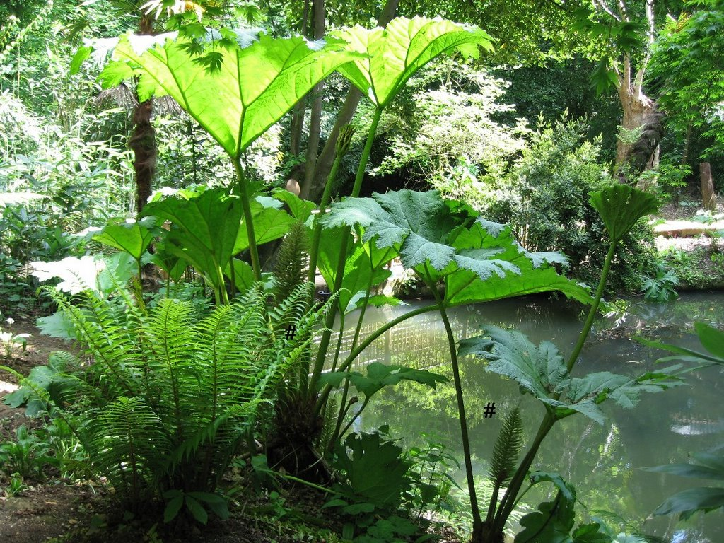
Demonstration

Slide 11
Extensions/Potential Future Work
Have the inside STM32 perform data analytics using the data collected to measure when plants will need the most water. As a result, send the controls back to the outside STM32 to deliver pump controls
Completely Solar Powered
Build a Housing/Shelter for the STM32
Build a Terrace to run water to more plants
Upgrade the motor for more reliability and throughput
Research optimal soil levels/ plant, fish nutrition needed

Slide 12


