Slide 1
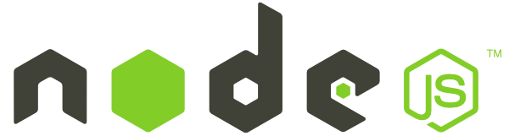





Slide 2
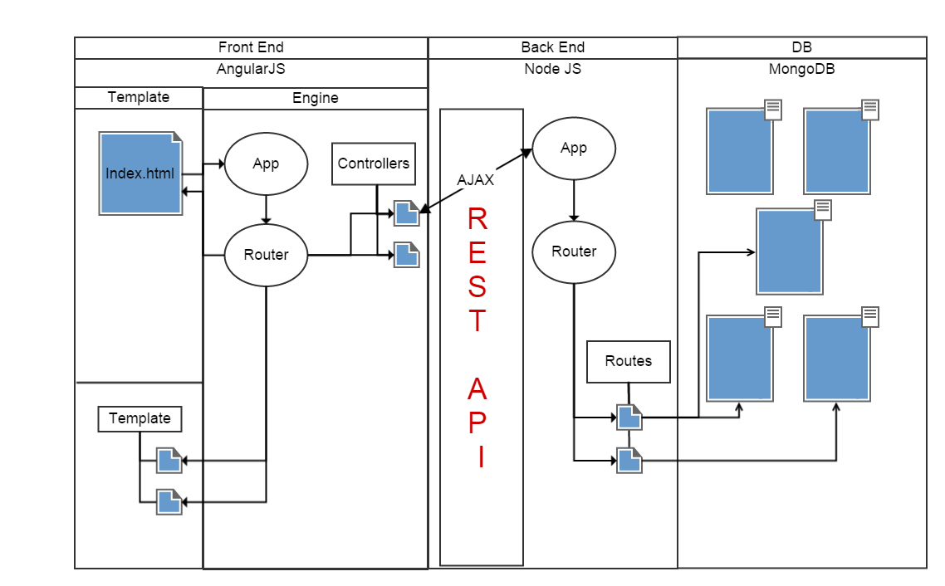

Slide 3
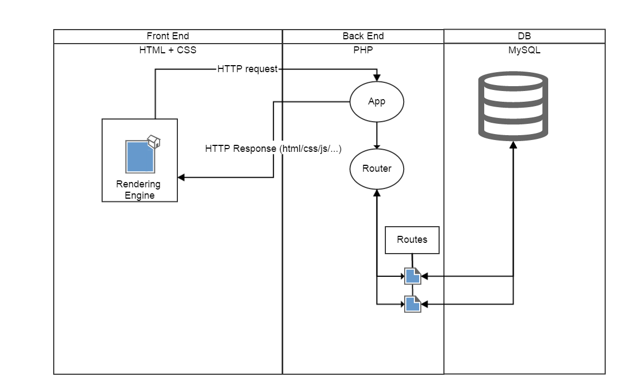

Slide 4
Inhoud
AngularJS
Controllers
Directives
Services
NodeJS
expressJS
Routes
Middelware
NPM
MongoDB
SQL VS MongoDB
NoSQL
Vrijheid == blijheid ?
Demo

Slide 5

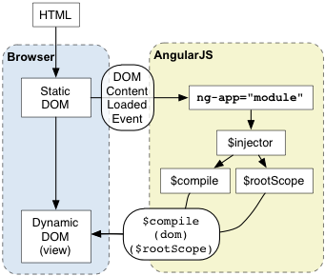
AngularJS
Javascript MVW framework
MVW – Model View Whatever
Single page apps
Notes:
AngularJS is een Javascript framework
Profleert zich als MVW framework – afgeleid van mvc
Je kan het gebruiken voor single page applicaties – alles wordt met ajax geladen
HTML wordt dynamisch door overall listeners aan te hangen

Slide 6
Controllers
Javascript object
var app = angular.module('myApp', []);
app.controller('myCtrl', function($scope) {
$scope.firstName = "John";
$scope.lastName = "Doe";
});
<div ng-app="myApp" ng-controller="myCtrl">
First Name: <input type="text" ng-model="firstName"><br>
Last Name: <input type="text" ng-model="lastName"><br><br>
Full Name: {{firstName + " " + lastName}}
</div>
Notes:
Controller = javascript object
Controller wordt aan een view toegekend
De view kan variable uit de controller benaderen en functies aanroepen

Slide 7
Directives
Extend HTML
<input type="text" ng-model="directivename" placeholder="name" /> <span ng-bind="directivename"></span>
<span ng:bind="directivename"></span>
<span ng_bind="directivename"></span>
<span x-ng-bind="directivename"></span>
<span data-ng-bind="directivename"></span>
<directivename></directivename>
Notes:
HTML uitbreiden zodat het interactief wordt.
Standaard html onderdelen in een custom directive maken duplicate code minder
Verschillende manieren om directives te gebruiken

Slide 8
Directives
ngApp
ngBind
ngBindHtml
ngBindTemplate
ngBlur
ngChange
ngChecked
ngClass
ngClassEven
ngClassOdd
ngClick
ngCloak
ngController
ngCopy
ngCsp
ngCut
ngDblclick
ngDisabled
ngFocus
ngForm
ngHide
ngHref
ngIf
ngInclude
ngInit
ngJq
ngKeydown
ngKeypress
ngKeyup
ngList
ngModel
ngModelOptions
ngMousedown
ngMouseenter
ngMouseleave
ngMousemove
ngMouseover
ngMouseup
ngNonBindable
ngOpen
ngOptions
ngPaste
ngPluralize
ngReadonly
ngRepeat
ngSelected
ngShow
ngSrc
ngSrcset
ngStyle
ngSubmit
ngSwitch
ngTransclude
ngValue

Slide 9

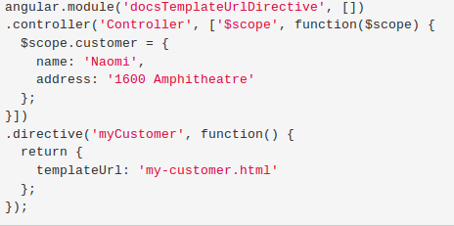
Custom directives
Notes:
@TODO

Slide 10
Services
Angular services are substitutable objects that are wired together using dependency injection. You can use services to organize and share code across your app.
Functies injecteren waar nodig

Slide 11

NodeJs
Officiele definitie: “Node.js is a platform built on Chrome’s JavaScript runtime for easily building fast, scalable network applications. Node.js uses an event-driven, non-blocking I/O model that makes it lightweight and efficient, perfect for data-intensive real-time applications that run across distributed devices.” – Nodejs.org
Simpele definitie: Een platform die het maken van krachtige c/c++ server-side applicatie makkelijker maakt door deze te verpakken in javascript.
Notes:
http://blog.cloudfoundry.org/2012/06/27/future-proofing-your-apps-cloud-foundry-and-node-js/

Slide 12
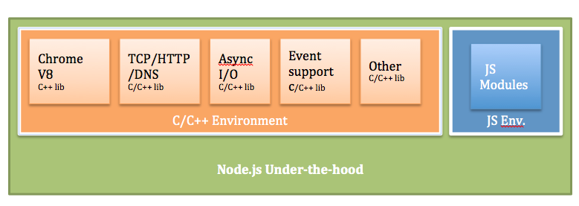
NodeJs
80% C/C++, 20% javascript
C/C++ libraries
Uitvoeren javascript (Chrome V8)
Ondersteuning: HTTP, DNS, TCP, etc..
JS libraries
Extra’s
Notes:
http://blog.cloudfoundry.org/2012/06/27/future-proofing-your-apps-cloud-foundry-and-node-js/

Slide 13
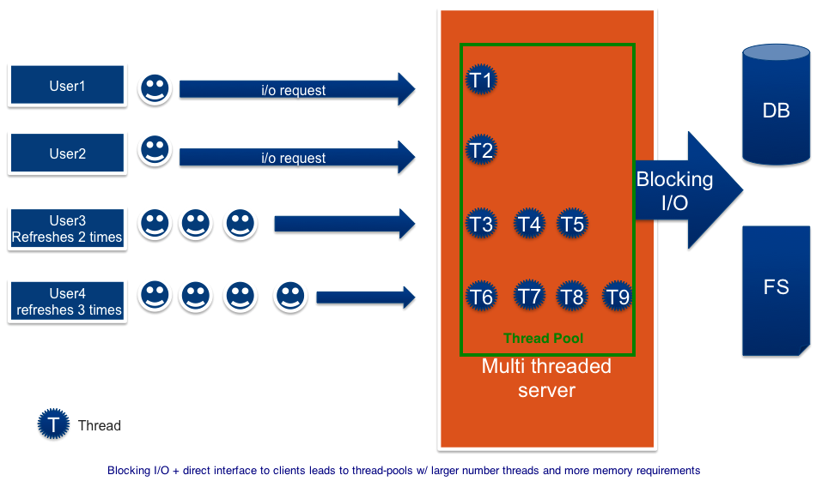
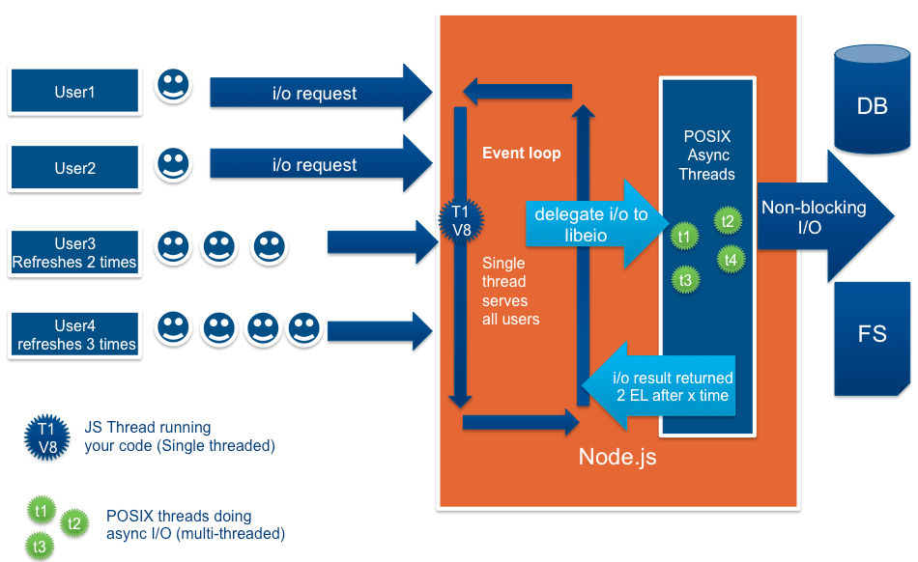
NodeJs
synchronous, blocking I/O model
Makkelijker manier I/O
Heavy load → meer threads
Meer threads → meer geheugen, meer CPU
Asynchronous I/O
Single main thread → minder threads
Minder threads → minder heuegen, minder CPU
Notes:
Synchroon:
The above diagram depicts a simplified multi-threaded server. There are four users logging into the multi-threaded server. A couple of the users are hitting refresh buttons causing it to use lot of threads. When a request comes in, one of the threads in the thread pool performs that operation, say, a blocking I/O operation. This triggers the OS to perform context switching and run other threads in the thread pool. And after some time, when the I/O is finished, the OS context switches back to the earlier thread to return the result.
Architecture Summary: Multi-threaded servers supporting a synchronous, blocking I/O model provide a simpler way of performing I/O. But to handle a heavy load, multi-threaded servers end up using more threads because of the direct association to connections. Supporting more threads causes more memory and higher CPU usage due to more context switching among threads.
For more details, we recommend going through Benjamin Erb’s thesis paper here: http://berb.github.com/diploma-thesis/.
Asynchroon(node js):
And at the back of the server, you have libuv (includes libio) and other C/C++ libraries that provide asynchronous I/O.
Whenever a request is made from a browser, mobile device, etc., the main thread running in the V8 engine checks if it is an I/O. if it is an I/O then it immediately delegates that to the backside (kernel level) of the server where one of the threads in the POSIX thread pool actually makes async I/O. Because the main thread is now free, it starts accepting new requests/events.
And at some point when the response comes back from a database or file system, the backend piece generates an event indicating that we have a result from I/O. And when V8 becomes free from what it is currently doing (remember it is single-threaded), it takes the result and returns it to the client.
Architecture Summary: This architecture utilizes an event loop (main thread) at the front and performs asynchronous I/O at the kernel level. By not directly associating connections and threads, this model needs only a main event loop thread and many fewer (kernel) threads to perform I/O. Because there are fewer threads and consequently less context-switching, it uses less memory and also less CPU.

Slide 14
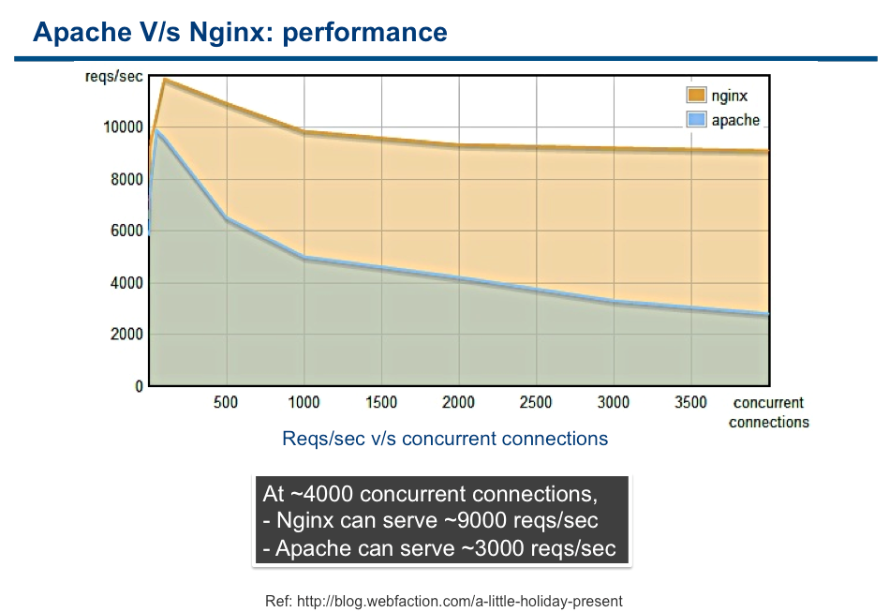
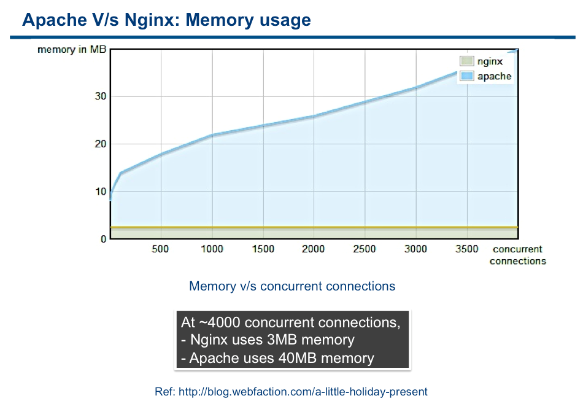
Voordelen - NodeJS
Notes:
Nginx uses evented, non-blocking architecture, where as Apache uses multi-threaded architecture. Nginx doesn’t use Node.js, this is just an architecture comparison).

Slide 15
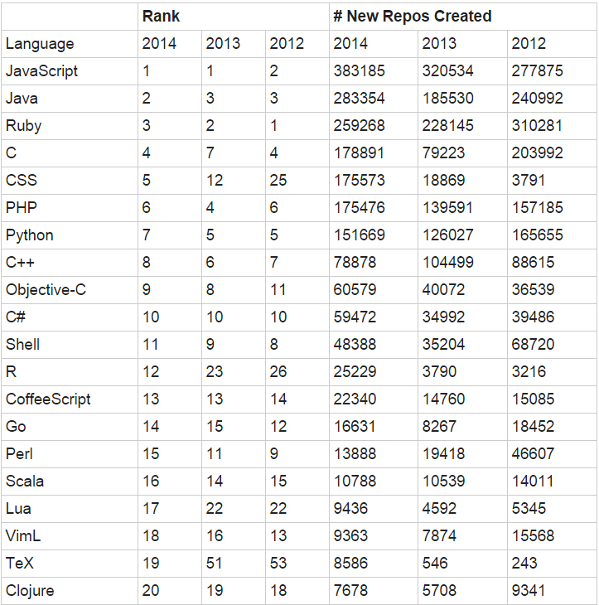
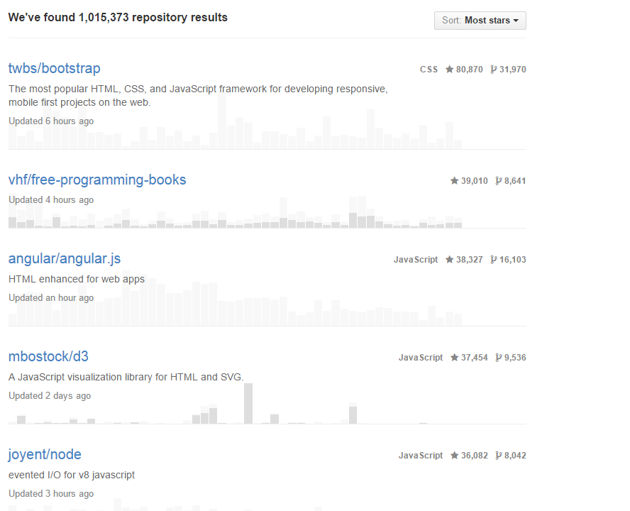
NodeJS
Bron: github
Bron: github
Notes:
Javascript al jaren een van de meest populaire talen, nodejs is een van de meest populaire projecten op github

Slide 16
NodeJS
Wanneer te gebruiken
Wanneer niet te gebruiken
Nadelen
Notes:
Wanneer te gebruiken
Voor real-time apps
Voor high-performance, hoge I/O, TCP apps, bv. Proxy servers, databases, etc..
Voor backend logging apps
Voor CLI-apps, zoals ant of Make
Voor RESTful API-based web server.
Wanneer niet te gebruiken
Voor cruciale apps zoals hart monitoring, met hoge CPU Load
Voor simpele CRUD apps, die niet real-time of hoge prestatie moeten zijn
Voor apps die een speciale library nodig hebben.
Nadelen
Elke maand wel een nieuwe versie, kan versie problemen veroorzaken. Oplossing npm en package.json
Veel libraries nog niet beschikbaar in nodejs
Een andere manier van programmeren ipv OOP is het callbackdriven programeren
Meer complexiteit in de code door de callback driven model

Slide 17
ExpressJS
Framework
Minimalistisch
Modulair
Zonder prestatie verlies
Maakt het makkelijker
var express = require('express');
var app = express();
app.get('/', function (req, res) {
res.send('Hello World!');
});
var server = app.listen(3000, function () {
var host = server.address().address;
var port = server.address().port;
console.log('Example app listening at http://%s:%s', host, port);
});

Slide 18
Routes
var express = require('express');
var app = express();
/ respond with "Hello World!" on the homepage
app.get('/', function (req, res) {
res.send('Hello World!');
});
// accept POST request on the homepage
app.post('/', function (req, res) {
res.send('Got a POST request');
});
// accept PUT request at /user
app.put('/user', function (req, res) {
res.send('Got a PUT request at /user');
});
// accept DELETE request at /user
app.delete('/user', function (req, res) {
res.send('Got a DELETE request at /user');
});
var server = app.listen(3000, function () {
var host = server.address().address;
var port = server.address().port;
console.log('Example app listening at http://%s:%s', host, port);
});
var http = require('http');
var handler = function(req, res){
if(req.url === "/"){
if(req.method === "GET"){
res.writeHead(200, {"Content-Type": "text/plain"});
res.send("Hello World\n");
}else if(req.method === "POST"){
res.writeHead(200, {"Content-Type": "text/plain"});
res.send("Got a POST request\n");
}
}else if(req.url === "/user”){
if(req.method === "PUT"){
res.writeHead(200, {"Content-Type": "text/plain"});
res.send("Got a PUT request at /user\n");
}else if(req.method === "DELETE"){
res.writeHead(200, {"Content-Type": "text/plain"});
res.send("Got a DELETE request at /user\n");
}
}
var server = http.createServer(handler)
server.listen(8080);
}
NodeJs
ExpressJS

Slide 19
Middelware
Concept
Ketting van functies
Volgorde
Req, res

Slide 20
Middelware
var app = express();
// a middleware with no mount path; gets executed for every request to the app
app.use(function (req, res, next) {
console.log('Time:', Date.now());
next();
});
// a middleware mounted on /user/:id; will be executed for any type of HTTP request to /user/:id
app.use('/user/:id', function (req, res, next) {
console.log('Request Type:', req.method); next();
});
// a route and its handler function (middleware system) which handles GET requests to /user/:id
app.get('/user/:id', function (req, res, next) {
res.send('USER');
});
// a middleware sub-stack which prints request info for any type of HTTP request to /user/:id
app.use('/user/:id', function(req, res, next) {
console.log('Request URL:', req.originalUrl); next();
}, function (req, res, next) {
console.log('Request Type:', req.method); next();
});

Slide 21
NPM
Package manager
dependencies
Package.json
Npm install
Npm update

Slide 22

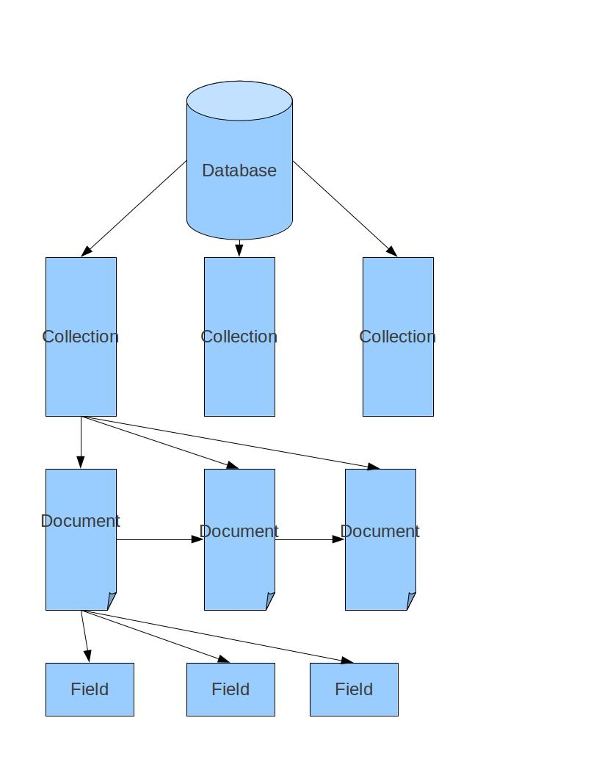
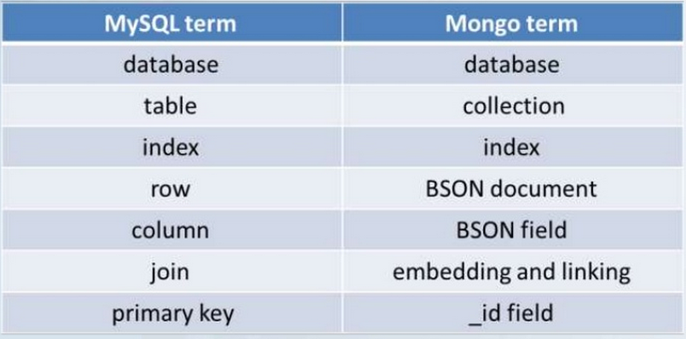
MongoDB
Name: humongous
C++
Notes:
-MongoDB ontwikkeld: 2009
-NOSQL
-Opgeslagen als BSON (binair JSON)
-Flexibel
-De naam "MongoDB" is afgeleid van het Amerikaanse slangwoord "humongous" wat extreem groot betekent.

Slide 23
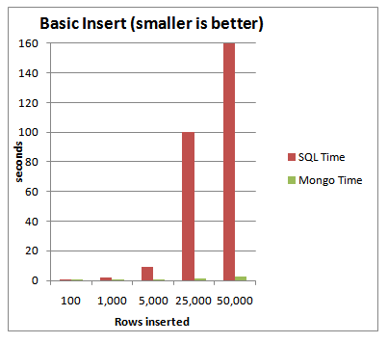
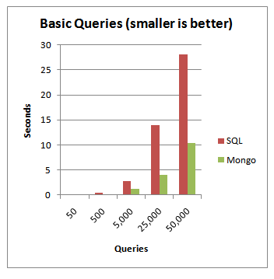
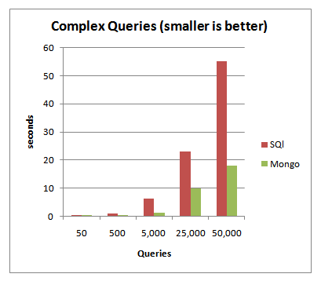
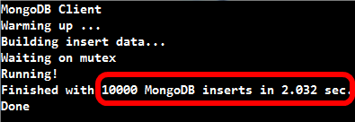
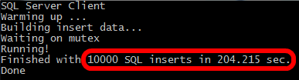
SQL vs MongoDB
Bron: http://blog.michaelckennedy.net/2010/04/29/mongodb-vs-sql-server-2008-performance-showdown/
Notes:
-MongoDB ontwikkeld: 2009
-NOSQL
-Opgeslagen als BSON (binair JSON)
-Flexibel
-De naam "MongoDB" is afgeleid van het Amerikaanse slangwoord "humongous" wat extreem groot betekent.

Slide 24

NoSQL
INSERT INTO PERSON (`name`, `zipcode`, `city` , `street`, `adress`, `email`)VALUES (“Bjorn de Mul”, “4587RB” “Kloosterzande”, “Kruisdorpstraat”, 11, “mul0003@hz.nl”);
Db.person.insert({name: “Bjorn de mul”, zipcode: “4587RB”, city: “Kloosterzande”, street: “Kruisdorpstraat”, street: 11, email: “mul0003@hz.nl)
SELECT * FROM PERSON; SELECT `name` FROM PERSON
Db.person.find(); db.person.find({},{name: 1, _id: 0});
Notes:
-MongoDB ontwikkeld: 2009
-NOSQL
-Opgeslagen als BSON (binair JSON)
-Flexibel
-De naam "MongoDB" is afgeleid van het Amerikaanse slangwoord "humongous" wat extreem groot betekent.

Slide 25
NoSQL
Joins
Geen joins
Joins tijdens ontwerp, niet tijden de query
Minder joins nodig
Constraints
Geen foreign key
Unique indexes
Schaalbaar
Goed voor veel data
Developer vriendelijk.
Data is gemodeleerd naar hoe de app gebruikt wordt
Geen statische schema’s

Slide 26
Vrijheid == Blijheid ?
Geen schema’s
Geen datatypes
Sub-documenten
Geen constraints

Slide 27
DEMO
https://github.com/bram96/canon
http://localhost:9000

