Slide 1
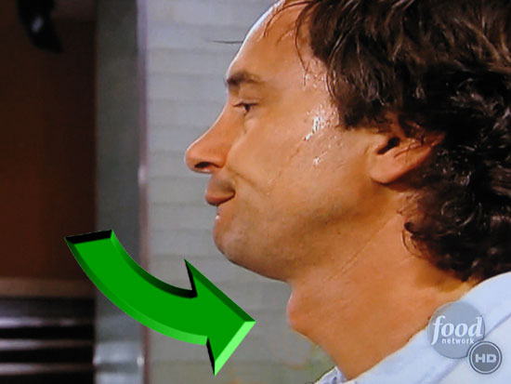
Short vowel sound
/ă/ Adam’s Apple
        ă
Notes:
“Vowel sound for a short a is /a/. Say /a/. Key word for /a/ is Adam’s Apple. Touch your throat and say /a/ Adam’s Apple.”

Slide 2
bat
Notes:
Right swipe on the words that include the letter a.

Slide 3
and

Slide 4
pan

Slide 5
bit

Slide 6
crack

Slide 7
moss

Slide 8
GREAT !
Now let’s sound out words featuring the short a.
Remember, the sound of short a is /a/.

Slide 9
n

Slide 10
a

Slide 11
p

Slide 12
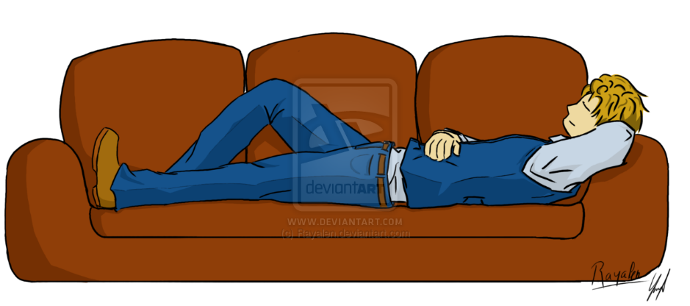
GREAT !
n
a
p
nap
Notes:
“Nap. Nap. Time to take a nap.”

Slide 13
nap
Time to take a nap.
Notes:
“Nap. Nap. Time to take a nap.”

Slide 14
c

Slide 15
a

Slide 16
n

Slide 17
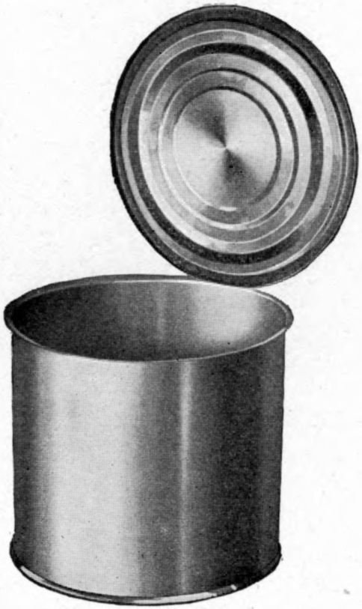
GREAT !
c
a
n
can
Notes:
“Can. Can. Please open this can.”

Slide 18
Please open this can.
can
Notes:
“Can. Can. Please open this can.”

Slide 19
m

Slide 20
a

Slide 21
n

Slide 22

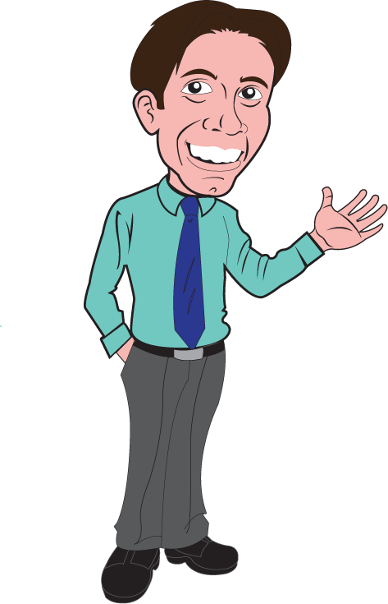
GREAT !
m
a
n
man
Notes:
“Man. Man. The man is happy.”

Slide 23
The man is happy.
man
Notes:
“Can. Can. Please open this can.”

