Slide 1
OME Team Training: Jupyter Workshop Dundee 2017
Balaji Ramalingam
University of Dundee
The OME Consortium

Slide 2
Outline
Installation of Jupyter and writing notebooks!
Modules in the Jupyter world!
OMERO-py in Jupyter!
Jupyter Kernels and Integration of R with Jupyter!
Jupyter-Docker (OMERO)
Where do the notebooks get stored?
Jupyter in the IDR world!

Slide 3
Installation of Jupyter
For experienced Python users:
pip3 install --upgrade pip // pip install –upgrade pip
Pip3 install jupyter // pip install jupyter
For this workshop:
Install using Anaconda:
https://www.anaconda.com/download
https://repo.continuum.io/archive/Anaconda2-5.0.0-MacOSX-x86_64.pkg)
>> which jupyter
>> jupyter notebook
Task: Run an example notebook to understand the interface.
Example Notebook: example_notebook_jupyter.ipynb

Slide 4
Modules in the Jupyter world!
Task : Import and Run the module within Jupyter Notebook.
Requirement: Hello_world python module.
Add to Path:
>> export PYTHONPATH=$PYTHONPATH:/Users/bramalingam/Documents/Anaconda_Training/python_module/
Example Notebook: python_module_example.ipynb

Slide 5
(External) Modules in the Jupyter world!
Install and use external Python modules:
Task : Import and Run the module within Jupyter Notebook.
Requirement: External Python Module (tqdm, opencv).
Example Notebook: Install_external_module.ipynb
OMERO and Jupyter:
Task : Install dependencies for OMERO-PY and create a blitzgateway connection.
Requirement: OMERO-PY, ICE
Add to Path:
export PYTHONPATH=/Users/bramalingam/Downloads/OMERO.server-5.4.0-ice36-b74/lib/python/
Example Notebook: Install_external_module.ipynb

Slide 6
Integration of R with Jupyter
Currently available kernels:
https://github.com/jupyter/jupyter/wiki/Jupyter-kernels
Task: Integrate R-kernel with Jupyter and install rOMERO-gateway
Requirements: r , r-essentials, conda environment(optional), install.r (rOMERO-gateway installation script)
Useful links: https://github.com/ome/rOMERO-gateway
>> cd anaconda/bin
>> ./conda create -n my-r-env -c r r-essentials
>> source ./activate my-r-env
>> which jupyter
>> jupyter notebook
Example Notebook: rExampleNotebook.ipynb

Slide 7
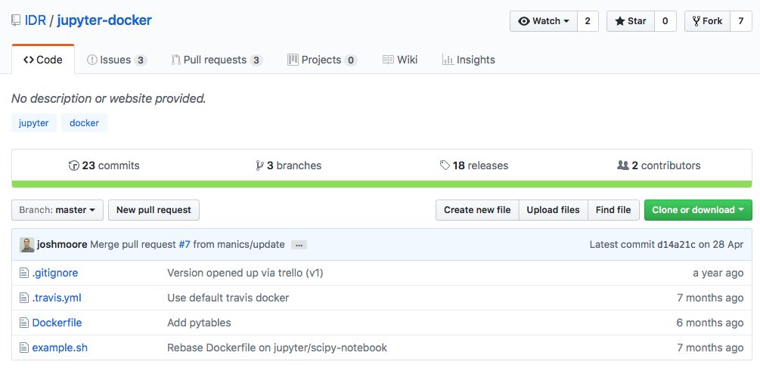
Packaging Jupyter with OMERO (Docker)
Current Resource : https://github.com/IDR/jupyter-docker

Slide 8
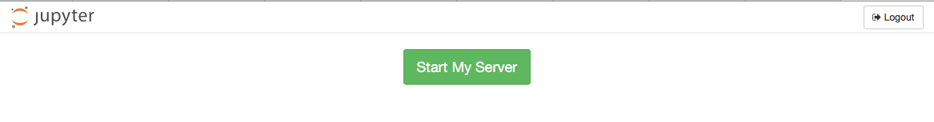
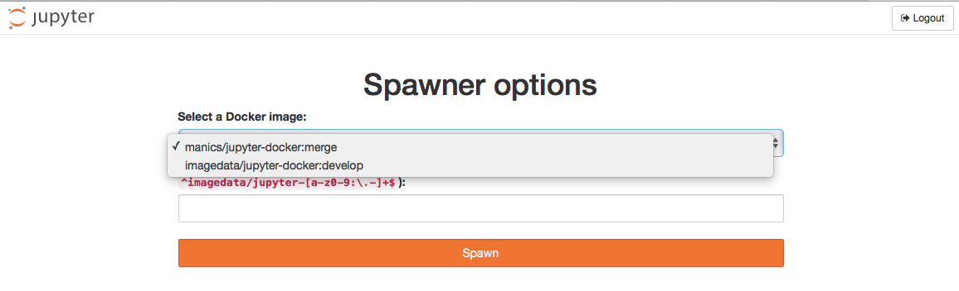
Jupyter Hub (IDR Context)
Resource: https://idr.openmicroscopy.org/jupyter/hub/home
Example Resource: https://idr-testing.openmicroscopy.org/jupyter/hub/spawn

Slide 9
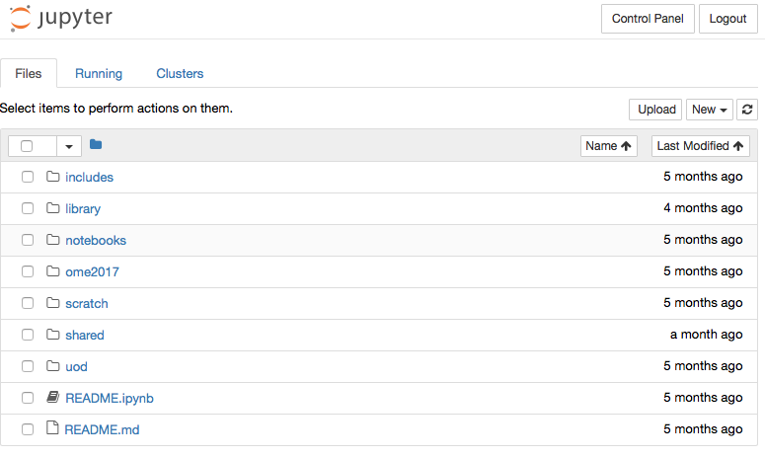
Sharing with Jupyter?
Resource: https://jupyter.openmicroscopy.org/jupyter/hub/home

Slide 10
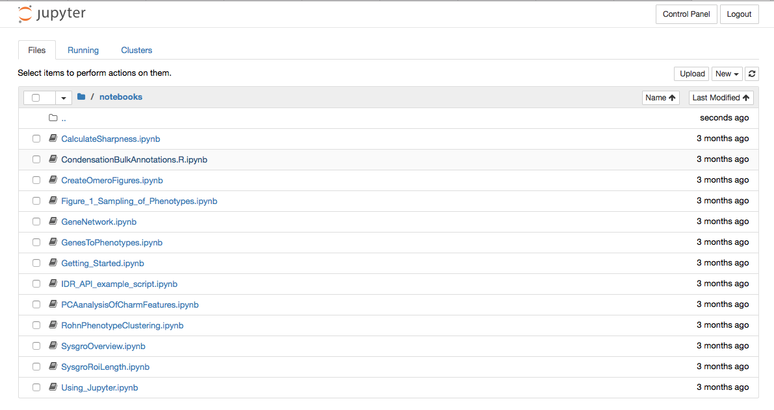
Jupyter in the IDR World (Current Status)
Marriage of 3 repositories:
Jupyter-Docker : https://github.com/IDR/jupyter-docker
IDR-PY : https://github.com/IDR/idr-py
Idr-notebooks : https://github.com/IDR/idr-notebooks
ProductionIDR/Jupyter: https://idr.openmicroscopy.org/jupyter/hub/home

Slide 11
Current aspects in review
Sharing workflows with Jupyter notebooks
https://github.com/jupyter/jupyter-drive
Repository management for new Notebooks:
An OMERO centric notebook repository for training workflows.
Convert python documentation page into notebooks, i.e convert python examples into notebooks (https://github.com/openmicroscopy/openmicroscopy/tree/v5.3.4/examples/Training/python)
One docker file per repository/language?

Slide 12
Useful Links
Jupyter : https://jupyter.org
Anaconda : https://anaconda.org
Jupyter Tricks: https://www.dataquest.io/blog/jupyter-notebook-tips-tricks-shortcuts/
General Example Notebooks : https://github.com/jupyter/jupyter/wiki/A-gallery-of-interesting-Jupyter-Notebooks

Slide 13
QUESTIONS?

