Slide 1

Image Classification Project
Submitted by:
Bramee Venkatesan

Slide 2
ACKNOWLEDGMENT
I would like to thank Flip Robo Technologies for providing me with the opportunity to work on this project from which I have learned a lot. I am also grateful to Sapna for her constant guidance and support.
Reference sources are: -
• Google
• AnalyticsVidhya.com
• Notes and repository from Data Trained
• Medium.com

Slide 3
Business Problem
Images are one of the major sources of data in the field of data science and AI. This field is making appropriate use of information that can be gathered through images by examining its features and details.
We are trying to give an exposure of how an end-to-end project is developed in this field.
The idea behind this project is to build a deep learning-based Image Classification model on images that will be scraped from e-commerce portal. This is done to make the model more and more robust.

Slide 4
Motivation for the Problem Undertaken
In today world we are dealing with lots of data, which is present in various formats like numbers, categories, images etc.
The data present in numbers or categorical form is easy to store and understand but image data is somehow different form these.
In image data we must use some different techniques to deal it and these new techniques, algorithms to save and interpret and the way to deal image data motivates me to undertake this project and build a model for image classification.

Slide 5
Data Modelling
In this project we are dealing with image classification model that will classify between these 3 categories.
This project is divided into 2 main phases.
a) Data Collection Phase
b) Model Building Phase
In data collection phase we must scrape and collect data and after collection data we must build convolution neural network model.
Before the model building, we scraped the images of sarees, jeans, trousers from e-commerce website Amazon.

Slide 6
Data Collection
We gathered our data from online e-commerce website Amazon. As this is image classification project of 3 categories.
So, we collected the images of only 3 categories i.e., Sarees, Jeans and Trousers.
We save these images into our local system and then using Kera’s and TensorFlow modules we build an image classification model.
So, in these steps we collected the URLs links for each image into a separate list and then using these lists we save/downloaded the image into our system.

Slide 7
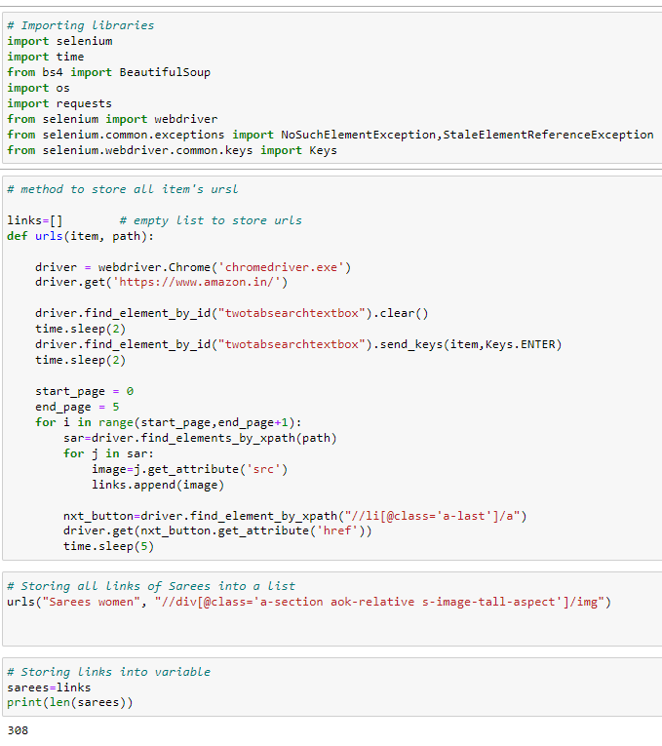
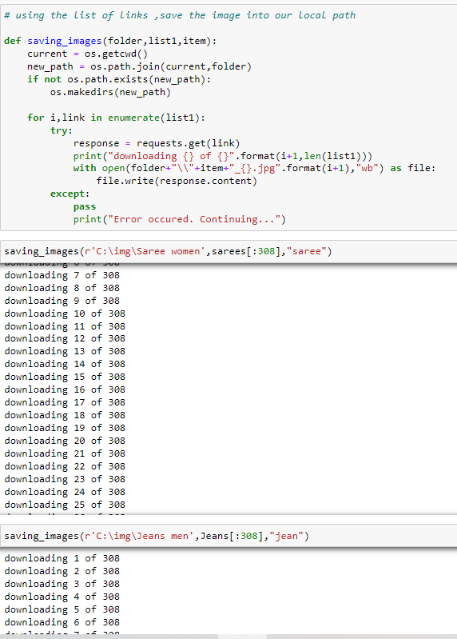
Data Collection

Slide 8
Data Pre-Processing
I have used Jupyter Notebook for data pre-processing and model building. Libraries used in this project are,
1. Os
2. Numpy
3. Matplotlib
4. Keras
5. Tensorflow
After imported the necessary libraries and images, we can see that there are 924 images as a total.
Let’s see the sample images and Re-sizing the image to the size of 200*200 and saving the re-sized image to the desired folder.

Slide 9
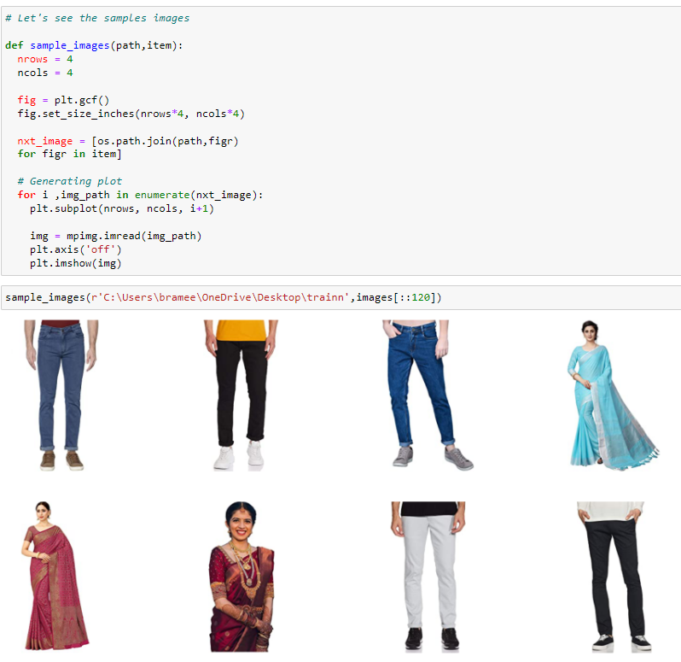
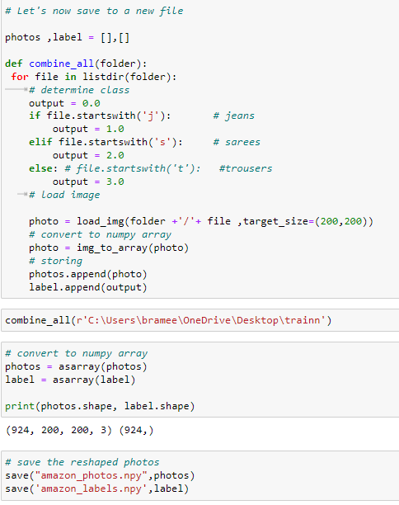
Data Pre-Processing

Slide 10
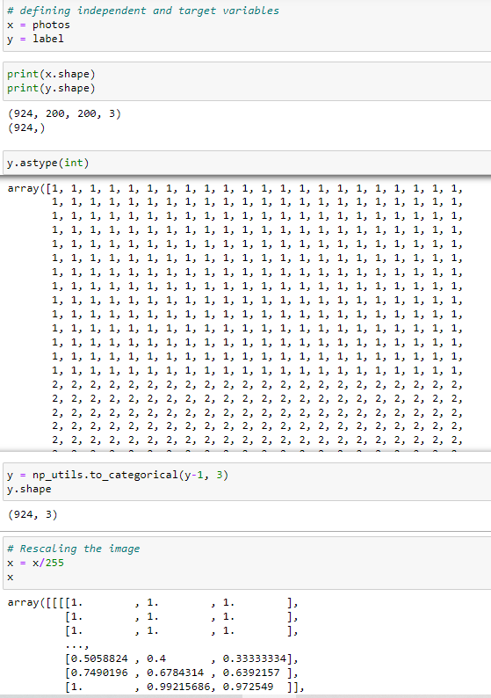
Data Pre-Processing
Now we assign independent and target variable i.e., x and y respectively. The y variable defines the category of image, which is Saree, Jeans or Trouser.
After this the most important step is to rescale our independent data. We are rescaling the data into 255 scale.

Slide 11
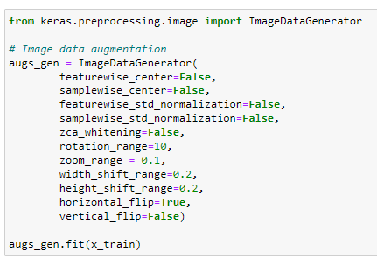
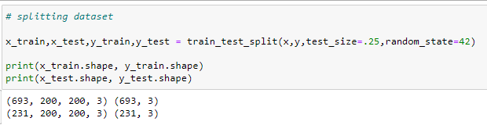
Data Modelling
In model building phase first we splitted our dataset into train and test data using the train_test_split model selection method.
After splitting are using ImageDataGenerator technique. This technique is used for data argumentation which means to create more data from the present data.
This technique will produce more data using the zoom, rotation etc methods.

Slide 12
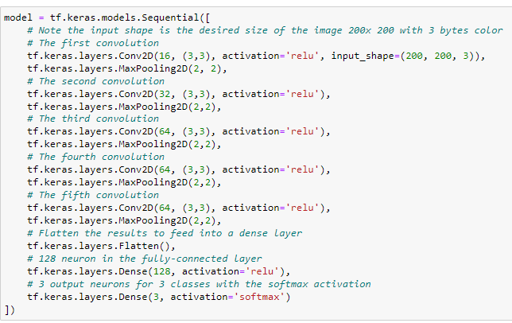
Data Modelling
So, this is CNN (Convolution Neural Network) project, we are using the Sequential method to build our model which is present in TensorFlow module. In this Sequential model we are using 6 step Convolution2d and MaxPooling layers.
In 1st layer of Convolution2d layer we are using 16 filters with a kernel size of (3,3) and the activation method used is “Relu activation”. After this Maxpooling layers follows up. In 2nd layer of Convolution2d we increase the filter size by 2 and so on in other layers.
After convolutional and Maxpooling another layer present is flattening layer Flattening a tensor means to remove all the dimensions except for one. This is exactly what the Flatten layer does.

Slide 13
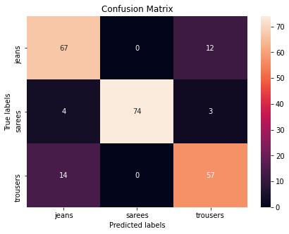
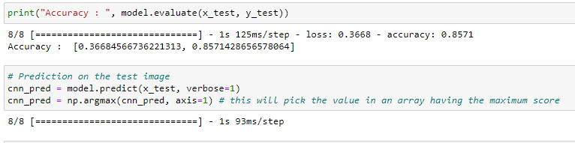
Model Evaluation & Confusion Matrix

Slide 14
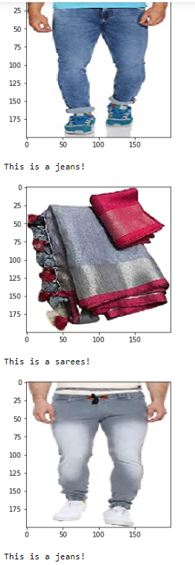
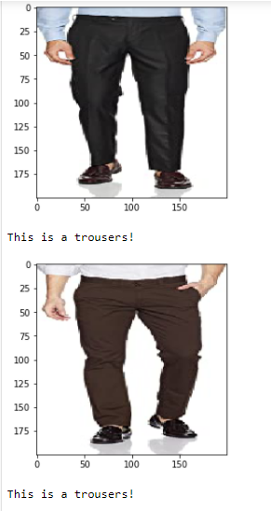
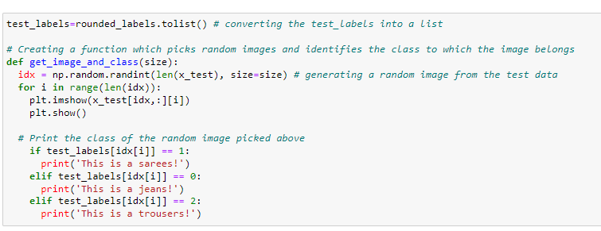
Predictions

Slide 15
Conclusion
The key finding and the conclusion of the study: -
1. The image data was collected using Web scrapping from Amazon for Jeans, Sarees and Trousers.
2. We have used Convolutional Neural Network for the project and giving us the accuracy of 85% with 0.3 log loss.

Slide 16
Thank You !! ☺

