Slide 1

Rating Reviews Classifier Project
Submitted by:
Bramee Venkatesan

Slide 2
ACKNOWLEDGMENT
Thanks for giving me the opportunity to work in FlipRobo Technologies as Intern and would like to express my gratitude to Data Trained Institute as well for trained me in Data Science Domain. This helps me to do my projects well and understand the concepts.
Dataset – FlipRobo Tech
Resources used – Google, GitHub, Blogs for conceptual referring.
Links – Medium.com, towardsdatascience.com, machinelearningmastery.com

Slide 3
Business Problem
A client who has a website where people write different reviews for technical products. Now they are adding a new feature to their website i.e. The reviewer will have to add stars(rating) as well with the review.
The rating is out 5 stars, and it only has 5 options available 1 star, 2 stars, 3 stars, 4 stars, 5 stars.
Now they want to predict ratings for the reviews which were written in the past and they don’t have a rating.
So, we must build an application which can predict the rating by seeing the review.

Slide 4
Motivation for the Problem Undertaken
This will help the customers to understand the product before buy from the website.
The rating system is easy for the customers to understand about the product than going over all the reviews and it will help the client to bring modifications to the product.

Slide 5
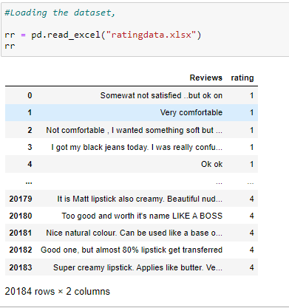
Data Sources and their formats
Dataset is collected by various websites through scraping.
It has 20814 rows and 2 columns.

Slide 6
Mathematical/ Analytical Modeling of the Problem
Data has null values in reviews column, and it has been removed.
As our input is review which has regular expressions, punctuations, and emoji, need to treat it using lemmatization, stemming word count vectorizer.
Target variable is im-balanced and need to balanced using resampling technique.
Therefore, we will be handling this modelling problem as classification.

Slide 7
Data Pre-processing Done
For Data pre-processing we did some data cleaning, where we used WordNet lemmatizers to clean the words and removed special characters using Regexp Tokenizer.
Then, filtered the words by removing stop words and then used lemmatizers and joined and return the filtered words.
Used TFIDF vectorizer to convert those text into vectors.

Slide 8
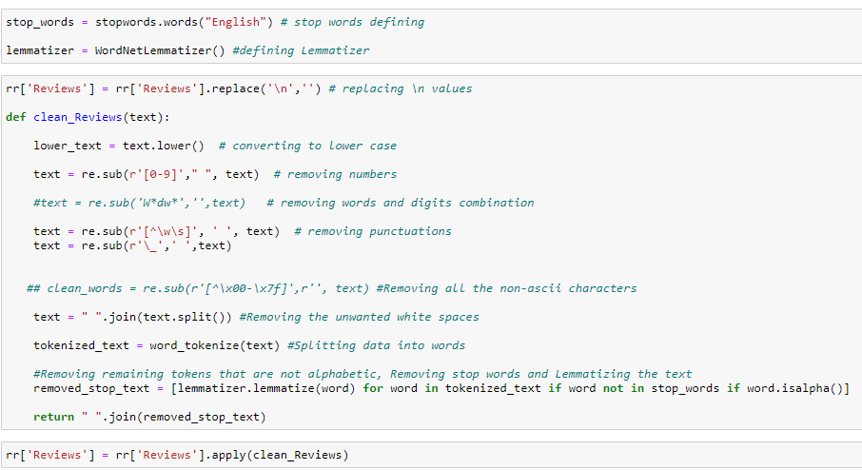
Data Pre-processing

Slide 9
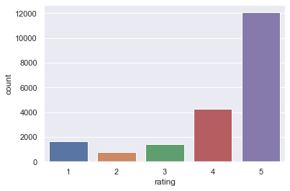
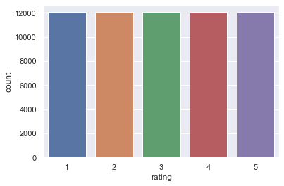
Data Visualization -
Used Count plot for the different target variables.

Slide 10
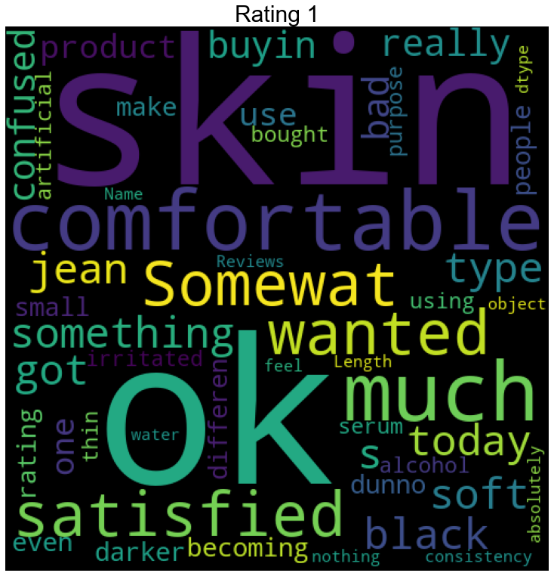
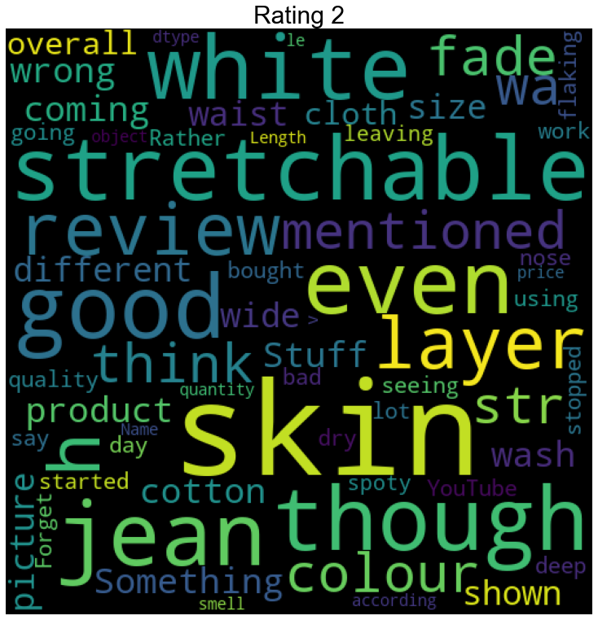
Data Visualization -

Slide 11
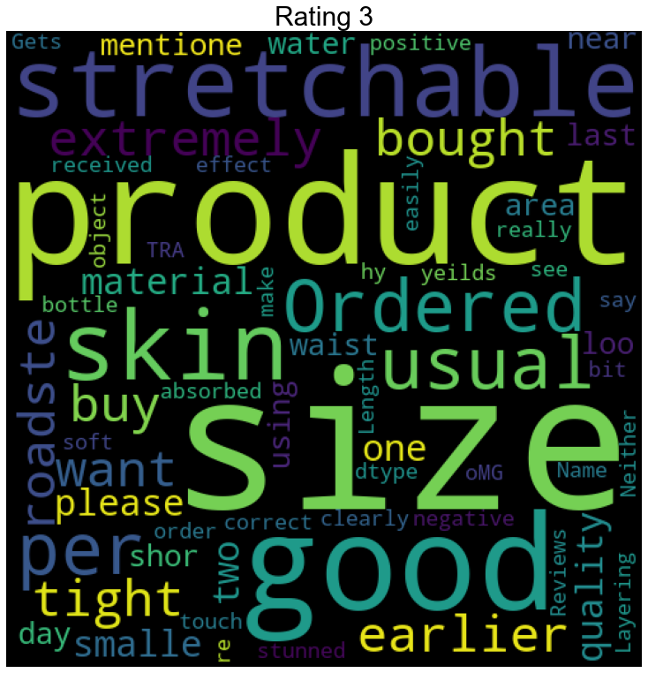
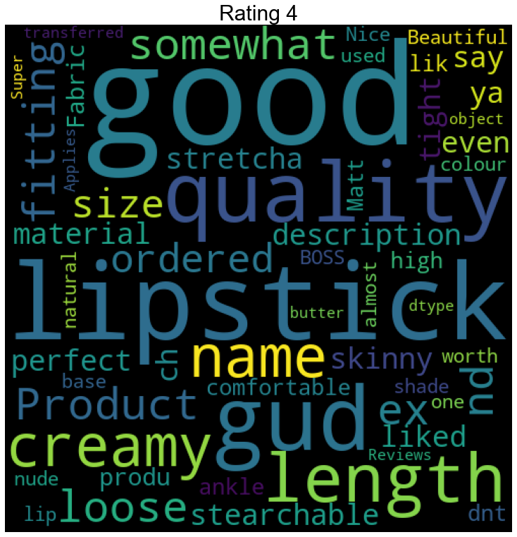
Data Visualization -

Slide 12
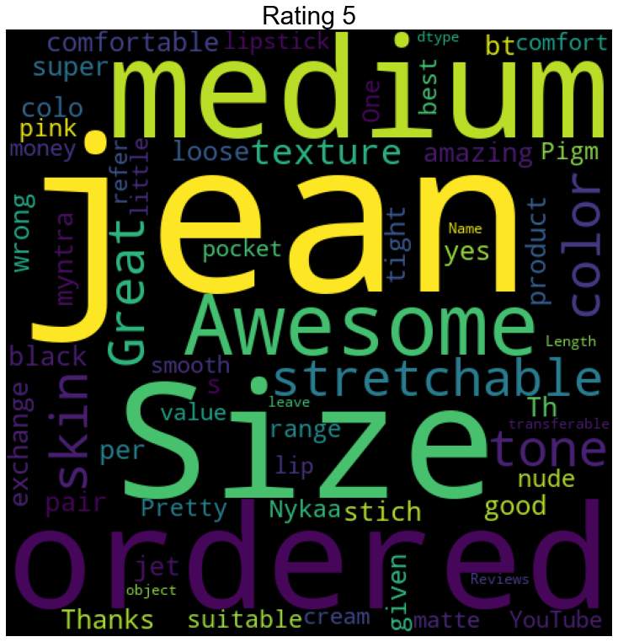
Data Visualization -

Slide 13
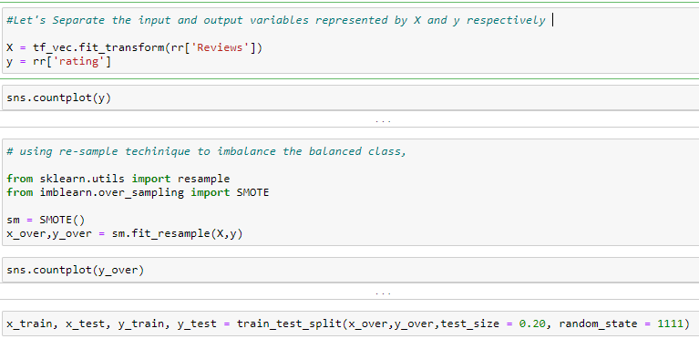
Split the train and test data for model building,
Logistic Regression
Decision Tree
Random Forest
Passive Aggressive

Slide 14
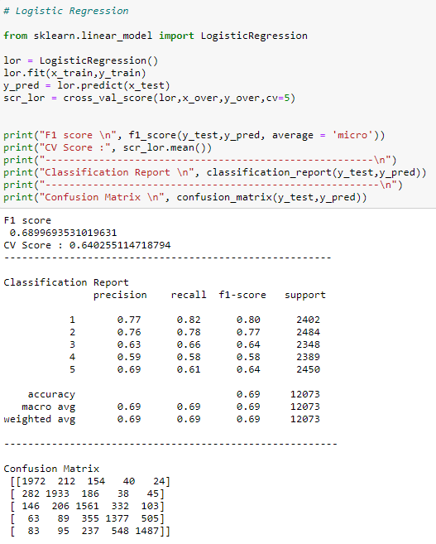
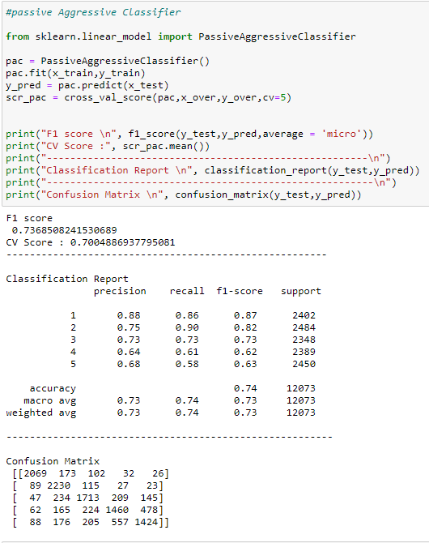
Model Building:
Logistic has CV Score – 64.05%
Passive Aggressive has CV Score –70.04 %

Slide 15
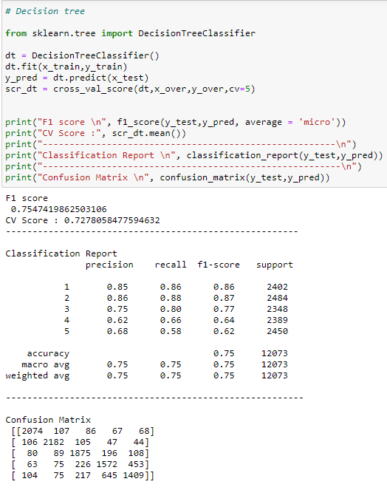
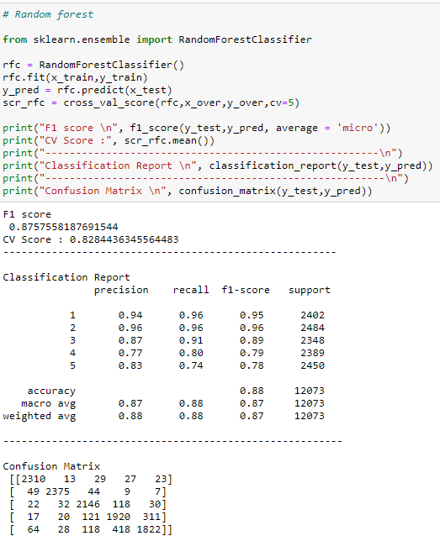
Decision Tree has CV Score – 72.78 %
Random Forest has CV Score – 87.57 %

Slide 16
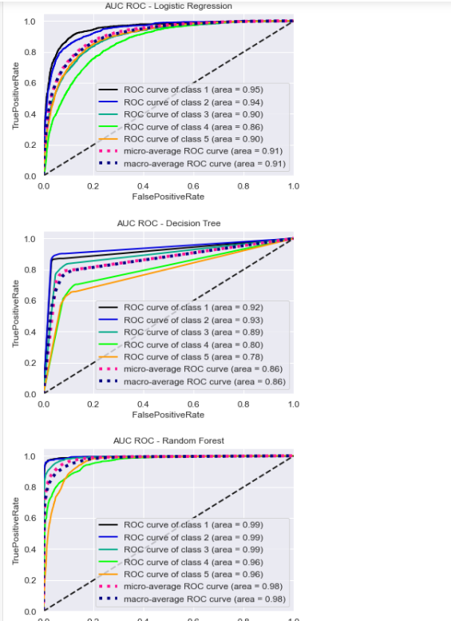
ROC AUC Curve for all Models

Slide 17
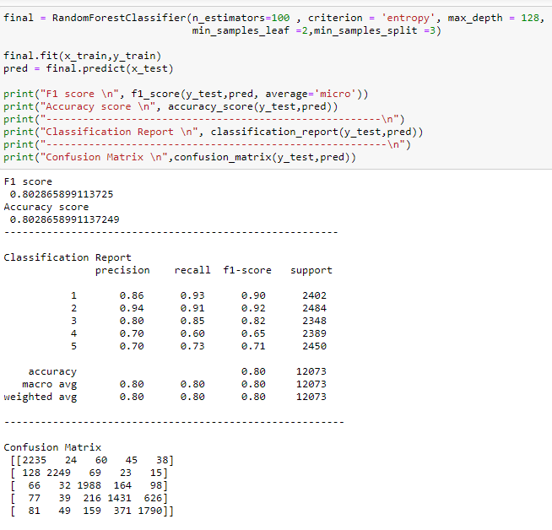
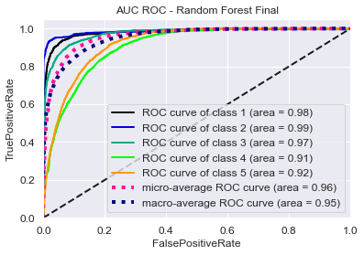
Hyper Parameter Tuning for the final model -> Random Forest

Slide 18
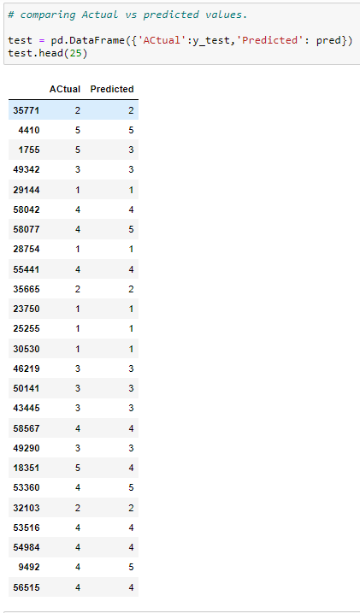
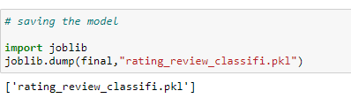
Finally Saving the model .pkl file and Checking the Actual and Predicted values

Slide 19
Thank You !! ☺

